Slide 1



Homelessness among mobile EU citizens:
A tool for legal experts and local authorities working with mobile EU citizens in destitution
3 modules
→ An overview of homelessness in Europe
→ Homelessness among mobile EU citizens
→ Support measures for mobile EU citizens experiencing homelessness
This material has been prepared by FEANTSA team in the context of PRODEC project –Protecting the Rights Of Destitute mobile EU Citizens.
Contact us at migration@feantsa.org
July 2022
Notes:
Hello and welcome to our new tool for professionals working with mobile EU citizens in destitution.
This is a series of three modules on EU free movement and homelessness. Each module focuses on a particular topic: module number one has set the scene by introducing us to the concept of homelessness and its current state in Europe. This second module focuses on a specific group among people experiencing homelessness in Europe: those who move from one EU country to another and become homeless in the ‘host Member State’.
We will get started and hope you will enjoy the modules and find this tool useful! Don’t hesitate to get in touch if you have questions or suggestions!

Slide 2
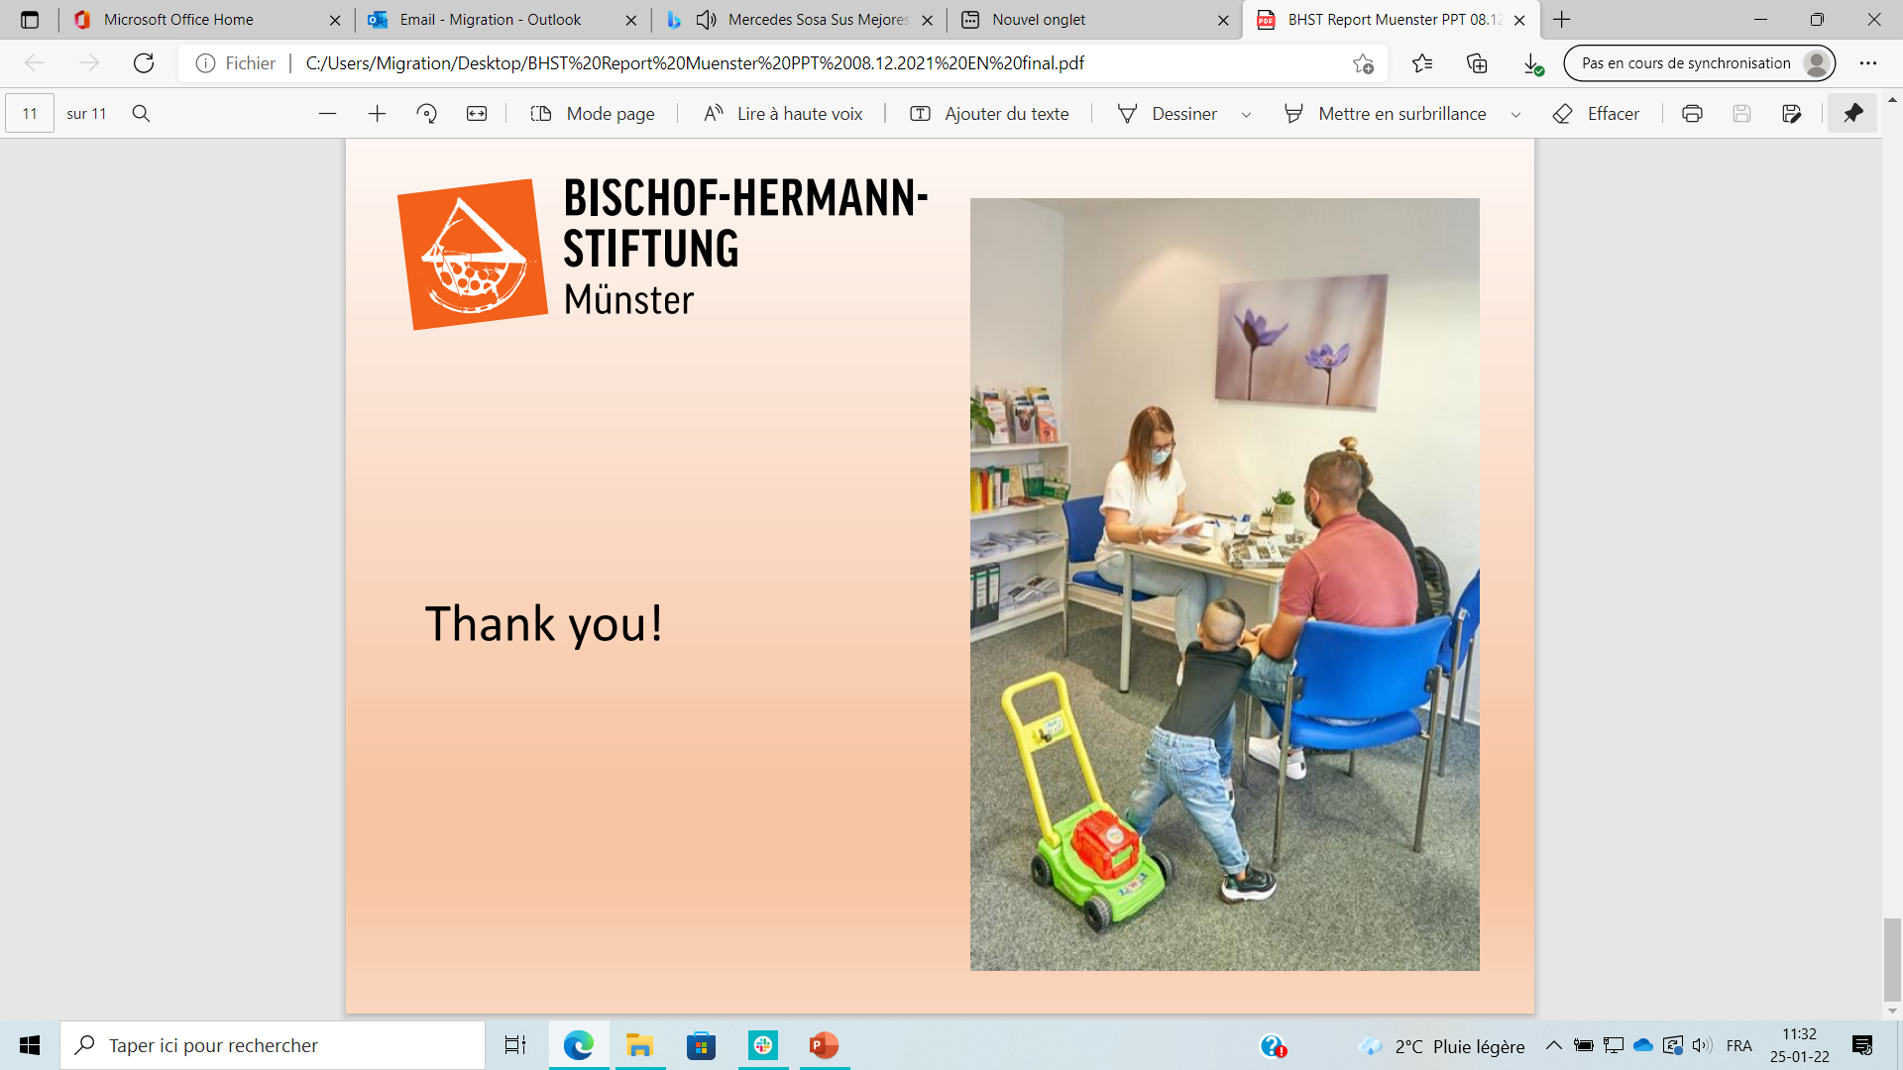

MODULE 2:
HOMELESSNESS AMONG MOBILE EU CITIZENS
Available data on intra-EU migration
Mobile EU citizens in destitution
How many mobile EU citizens are experiencing homelessness? Who are they?
Factors contributing to the vulnerability of mobile EU citizens
Main gaps and obstacles in legislation
Credit: BISCHOF-HERMANN-STIFTUNG, Münster (Germany)
Notes:
To begin, this module will introduce available data on mobile EU citizens, with a particular focus on those experiencing destitution and homelessness. We will also consider the factors that contribute to vulnerabilities among mobile EU citizens. Furthermore, we will discuss the main existing gaps in legislation that are potential factors of destitution. and address the obstacles in legislation that push individuals into situations of destitution.

Slide 3
Available data on intra-EU migration
It is estimated that in 2020, around 13.3 million EU citizens have exercised their right to free movement and are residing in another Member State.
Eurobarometer (2020): 84% of respondents thought EU free movement overall benefits to the economy of their country.
Around 3.7 million EU citizens were living in the UK, and over 1 million UK nationals were residing in EU countries (2020).
Among the EU citizens of working age, 3.3 % resided in an EU country other than that of their citizenship in 2020.
Frontier workers: people who work in one EU Member State but live in another. In 2019, this was the case for 1% of the total EU workforce aged 20-64.
Source: European Commission (2020) European Citizenship report
Notes:
According to data from 2020, it is estimated that around 13.3 million EU citizens are residing in an EU country different from the one they are citizens of.
Within this population, data shows that the nationalities most represented in absolute terms are Romanian, Italian and Polish. Data collected by FEANTSA members from beneficiaries of their services in 2020 also confirm that people coming from Romania, Poland or Bulgaria are often the most represented among the mobile EU citizens experiencing homelessness, as also shown in several surveys from public institutions.
For more information on this, you can consult the city reports drafted under FEANTSA’s PRODEC project: “Homelessness among mobile EU citizens: new data from four European cities”.

Slide 4
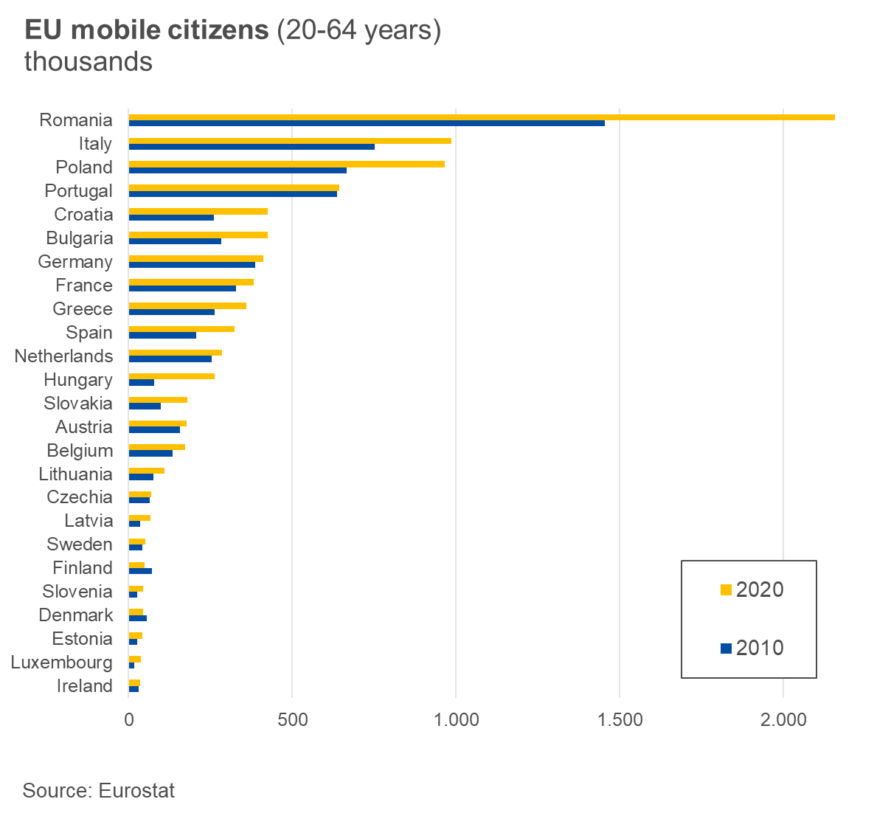
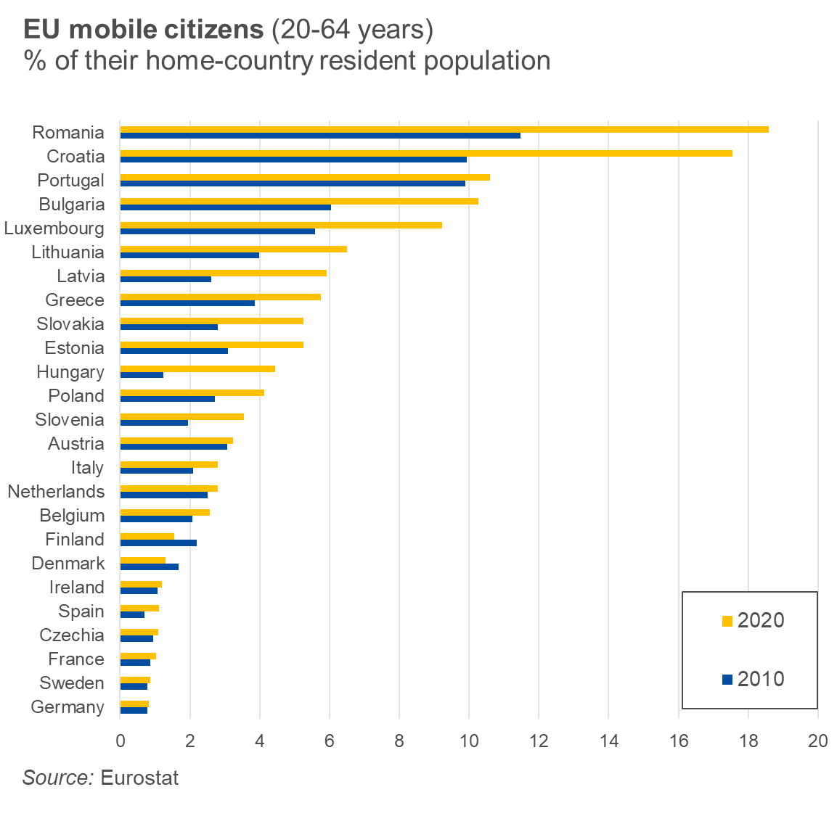
Source: Eurostat
Notes:
However, in relative terms (the percentage they represent of their home-country resident population), Romanians and Croatians abroad are the largest groups compared to other nationalities.
Finally, it is also important to highlight the increase in the number of mobile EU citizens residing in a different MS from 2010 to 2020, which happened for almost every nationality. This number could be even higher if the UK were still part of the EU, given the presence of circa 3.7 million EU citizens there.

Slide 5
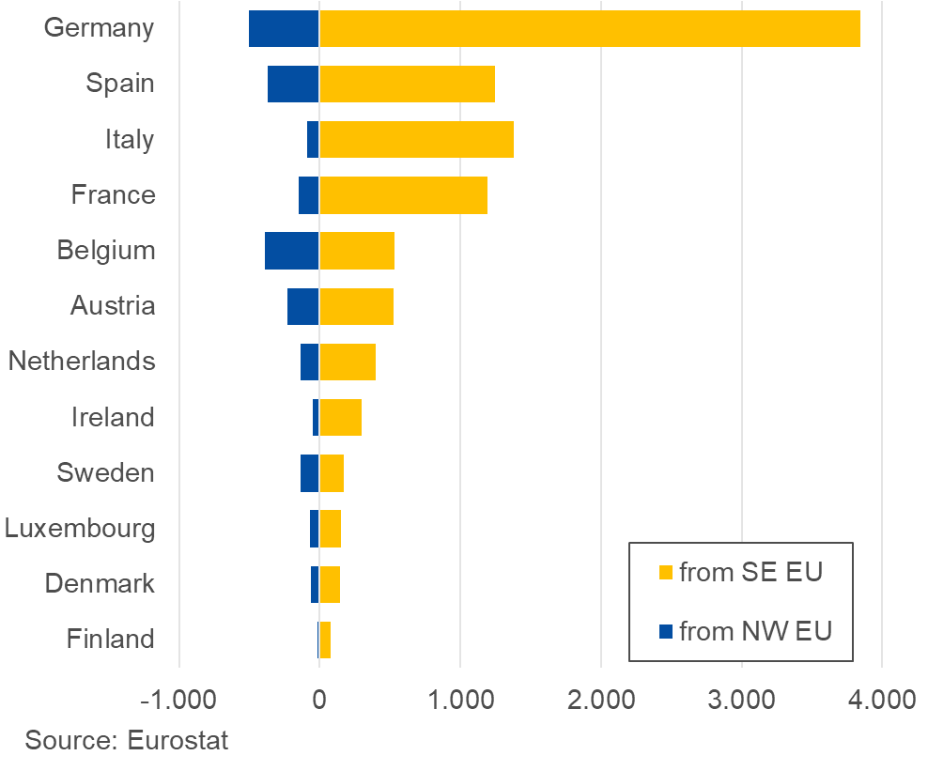
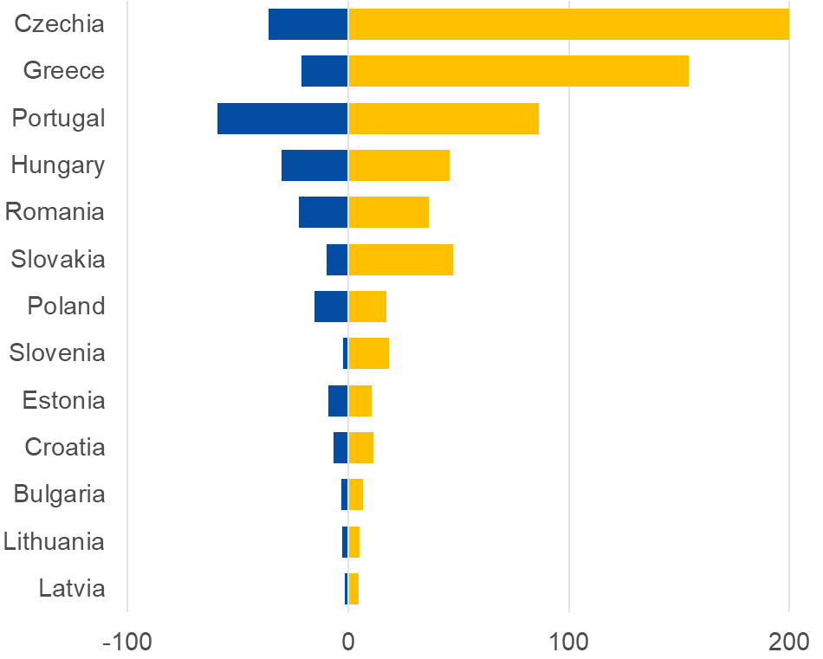
Mobile EU citizens in countries of destination (2020), in thousands
Source: Eurostat
Notes:
It has become clear that most mobile EU citizens are from Southern and Eastern parts of the EU, with a clear difference to the number of migrants who are nationals of the Northern and Western countries of Europe. Portugal is the only country that receives a relatively balanced proportion of South-Eastern and North-Western migrants.
By far, Germany is the country receiving the most EU migrants: almost 4 million people from Southern and Eastern countries, plus around 500 thousand people from Northern and Western countries have migrated there. It is followed by Spain, Italy and France, receiving around 1.5 million EU migrants each.
It is also clear that the countries where most mobile EU citizens live are in the Northern and Western parts of the EU, probably because those countries offer better job prospects than the Southern and Eastern ones. Spain and Italy are notable exceptions.

Slide 6
Why do people migrate to other EU countries?
Looking for a job. The hope to obtain a better job than in their home countries is the main reason why most respondents migrate.
Having a job. Some of the people in our research move already having a job, be it declared or undeclared.
Reuniting with family: meeting relatives or friends in the host country is another frequent reason.
Avoiding discrimination and living more safely. This is the case especially for those belonging to an ethnic minority, e.g. Roma.
Having the chance to access better healthcare, education and other welfare services. Even if not the main reason, this is often cited as important.
Source: FEANTSA’s and our members’ studies. As an example, you can read some in “Homelessness among mobile EU citizens: new data from four European cities”.
Notes:
Research carried out by FEANTSA and members shows what the main reasons are why mobile EU citizens migrate:
Job-related reasons (either looking for one or having one already) are the most frequent reasons why people migrate to other EU countries. People’s main goal is to improve their own and their families’ living conditions, who either live in their home country or the host country. When the main reason is looking for a job, however, it may increase the chances of facing vulnerability. We will have a closer look into this in the following slides.
Family reunion or the possibility to access better services (e.g. healthcare) are also frequent reasons.
Finally, for some people belonging to a minority (e.g. Roma), moving to another EU country is also a way to escape discrimination and be safer than in their origin countries.

Slide 7

Mobile EU citizens in destitution

Slide 8
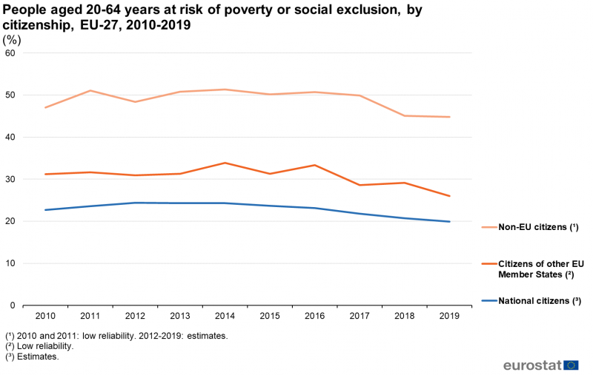
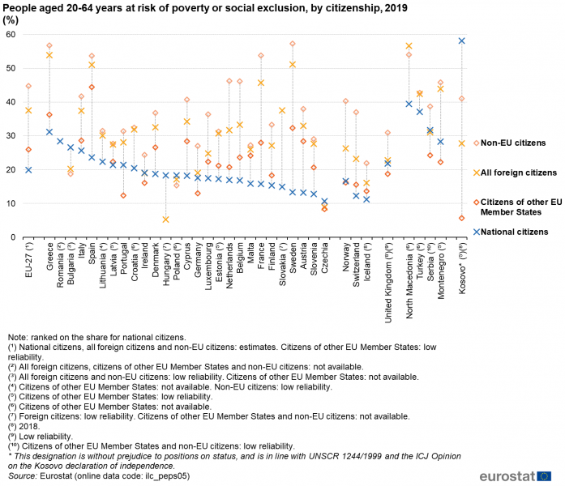
People aged 20-64 years at risk of poverty or social exclusion, by citizenship, EU-27, 2010-2019 (%)
People aged 20-64 years at risk of poverty or social exclusion, by citizenship, 2019 (%)
Source: Eurostat (mii database)
Notes:
As data show, migration can be a factor of vulnerability and/or exclusion. This, among other reasons, may explain why migrants are often overrepresented in the homeless population in many European cities.
Both mobile EU citizens and third country nationals have higher chances to be at risk of poverty or social exclusion than the nationals of their host country, including in the area of housing. On average, the number of mobile EU citizens at risk of poverty or social exclusion has been ten percentage points higher than that of national citizens in the last decade, and only since 2016 has there been a downwards trend.
This is true not only on average, but also for almost every Member State individually, with only a few exceptions (Portugal, Ireland or, notably, Germany).

Slide 9
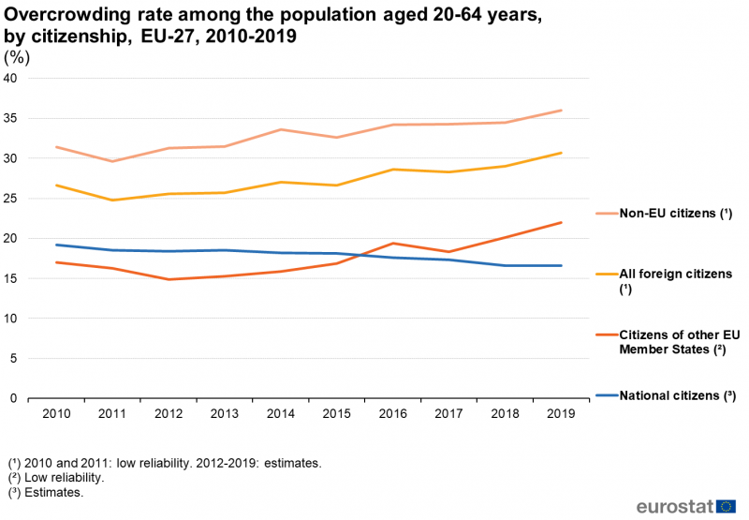
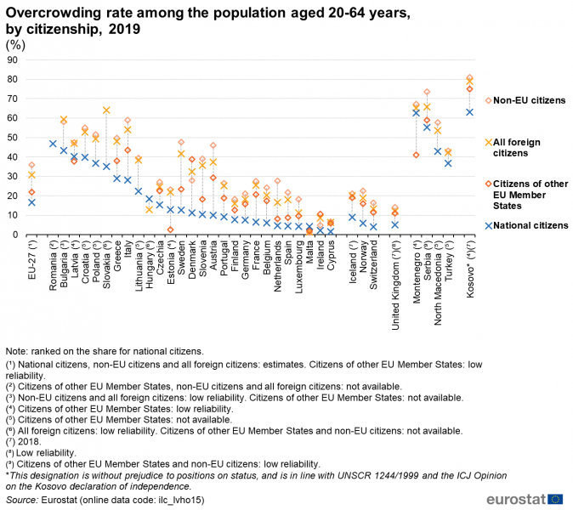
Overcrowding rate among the population aged 20-64 years, by citizenship, EU-27, 2010-2019 (%)
Overcrowding rate among the population aged 20-64 years, by citizenship, 2019 (%)
Source: Eurostat (mii database)
Notes:
In terms of housing, migrants may also face more deprivation than the nationals of the country they are living in. However, there have only been more mobile EU citizens than nationals in overcrowded accommodation since 2016. To explain this, it could be relevant to compare this data to any possible changes in the migration flows since 2015, especially looking at the country of origin and the level of income. However, this analysis is beyond the scope of these modules.
However, what we can see is that, in 2019, there were more mobile EU citizens than nationals living in overcrowded housing in almost every EU country, with the highest difference in Italy, Denmark or France. It is alarming that in many countries, between 40-50% of the EU migrants live in these conditions.
The numbers in these graphs demonstrate the acute housing crisis Europe is facing. This crisis affects both nationals and migrants, but is particularly severe for the latter.

Slide 10
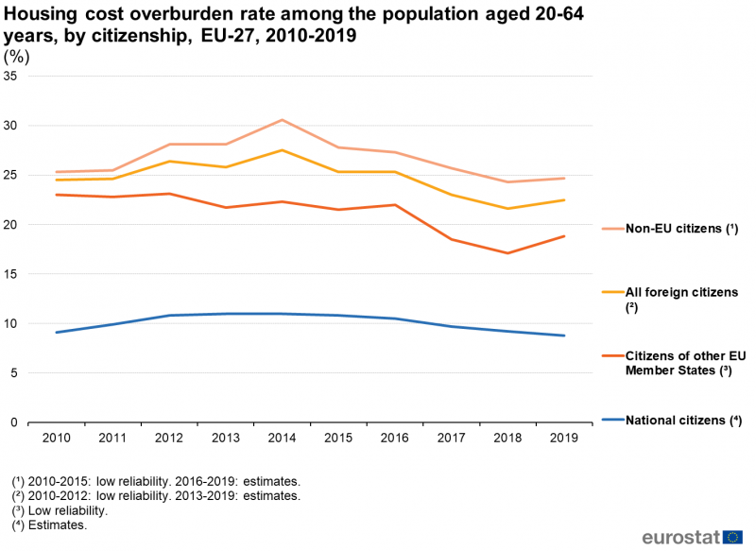
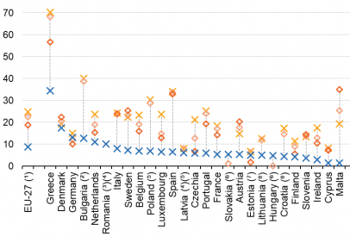
Housing cost overburden rate among the population aged 20-64 years, by citizenship, EU-27, 2010-2019 (%)
Housing cost overburden rate among the population aged 20-64 years, by citizenship, 2019 (%)
Source: Eurostat (mii database)
Notes:
Finally, the housing and/or social exclusion of many migrants is also reflected when looking at the housing cost overburden rate. Eurostat defines this rate as “[the] percentage of the population living in a household where total housing costs (net of housing allowances) represent more than 40% of the total disposable household income (net of housing allowances)”.
On average, throughout the last decade this rate has been the double for migrants (both mobile EU citizens and third country nationals) than for nationals.
In 2019, this is true not only for the EU-27 average but also for each Member State, with only a few exceptions. For Italy, Sweden and Spain the difference between the rates is enormous, but it is notably for Greece, where almost 60% of the mobile EU citizens face a housing cost overburden.

Slide 11
How many mobile EU citizens are experiencing homelessness?
National and local counts point to an overrepresentation of mobile EU citizens among people experiencing homelessness in many cities and services:
Copenhagen: 88% of the migrants living rough in 2017 came from Central and Eastern European countries (European Social Policy Network, 2019).
Barcelona: an estimated 45% of the homeless population comes from other EU countries (Síndica de greuges, 2018).
Brussels: DIOGENES outreach workers were in contact with more mobile EU citizens than Belgians in 2018 (FEANTSA, 2020).
London: 31% of those seen rough sleeping in 2018/19 were from Central and Eastern European countries (CHAIN).
Notes:
It is difficult to say how many mobile EU citizens are experiencing homelessness. As explained in the previous module, there are currently no official and harmonised data on homelessness across the European Union, which also contributes to the lack of adequate policies at European level.
Obviously, this is the case for homelessness in general and also for homelessness among mobile EU citizens in particular. However, as shown in this slide, the available data suggests that mobile EU citizens are over-represented among people experiencing homelessness in many cities.
Taking into account that there is a large number of mobile EU citizens facing housing exclusion or being at risk of poverty or social exclusion, it is no surprise that this vulnerability is also reflected in the homelessness statistics.

Slide 12
The diversity of profiles among mobile EU citizens in homelessness
Job seekers and precarious workers. They live in a constant change between rough sleeping or staying in temporary shelters and renting precarious accommodation.
Severely excluded individuals. Even if a minority within mobile EU citizens experiencing homelessness, their living conditions are usually the worse.
Roma individuals and families. The main reason to migrate is the discrimination they encounter in their home countries that makes it almost impossible to get a regular, decent job.
Diversity in terms of gender and age. Men are more represented than women among the mobile EU citizens experiencing homelessness, but we need to consider ‘hidden homelessness’. There is a big variety in age groups as well.
Source: FEANTSA(2016) Homelessness among Mobile EU Citizens. How to better understand the problem and find solutions
Notes:
Similarly to people experiencing homelessness in general, mobile EU citizens living in homelessness are not a homogeneous group, meaning that their living conditions, profiles, and causes of their homelessness vary significantly. Therefore, it is important to explore this diversity by taking a closer look at their different realities.
Firstly, for job seekers and precarious workers, even if most of them are healthy and eager to work, they often lack the language skills required in the host country and information about the labour market and welfare system. All these barriers make it difficult to find a decent job.
A second profile is the one of severely excluded individuals. They can suffer from several health problems, drug addictions or mental illnesses. These are caused by living on the streets, particularly if that happens for an extended period of time. They are more likely to be victims of violence, lack social networks and have lost contact with families.
Thirdly, Roma individuals and families are also part of the mobile EU citizens experiencing homelessness. Some travel for seasonal jobs and return home periodically, whereas others settle down in their host countries.
Finally, there is also a great variety in terms of gender and age, as shown in the data collection processes undertaken by our members. In relation to age, people in their 30s, 40s and 50s are frequently the most represented groups, but without any remarkable differences to other groups.

Slide 13
Factors contributing to the vulnerability of mobile EU citizens (I)
Administrative reasons. When EU citizens want to stay in another EU country for more than three months, they may be required to register with the relevant authorities. This registration process is not always straightforward.
Health issues. Physical and mental illnesses, and/or any addictions, make social integration more difficult. These are even worsened by restrictions to access healthcare services and discrimination.
Unemployment or precarious jobs. The lack of a stable job might result in the loss of residence rights and, consequently, the loss of entitlement to welfare benefits and support.
Source: FEANTSA (2016) Homelessness among Mobile EU Citizens. How to better understand the problem and find solutions
Notes:
The factors pushing people into homelessness may be different for every individual and can be cumulative or not. However, there are some factors that have been identified as frequent:
Administrative reasons. Unawareness of the procedures to follow, a lack of clarity about what needs to be provided, language barriers and a lack of support may be reasons to not register properly in the host state, making a person more vulnerable to destitution and homelessness.
Health issues. Being homeless is already a health risk and, in addition, mobile EU citizens often encounter restrictions to accessing healthcare for administrative reasons or because they cannot afford health insurance, which is required in several Member States.
Unemployment or precarious jobs. In the case of people who are unemployed, access to the labour market can be very difficult due to lack of language skills or qualification, strict criteria to hire foreigners, etc. For those employed, job insecurity, low-wage contracts or undeclared work make their housing situation very vulnerable and their access to social protection very difficult.

Slide 14
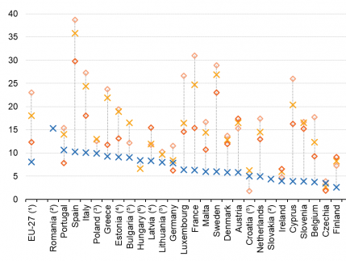
People aged 20-64 years at risk of in-work poverty, by citizenship, 2019 (%)
Source: Eurostat (mii database)
Notes:
This graph is useful to illustrate the precariousness of jobs held by many mobile EU citizens. On average for the EU-27, the in-work poverty rate was twice as high for mobile EU citizens as for nationals. And this is also the case when looking at Member States individually, as only three countries (Portugal, Germany and Czechia) have a lower in-work poverty rate for mobile EU citizens than for nationals. However, it is important to note that the data refer to all mobile EU citizens, those with higher income included. The in-work poverty rate would probably be higher when considering only those with low earnings.

Slide 15
Factors contributing to the vulnerability of mobile EU citizens (II)
Discrimination. Homelessness in itself comes with prejudices and stigma, which worsens when a person experiencing homelessness has a different national or ethnic background, as is the case for mobile EU citizens.
Human trafficking. Mobile EU citizens are also victims of this crime, especially women engaged in sex work. The people affected by this often do not sleep rough, but rather experience 'hidden' homelessness as they live under the threat of violence and eviction.
Domestic violence. This is a major cause of homelessness for many women, including those who migrate to another EU country, either when they are in an abusive relationship or once they are out of it.
Source: FEANTSA (2016) Homelessness among Mobile EU Citizens. How to better understand the problem and find solutions
Notes:
Other factors that may contribute to the vulnerability of mobile EU citizens, and, ultimately, might push them into homelessness are:
Discrimination. When it is combined with houselessness and lack of income, it is very easy to fall into a downward spiral.
Human trafficking. Even if it may affect only a minority among the mobile EU citizens in homelessness, it is also a factor to be considered.
Domestic violence. Many survivors find themselves isolated and without enough financial resources or networks to live independently, worsened by the fact that they are migrants. Support services and public authorities must include a gender perspective to develop inclusive services for all women who are victims of gender-based violence, regardless of their nationality.

Slide 16
Main gaps and obstacles in free movement legislation (I)
Obstacles to entry: non-recognition of identity documents, not accepting visas for non-EU family members, etc.
Long waiting periods and delays in issuing residence documents.
Complicated registration formalities.
Requirement to prove possession of sufficient resources.
“Comprehensive sickness insurance” condition and access to healthcare in the host country.
Source: ECAS, EU Rights Clinic, FEANTSA and Médécins du Monde (2020) Policy Paper: Analysis of the obstacles to freedom of movement and political participation
Notes:
However, not only individual or social factors impact the lives of destitute mobile EU citizens and may push them into homelessness. At FEANTSA we have also identified several barriers in the legislation on free movement, which may be a factor of destitution and/or an obstacle to exit from it.
The Free Movement Directive of 2004 includes ambiguous concepts, such as “sufficient resources” or “comprehensive sickness insurance”. When transposing this Directive, Member State define these concepts differently, leading to restrictive interpretations in many cases.
For example, for precarious workers or job seekers, it may be difficult to prove they have sufficient resources or to obtain a health insurance, leading in many cases to difficulties in or lack of registration, which has serious consequences in terms of access to rights, services and jobs.
Other factors, such as registration formalities that are too long or complicated or obstacles to entry, often play a role as well.

Slide 17
Main gaps and obstacles in free movement legislation (II)
Excessive requirements for obtaining permanent residence.
The notion of “worker” and “genuine chance of being engaged”.
The notion of public policy.
Begging and forced expulsions.
To know more, you can have a look at our set of modules “EU free movement guide: a tool for professionals working with destitute EU migrants” and our guide for professionals.
Source: ECAS, EU Rights Clinic, FEANTSA and Médécins du Monde (2020) Policy Paper: Analysis of the obstacles to freedom of movement and political participation
Notes:
Similarly, the fact that the European Directive does not clearly define concepts such as “worker” is also a challenge. Many Member States require a specific amount of working hours or wages in order to be registered as a worker. As seen before, many mobile EU citizens are in precarious work situations, experiencing in-work poverty, working few hours or low-paid jobs. These are often not enough for them to obtain and/or retain a worker status.
The same applies to jobseekers, who have to prove they have “genuine chance of being employed” in order to keep their right to residence. Very often, Member States establish interpretations of these concepts that are too restrictive.
Mobile EU citizens who are sleeping rough and may recur to begging to earn some kind of income are more exposed to receive an expulsion order. However, there is no legal basis for this, as shown by the sentence of the Court of Justice of the EU on the UK policy to deport EU migrants sleeping rough (applied until 2017 by the Home Office). The same applies to the issue of forced expulsions, for which the legal grounds are unclear in many occasions. To explore this in further detail, you can access the links within the slide.
Finally, we invite you to read our set of modules on EU free movement and our practical guide targeted at professionals working with people in homelessness, which further develop the contents of this module and provide guidance for problems encountered by homeless service providers in their day-to-day work.

Slide 18
Thank you for your attention www.Feantsa.org
Notes:
We have reached the end of this module.
In the next module, we will find out more about how to support mobile EU citizens experiencing homelessness.
Thank you for your attention!

