Slide 1
Homelessness among mobile EU citizens:
A tool for legal experts and local authorities working with mobile EU citizens in destitution
3 modules
→ An overview of homelessness in Europe
→ Homelessness among mobile EU citizens
→ Support measures for mobile EU citizens experiencing homelessness
This material has been prepared by FEANTSA team in the context of PRODEC project –Protecting the Rights Of Destitute mobile EU Citizens.
Contact us at migration@feantsa.org
July 2022
Notes:
Hello and welcome to our new tool for professionals working with mobile EU citizens in destitution.
This is a series of three modules on homelessness among mobile EU citizens, designed for legal experts and local authorities working with destitute mobile EU citizens, but useful for everyone who wants to learn more about this subject.
Each module focuses on a particular topic: this first module introduces us to the concept of homelessness and the current situation in Europe. Module number two focuses on a specific segment of the people who are experiencing homelessness in Europe: those who move from one EU country to another, mobile EU citizens. Finally, the third module introduces good practices for supporting mobile EU citizens experiencing homelessness.
We hope you will enjoy the modules and find this tool useful!

Slide 2
MODULE 1:
AN OVERVIEW OF HOMELESSNESS IN EUROPE
What is homelessness?
European housing exclusion and homelessness
The many faces of homelessness in Europe
The role of FEANTSA: the European Federation of National Organisations Working with People in Homelessness
Solutions to homelessness
Credit: Juan Lemus / Arrels Fundació, Barcelona (Spain)
Notes:
In this first module, we will address the following questions:
How is homelessness defined?
What is the current situation of housing exclusion and homelessness in Europe? What data are available?
What are the different profiles of homelessness in Europe?
What is FEANTSA, and what does it do?
Finally, we will present solutions for putting an end to homelessness in Europe.

Slide 3
What is homelessness?
Lack of a European-wide, common definition. Some examples:
Austria: “No official national definition. Administrative definitions usually address roofless people (people living rough and people in emergency accommodation/night-shelter) and people living in short-term or longer-term accommodation for homeless people.”
Estonia: “A homeless person is a person who has no legal relationship (ownership, permanent contract, tenancy) with any building or room qualifying as a living space and who does not have the necessary income or social skills to change their situation.”
Statistics division of the UN Economic and Social Affairs Department:
“Primary homelessness (or rooflessness). This category includes persons living in streets or without a shelter that would fall within the scope of living quarters;”
“Secondary homelessness. This category may include the following groups: (i) Persons with no place of usual residence who move frequently between various types of accommodation (including dwellings, shelters or other living quarters); (ii) Persons usually resident in long-term (also called “transitional”) shelters or similar arrangements for the homeless.”
Sources: European Commission (2019) Baptista, I., Marlier, E., Fighting homelessness and housing exclusion in Europe : a study of national policies; United Nations office in Brussels (2021) “European platform on combatting homelessness: 10 elements for consideration”
Notes:
Presently, no common definition of homelessness has been adopted, neither at international nor at European level.
Even if there are some similarities between existing definitions at the national level, each Member State of the European Union has a different way of defining homelessness. Some do not have any official definition yet.
At the level of the United Nations, a categorisation is provided in order to collect and produce statistical data on homelessness.

Slide 4
FEANTSA → ETHOS classification ETHOS - European Typology on Homelessness and Housing Exclusion
Purpose = to cover all living situations which amount to forms of homelessness across Europe
4 main categories of living situations
Rooflessness: without a shelter of any kind, sleeping rough
Houselessness: with a place to sleep, but temporary, in institutions or shelter
Living in insecure housing: threatened with severe exclusion due to insecure tenancies, eviction, domestic violence
Living in inadequate housing: in caravans on illegal campsites, in unfit housing, in extreme overcrowding
Notes:
As properly defining homelessness is key to addressing it, in 2005 FEANTSA organised a collective effort with researchers and experts to establish some common standards. The result was ETHOS: the European Typology on Homelessness and Housing Exclusion.
This Typology categorises homelessness into 4 main definitions: rooflessness, houselessness, insecure housing and inadequate housing.
To find out more, we invite you to consult our website - https://www.feantsa.org/download/ethos2484215748748239888.pdf
Since its establishment, ETHOS has been widely used in academia, statistics and policies related to homelessness in Europe.

Slide 5
Notes:
The four conceptual categories used to define homelessness represent several living situations, encompassing a wide understanding of homelessness.
ETHOS determines that having a ‘home’ is much more than its physical component: a roof over one’s head, a shelter or a house does not always mean having a home. The living spaces of people in inadequate housing, or of the women suffering from gender-based violence, cannot be considered a ‘home’.

Slide 6
European housing exclusion and homelessness

Slide 7
Housing exclusion in Europe: key statistics
Source: ‘Seventh overview of Housing exclusion in Europe’ (FEANTSA, 2022), extracted from EUROSTAT/EUSILC (2020)
Notes:
Eurostat periodically collects data on the housing conditions of European households.
From the 2020 results, we know that almost 8.5 million households (4%) were facing severe housing deprivation, and that 29 million households (14.8% of the total) live in damp conditions. It is also relevant to highlight that 7.4% of all households struggle to have an adequate housing temperature, while almost the same percentage of households are overburdened by housing costs.
However, the number of people experiencing homelessness in Europe remains unknown. This is because of the lack of harmonised definitions and data on homelessness across Europe: Member States may categorise “homelessness” under diverse situations, others may not have an official definition of the concept, and homelessness counts may be organised differently –at national or local level, a one-time survey or a continuous monitoring, produced by statistical institutions or public administrations, etc. More information about this can be found in Vol.14 (3) of the European Journal of Homelessness (2020), available at: https://www.feantsaresearch.org/public/user/Observatory/2021/EJH_14-3/EJH_14-3_FullVersion_web2.pdf

Slide 8
European index of housing exclusion 2022
Source: ‘Seventh overview of Housing exclusion in Europe’ (FEANTSA, 2022), extracted from EUROSTAT/EUSILC (2020)
*Poor households are those where the equivalised income is below the threshold of 60% of the national equivalised median income (Eurostat)
Notes:
The number of European households in indebtedness has grown by 22% from 2019 to 2020, affecting in particular poor households: 8% of them are in rent or mortgage arrears. However, there are big differences across the EU: while the number of indebted poor households in Spain, France, Ireland or Greece varies between 15-20%, Central and Eastern European countries have the lowest percentages.
The housing conditions of families are important as well, and in that regard it is very worrying that almost one in every four poor children in the EU27 lived in unfit housing in 2020. A total of 13 countries have a percentage even higher than the EU average.

Slide 9
European index of housing exclusion 2022
Source: ‘Seventh overview of Housing exclusion in Europe’ (FEANTSA, 2022), extracted from EUROSTAT/EUSILC (2020)
Notes:
In addition, an increasing number of households are experiencing difficulties in maintaining an adequate housing temperature: from 2019 to 2020, there has been a growth of 7% on the EU27 average for the total population. Nevertheless, it is specially worrying that between 17-27% of the total number of households in Bulgaria, Cyprus, Greece, Portugal or Lithuania have financial difficulties to keep adequate housing temperatures. This percentage almost doubles in the case of poor households in these countries.
Although data do not exist for 2022 yet, it is expected that the percentage of households with financial difficulties has increased, given that the price for energy sources in the EU was almost 50% higher in January 2022 than in the same month of 2020. The inflation caused by the invasion of Ukraine is likely to continue as long as the war does not cease, having an impact in the number of households facing energy poverty in Europe in the coming years (for more information: https://fr.euronews.com/2022/05/31/avec-la-guerre-en-ukraine-et-les-sanctions-l-inflation-atteint-un-nouveau-record-en-Europe)

Slide 10
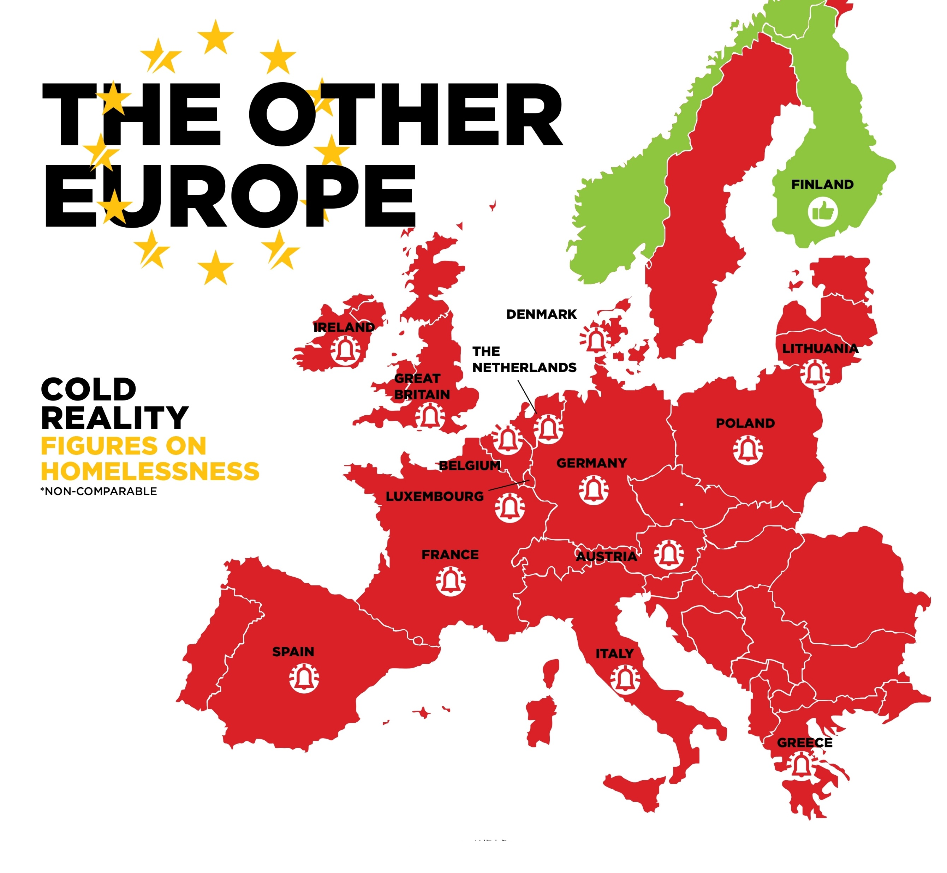
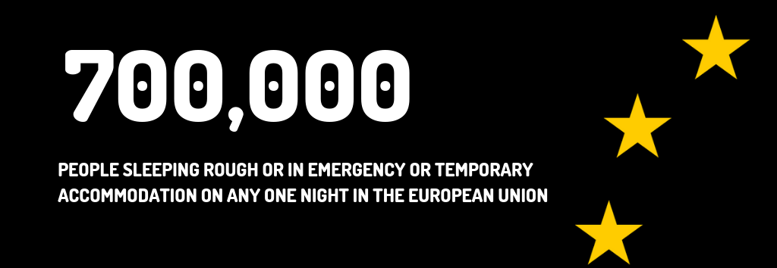
+ 70%
in 10 years
Source: ‘Fifth overview of Housing exclusion in Europe’ (FEANTSA, 2020)
Notes:
FEANTSA estimated that in 2020, there were at least 700,000 people sleeping rough in Europe (including the UK). In 24 of the 27 EU Member States, it is estimated that homelessness has increased over the last decade, resulting in a rise in homelessness by 70% on a Europe-wide average. Finland is the only country of the EU to have significantly reduced homelessness over the last 30 years.
Even if the UK has left the EU, it is important to mention that the number of people experiencing homelessness there has increased during the last decade as well.

Slide 11
Estimated numbers of people experiencing homelessness
+100%
from 2012 to 2021
+90%
from 2009 to 2021
2,600
minors living in homelessness
FRANCE.
+19%
from May 2021 to February 2022
THE NETHERLANDS.
Estimated 300,000 people in homelessness in 2021 (Fondation Abbé Pierre)
32,000 people at 1 January 2021 (CBS - official statistics of the Netherlands)
IRELAND.
CZECH REPUBLIC.
Out of 21,230 people counted in spring 2019
(Ministry of Employment and Social Affairs)
+30%
from 2010 to 2020
9,492 people in emergency accommodation in February 2022 (Department of Housing)
37,705 people in 2020
SPAIN.
Average of 17,772 people/day in emergency accommodation (National Institute of Statistics)
POLAND.
Received welfare benefits due to homelessness (Ministry of Family, Labour and Social Policy)
Source: ‘Seventh overview of Housing exclusion in Europe’ (FEANTSA, 2022), extracted from EUROSTAT/EUSILC (2020)
Notes:
Data is being collected differently in every Member State.
The official statistics institution in Spain estimated an average of people sleeping in emergency accommodation on any given day of 2020. In the Czech Republic, the Ministry organized a one-week count in the emergency reception services for homeless people and the hospital or prison services of 403 municipalities. In France, the only available official statistics are from a one-night survey carried out in 2012 (with 143,000 people counted), while the NGO Fondation Abbé Pierre estimated this number has doubled now, considering people sleeping rough, in homeless accommodation, or asylum seeker accommodation.
Comparing the number of people experiencing homelessness in the different Member States gives insight into the differences that exist at the national level. For example, the number of people who are in homelessness in Poland doubles the one for Spain, even though there are more inhabitants in this country. On the contrary, this number is estimated to be ten times bigger in France than in Poland, despite their population is only half of the French one.

Slide 12
Challenges in combatting homelessness
Most national policies are inadequate: predominant focus on temporary accommodation & support.
Lack of EU harmonized datasets = no common definitions and methodologies = data not comparable.
Problem: EUSILC datasets do not include people out of housing markets/who are homeless. There is no comprehensive data about the number of people who live without a home, their profiles or their needs.
EU-wide housing crisis: increasing housing inequalities; widening housing cost gap between households classified as poor and those labelled non-poor; lack of affordable housing.
Notes:
As stated before, there is a lack of a common definition of homelessness and of methodologies to measure it in Europe. This lack of comparable data is indeed a challenge because it makes it difficult to provide nuanced and complete analysis, monitor policy progress, or compare developments across Europe.
In addition, EUSILC datasets managed by Eurostat are based on households, therefore excluding people that are experiencing certain types of homelessness. There is also an EU-wide housing crisis, with a lack of affordable housing and increasing inequalities between households classified as poor and those labelled non-poor.
The fact that only ten Member States have some kind of national homeless strategy (as stated in the report drafted by the European Social Policy Network in 2019: https://op.europa.eu/en/publication-detail/-/publication/2dd1bd61-d834-11e9-9c4e-01aa75ed71a1/language-en) shows that more ambition is needed to combat homelessness.

Slide 13
The many faces of homelessness in Europe
Notes:
Homelessness varies across Europe and it affects different groups.

Slide 14
women and families
Ireland: ONE IN THREE people experiencing homelessness in temporary accommodation in October 2019 was a CHILD, with an increase by 400% between 2014 and 2019.
In January 2020, 39% of adults using emergency accommodation in Ireland were women.
Sweden: In 1993, 83% of the people living in homelessness were men and 17% were women. In 2017, 62% were men and 38% were women.
In Finland: 25% of those experiencing homelessness in 2020 were women.
“Women are more likely to experience homelessness as ‘hidden’ or ‘concealed’ homelessness and systems for recording whether someone is homeless, i.e. they are living with an acquaintance, friend or relative because they have nowhere else to go, are variable across Europe.”
Source: ‘Fifth overview of Housing exclusion in Europe’ (FEANTSA, 2020) and Bretherton, J. and Mayock, P. (2021) Women’s Homelessness: European Evidence Review. Brussels: FEANTSA.
Notes:
Homelessness among women and families (mostly single women with their children) is present across Europe, with a worrying upwards trend for the last decades. For example, data from Sweden show that the proportion of women among people experiencing homelessness (compared to men) has doubled since the early 90s.
However, homelessness among women is still difficult to estimate and to record. For example, it is difficult to record when a woman is suffering gender-based violence in her own house (one of the categories in ETHOS), or when she has left an abusive situation to stay with relatives or friends (another of the ETHOS categories).

Slide 15
youth and LGBTIQ+
In Europe, one in five LGBTIQ people, one in three transgender people and 40% of intersex people have already experienced homelessness.
In the Netherlands, the number of young people (between 18 and 29 years old) experiencing homelessness increased from 4,000 in 2009 to 12,600 in 2018.
In Austria, 15% of people experiencing homelessness counted in 2018 were aged 18-24. In Salzburg and Graz, 44% and more than 50% were aged 18-30, respectively (in 2019).
In Finland, 15% of people living in homelessness counted in 2019 were young people.
In Paris, according to the Night of Solidarity count of March 2021, 13% of people sleeping rough were under 25 years and 34% were aged 25-39.
Source: ‘Sixth overview of Housing exclusion in Europe’ (FEANTSA, 2021)
Notes:
Likewise, homelessness is increasing among young people in Europe. The number of youth experiencing homelessness more than tripled in the Netherlands in only 9 years, while in some Austrian cities people under 30 represent up to half of the total homeless population. It is the case as well for Paris, where 47% of the people counted in the Solidarity Night were less than 40 years old.
It is also important to highlight the worrying prevalence of homelessness within the LGBTIQ+ community in Europe in general as well as within certain groups, such as transgender and intersex people, specifically.

Slide 16
migrants
Studies conducted by FEANTSA and our members point out that migrants are highly represented amongst people experiencing homelessness across the EU.
This concerns both third country nationals, including refugees and asylum seekers, and mobile EU citizens exercising their right to free movement.
Restrictive migration rules, discrimination and administrative barriers are factors contributing to homelessness among migrants.
Notes:
In the past years, migrants – including both third country nationals as well as mobile EU citizens - have increasingly experienced homelessness in many European cities. Again, there is a lack of comprehensive data, but estimations from cities show that at least for mobile EU citizens the numbers can be as high as thousands, as we will see in the next module.
The high number of asylum seekers arriving in Europe in 2015 and the limited capacity of asylum systems across MS have led to a “reception crisis” in what concerns the applicants for international protection – increasing episodes of homelessness are reported in cases where individuals wait to apply for asylum or to receive an answer on their application, despite the EU commitment to ensure adequate accommodation for those who are in search of asylum on EU territory. Furthermore, even after being granted protection, there is no guarantee that access to housing will be achieved.

Slide 17
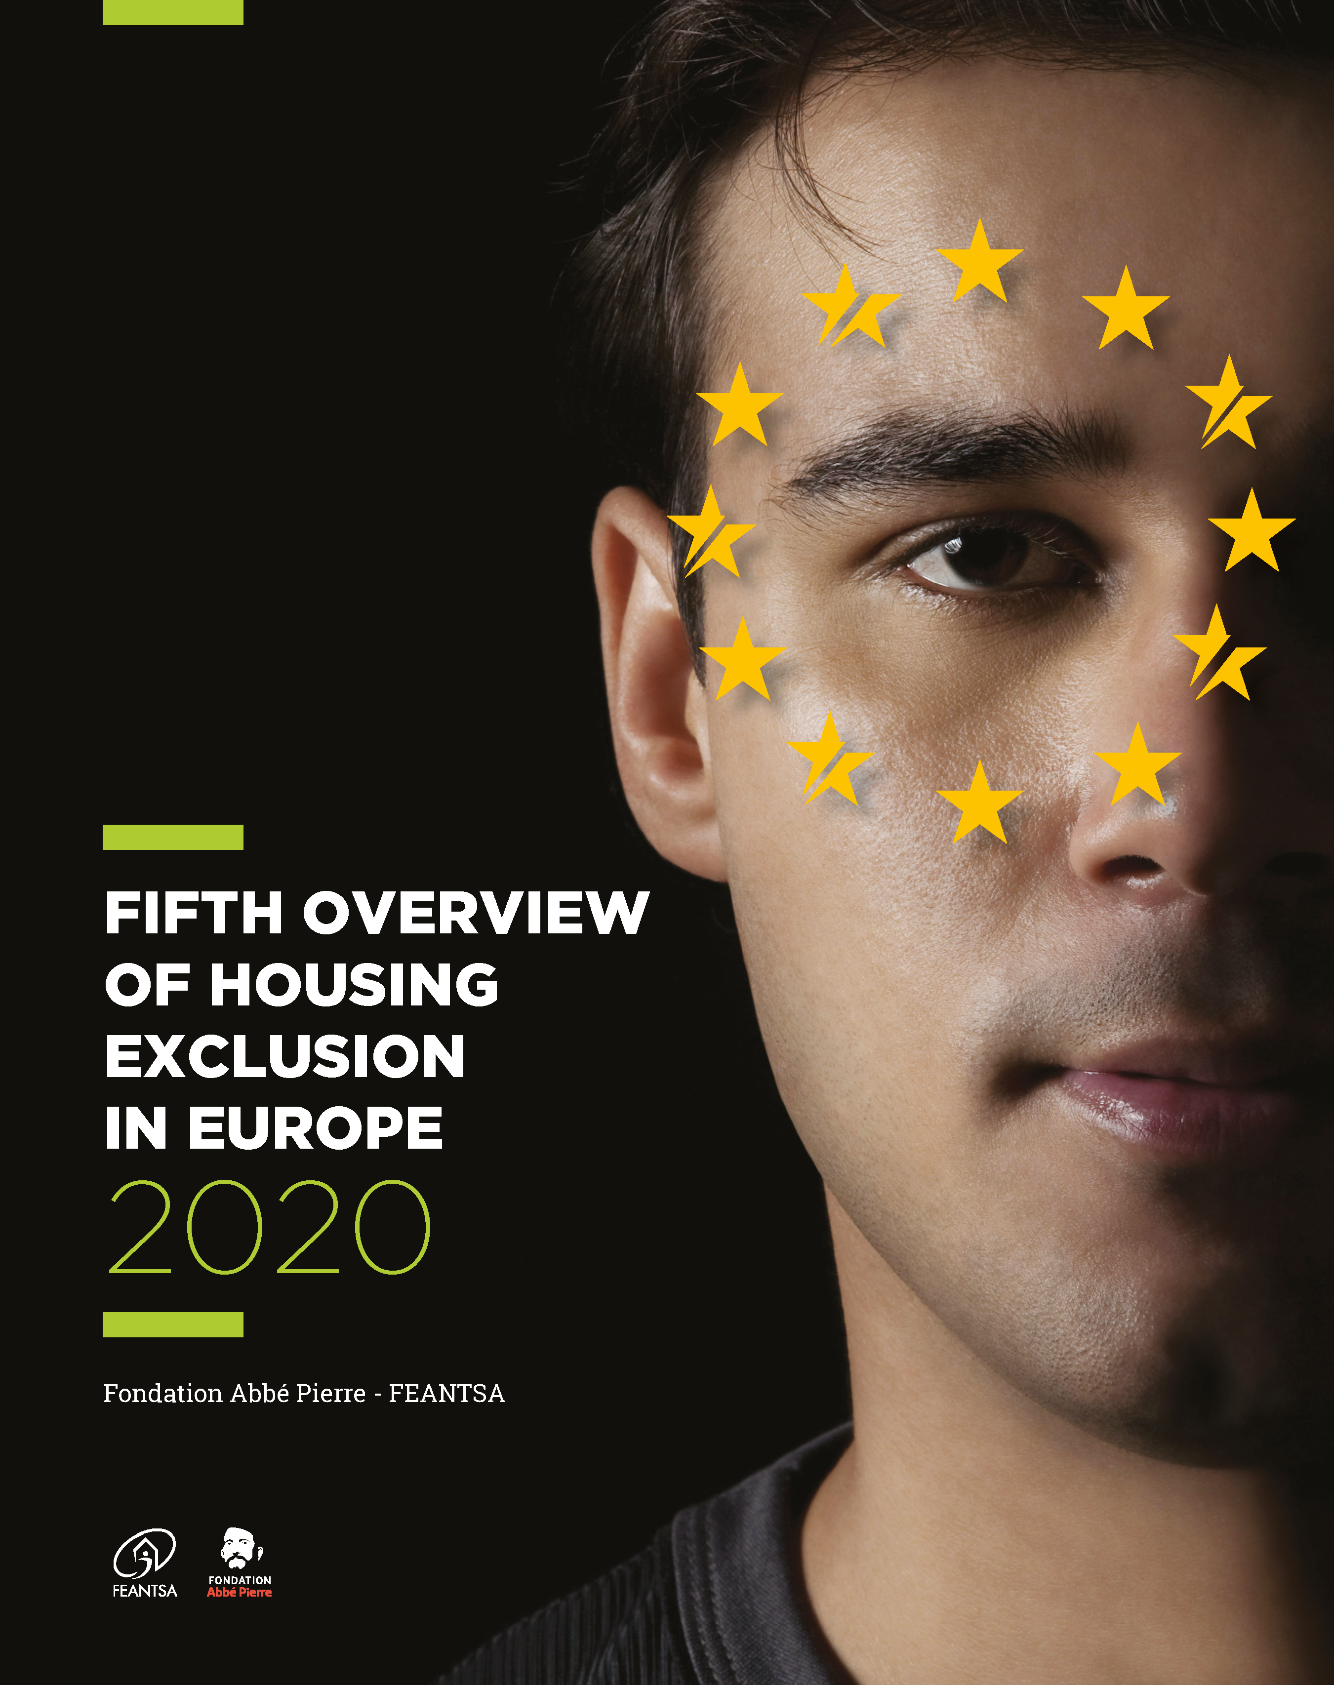
In Sweden, 43% of people living in homelessness are foreign nationals (data from 2017).
In Finland, 25% of families living in homelessness are migrants (data from 2019).
According to a count carried out by the homeless service provider Arrels Fundació (Barcelona) in November 2020, 27% of people rough sleeping were mobile EU citizens and 44% were third-country nationals.
In London, 31% of those seen sleeping rough in 2018/19 were from Central and Eastern European countries (data from CHAIN counts).
In Brussels, almost 50% of the people accompanied in 2020 by the homeless service provider DIOGENES were mobile EU citizens.
In the Netherlands, 20% of people in homelessness had a ‘non-western’ migrant background as of 1 January 2021 (CBS - official statistics of the Netherlands).
In Greece, 16% of 3,774 unaccompanied minors were sleeping rough in 2019.
In addition, Covid-19 has worsened the reception conditions of asylum seekers, leading to an increase in homelessness among them.
Where not specified, the source is: ‘Fifth overview of Housing exclusion in Europe’ (FEANTSA, 2020)
Notes:
These numbers from different cities across the continent provide an overview on the high number of migrants who are experiencing homelessness in Europe.

Slide 18
European Federation of National Organisations Working with Homeless people
→ European coalition aiming to end homelessness in Europe
120+ members from across Europe EU + EFTA + UK
1989 – 2019: membership limited to NGOs working with people experiencing homelessness
Since 2019: open to broader range of actors in fight against homelessness (national/regional public authorities, cities, public agencies, foundations, neighbouring sectors - social housing, health, migration, research institutions, universities, think tanks etc.)
→ Our work
Research
Learning, expertise & knowledge
Advocacy
Awareness raising
Thematical: women, youth, LGBTIQ, migrants (EU & TCN), participation, health, employment, housing as a human right.
www.feantsa.org
Notes:
FEANTSA (the European Federation of National Organisations Working with Homeless People) is a coalition of over 120 members from across the EU (and several non-EU members), primarily non-profit services that work to support people experiencing homelessness. Since 2019 it also includes actors such as national/regional public authorities, cities, public agencies or foundations. FEANTSA was established in 1989 and is the only European NGO focusing exclusively on the fight against homelessness.
Through national members and the secretariat in Brussels, FEANTSA is in constant dialogue with the European institutions, as well as national and regional governments to promote the development and implementation of effective measures to end homelessness.

Slide 19
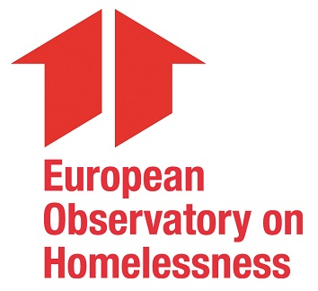
FEANTSA coordinates three different platforms in the area of housing:
Housing First Europe Hub →promotes Housing First in Europe
Housing Solutions Platform→ works to find innovative solutions for affordable housing
Housing Rights Watch→ promotes the right to housing in Europe
FEANTSA has set up the European Observatory on Homelessness since1991 with the purpose to carry out transnational research on homelessness and housing exclusion.
Notes:
FEANTSA also coordinates three different platforms in the area of housing to advance work on research and advocacy regarding housing exclusion and homelessness in Europe, as well as an Observatory led by researchers and academics working on homelessness.

Slide 20
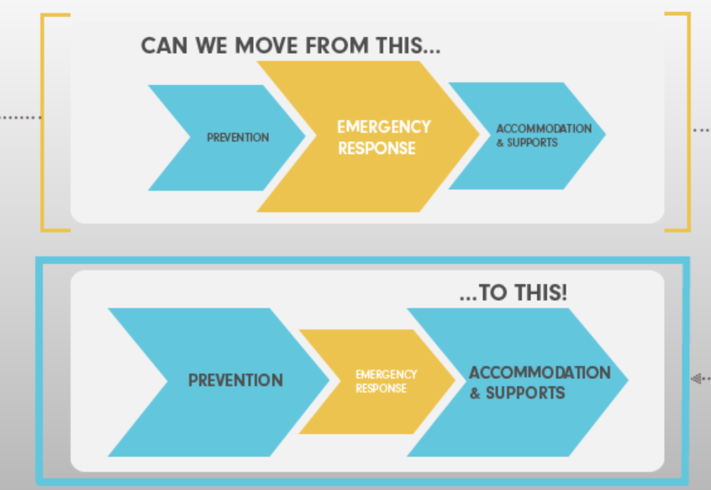
Solutions to homelessness
All the evidence suggests that homelessness policies should be housing-led in order to:
Prevent people from losing housing
Provide people experiencing homelessness with permanent housing solutions quickly
Provide accompanying support as needed
Housing First has demonstrated unprecedented success in solving homelessness for those considered « hardest » cases
Source: Steve Gaetz, Canadian Observatory on Homelessness
Notes:
Scientific research suggests that current existing policies addressing homelessness are not successful (as shown, a 70% increase in homelessness was registered during the last decade) and that they should be replaced with a housing-led approach, which is also more cost-effective.
Instead of focusing on the emergency response, policy makers should invest more in the prevention of homelessness and in providing adequate, stable accommodation together with support measures.
The traditional system in place to support people living in homelessness is based on an emergency response. It is focused on shelters, provision of basic needs, etc. However, this system does not work when people experience homelessness for a long time (as they are no longer in an emergency situation), and it will not help them regain stability as quickly as possible.
In sum, housing should be considered a basic right and, therefore, a lack of it should be overcome as quickly as possible with housing-led policies that ensure this basic right is respected.

Slide 21
Promising policies in Europe
The Netherlands
Plan to invest 200 million Euros in new housing and accommodation for people experiencing homelessness in 2020/2021.
10,000 supported housing units, increased prevention, shelter transformation
Goals: shift to a housing-based response; no one to stay longer than 3 months in shelter
Lyon
Commitment to « Zero Returns to the Street »
Plan to mobilise 500 social housing units for this purpose in first phase
Scotland
Fast-tracked legislation limiting stays in temporary accommodation to 7 days post-pandemic, after which permanent housing must be offered
Prague
City Hall plans to continue to house hundreds in hotels
Looking into buying units to provide long-term supported housing
Requested Council of Europe Development Bank Finance
Notes:
The housing-led approach is increasingly being adopted in many areas across Europe, with examples from the Netherlands, Prague or Scotland. However, this approach still needs to be mainstreamed in homelessness policies. FEANTSA advocates for this systemic change and works for this to become a reality in Europe.
The COVID-19 health crisis has brought more attention to homelessness as a matter of public health. It proved the importance of housing as a health determinant, therefore many promising policies were put in place to shelter people from the virus.

Slide 22
The role of the EU in addressing homelessness
Policy support & coordination
Launch of the European Platform on Combatting Homelessness (Lisbon Declaration, June 2021)
Political commitment to ending homelessness
Monitoring, policy guidance, support to mobilise EU funding & finance, scale-up Housing First.
Funding & finance
MFF 2021 – 2027
Structural funds, InvestEU, European Social Fund+, Fund for European Aid to the Most Deprived (FEAD)
Next Generation EU
€750 billion Recovery & Resilience Facility
Opportunity to integrate housing to address homelessness in the recovery and resilience plan
Notes:
Finally, the EU has an important role in the fight to end homelessness. As shown, homelessness and housing exclusion are problems affecting all EU Member States. Therefore, solutions should not only come from national/regional/local authorities, but also from EU institutions.
In this regard, the use of EU funds to address homelessness and especially the launch of the European Platform on Combatting Homelessness (EPOCH) are very important tools. The Lisbon Declaration signed in June last year, establishing the Platform, was the first time when all Member States and EU institutions committed to working together towards ending homelessness by 2030. FEANTSA is part of the Steering Committee that coordinates the implementation of the EPOCH.

Slide 23
Thank you for your attention www.Feantsa.org
Notes:
We have reached the end of this module.
In the next module, we will find out more about homelessness among mobile EU citizens specifically.
Thank you for your attention!

