Slide 1
An introduction to European Union law
3 modules:
→ Introduction to the EU Law and Institutions
→ The Relationship between EU law and national laws
→ Power and procedures of the Court of Justice
This material has been prepared by Mattia Bosio (matt.bosio@gmail.com) in the context of PRODEC project.
Notes:
Hello and welcome!
This is a new tool for professionals working with destitute mobile EU citizens, complementary to our previous 4 modules on EU Free Movement Guide - FEANTSA - YouTube . In this training we will present general information on the European Union law.
The first training module contains a brief introduction to the main principles and notions governing European Union law. In the second training module, we will look at the Relationship between EU law and national laws and in the third training module, we will learn about the powers and procedures of the Court of Justice of the EU.
We hope you will enjoy the modules and find this tool useful!

Slide 2
Introduction to the law and institutions of the EU
What is the EU? Which countries are EU members?
EU vs Euro Zone vs Schengen Area
The EU Treaties
The EU institutions
The powers and composition of the EU Parliament, EU Commission, Council and European Council
The sources of EU law: the EU secondary legislation.
The Procedures of adoption of EU secondary legislation.
Notes:
What is this first module about? What will you learn today?
We will start with a short history of the European Union. What is the EU? Do you know which European countries are members of the EU? Which country left the EU and which ones may join the EU in the future?
What is the difference between European Union, Euro Zone and Schengen Area?
What is the main legal basis of the EU? The EU Treaties.
What are the EU institutions? Which institutions have a legislative power?
The Powers, compositions and functions of the European Commission, European Parliament, the Council and the European Council.
What are the sources of EU law? You may have heard before about Regulations, Directives and Decisions. These are the main secondary legislative acts of the EU.
Who may adopt these acts? What are the procedures for adopting these acts?
These are the main contents of this first module. We will start slowly by looking at a map of Europe!

Slide 3
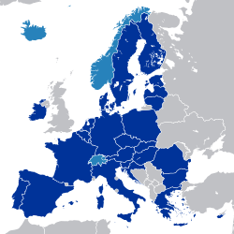
What is the European Union? Which are the Member States of the EU?
27 Members States
446 millions of habitants
24 Official Languages
Internal common market without borders
Notes:
The first thing we need to answer is: What is the European Union? How would you define it?
The European Union (abbreviated to “the EU”) is a political and economic union of 27 Member States (abbreviated to “MS”). It represents a population of 446 millions of Habitants and it has 24 official languages.
Between the Member States of the EU there is an internal common market without borders. Access to this market also extends to the territories (in light blue on this Chart) and citizens of Switzerland, Iceland, Norway and Lichtenstein. These four countries forming the European Free Trade Association (EFTA) are not EU members, but have partly committed to the EU's economy and regulations.
The United Kingdom left the European Union and the common market in December 2020.

Slide 4
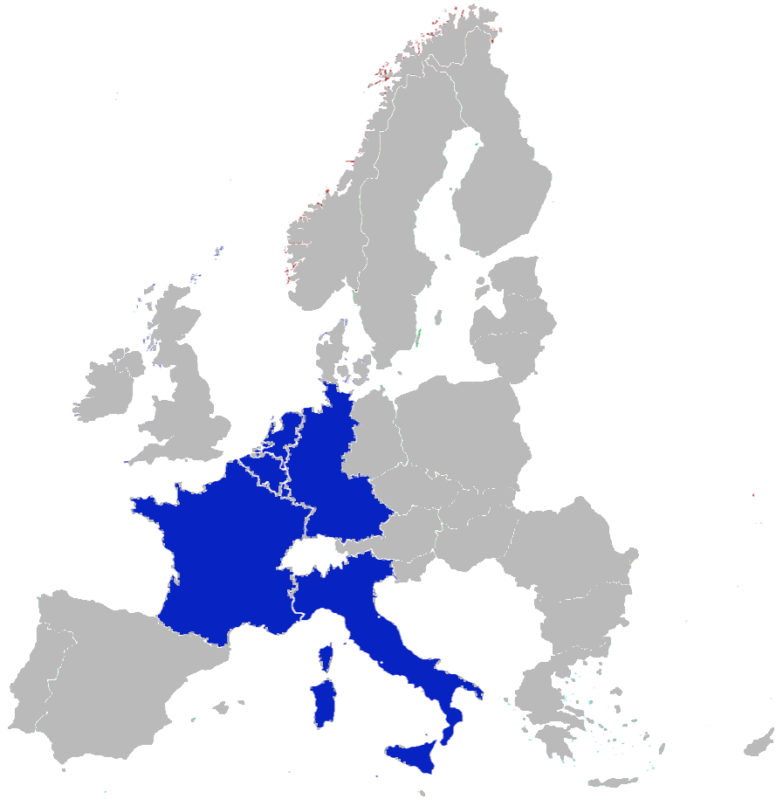
When and who founded the EU ?
6 Founding Countries in
1957
Belgium
France
West Germany
Italy
Luxembourg
Netherlands
Notes:
The predecessor of the EU was created in the aftermath of the Second World War.
It was named the European Economic Community (the “EEC”) and was created in 1957 with the initial aim of increasing economic cooperation between six countries: Belgium, West Germany, France, Italy, Luxembourg and the Netherlands.
To become a member, a country must guarantee a stable democracy that respects human rights and the rule of law and a functioning market economy. In addition, new member States must guarantee compliance with the obligations of membership.

Slide 5
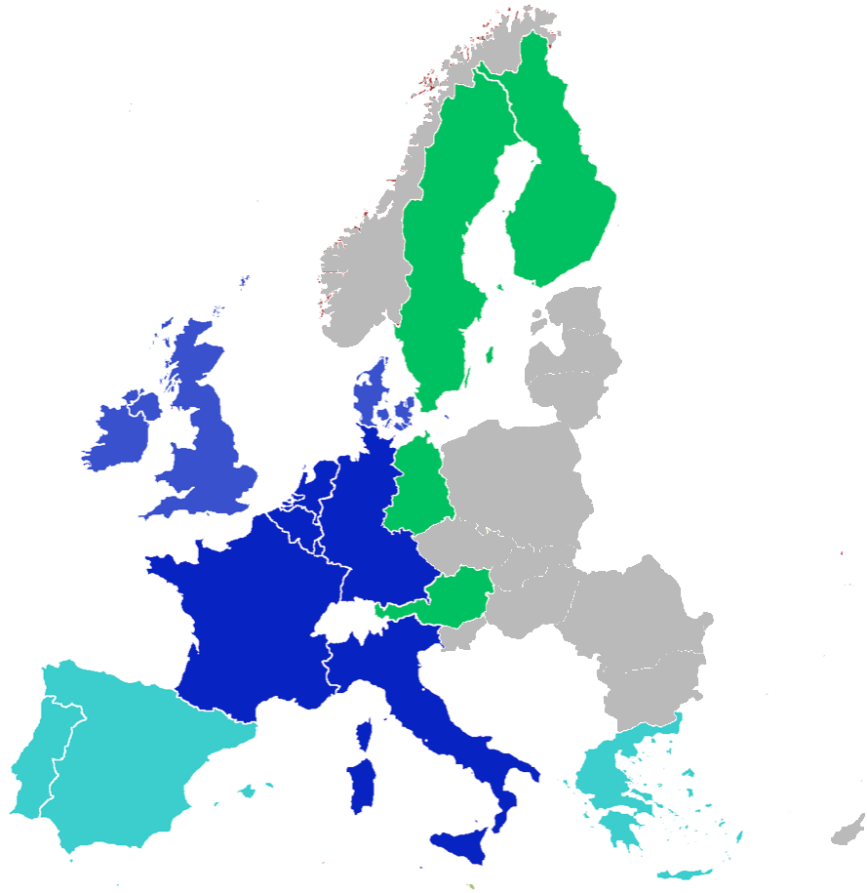
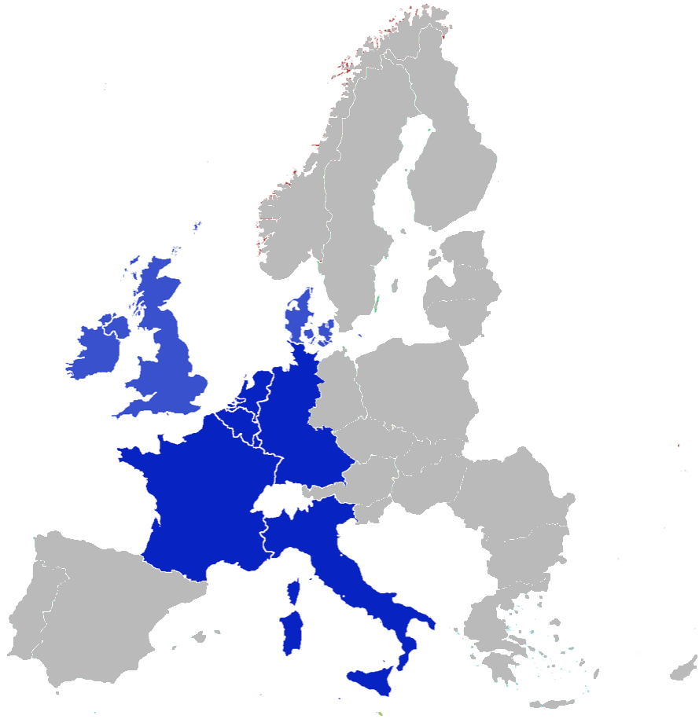
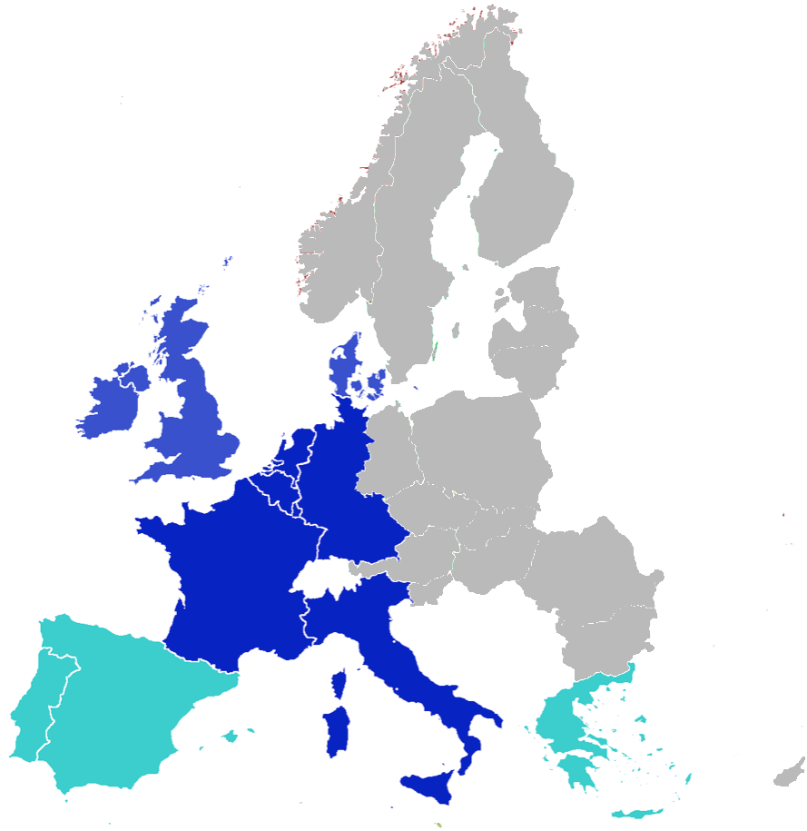
When Other Member States joined?
1973
UK, Ireland and Denmark
1980’s
Spain, Portugal and Greece
1990’s
East Germany, Sweden, Finland and Austria
Notes:
Since then, 22 more countries progressively joined.
In 1973 UK, Ireland and Denmark entered the EU. In the Eighties it was the turn of the emerging democracies of Southern Europe, with the accession of Greece in 1981 and Spain and Portugal in 1986.
The fall of the Berlin Wall led in 1990 to Germany’s full reunification and to the integration of East Germany into the European Union.
The 1995 enlargement saw Austria, Finland and Sweden accede to the European Union.

Slide 6
The East Enlargement
2004
Latvia, Lithuania, Estonia, Malta, Czech Republic, Poland, Slovakia, Slovenia, Cyprus, Hungary
2007
Bulgaria and Romania (EU 27)
Notes:
Following the collapse of THE Soviet Union, ten post-communist Central and Eastern European states started reforms of their legal, political and economic system, which culminated in the East enlargement.
The largest expansion of the European Union, in terms of territory, population, number of states (not only former Soviet socialist republics), took place in 2004, when Latvia, Lithuania, Estonia, Malta, Czech Republic, Poland, Slovakia, Slovenia, Cyprus, and Hungary joined the European Union.
In 2007 it was the turn of Bulgaria and Romania. From that date the Member States of the European Union started to be referred as the EU 27.

Slide 7
Croatia joined in 2013 (28)
UK left in 2020 (EU 27)
Potential new members:
Albania
Bosnia
Montenegro
North Macedonia
Serbia
Kosovo
Turkey
Who is next? Who left?
Notes:
What happened in recent years?
Croatia Joined the EU in 2013 raising the total number of the Member States to 28. In 2020, for the first time in history, a Member State, the United Kingdom, left the Union and so the number of Member States went back to 27.
Looking at the map of Europe, we can see that there are some European countries that are still not part of the European Union. The countries that today are recognised as possible candidates for Membership of the EU are Albania, Bosnia, North Macedonia, Montenegro, Serbia, Kosovo and Turkey.

Slide 8
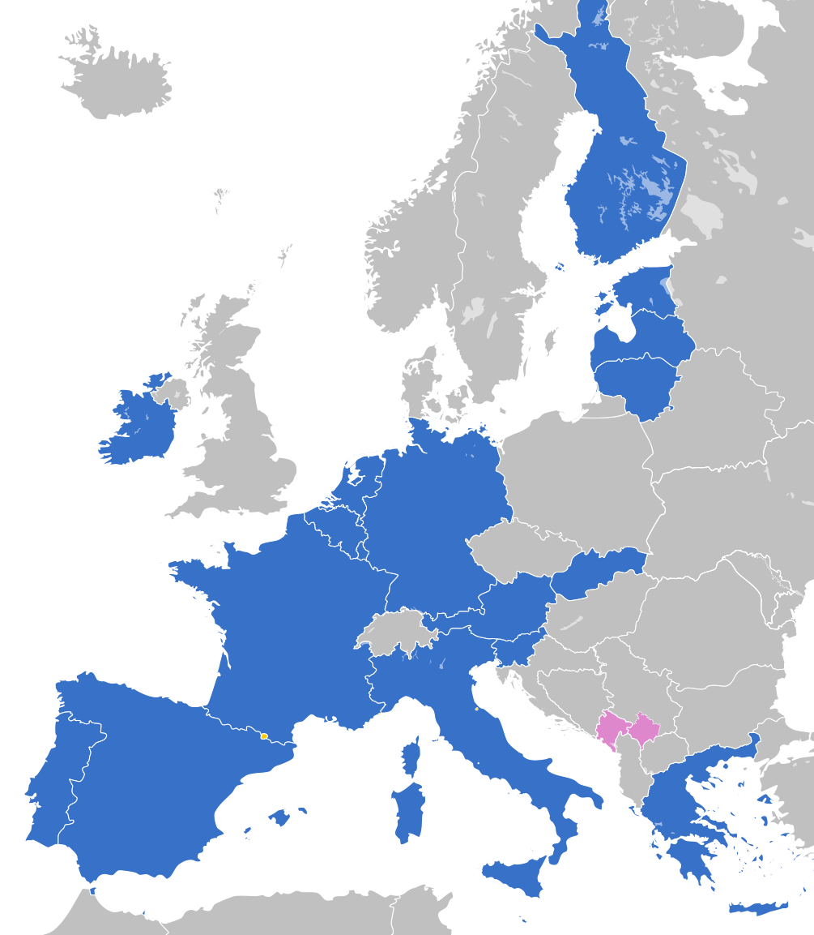
EURO ZONE
SCHENGEN AREA
Notes:
Sometimes it may be difficult to get oriented in the growing complexity of multiple and overlapping regional agreements that created different levels of integration between Member States within the European Union. It is often the case with Euro Zone and Schengen Area, two of the most famous EU agreements that definitively changed the life of the European citizens.
The Euro zone (or Euro Area) is a monetary union composed of 19 EU Member States which use the Euro as a common currency. Eight countries (Bulgaria, Croatia, Czech Republic, Denmark, Hungary, Poland, Romania, and Sweden) are EU members but do not use the euro. Montenegro and Kosovo (in pink in the map) unilaterally adopted the Euro currency.
The Schengen area is an area comprising 26 countries (both EU members and non-EU Members) where internal passports controls and borders checks are forbidden. Today, the Schengen Area includes most EU Member States. Bulgaria, Croatia, Cyprus and Romania are candidate Countries. Also, some non-EU countries (Iceland, Norway, Switzerland and Liechtenstein, in light blue in the map) have joined the Schengen Area. UK and Ireland have never been members of Schengen.

Slide 9
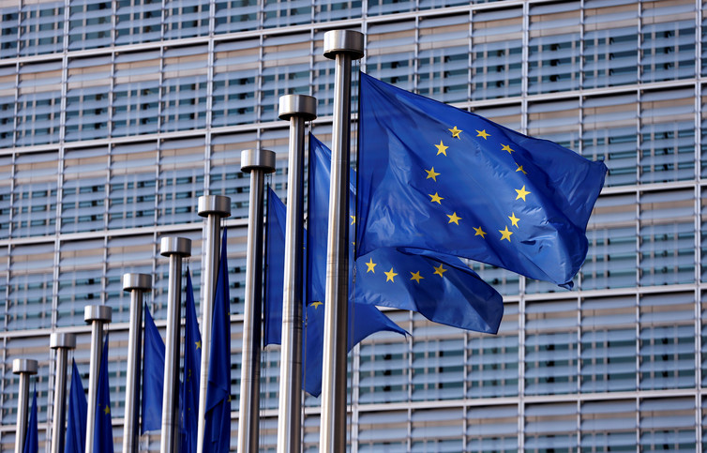
Why the EU is different ?
Community Method ≠ Intergovernmental:
Creation of a supranational power
EU law binding for Member States
Direct effect of EU law
Notes:
In the world there are other intergovernmental (as United Nations) and regional organizations (as the African Union or Council of Europe) between countries.
Why the European Union is different?
Classic international organizations function based on an intergovernmental decision-making process. A system that works on a voluntary and unenforceable basis.
The EU adopted a different constitutional approach, named the community method. This new method is based on the creation of a supranational normative power. When joining the EU, Member States accepted a reduction of their sovereignty and transferred part of their public powers in some areas to the EU institutions.
The legislation adopted at EU level is directly binding for Member States and their public authorities must give direct effect to EU law and disapplying conflicting national legislation. We will see later in the second module what this means in practice.

Slide 10
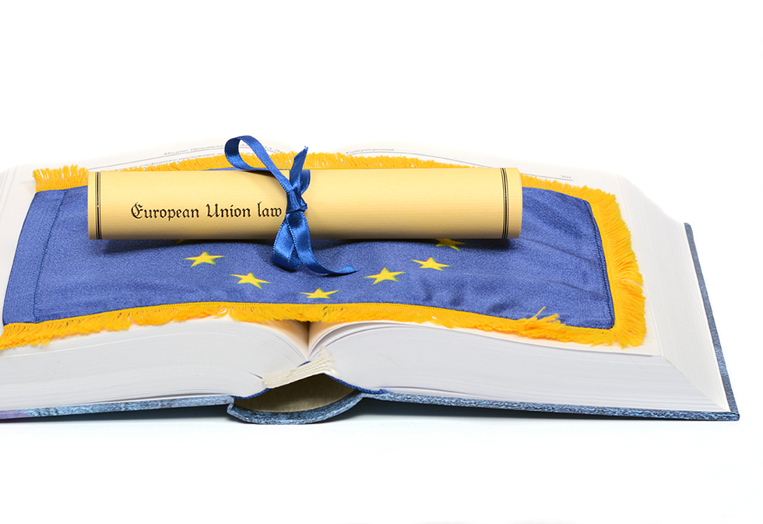
The EU Treaties
2007
The Treaty of Lisbon
TEU:
Democratic principles
Foreign and security policy
Defence
TFEU:
Functioning of the EU
EU policies
EU Competences
Notes:
In 1957 the six founding Member States signed the Treaty of Rome establishing the European Economic Community (EEC). Several treaties followed (Maastricht, Amsterdam, Nice and the aborted Constitutional Treaty) which progressively expanded the powers and the role of the EU Parliament and established the EU citizenship and the EURO zone. These treaties also specified the scope of EU competences and increased the use of the qualified majority in decision making.
In 2007, the Lisbon treaty was adopted, which is currently in force and has repealed all the previous Treaties. It is composed of 2 treaties (conventionally referred to as the EU Treaties, or simply the Treaties) which represent the institutional framework of the EU.
These two treaties are:
The Treaty on the European Union which specifies the democratic principles, The Foreign and Security Policy and the defence Policy of the EU.
The Treaty on the Functioning of the European Union which includes all the working rules of the EU and set out the distribution of competences between the EU and Members States and the powers of the institutions to implement EU policies.

Slide 11
The Main institutions of the European Union
The European Commission
The European Parliament
The Council (of Ministers)
The European Council
The Court of Justice
The European Central Bank
The Court of Auditors
Notes:
According to the Treaties, the institutional framework of the EU comprises 7 institutions:
the European Parliament;
the European Council;
the Council of the European Union or the Council of Ministers (often simply called ‘the Council’);
the European Commission;
the Court of Justice of the European Union;
the European Central Bank;
the Court of Auditors.
In this module we will look in detail only at the first 4 institutions, which are the political institutions of the EU. The European Council and the Council of the European Union are two different EU institutions and must not be confounded with the Council of Europe which is a third regional organisation and not an EU institution. The Court of Justice will be the subject of the third module.
The European Central bank and the Court of Auditors are technical institutions and are beyond the scope of our presentation.

Slide 12
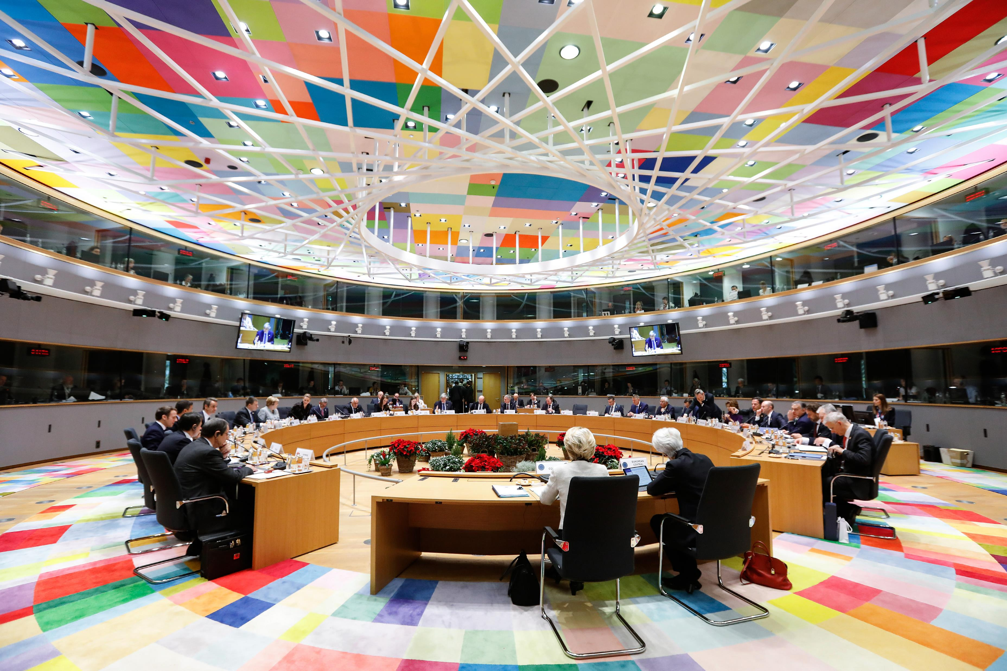
The European Council
Members are heads of State of MSs
Meet at least 4 times a year
Decisions are secret and by consensus
Not voting President elected for 2.5 years
Notes:
The European Council is composed by the heads of state or government of each EU member state plus the president of the European Council and the president of the European Commission.
It is the EU institution that sets out the EU’s political direction and priorities.
The President is elected by the European Council for a period of two years and a half, with the role of chairing the meetings, cooperating with other institutions and representing the EU externally for Foreign and Security Policy. The president does not participate in the voting within the European Council.
Decisions within the European Council are confidential and are generally taken by consensus. The European Council must meet at least 4 times a year.

Slide 13
The powers of European Council
main lines of the EU policies for the future
does not design laws
EU foreign and security policy
nominates and appoints important EU roles
urgent issues at EU level
eligibility criteria for new MS
Notes:
The European Council decides the main lines of the EU policies for the future but does not design laws (but it can propose laws to the EU Commission).
The European Council was institutionalized by the Treaty of Lisbon which recognized it as a full institution. It also became the most influential institution. The Council of Ministers, being composed by national ministers, always follows the indications of the European Council. It is therefore very difficult for the EU Commission and EU Parliament to not follow the policy objectives indicated by the European Council.
The European Council sets the foreign and Security policy. It also discusses pressing issues (such as the ‘Refugee Crisis’ or Brexit), decides on institutional reforms and on the accession of new member States.
It proposes the president and appoints members of the European Commission.

Slide 14
EU Commission
EU Interests
1 Commissioner from each MS
MSs suggest the Commissioners
European Council proposes the president
Voted by the EU Parliament
Term of office is 5 years
Notes:
The European Commission represents the interests of the EU.
It is made up of 27 commissioners (one from each member state) and it is based in Brussels. Commissioners are independent from their home national governments. After European Elections, the President of the European Commission is proposed by the European Council and approved by the European Parliament. Then, each member state nominates a commissioner that is approved by the European Parliament and appointed by the European Council.
The term of office of the European Commission is 5 years.
Commissioners do not represent their countries. Instead, each one has a field of responsibility (as a national minister) for the execution of tasks conferred by the European Commission. What are these tasks?

Slide 15
The powers of the EU Commission
Propose legislation
Guardian of the Treaties
Executive of the EU
Representation of the EU
Executive powers (competition, agriculture)
Notes:
In a nutshell, the Commission is responsible for initiating laws, enforcing the laws of the EU and managing EU’s policies.
Concerning legislation, the Commission makes proposals for laws that are sent to the EU Parliament and to the Council for approval. We will see later in detail how EU laws are adopted.
The Commission is the Guardian of the Treaties and has the power to monitor enforcement of EU law and to take actions against businesses or states that are failing to comply with EU law.
The Commission is also the executive of the EU. It manages policies and drafts budgets and has executive powers in the field of competition and agriculture.
In terms of representation, the Commission represents the EU in negotiations with other countries or organisations.

Slide 16
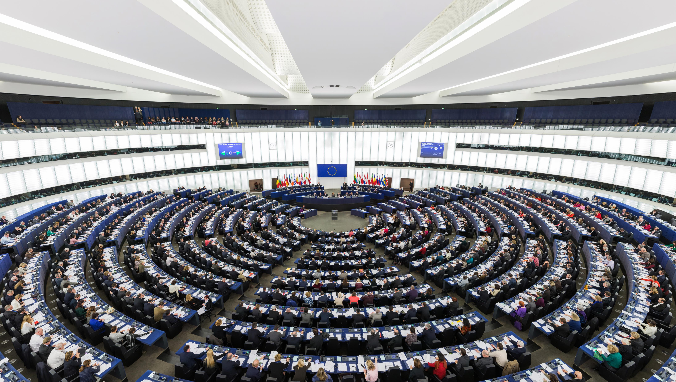
EU Parliament
Directly elected
Represents the EU population
Seat distribution on the population of each MS
MEPs join groups of the same political family
Vote by simple majority
Notes:
The European Parliament is the only directly elected body within the EU. It represents the citizens of the European Union.
The Parliament has 705 seats and European Elections are organised to elect the its members (also called MEPs) in all member states every 5 years. The number of MEPs for each member state is proportional to their total population. No country can have less than 6 MEPs or more than 96 MEPs. The Parliament elects its own president for a term of 2 and half years.
MEPs join groups of the same political family (Socialists and Democrats, European People‘s Party , liberals, Greens). They generally do not vote with the other Members of the EU parliament from the same Member State but with their European colleagues from the same political group (this means that for example a French socialist MEP will vote together with the European Socialist Group and not with French members of the European People’s Party).
Decisions are taken on a simple majority.

Slide 17
Powers of the European Parliament
Legislative power
Budgetary power
Supervisory power on the Commission
Elective powers
Notes:
The EP shares the legislative power with the Council in the framework of the ordinary legal procedure and the special legal procedure. Unlike most national parliaments, the European Parliament cannot initiate legislation, but it may ask the Commission to initiate laws.
The EP decides the expenditure and establishes the annual budget of the Union.
The EP holds the EU Commission accountable and can inquire on the operation of the EU Commission through written or oral questions.
The EP must approve the members and the president of the EU Commission.

Slide 18
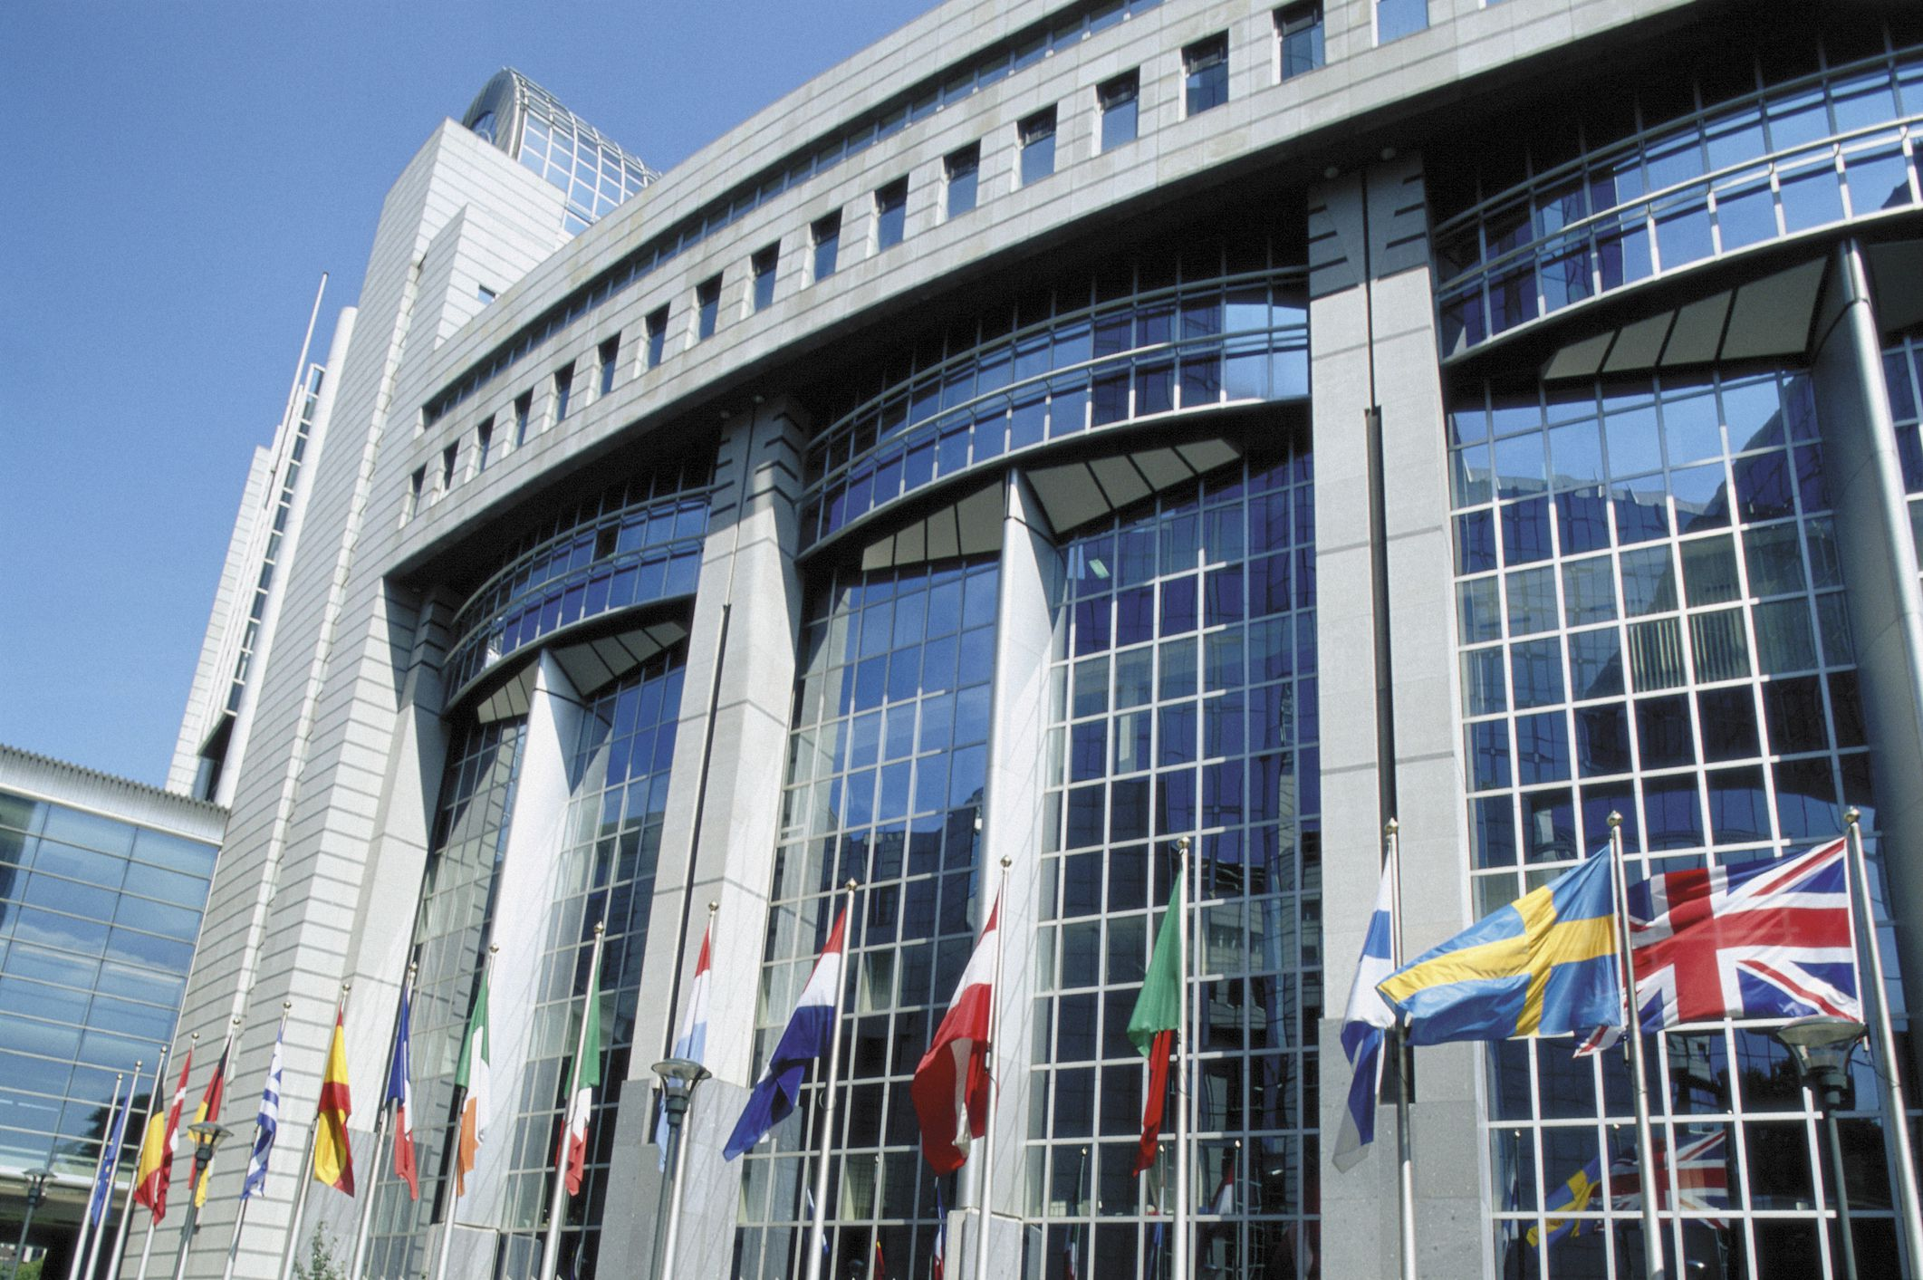
The Council of the EU (of Ministers)
Represents interests of MS
One minister for each MS
6 months Presidency
Qualified Majority:
55% of MSs and
65% of the Population
Notes:
The Council of the European Union (also the Council of Ministers, or simply the Council) is composed by national ministers representing the interests of their MS in different fields.
The Composition varies according to the topic. Depending on the different law or policy discussed a different national minister competent on the field will represent each Member State. For example, if immigration is under discussion, the Council will be composed of the ministers with responsibility for immigration of each member state
The presidency of the Council rotates every six months between the Member States.
Decisions are generally taken by qualified majority voting (QMV) for the most part of the topics. Unanimity is generally the exception used for most sensible political matters such as foreign affairs and taxation.
To reach Qualified Majority:
At least 55% of the member states must agree and
The member states in agreement must represent at least 65% of the EU population.

Slide 19
The powers of The Council (of Ministers)
Legislative powers
Conclusions of international agreement
Budgetary function
Economic guidelines for Member States
Foreign and Security Policy
Notes:
The Council has the following functions:
It shares the legislative power with the European Parliament.
The Council has a supervisory role and the final say when the EU is negotiating international agreements with other countries and international organisations.
The Council adopts the EU budget together with the Parliament.
Every year, the Council drafts guidelines for the economic policies of member states.
Following the instructions from the European Council it also develops the EU’s foreign and security policies.

Slide 20
The Sources of EU law
Primary Legislation:
Treaties
General Principles of EU law
Charter of Fundamental Rights
Main Secondary Legislation:
Directives
Regulations
Decisions
Notes:
The EU has adopted a complex set of rules. The main sources of primary law are the treaties, which have been presented earlier. All treaties must be ratified by member states.
Primary law also includes:
The General principles of EU law established by the Court of Justice.
The European Charter of Fundamental Rights that has the same legal value as the treaties.
Treaties also give powers to EU institutions to make and change secondary laws. The main binding sources of Secondary law are:
Regulations;
Directives; and
Decisions.
Secondary legislation also includes non binding acts (such as opinions, recommendations, communications, resolutions…)

Slide 21
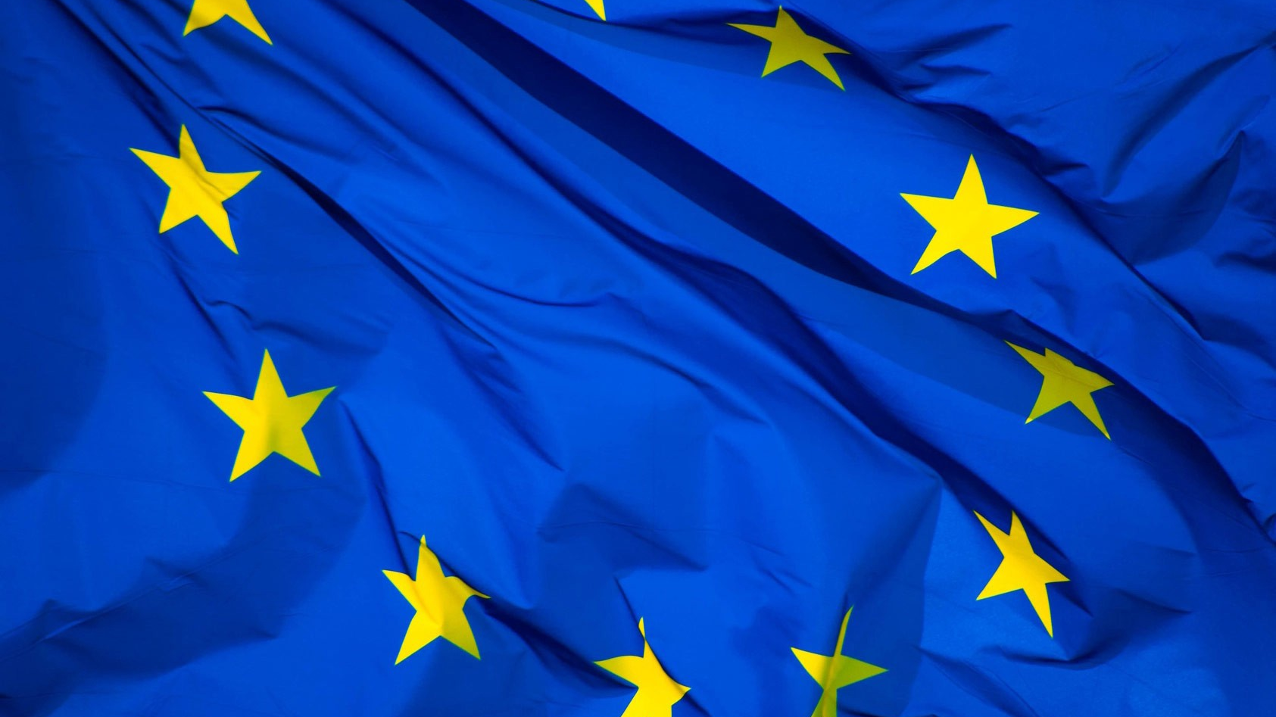
What is a Regulation?
Law of general application to all member States
Binding in their entirety
With direct effect
No transposition required
Notes:
Regulations, as defined by the Treaties, are laws of general application, binding in their entirety and directly applicable.
This means that Regulations apply to all member states, and they do not need a transposition to become part of national law. Regulations can be enforced through the national courts and public authorities of each member state from the time they come into force.
They must be complied with fully by those to whom they apply (private individuals, Member States, EU institutions).
They are designed to ensure the uniform application of Union law in all the Member States. Regulations supersede national laws incompatible with their substantive provisions.

Slide 22
What is a Directive?
Law that sets goal for MS to implement
Requires national laws for transposition
Binding as to the result
Notes:
Directives are laws that set goals for member states to implement. Compared to the Regulation, a Directive needs to be incorporated into national law, for which MS normally receive deadlines.
Directives are binding, as to the result to be achieved, but they leave to the national authorities the choice of form and methods to transpose the regulation into national law. National legislators must adopt a transposing act or ‘national implementing measure’ to transpose directives and bring national law into line with their objectives.
Individual citizens are given rights and are legally bounded only once the transposing act has been adopted. In principle, directives are not directly applicable. We will see more in detail in the second module the cases where directives may be considered as directly applicable.

Slide 23
What is a Decision?
Law addressed to specified bodies
Only binding for the recipients
Notes:
Decisions are laws that are only addressed to specified bodies. The decision is thus binding and has a direct effect on the country, company or organisation that the decision is issued against.
An individual may invoke the rights conferred by a decision addressed to a Member State only if that Member State has adopted a transposing act.
Decisions may be directly applicable on the same basis as directives.

Slide 24
How EU rules are adopted?
Commission proposes an EU law
Parliament & Council adopt the law
Member States apply the law
EU Commission and Court of Justice - compliance check
Notes:
Secondary legislation is based on the Treaties and adopted by EU institutions in accordance with the Treaties.
We said before that the power to propose EU legislation is conferred to the European Commission. The proposal is then generally addressed to the EU Parliament and to the Council. EU laws are adopted by these two institutions. After their publication in the official Journal, secondary legislation is applied and implemented at national level by courts and authorities of the Member States. The European Commission and the Court of Justice, as we will see more in detail in the second module, are then competent to check if Member States comply with EU law.
In practice the procedure of adoption may be quite complex. Let’s see how it works in the case of the ordinary legislative procedure, that is the most used procedure for adopting secondary legislation at EU level.

Slide 25
Proposals by the Commission
The Council by QM may accept, reject or amend
The Council accepts, rejects or amends
Third Reading:
Adoption or abortion
the Ordinary Legislative Procedure
Firs Reading: the Parliament by majority of votes
Conciliation Committee drafts a joint text
Second Reading: the Parliament adopts, rejects or
amends
Signing
and Publication
Notes:
Under the Ordinary Legislative Procedure, EU Parliament and the Council must approve the same text. The proposal by the EU Commission is sent to the EU Parliament for its first reading. It may approve, amend or reject the proposal. The position of the EU Parliament is then sent to the Council. If approved, the proposal is adopted, signed and published in the official journal.
The Council may also reject or amend the position of the EU Parliament. In this case, the proposal is sent back for a second reading. If the EU Parliament approves the amendments of the Council, it is adopted. If it proposes amendments, the proposal is sent back again to the Council. If the Council approves the amendments, it is adopted.
If the Council does not accept amendments, a Conciliation Committee is formed that tries to agree on a joint text. If it succeeds, the proposal is sent back to EU Parliament and Council for third readings. At this stage, the text of the proposal cannot be amended again, but only adopted or rejected.

Slide 26
The special legislative Procedures
The Consent procedure:
European Parliament can approve or refuse.
No amendments.
The Consultation procedure:
Final decision up to the Council.
European Parliament only consulted for advice.
Notes:
In certain cases, the treaties allow for a different procedure than the ordinary. The two main examples are the Consent and Consultation procedure. Both procedures provide for a reduced role of the EU parliament.
Under Consent procedure, the Council adopts legislation based on a proposal by the EU Commission after obtaining the consent of the EU Parliament. In this procedure, the Parliament can either approve or disapprove a proposal, but cannot amend it. This procedure is mostly used for international agreements.
Under the consultation procedure the Council adopts a legislative proposal. After that, the EU Parliament can only submit an opinion on it. The Council is not legally obliged to take the Parliament's opinion into account. This means that the Council may adopt the proposal even against the advice of the Parliament.

Slide 27
Thanks for your attention! for further questions or comments please contact us at simona.barbu@feantsa.org
Notes:
We have reached the end of this module.
In the next module, we will go into detail about the Relationship between EU law and national law.
Thank you for your attention!

