Slide 1

Profile and future of migrants in Paris emergency camps
(JUNE 2015 - NOVEMBER 2016)
14th European Research Conference on Homelessness
Septembre 20, 2019
Émilie Segol

Slide 2
INTRODUCTION
In spring 2015, the French Government adopted administrative support and accommodation policies in an attempt to provide an answer to the migration crisis that had sprung a few years before
This resulted in successive closing of 31 migrants’ camps in Paris between June 2015 and November 2016 - representing 21,241 people evacuated (Ministry of Interior’s data)
Migrants were brought by bus from camps to 266 emergency accommodations in the Paris area
By July 2017, a part of this sheltered population was no longer in the accommodation facilities: some had already been directed to the regular facilities or granted asylum, others had left voluntarily the shelters or been excluded
Is there any difference between the profile of migrants who are still in emergency accommodations and the ones who have left?
Among migrants who are no longer in accommodation facilities, do migrants who left emergency accommodations voluntarily or after an expulsion have a different profile from the ones who ha been directed to the regular facilities ?

Slide 3
DATA : SOURCE, contents and limits
Data used in this research are coming from the organisation Habitat et Interventions Sociales commissioned by the French administration to monitor the progress of migrants’ administrative requests
Data refers to 14 214 migrants who have been sheltered in emergency accommodations between June 2015 and November 2016. Those dates correspond to the first evacuation of migrants living in Paris’ North camps and the opening of a dedicated center, providing emergency accommodation and administrative support to migrant newcomers.
Fully anonymised data provides information on both demographic characteristics and the last known administrative situation of migrants
The database does not include :
  Migrants from camps who refused to take buses during evacuations
  Migrants from camps who left accommodations before the census

Slide 4
METHOD
Data used include a variety of socio-demographic characteristics as well as the type of administrative process through which each of the individuals in the database has to go through in order to be granted asylum.
The analyses start with a description of the distribution of each of the characteristics among migrants who are still sheltered in an emergency accommodation by July 2017, those who have already been directed to the regular accommodation system, and those who have either left voluntarily or been excluded.
We then test for the significant impact of gender, age, citizenship on the probability to have left the emergency accomodation before the end of the asylum seeking process, using a logistic regression. The models also include controls for the different waves of camps’ evacuation (held between June 2015 and November 2016).

Slide 5
Are migrants still sheltered or have they already left ? Status in july 2017 ?
14,214 migrants brought from camps to emergency accommodations between June 2015 and November 2016 have been identified
By July 2017, two-thirds (67.1 %) of this sheltered population was no longer in accommodation facilities
The vast majority of migrants still in the accomodation facility (65.9%) by July 2017 are still undergoing the asylum application process, and 23.8% have already been granted asylum

Slide 6
gender and age of migrants according to their accommodation status in july 2017
Migrants who have been sheltered in accommodation facilities are almost exclusevily men (95.7%), both among the migrants no longer in the accommodation facilities and those who are still in the accommodation facilities by July 2017
Nearly one out of two people (48.1%) is aged between 18 and 24, both among migrants who are still in the emergency centers (48.3%) and those who have left (48.0%)
A few minors have been identified (1.4%)
Non-response : n=86 (0.6%)
Non-response : n=780 (5.5%)

Slide 7
CITIZENSHIP of migrants according to their accommodation status in july 2017
A large part of migrants are Sudan nationals (48.1%), followed by Afghans (29.9%)
Distributions of citizenships among migrants who are still in accommodation facilities and the ones who have left appears to be similar
Non-response : n=673 (4.7%)

Slide 8
MIGRANTS NO LONGER IN EMERGENCY ACCOMMODATIONS BY JULY, 2017- STATUS
Among people who are no longer in emergency accommodations by July 2017 (n=9,533):
  47.2 % have been lost to follow-up
  52.8 % have been directed to regular facilities (85.4%) or granted asylum (14.6%)

Slide 9
MIGRANTS NO LONGER IN EMERGENCY ACCOMMODATIONS BY JULY, 2017- By GENDER and age
Migrants no longer in emergency facilities are almost exclusively men (95.7%), either among the ones who have left before the end of the administrative process (94.9%) and persons who have been directed to regular facilites or granted asylum (96.4%)
Migrants who have been directed to regular facilities or granted asylum are more frequently aged under 25 than migrants who have left the emergency accommodations before the end of their administrative process (52.1 % against 46.9 %)
Non-response : n=70 (0.7%)
Non-response : n=630 (6.6%)

Slide 10
MIGRANTS NO LONGER IN EMERGENCY ACCOMMODATIONS BY JULY, 2017 – BY CITIZENSHIP
Afghans are 2.5 times more numerous among people who have been directed to regular facilities or granted asylum (41.0 % against 16.7 % of people who have left before the end of their administrative process)
Non-response : n=543 (5.7%)

Slide 11
MIGRANTS NO LONGER IN EMERGENCY ACCOMMODATIONS BY JULY, 2017 odds of leaving emergency accommodation before the end of the administrative process
The odds of leaving the emergency accommodation before the end of the administrative procces are significantly larger for Eritrean (p<0.001), African (Others) (p<0.01) and Ethiopian (p<0.001), than for Sudanese nationals
Afghans are signifantly more likely to be directed to regular facilities or granted asylum than Sudanese nationals
Gender appears not to be associated significantly to the odds of leaving the emergency accommodation before the end of the administrative process
Women represent only 4.3% of the population, as a consequence :
  The baseline model reflects mostly the significant effects observed in men sample
  Lack of significance observed in women sample is likely to be due to small sample size (n=381)
Variable |  | Model 1 Men only |  |  |  | Model 2 Women only |  |  |  | Model 3 Baseline
 |  | n | % | Odd Ratio | SE | n | % | Odd Ratio | SE | n | % | Odd Ratio | SE
Age
18-24 | <18 | 69 | 1.9% | 1.77* | 0.41 | 15 | 7.5% | 1,00 | 0.51 | 84 | 2.2% | 1.8** | 0.37
 | 25-29 | 1,275 | 35.8% | 1.04 | 0.06 | 49 | 24.4% | 0.51* | 0.14 | 1,324 | 35.2% | 1.01 | 0.05
 | 30-34 | 356 | 10.0% | 0.84* | 0.07 | 27 | 13.4% | 1.38 | 0.53 | 383 | 10.2% | 0.87 | 0.07
 | >34 | 270 | 7.6% | 0.96 | 0.09 | 29 | 14.4% | 0.58 | 0.21 | 299 | 7.9% | 0.95 | 0.09
Citizenship
Sudan | Afghanistan | 600 | 16.8% | 0.31*** | 0.02 | 16 | 8.0% | 0.6 | 0.30 | 616 | 16.4% | 0.31*** | 0.02
 | Eritrea | 419 | 11.8% | 1.48*** | 0.12 | 63 | 31.3% | 0.72 | 0.28 | 482 | 12.8% | 1.45*** | 0.12
 | Africa - Others | 283 | 7.9% | 1.29** | 0.12 | 9 | 4.5% | 1.18 | 0.76 | 292 | 7.8% | 1.29** | 0.12
 | Somalia | 226 | 6.3% | 1.32** | 0.14 | 20 | 10.0% | 0.33* | 0.14 | 246 | 6.5% | 1.18 | 0.12
 | Ethiopia | 151 | 4.2% | 3.6*** | 0.64 | 43 | 21.4% | 1.05 | 0.46 | 194 | 5.2% | 3.06*** | 0.45
 | Near and Middle East | 105 | 3.0% | 0.84 | 0.12 | 12 | 6.0% | 0.51 | 0.29 | 117 | 3.1% | 0.84 | 0.11
 | Others | 35 | 1.0% | 7.3*** | 3.49 | 15 | 7.5% | 9.87* | 10.61 | 50 | 1.3% | 9.23*** | 4.05
Gender
Male | Female |  |  |  |  |  |  |  |  | 201 | 5.3% | 0.80 | 0.10
p |  | <0.001 |  |  |  | <0.001 |  |  |  | <0.001
n |  | 8,218 |  |  |  | 381 |  |  |  | 8,599
Logistic regression
Robust standard errors
* : p<0.05 ** : p<0.01 *** : p<0.001
Cross-tabulations show rather independantly distrubuted explanatory variables

Slide 12
MIGRANTS NO LONGER IN EMERGENCY ACCOMMODATIONS BY JULY, 2017 odds of leaving the emergency accommodation before the end of the administrative process
The odds of being directed to regular facilities or granted asylum is significantly larger for Afghans than migrants of other citizenships, in particular Ethiopians (OR=9,76)
Ethiopians are significantly more likely to leave emergency accomodations before the end of the administrative process than migrants of other citizenships
Variable |  | Model 1 Citizenship baselevel : Afghanistan |  |  |  | Model 2 Citizenship baselevel : Ethiopia |  |  |  | Model 3 Citizenship baselevel : Sudan (Baseline)
 |  | n | % | Odd Ratio | SE | n | % | Odd Ratio | SE | n | % | Odd Ratio | SE
Gender
Male | Female | 201 | 5.3% | 0.80 | 0.10 | 201 | 5.3% | 0.80 | 0.10 | 201 | 5.3% | 0.80 | 0.10
Age
18-24 | <18 | 84 | 2.2% | 1.8** | 0.37 | 84 | 2.2% | 1.8** | 0.37 | 84 | 2.2% | 1.8** | 0.37
 | 25-29 | 1,324 | 35.2% | 1.01 | 0.05 | 1,324 | 35.2% | 1.01 | 0.05 | 1,324 | 35.2% | 1.01 | 0.05
 | 30-34 | 383 | 10.2% | 0.87 | 0.07 | 383 | 10.2% | 0.87 | 0.07 | 383 | 10.2% | 0.87 | 0.07
 | >34 | 299 | 7.9% | 0.95 | 0.09 | 299 | 7.9% | 0.95 | 0.09 | 299 | 7.9% | 0.95 | 0.09
Citizenship
 | Sudan | 1,767 | 46.9% | 3.19*** | 0.19 | 1,767 | 46.9% | 0.33*** | 0.05 | 1,767 | 46.9% | - | -
 | Afghanistan | 616 | 16.4% | - | - | 616 | 16.4% | 0.10*** | 0.02 | 616 | 16.4% | 0.31*** | 0.02
 | Eritrea | 482 | 12.8% | 4.62*** | 0.40 | 395 | 7.3% | 0.47*** | 0.08 | 482 | 12.8% | 1.45*** | 0.12
 | Africa - Others | 292 | 7.8% | 4.12*** | 0.41 | 293 | 5.4% | 0.42*** | 0.07 | 292 | 7.8% | 1.29** | 0.12
 | Somalia | 246 | 6.5% | 3.78*** | 0.40 | 269 | 5.0% | 0.39*** | 0.07 | 246 | 6.5% | 1.18 | 0.12
 | Ethiopia | 194 | 5.2% | 9.76*** | 1.48 | 81 | 1.5% | - | - | 194 | 5.2% | 3.06*** | 0.45
 | Near and Middle East | 117 | 3.1% | 2.67*** | 0.36 | 192 | 3.5% | 0.27*** | 0.05 | 117 | 3.1% | 0.84 | 0.11
 | Others | 50 | 1.3% | 29.45*** | 12.96 | 11 | 0.2% | 3.02* | 1.38 | 50 | 1.3% | 9.23*** | 4.05
p |  | <0.001 |  |  |  | <0.001 |  |  |  | <0.001
n |  | 8,599 |  |  |  | 8,599 |  |  |  | 8,599
Logistic regression
Robust standard errors
* : p<0.05 ** : p<0.01 *** : p<0.001
Cross-tabulations show rather independantly distrubuted explanatory variables

Slide 13
MIGRANTS NO LONGER IN EMERGENCY ACCOMMODATIONS BY JULY, 2017 odds of leaving the emergency accommodation before the end of the administrative process
Even by controlling for the evacuation effect (as a potential proxy for delay between arrival in accommodation and exit and conditions related to accommodations) :
  Afghans are still significantly more likely than migrants of other citizenships to be directed to regular facilities or granted asylum
  Ethiopians are still significantly more likely to leave emergency accommodations before the end of the administrative process than migrants of other citizenships
Variable |  | Model 1 Citizenship baselevel : Afghanistan |  |  |  | Model 2 Citizenship baselevel : Ethiopia |  |  |  | Model 3 Citizenship level : Sudan (Baseline)
 |  | n | % | Odd Ratio | SE | n | % | Odd Ratio | SE | n | % | Odd Ratio | SE
Gender
Male | Female | 201 | 5.3% | 0.70** | 0.87 | 201 | 5.3% | 0.70** | 0.87 | 201 | 5.3% | 0.70** | 0.87
Age
18-24 | <18 | 84 | 2.2% | 1.64 | 0.35 | 84 | 2.2% | 1.64 | 0.35 | 84 | 2.2% | 1.64 | 0.35
 | 25-29 | 1,324 | 35.2% | 1.00 | 0.06 | 1,324 | 35.2% | 1.00 | 0.06 | 1,324 | 35.2% | 1.00 | 0.06
 | 30-34 | 383 | 10.2% | 0.91 | 0.08 | 383 | 10.2% | 0.91 | 0.08 | 383 | 10.2% | 0.91 | 0.08
 | >34 | 299 | 7.9% | 0.97 | 0.09 | 299 | 7.9% | 0.97 | 0.09 | 299 | 7.9% | 0.97 | 0.09
Citizenship
 | Sudan | 1,767 | 46.9% | 3.77*** | 0.24 | 1,767 | 46.9% | 0.37*** | 0.05 | 1,767 | 46.9% | - | -
 | Afghanistan | 616 | 16.4% | - | - | 616 | 16.4% | 0.10*** | 0.02 | 616 | 16.4% | 0.27*** | 0.02
 | Eritrea | 482 | 12.8% | 5.74*** | 0.53 | 395 | 7.3% | 0.56*** | 0.09 | 482 | 12.8% | 1.52*** | 0.12
 | Africa - Others | 292 | 7.8% | 4.58*** | 0.49 | 293 | 5.4% | 0.45*** | 0.08 | 292 | 7.8% | 1.22 | 0.12
 | Somalia | 246 | 6.5% | 3.36*** | 0.37 | 269 | 5.0% | 0.33*** | 0.06 | 246 | 6.5% | 1.18 | 0.12
 | Ethiopia | 194 | 5.2% | 10.20*** | 1.55 | 81 | 1.5% | - | - | 194 | 5.2% | 2.71*** | 0.40
 | Near and Middle East | 117 | 3.1% | 2.58*** | 0.38 | 192 | 3.5% | 0.25*** | 0.05 | 117 | 3.1% | 0.68** | 0.10
 | Others | 50 | 1.3% | 47.33*** | 21.87 | 11 | 0.2% | 4.64** | 2.22 | 50 | 1.3% | 12.56*** | 5.76
Evacuation (18) |  |  |  | Y |  |  |  | Y |  | - | - | - | -
p |  | <0.001 |  |  |  | <0.001 |  |  |  | <0.001
n |  | 8,599 |  |  |  | 8,599 |  |  |  | 8,599
Logistic regression
Robust standard errors
* : p<0.05 ** : p<0.01 *** : p<0.001
Cross-tabulations show rather independantly distrubuted explanatory variables

Slide 14
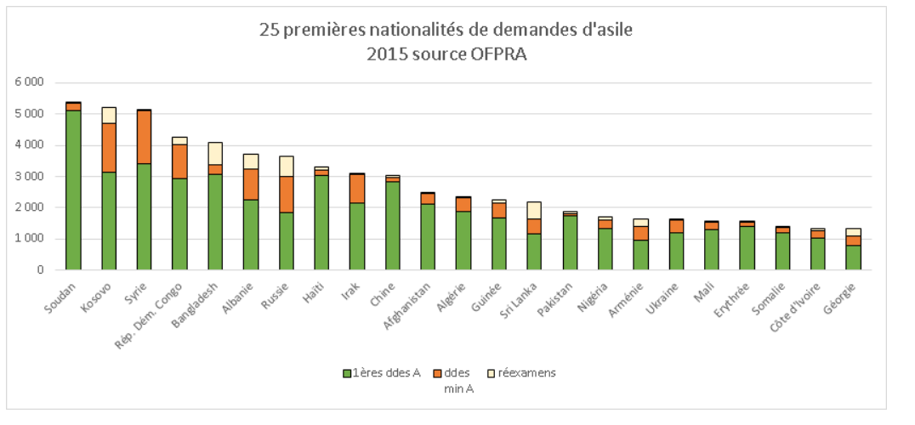
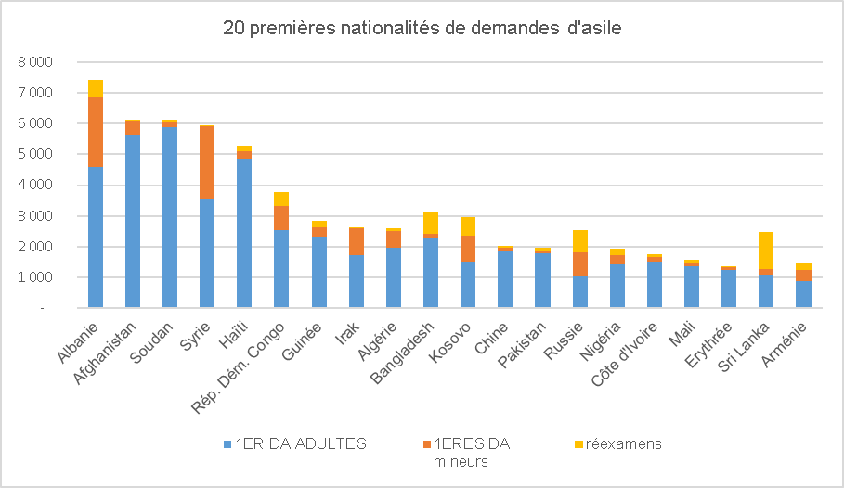
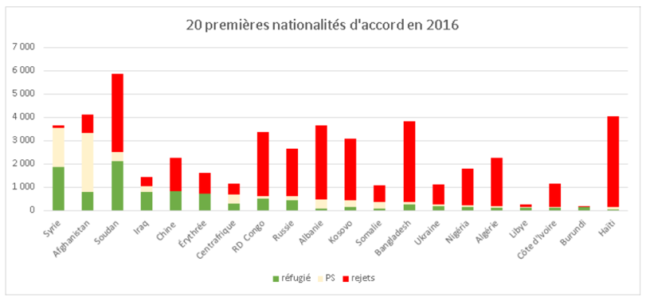
MIGRANTS NO LONGER IN EMERGENCY ACCOMMODATIONS BY JULY, 2017 what exactly about afghans ?
Afghanistan was the eleventh citizenship to seek asylum in 2015 in France, the second in 2016
International protection was granted to about 80% of afghan asylum seekers in 2015 and 2016
Some of the first citizenships to seek asylum in France in 2015 and 2016 are under-represented in the database (Syria (n=65 ), Albania (n=7), Kosovo (n=1)) or not represented at all (Congo Republic, Haiti)
2016
Source OFPRA
Source OFPRA

Slide 15
Discussion
Migrants in this database are the ones living in Paris’ North camps. They were brought by buses to emergency accommodations between June, 2015 and November, 2016. This database does not include :
    Migrants from camps who refused to take buses during evacuations
    Migrants from camps who left accommodations before they could be counted
As a consequence, the profile of Afghan and Ethiopian migrants who have been observed does not reflect the profile of all Afghan and Ethiopian migrants who were in the Paris area during this period
Are the afghans and/or ethiopians a proxy for one or several variables :
      Living conditions in accommodations ?
      Type of administrative procedure ?
    Other(s) proxy(s) ?
The database reflects migrants’ situation in July 2017. As a result :
    Data are censored
    Migrants who left accommodation facilities after this date are non included in analyses related to the exit status
The database is for administrative management purposes only, statistical analyses have to be read with cautiousness

Slide 16
conclusion
By July 2017, two-thirds (67.1 %) of migrants brought from camps to emergency accommodations between June 2015 and November 2016 and who have been identified were no longer in accommodation facilities
Migrants who have left accommodation facilities appear to have a similar profile to the ones who are still in the emergency accommodations by July 2017 :
  Almost exclusively men (95.7%)
  Nearly one out of two people (48.1%) is aged between 18 and 24
  A large part of Sudan nationals (48.1%), followed by Afghans (29.9%)
Among migrants no longer in emergency accommodations by July 2017, two profiles can be identified :
  Migrants who have left the emergency accommodation before the end of the administrative process (47.2%)
  Migrants who have been directed to regular facilities or granted asylum (52.8%)
Afghanistan nationals are significantly more likely than other citizenships to be directed to regular facilities or granted asylum (while controlling for gender, age, citizenship and evacuation)
The odds of leaving the emergency accommodation before the end of the administrative procces are significantly larger for Ethiopians (while controlling for gender, age, citizenship and evacuation)

Slide 17
Further investigation
The database includes the type of administrative procedure (Dublin, in the course of being regularised, regular, accelerated), nevertheless this information was recorded for only 59% of the population
In theory :
        Asylum seekers falling under Dublin procedure should be sent back to the country where they first apply for asylum or by which they entered EU for the first time
        People under an accelerated procedure should be the first to leave the accommodation facilities
Non-responses regarding the administrative process are not evenly distributed by the exit status. The type of administrative procedure could have an influence over the exit status.
The database includes the exit date, nevertheless this information was recorded for only 61.1% of the population.
What exactly about ethiopians ?
A Cox model (survival analysis) could be used to predict the delay between migrants’ arrival in emergency accommodations and exit, while controlling for right-censored data
Analyses should be conducted on an updated (after July 2017) database

Slide 18
Thank you for your attention
Eberhard (Mireille), Le Mener (Erwan), Segol (Emilie), Qui sont les migrants mis à l’abri ? Île-de-France (Juin 2015 – Novembre 2016) - ‘Who are the persons accommodated in migrants facilities? Île-de-France (June 2015 - November 2016)’, Direction Régionale et Interdépartementale du Logement et de l’Hébergement, 2018, 108 p.
Siffert (Isabelle), Cordone (Aude), Réginal (Mégane), Le Mener (Erwan), L’accès aux soins des ‘migrants’ en Île-de-France – ‘Access to care of ‘migrants’ in Île-de-France’, Agence Régionale de Santé, 2018, 181p.
Engliz-Bey (Evans), Cavalin (Catherine), Brocvielle (Manon), Le Mener (Erwan), Violences subies et état de santé : résultats et enseignements de santé publique tirés de bilans infirmiers réalisés en Île-de-France auprès de populations migrantes (Octobre 2015 – Juillet 2018) – ‘Violence and health : results and public health lessons learned from nursing assessments carried out in Île-de-France among migrant populations (October 2015 – July 2018)’, Bulletin Hébdomadaire Epidémiologique, 2019, p.312-326
e.segol@samusocial-75.fr
https://www.samusocial.paris/nos-enquetes

