Slide 1
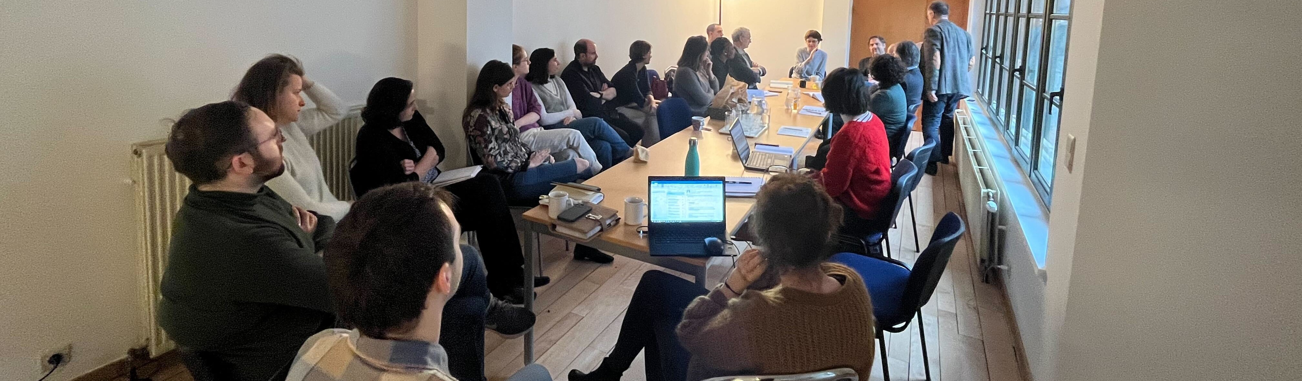
A Way Home in Flanders and Brussels
An Rommel
Opgroeien
02/06/2023

Slide 2

Contents
Why & how did we start
How do we support the A Way Home coalitions
How are the coalitions organized and what do they do
Challenges & future

Slide 3
°2018 ~ Why
Failure of the system: too many young adults leaving youth care were (at risk) of homelessness
  → prolongation of the age till 25
  → support for the youth care institutions to adopt a more young adult appropriated support
20 à 25% of the counted people in homelessness are between 18 and 25y old. But divided in approximately 3 evenly big groups:
  Young people leaving care
  Young refugees / Unaccompanied Minors
  Young people who were never in contact with support or care before
A coalition with broad community support is needed, with crucial actors of the housing field, job market, education, financial support, … → A WAY HOME

Slide 4







°2018 ~ AWH Coalition in Antwerp (Mind the Gap)
Choice for local / regional coalitions
Support for the launch of a first coalition in Antwerp with European funding
12 other local / regional coalitions from 2020 onwards

Slide 5
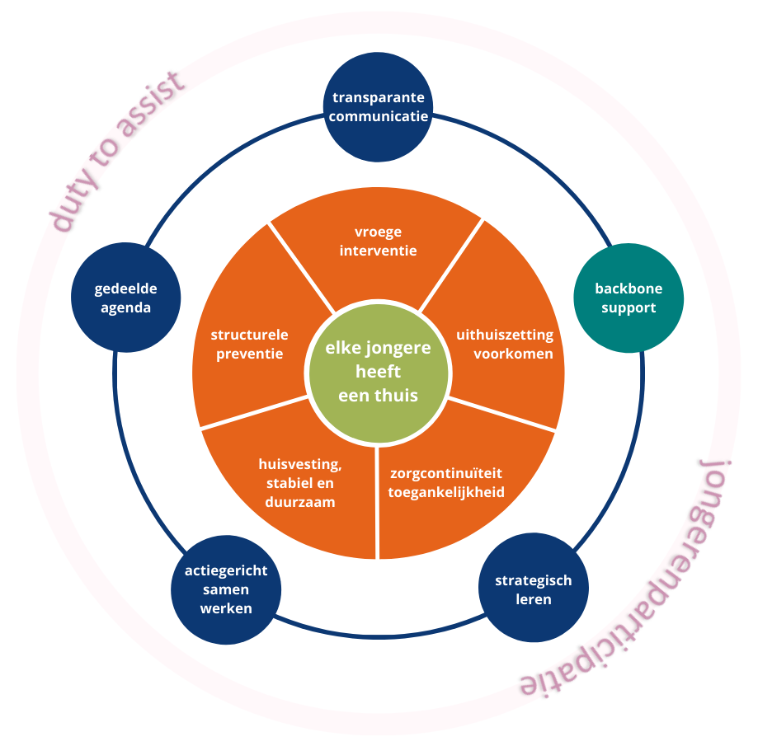

Slide 6

Organisation of the
A Way Home Coalitions
Back Bone, Action Groups, Coalition of the Willing
Back Bone structure
  Members
  Shared agenda, youth participation, knowledge sharing, stakeholder management, strategic learning, …
Action Groups: housing, early detection & prevention, continuity of care, …
Coalition of the Willing: broader community & important stakeholders

Slide 7
Important results
Sensitisation on youth homelessness and shared responsibility for the target group in the local communities
Young people with lived experience are important partners in the coalitions
Extra housing for young adults via partnerships with private owners, charity organisations, … More and more focus on housing first for youth
Low threshold spots for young people in homelessness
Inclusive support: care organisations organise support in trajectories where all the necessary competences and knowledge are present
…

Slide 8
Support of the Back Bone organisations
Peer learning / learning networks
Sharing knowledge
Close collaboration with university & university college
Participation in the Back Bone, focussing on collaboration & collective impact

Slide 9
Challenges & Future
Signature Actions: Upstream & Housing First for Youth
Linking local A Way Home networks with other platforms & initiatives
Raising the engagement of the different coalition members
Coalition at Flemish level
Sustainability of working in networks
Raising the impact of – Making more visible what the A Way Home coalitions do
Coalitions at local level are not enough

Slide 10
Thank you!
An Rommel, an.rommel@opgroeien.be

