Slide 1
War in Ukraine: Housing & Reception of Refugees
Simona Barbu, Policy Officer, FEANTSA
Marcin Tylman and Katarzyna Brzozowska, Fundacja Aktywizacji
Eszter Somogyi, Metropolitan Research Institute
02/06/2023

Slide 2
War in Ukraine: Housing & Reception of Refugees
Simona Barbu, Policy Officer
FEANTSA
02/06/2023

Slide 3
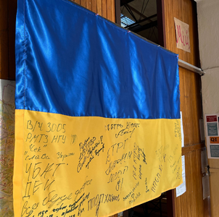
The war in Ukraine & homelessness
over 325,000 reports of destroyed, damaged housing within Ukraine (Feb 2023, The Kyiv Independent)
As of fall 2022, more than 2.4 million Ukrainians have had their homes damaged or destroyed (Politico, March 2023)
8,255,288 people entering EU – need of accommodation (May 2023, UNHCR)
5,140,259 registered for temporary protection = rights to accommodation (May 2023, UNHCR)
Main countries hosting beneficiaries of temporary protection from Ukraine:
Germany 1,067,755
Poland 976,575
Czechia 325,245
(Eurostat May 2023)

Slide 4
EU level response
Legal measures & guidance | Funding
Activation and implementation of the 2001 Temporary Protection Directive (2001/55/EC) | The Cohesion’s Action for Refugees in Europe (CARE)
Safe Homes Initiative | Flexible Assistance to Territories (FAST-CARE) ESF+
European Union Agency for Asylum ‘Practical recommendations on the provision of emergency placement in private accommodation for persons displaced from Ukraine’ | The European Regional Development Fund (ERDF) REACT-EU
The Solidarity Platform | The Asylum, Migration and Integration Fund (AMIF)

Slide 5
Access to accommodation
UNHCR Factsheet (Nov 2022) 34,145 respondents
UNHCR January 2023

Slide 6
Gaps in accommodating Ukrainian refugees
Overreliance on private hosting
Decreasing interest and possibility of hosting
Discrimination
Insecurity and violation of human rights
Lack of longer-term housing strategy →impact other rights (education, work, and social protection)
Refugee families increasingly report exhausting their savings
Accomodation likely to become a pressing need (rental costs and energy prices continue to increase)
Driver of intentions to return in the short-term (living in accommodation centres or collectively with other refugees or being hosted by local families)
Street homelessness:
Brussels, Czech Republic, UK, Ireland.

Slide 7
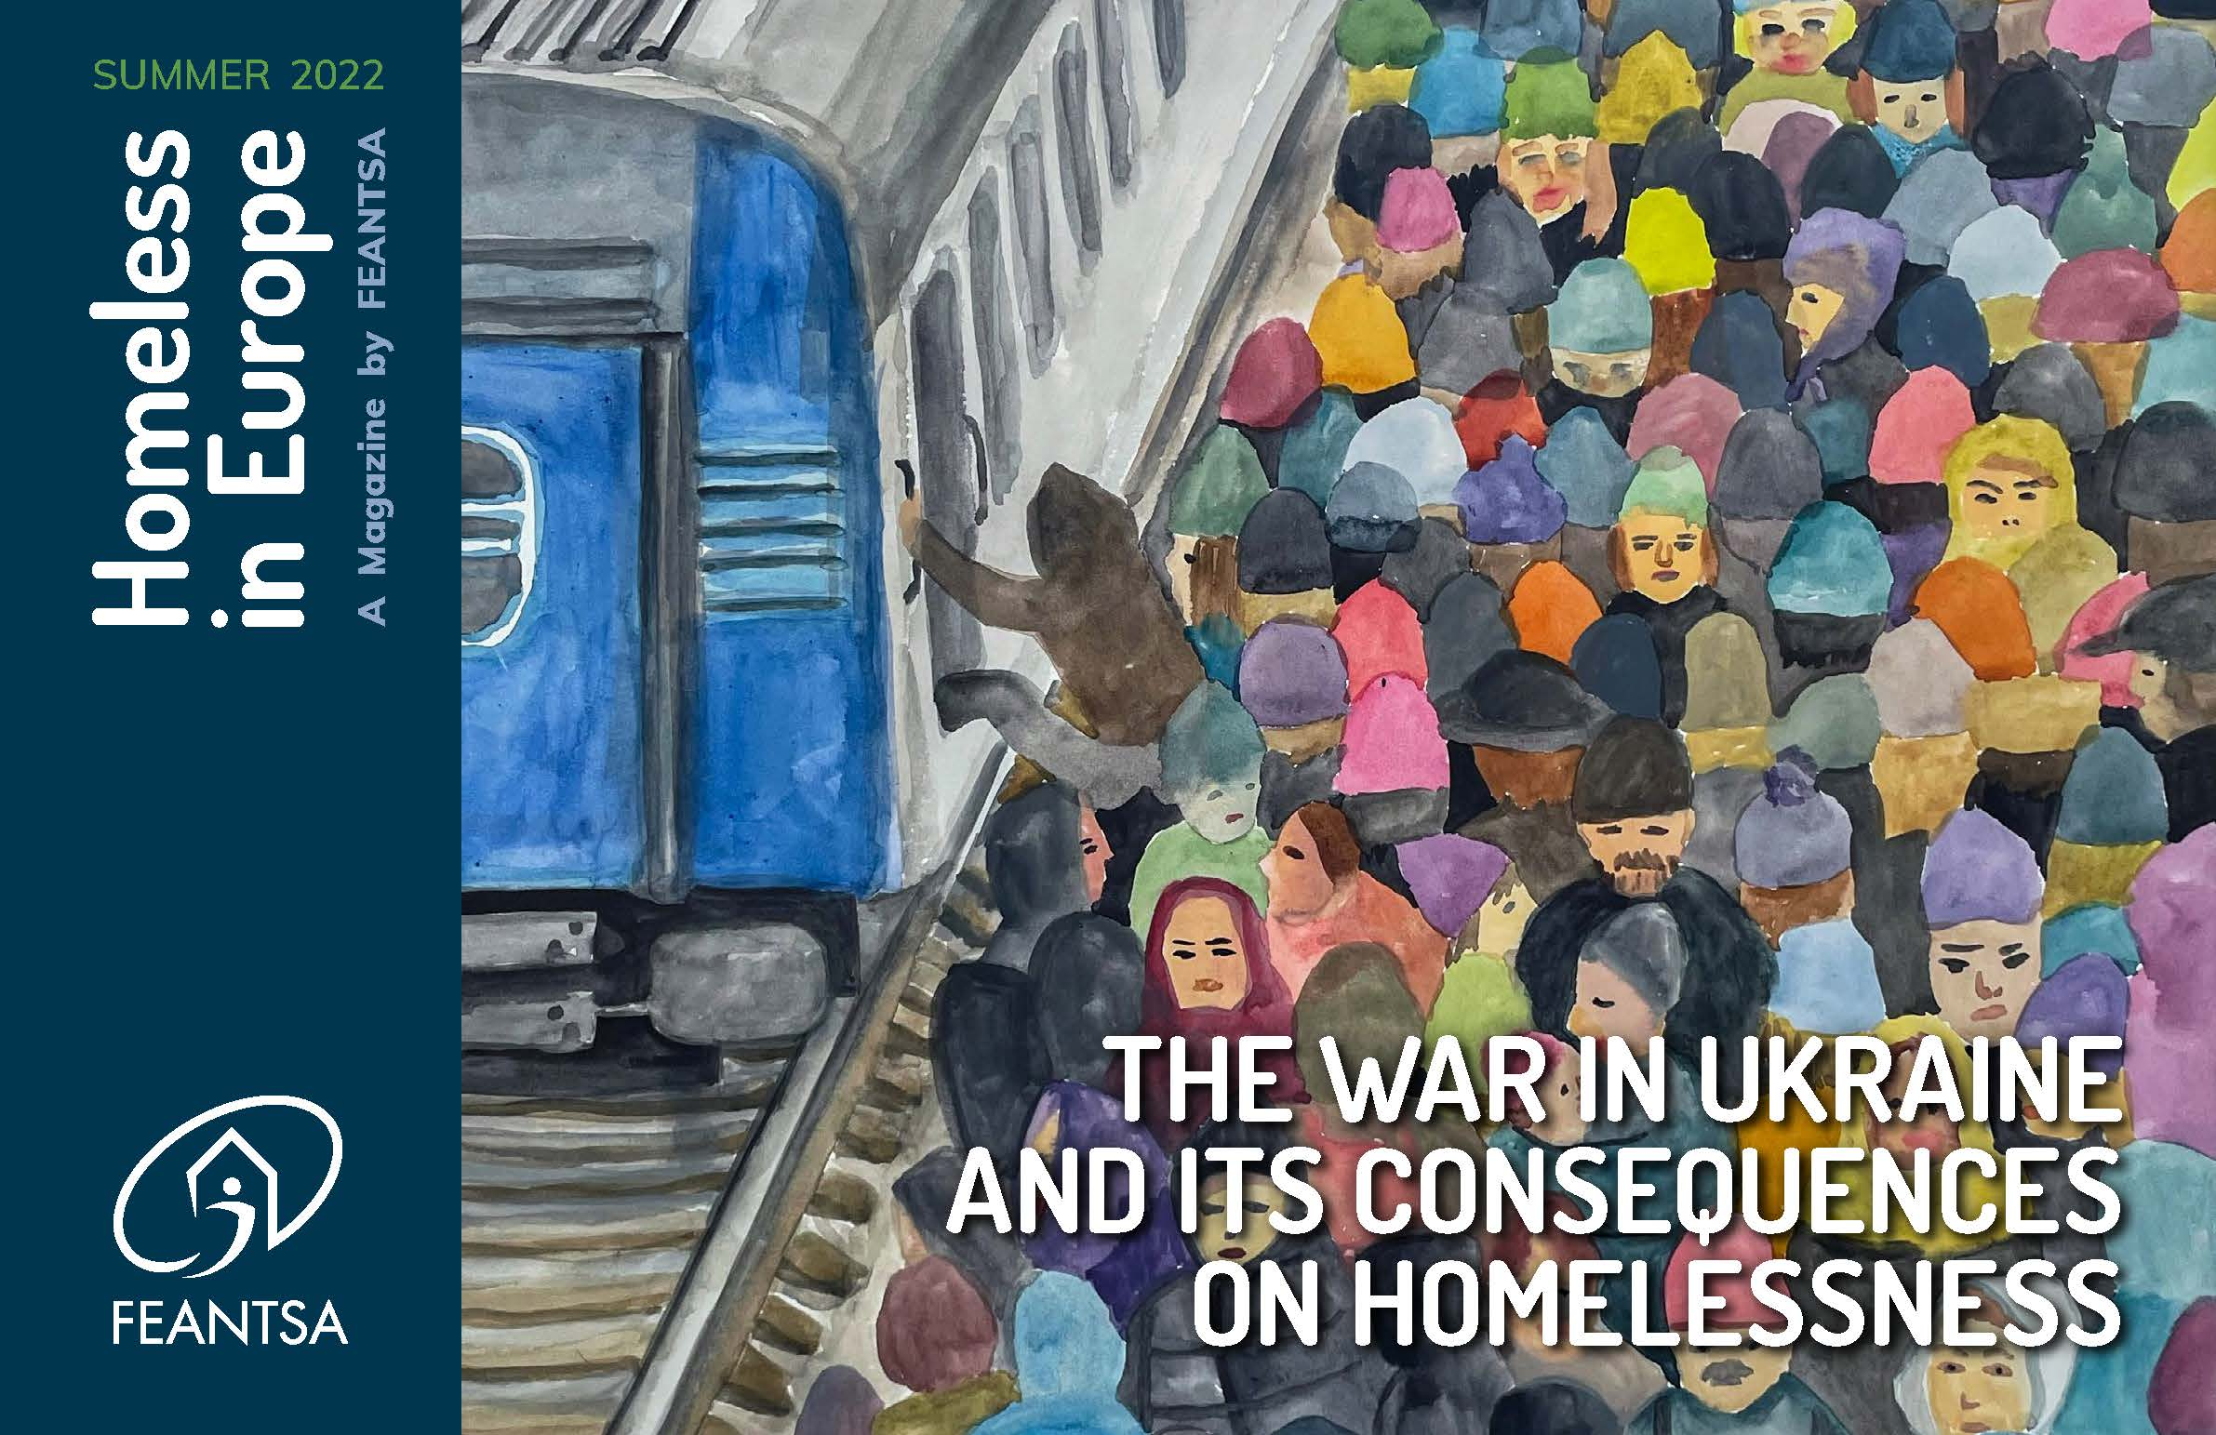
For more info:
Homeless in Europe Magazine Summer 2022: The war in Ukraine and its consequences on homelessness
Crucial role of homelessness sector in welcoming refugees
Reception → long-term, comprehensive housing support with individualised social services

Slide 8

Recommendations EU-level
Long-term regional housing strategy with multi-donor initiative (EU, OSCE, UNHCR, CEB, the governments of neighbouring countries, etc).
Allocate additional resources beyond the EU funding that is currently available to countries hosting large numbers of refugees for increasing affordable housing stock.
Strengthen methodological guidance on the relevant EU funds (ERDF+, ESF+, Cohesion Funds).
Communication with the international civil sector and national civil organisations should be more intense.

Slide 9
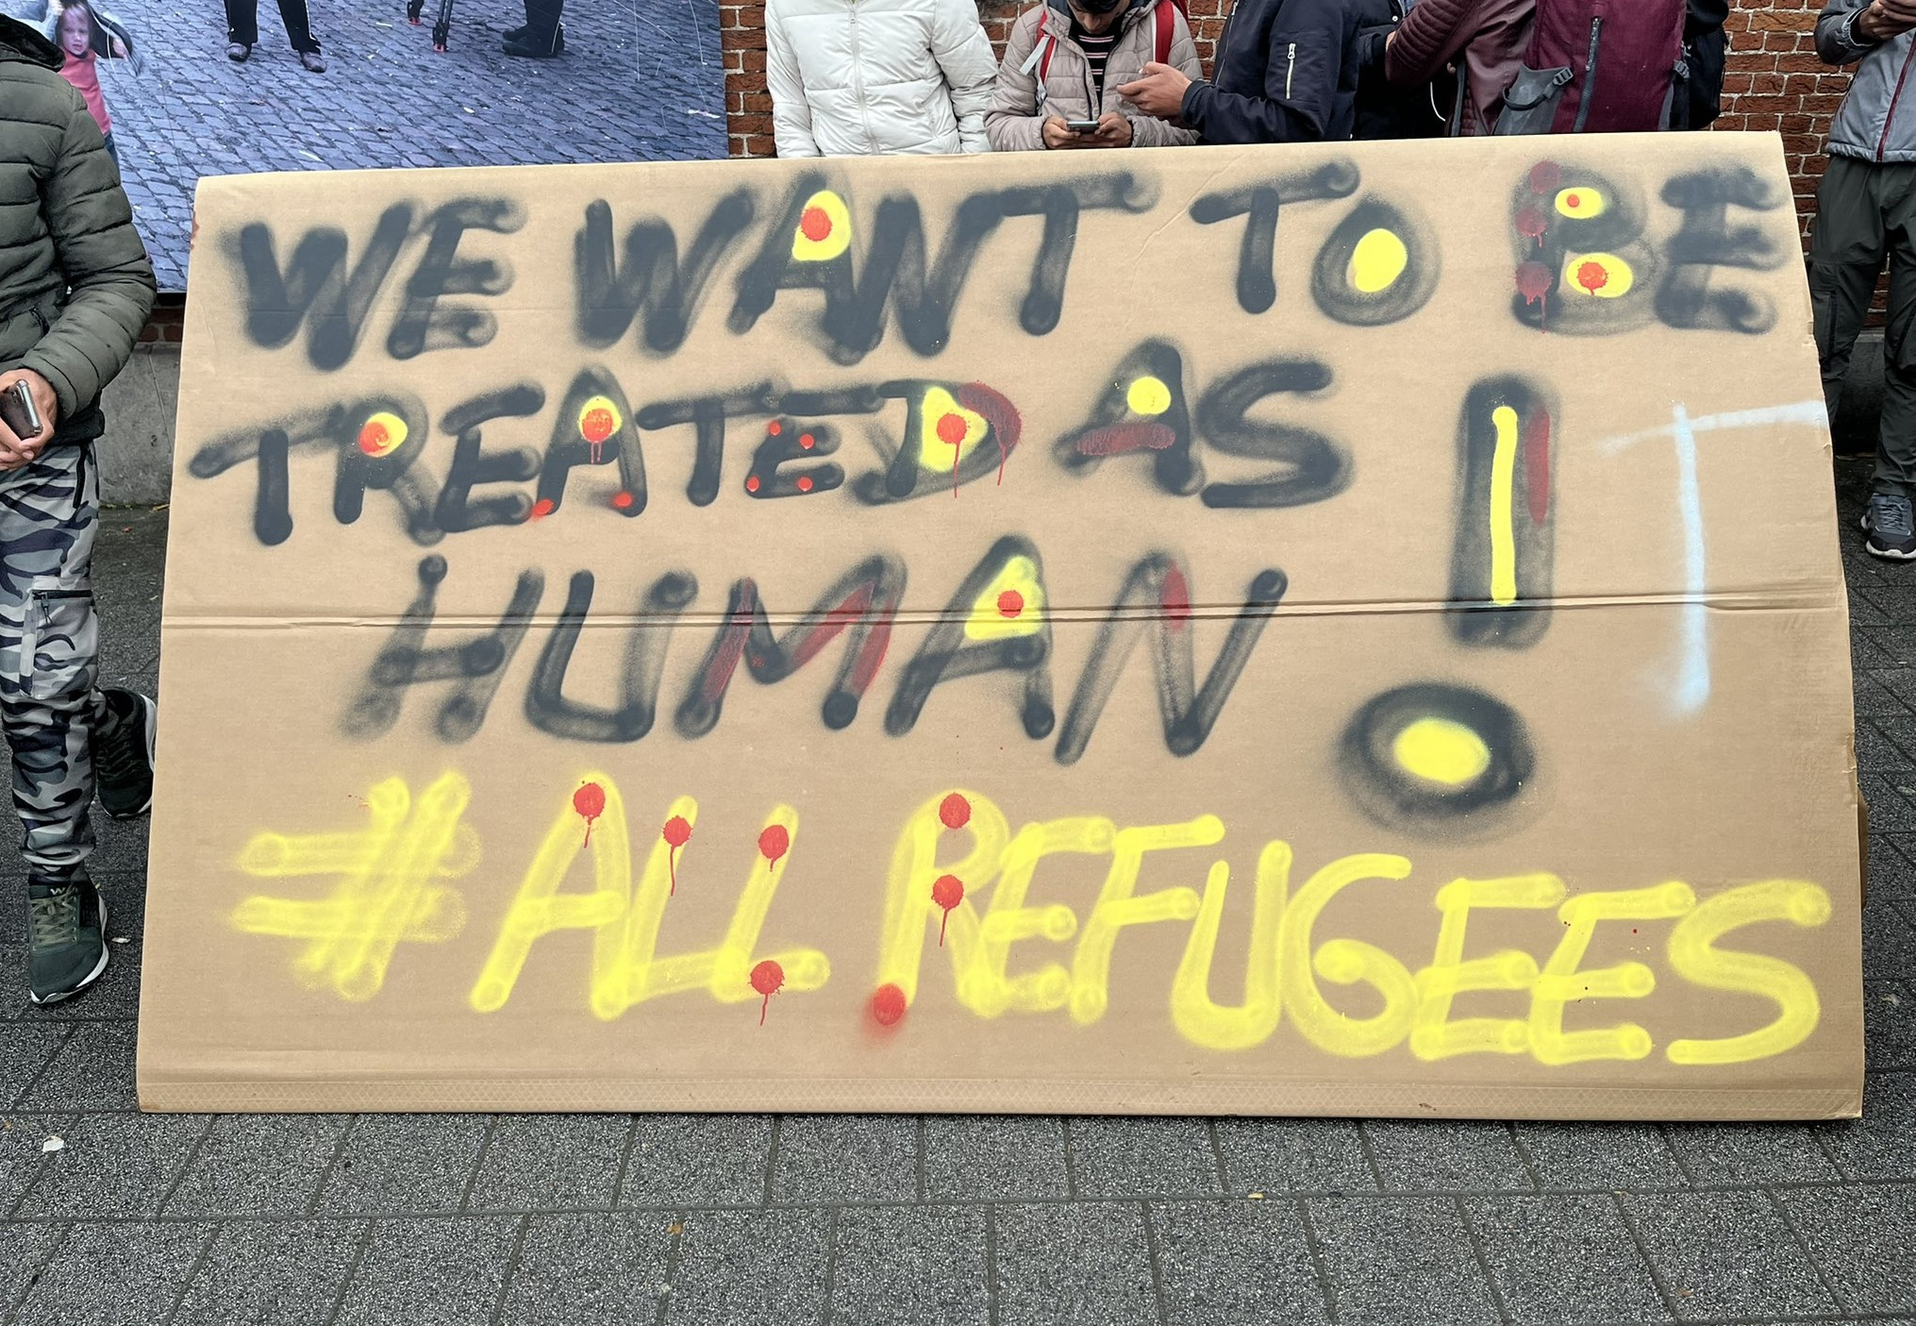
Learning lessons
Strengthen the asylum and migration system across Europe.
Affordable housing crisis on the public agenda.

Slide 10

Simona Barbu
Policy officer
simona.barbu@feantsa.org
www.feantsa.org
Thank you!

