Slide 1
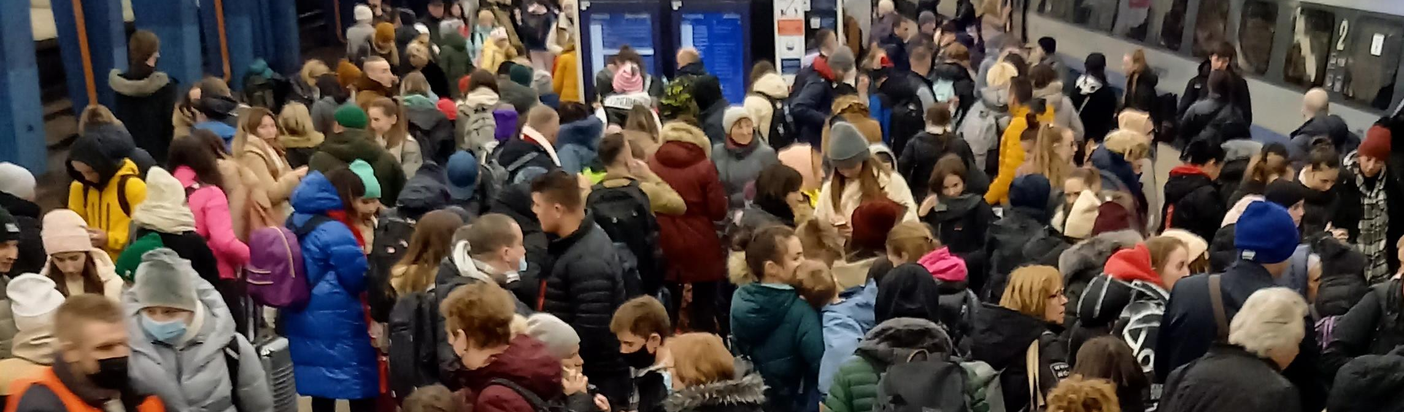
We’re with you- Poland
Marcin Tylman
Foundation for Activation and Integration
02/06/2023

Slide 2
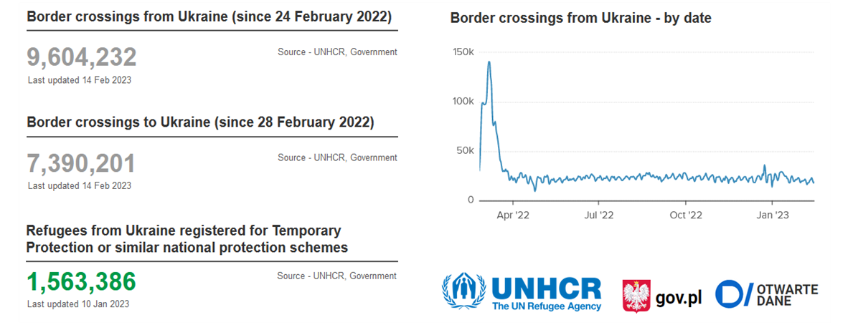

Slide 3
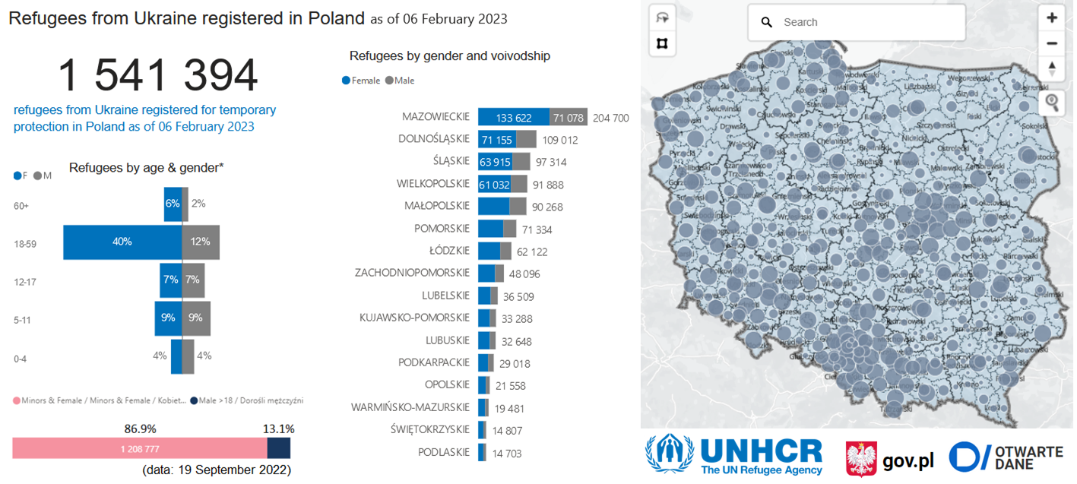

Slide 4
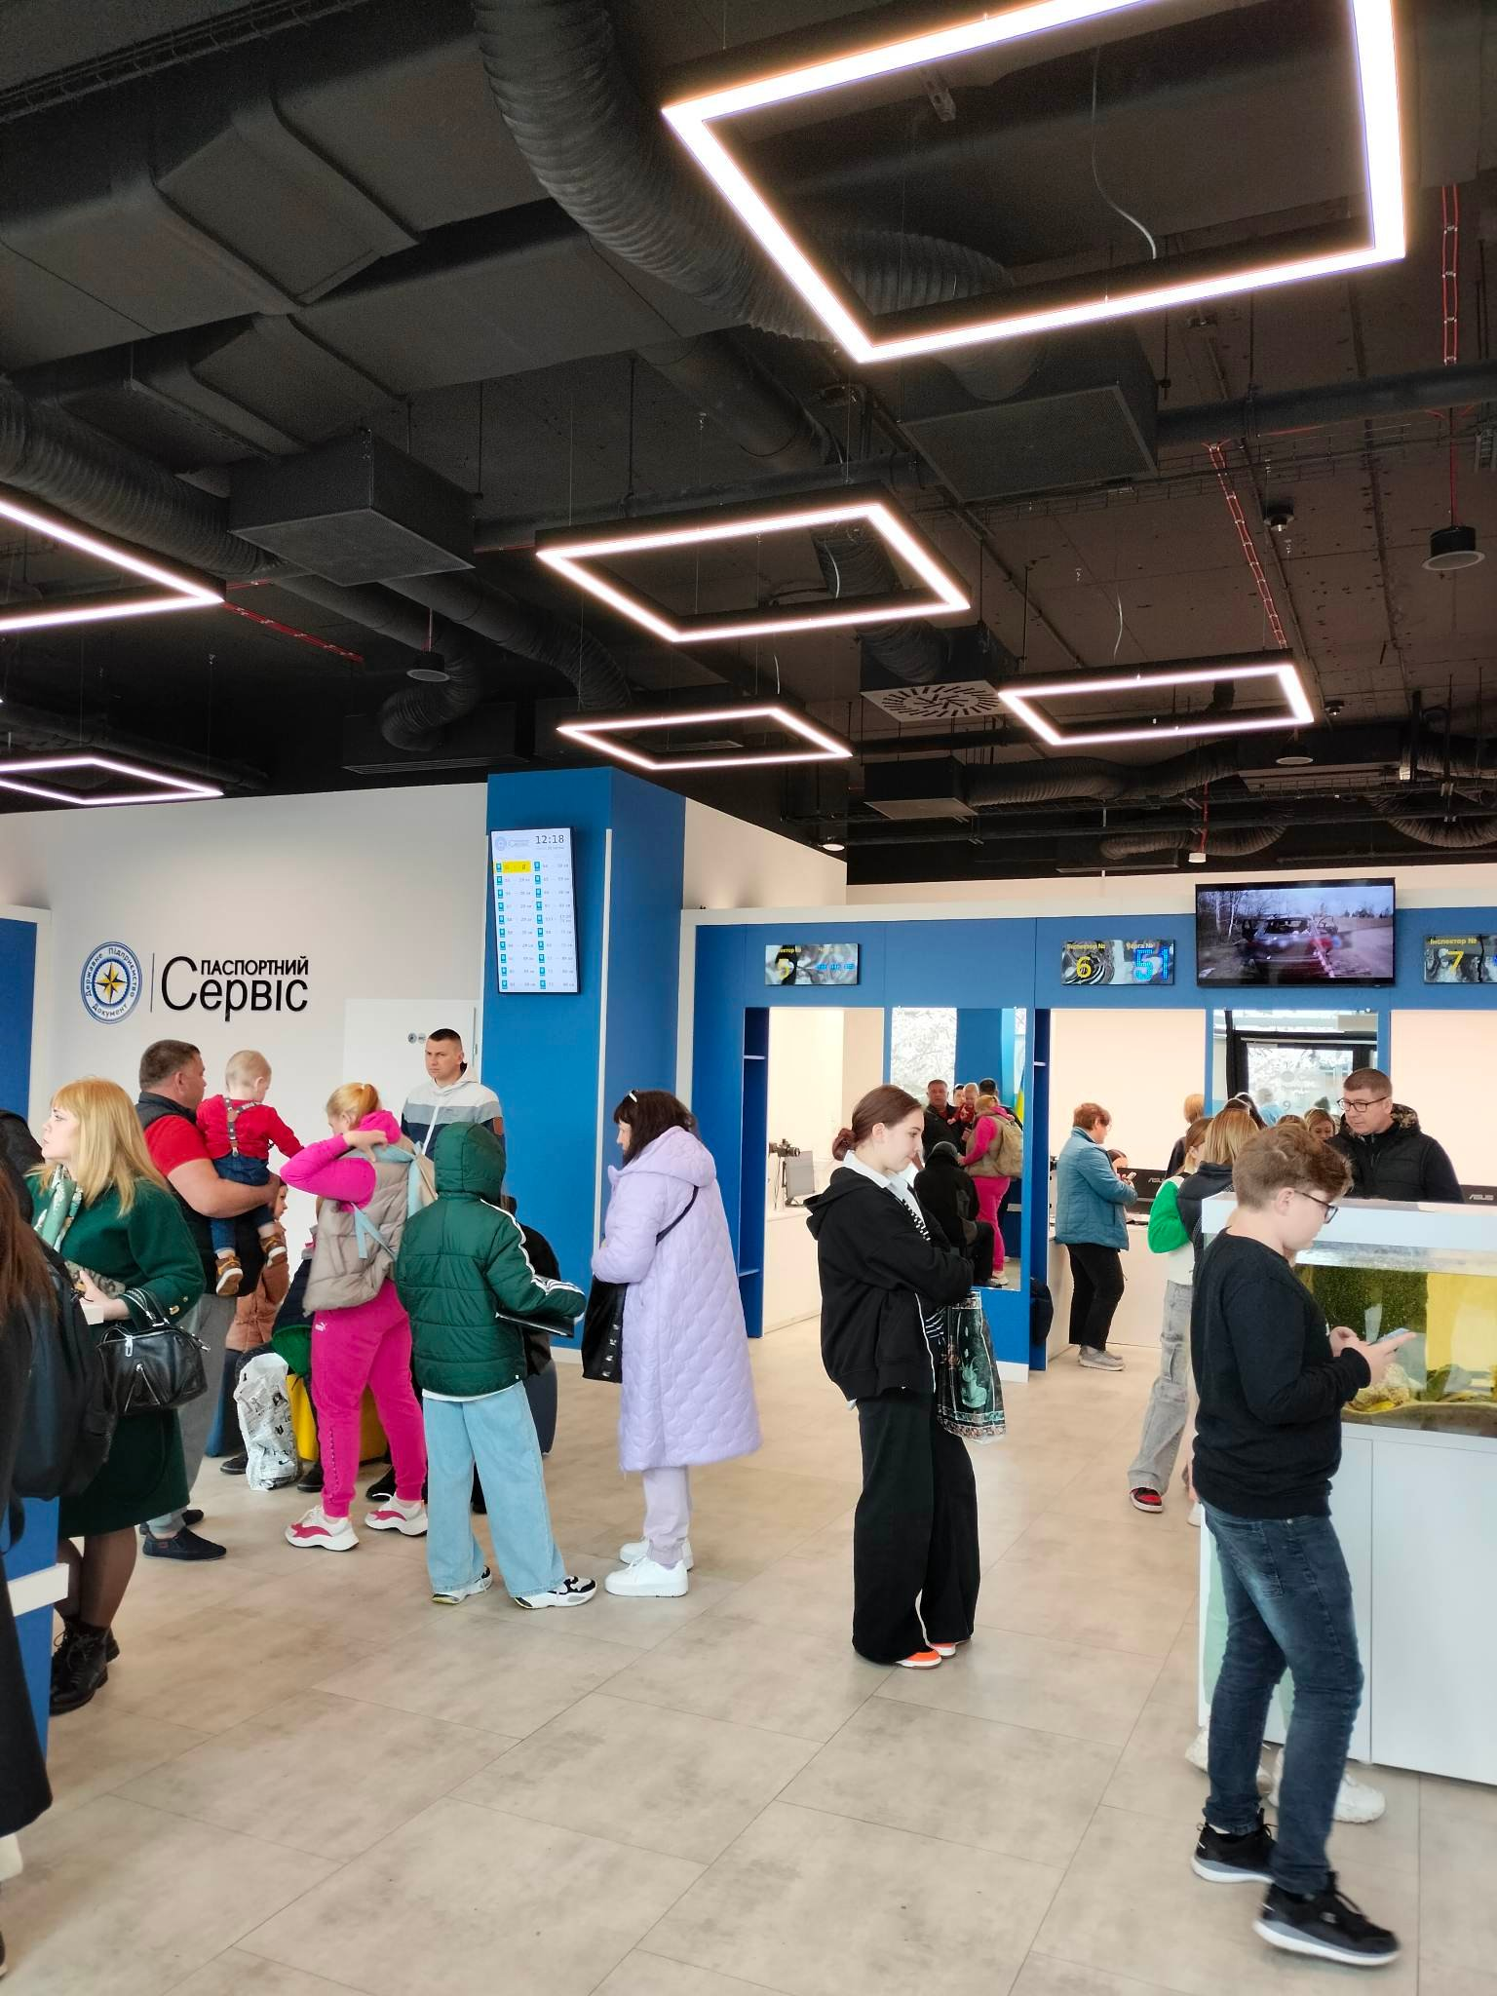
Housing situation in Poland
Very difficult tenancy situation for accommodation (before 24.02.2022).
Lack of systemic accommodation solutions (only a host "allowance" for hosting a refugee for 120 days).
Insufficient response from local authorities and government.
Frustration of families in solidarity who are hosting refugees in their homes.
Significant increase in prices of rents (25-40%)
Lack of accommodation on the free rental market (especially in large cities).

Slide 5
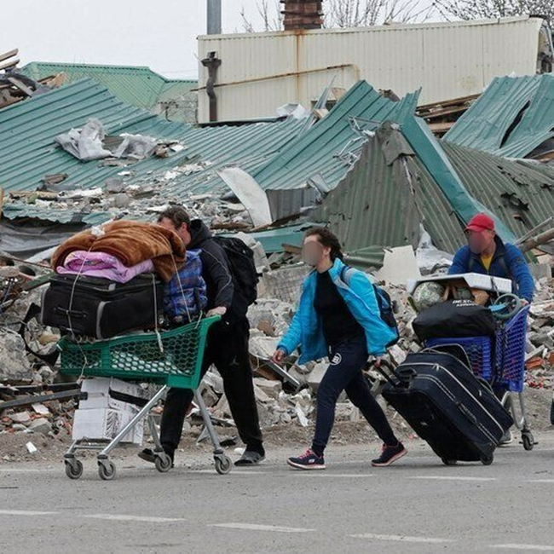
Housing situation in Poland
7. Governmental housing support focused on collective temporary accommodation (long duration of stay)
8.Very limited possibilities for NGOs to provide long-term housing assistance
9. Increase of homeless people, reported cases of homeless people of Ukrainian origin
10. Due to lack of residence opportunities, refugees return to Ukraine to areas of ongoing fighting.

Slide 6
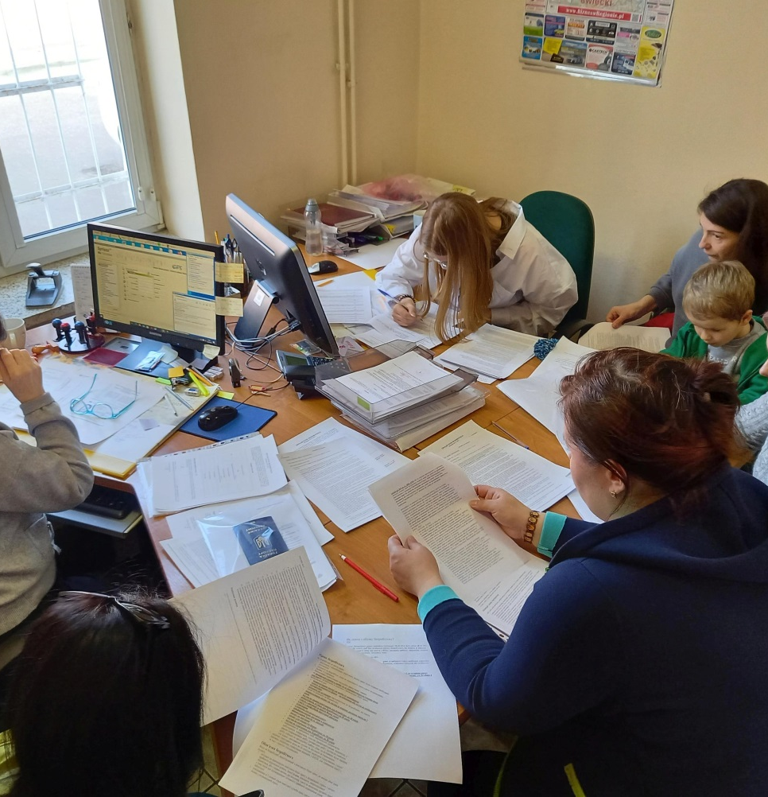
Other relevant issues
Lack of financial resources among refugees.
Language barriers (refugees from the east of the AU speak Russian).
Difficulties in professional activation (language, mental, procedural, competence, formal barriers).
Medical problems (especially female related health issues)- access to services.
Problems with care of young children (in the context of professional activation).
Psychological problems of refugees, insecurity about the future.
Changes in the attitudes of Polish society in the context of refugees.

Slide 7

About FAI
Foundation for Activation and Integration
The Foundation's activities focused on social support, equalising social opportunities. FAI works with people with disabilities, people in crisis of homelessness, seniors and children as well as youth with special needs. FAI is a member of OFRPB and is focused around the development and delivery of housing programmes. We are currently implementing a Training Housing Programme dedicated to youth leaving foster care - a project focused on preventing youth homelessness.

Slide 8
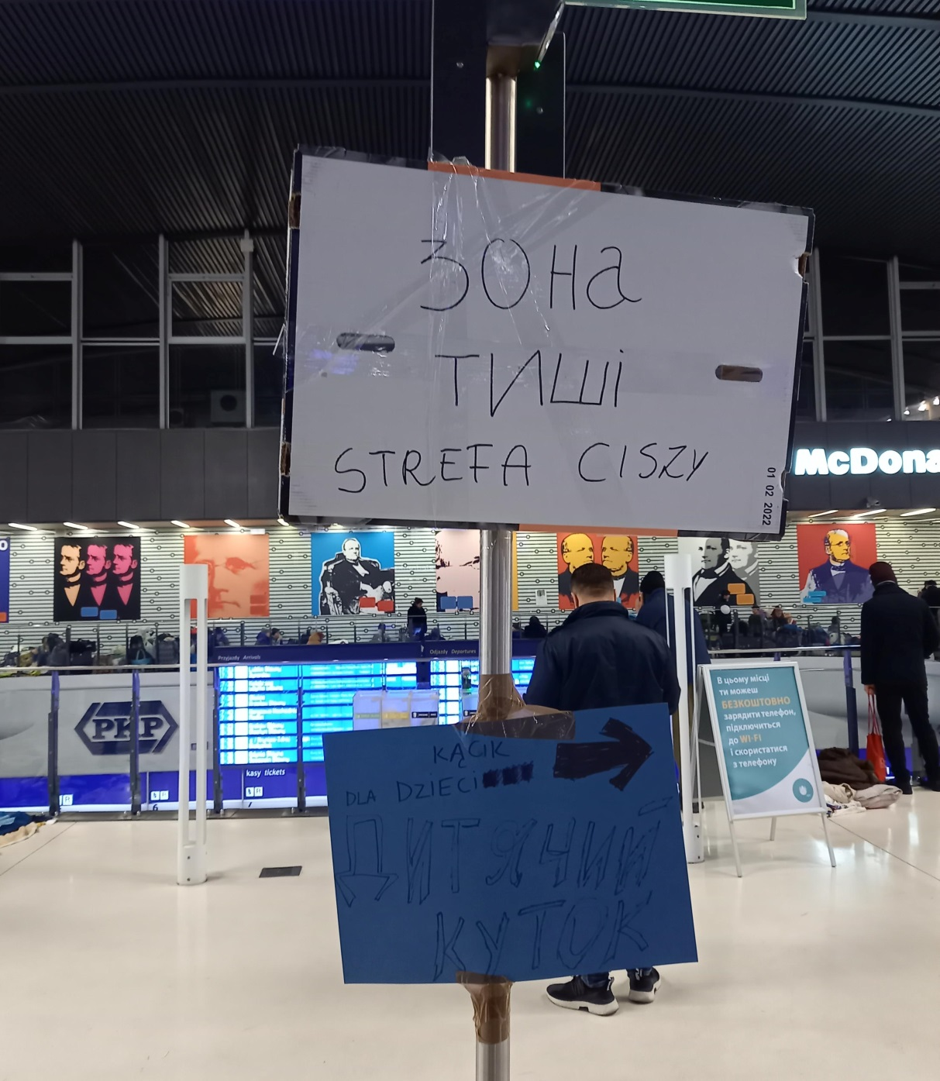
Introducing the Issue
28 February 2022 FAI took action
5 March 2022 fully equipped accommodation was prepared
6 March 2022 we brought 3 families from the reception point
Comprehensive support ( accommodation + individual support package) planned for 90 days!

Slide 9
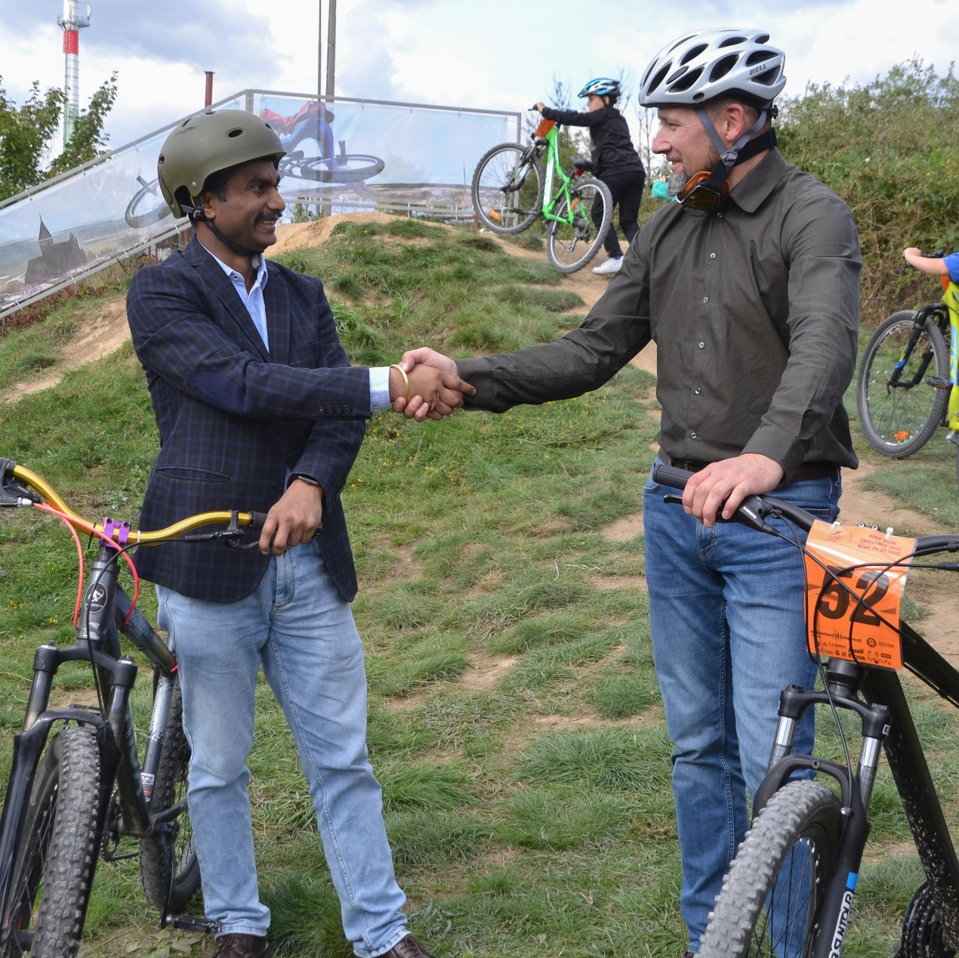
Introducing the Issue
April-May 2022 large influx of refugees to the municipalitie of Nowe
May 2022, in cooperation with the Polish-American Foundation we organised the first support services for all refugees
May 2022, we established a collaboration with OXFAM International, we presented our concept for a housing support programme
August 2022, we launched the 'Live among us' programme for 20 refugee families

Slide 10
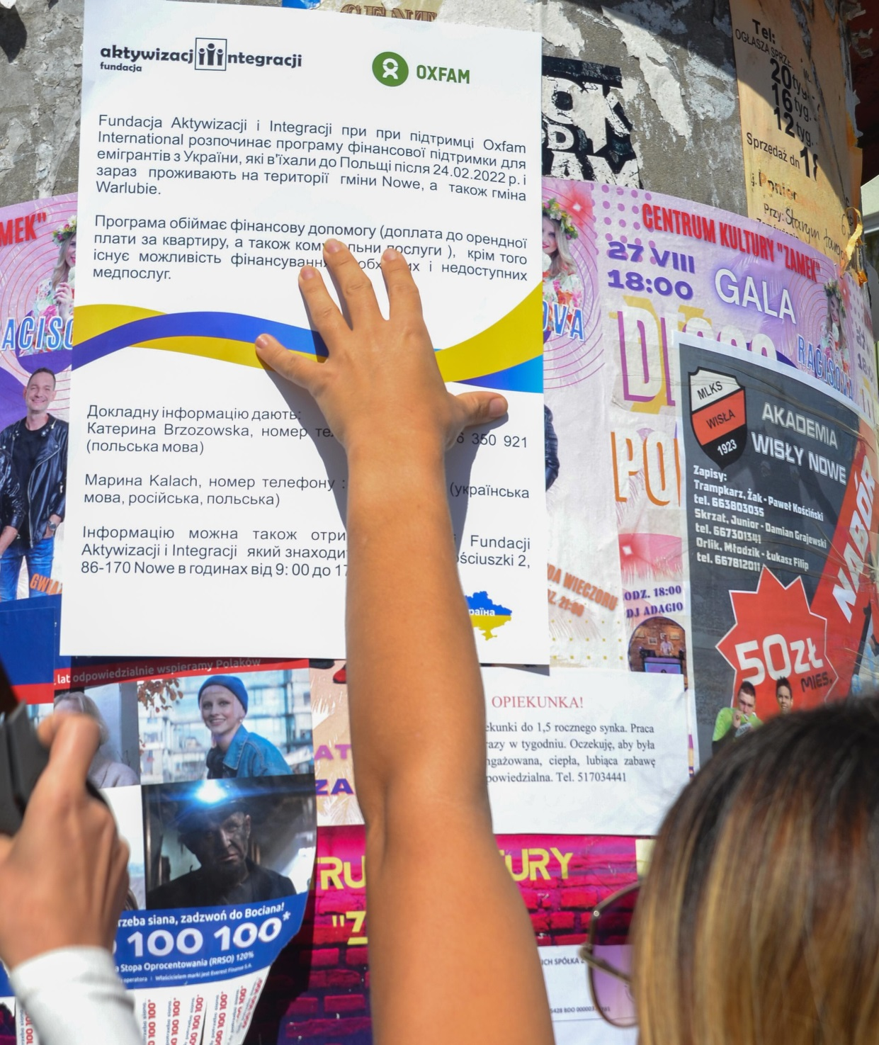
Introducing the Issue
May 2023,we modified our programme , proceeding our collaboration with OXFAM International
May 2023,we launched the same programme in another municipality, we established cooperation with the Fondation de France
We indicate our commitment to provide comprehensive housing support in the Ukraine - we are looking for partners

Slide 11
Summary of issue
On the 24th of February, the war in Ukraine begins, nearly 100 people, mostly women with children, are directed to Nowe between March and September 2022. The government only provides assistance in the form of benefits that guarantee the possibility of financing residence for up to 120 days, in addition it offers relatively low financial support ( family allowances). The local government did not take its own initiatives. FAI is independently implementing a support programme for 20 families for 14 months, with the alternative of further implementation until the end of 2023.
Comprehensive long-term housing support service ( renting of accommodation)
Assistantship focused on individual approach
Employment activation based on cooperation with labour market institutions and local business
Integration into the local community based on empathy and respect for the values of the parties involved
Medical support
Creation of alternatives to remain in Poland

Slide 12
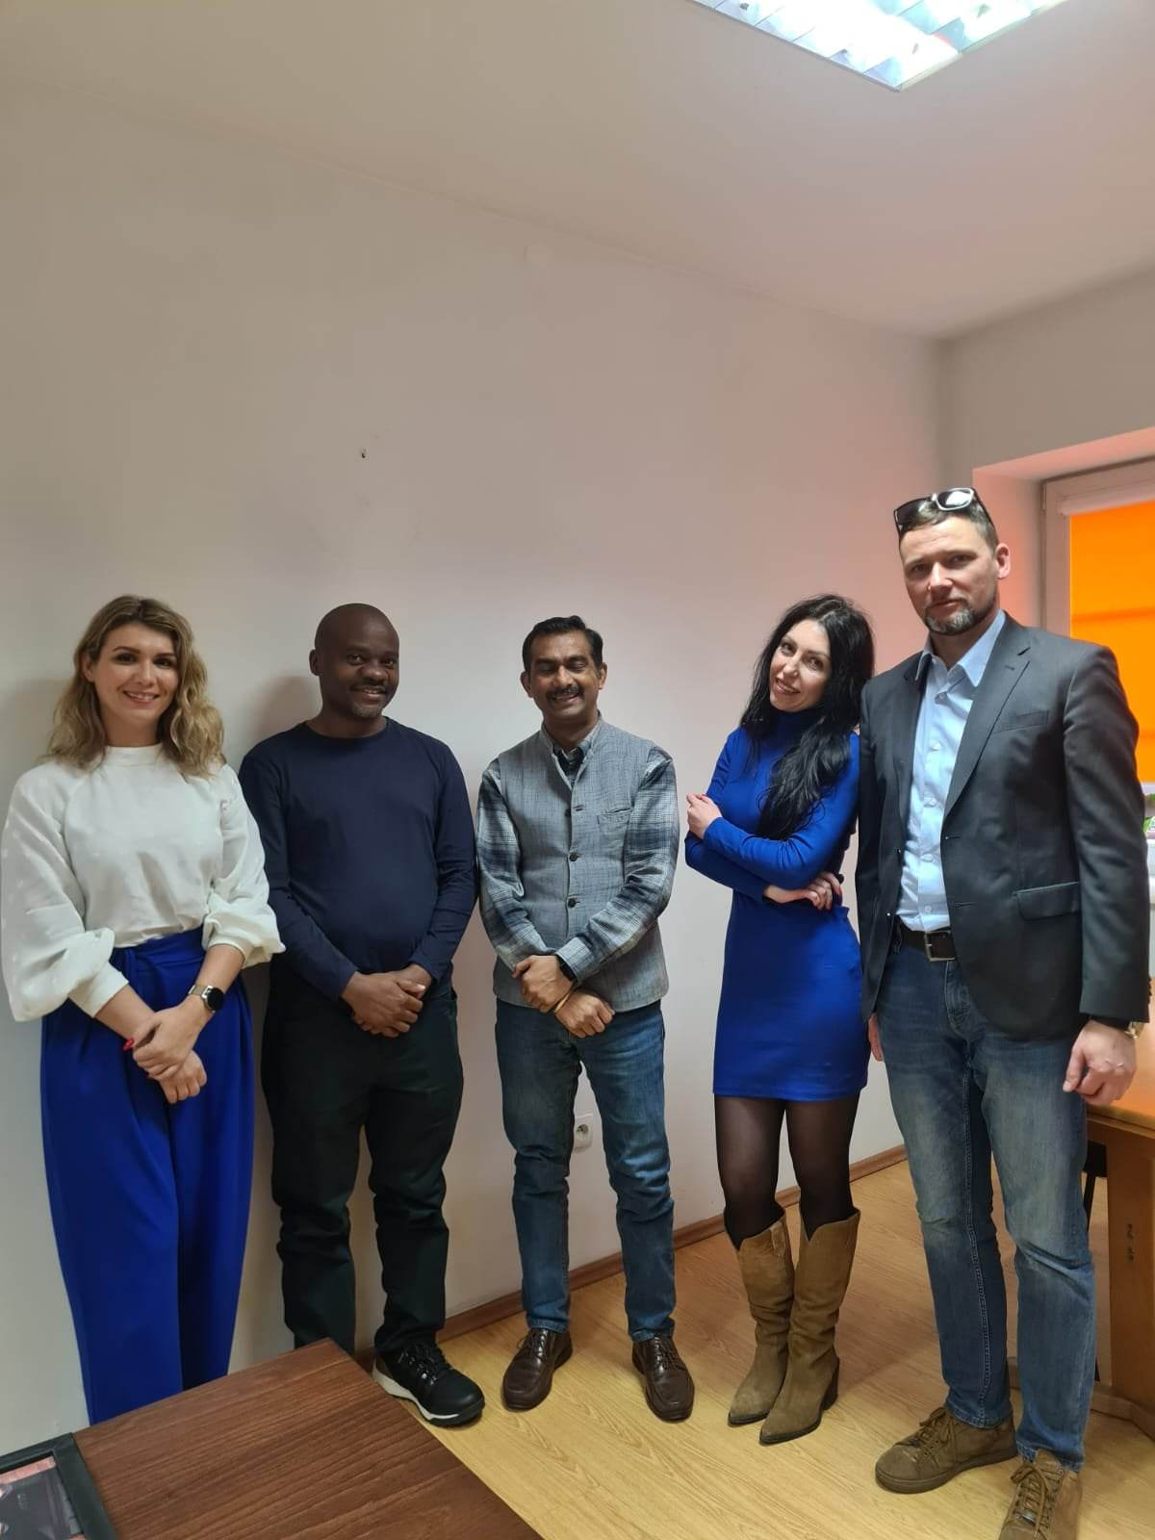
Solutions
Safe and long-term tenancy of residential premises
Mainly legal work, based on legal contracts
Comprehensive management of health problems
Individualised approach
Cooperation with partners

Slide 13
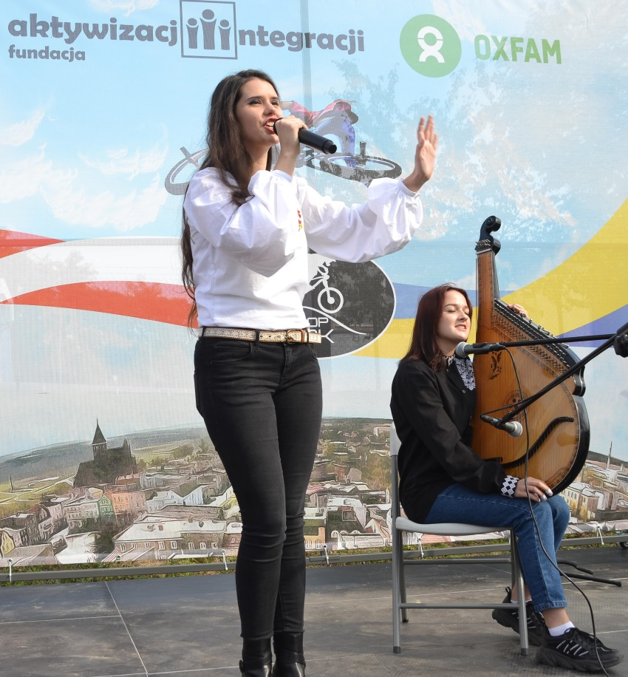
Summary of solutions
19 affordable accommodation units - tenancy agreements
Employment effectiveness of 64% - contracts, apprenticeships
26 individuals undergoing medically necessary procedures, 8 of them hospitalised
Committed work of 2 assistants, focused on multi-level support
Support from partners with a key role for OXFAM International

Slide 14
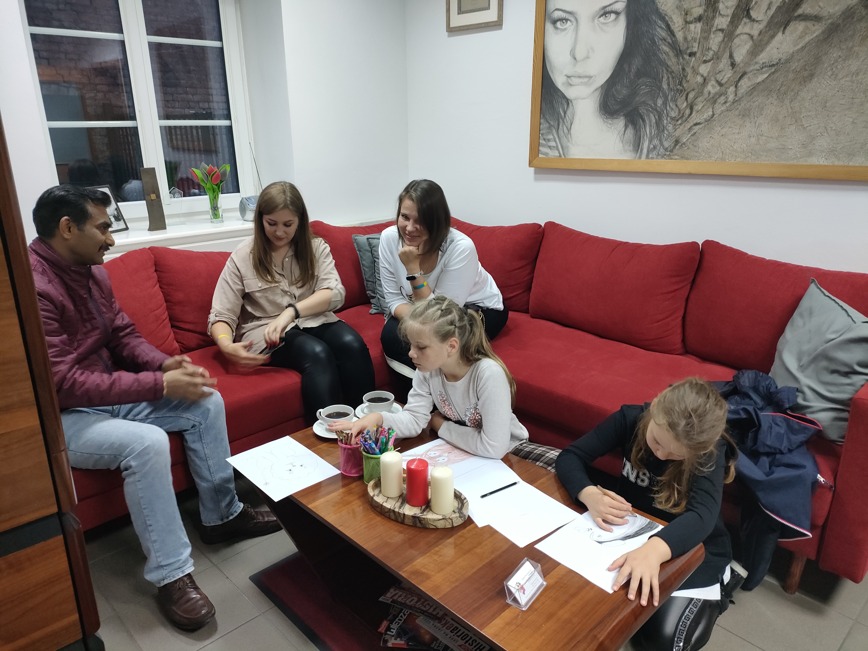

Slide 15
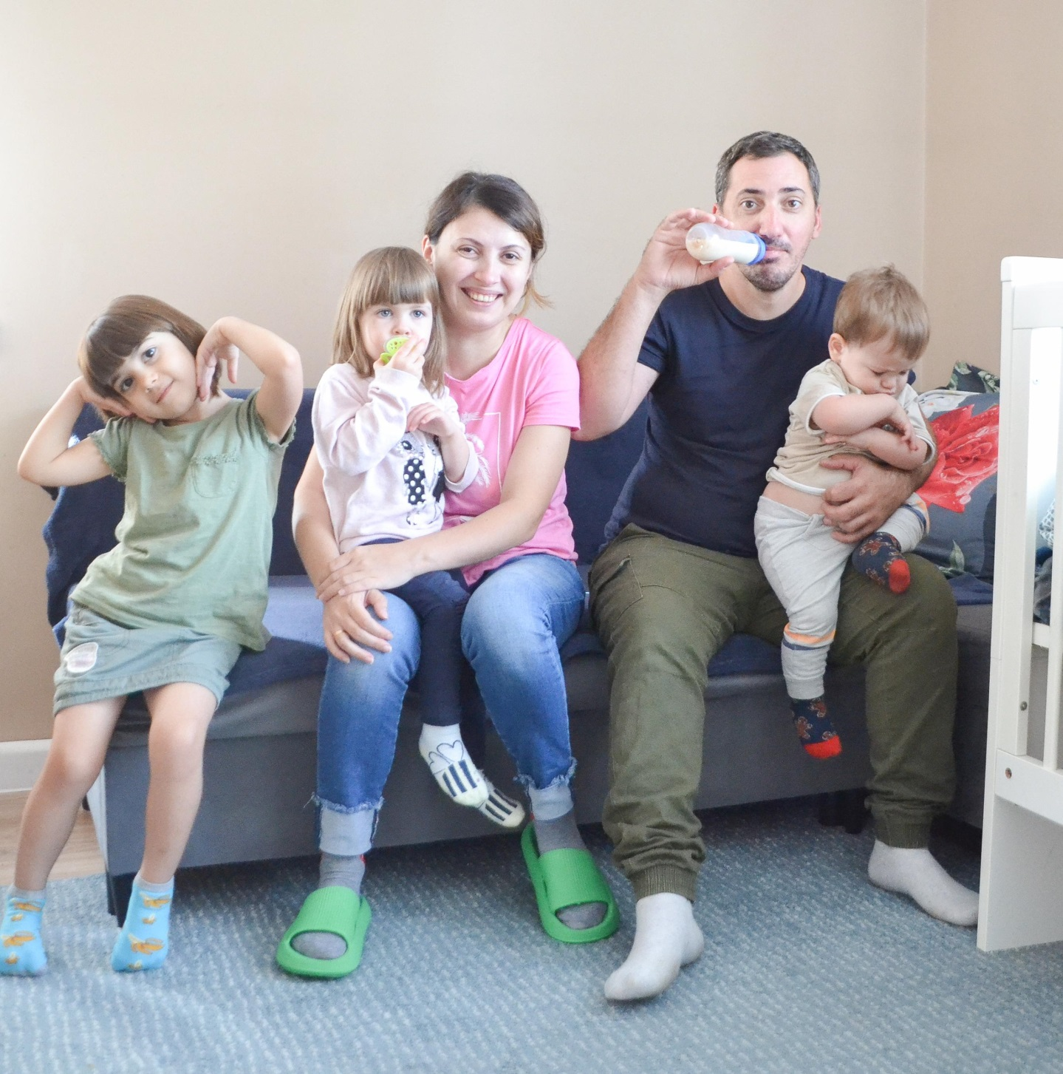
Solution evaluation
The key action is a transition in the support approach. We are moving from a humanitarian model to social support in order to make their independence safe. We believe that continuing with the current model minimises the chances of empowerment for those families who choose to remain in Poland.

Slide 16
Solution Evaluation
One: Continuation of the "Live among us" programme
until the end of 2023 (New, Warlubie)
Two: Implementation of support programme in themunicipality of Gniew until the end of 2023
Three: Willingness to take action
on the territory of Ukraine
Change of approach in the "Live among us" Programme from humanitarian to social (empowerment)
Reinforcement of professional competences
Change of support from assistance to mentoring/counseling
Work on a comprehensive housing support programme in the Ukraine

Slide 17
Closing remarks
Providing long-term accommodation
Financial support , employment, medical services
Assisting and individual approach
We believe that the implementation of such forms of housing support in smaller cities would stabilise and secure the situation of refugees in Poland. Unfortunately, our programme based on the experience of supporting the homeless is one of the few.
Thank you for your attention
FAI team
Marcin Tylman
Katarzyna Brzozowska

