Slide 1
Trauma informed care in practice:
the example of a trauma informed gynecological service for women experiencing homelessness
Piroska CLEASE – Boróka FEHÉR – Tamás GERENCSÉR

Slide 2
2 women-only shelters
5 shelters/hostels – for couples
Mixed day-centers

Slide 3
Our work
Night shelters
2 women-only
1 mixed, couples also accepted
Day centres, outreach
Hostels
mixed
some for couples
max stay of 2 yrs
Policy work
research
training for professionals
regular workshops (for ex. about homeless women)
transnational projects
Temporary housing for families with children
with a focus on the child
max stay 1 year
independent apartments
Notes:
Training: PTSD
projects: PIE (initial steps for a trauma informed organization)

Slide 4
Research - Needs Assessment (N=305)
Only 32% have seen a gynecologist in the past two years
Only 18% have been to breast checkup
Women over 45 are less likely to go to checkups…
37% have had health problems that they had not been to a doctor about in the past two years
36 women have been pregnant since homeless, 20 have had abortions, 19 miscarriage (highest numbers in night shelters)
Notes:
Need for gynecological services

Slide 5
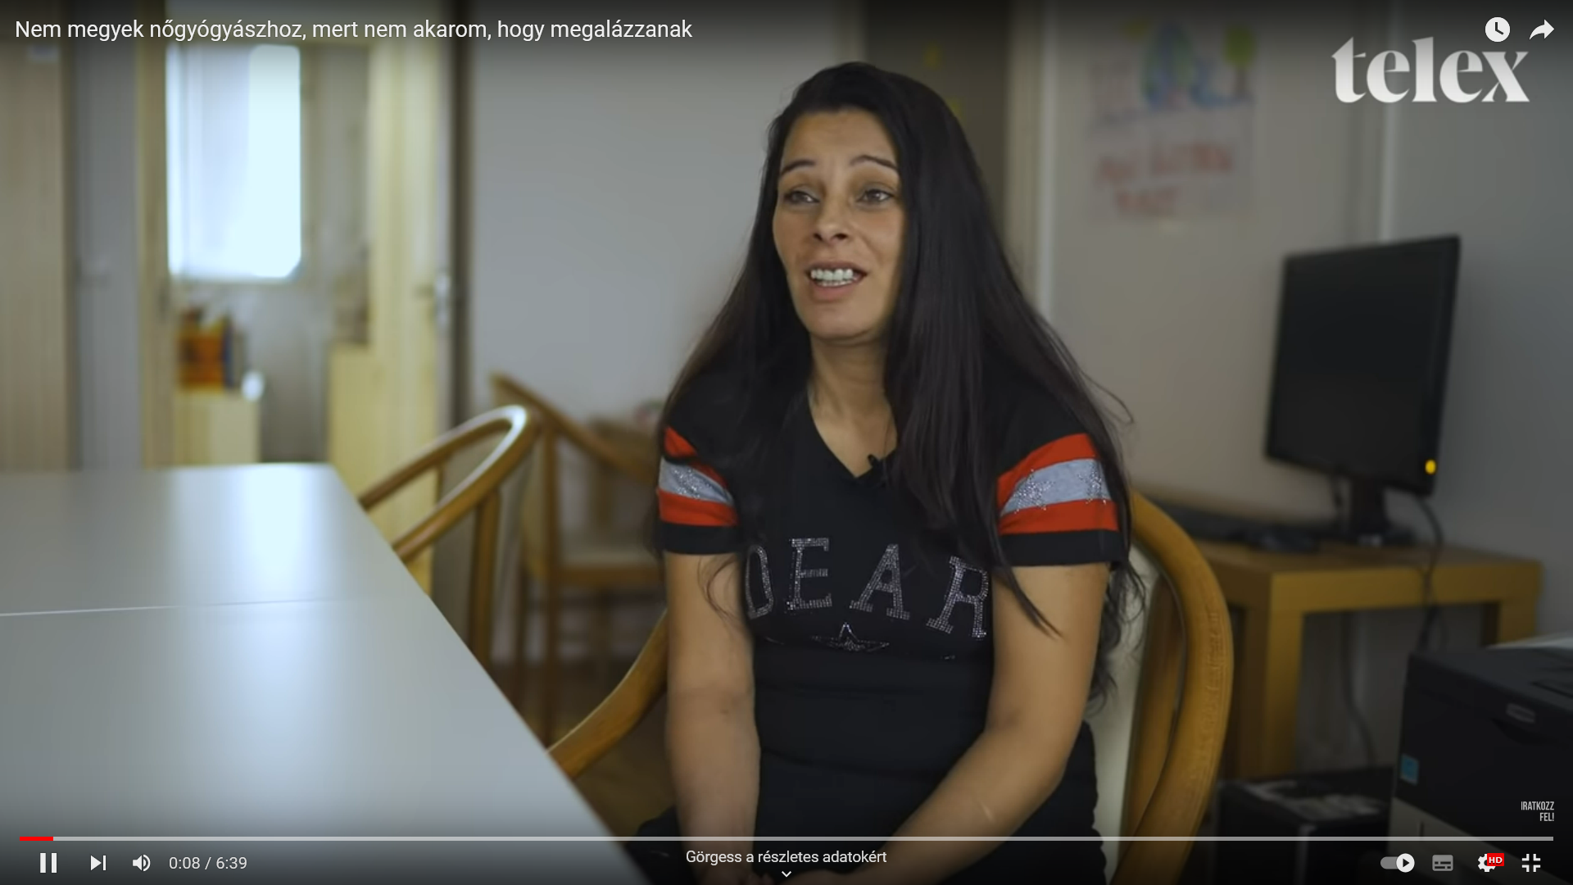
https://www.youtube.com/watch?v=Xp060d2_6G4

Slide 6
Programs aimed at developing support for
homeless women at BMSZKI
Erasmus+ Women and Homelessness project:
It was an international strategic partnership program to exchange good practice and expertise about their work with homeless women. Themes involved:
●Homeless women and children
●Emotional and physical safety
●Relationships, working with women who are in intimate relationships
●Participation
●Women’s health issues

Slide 7
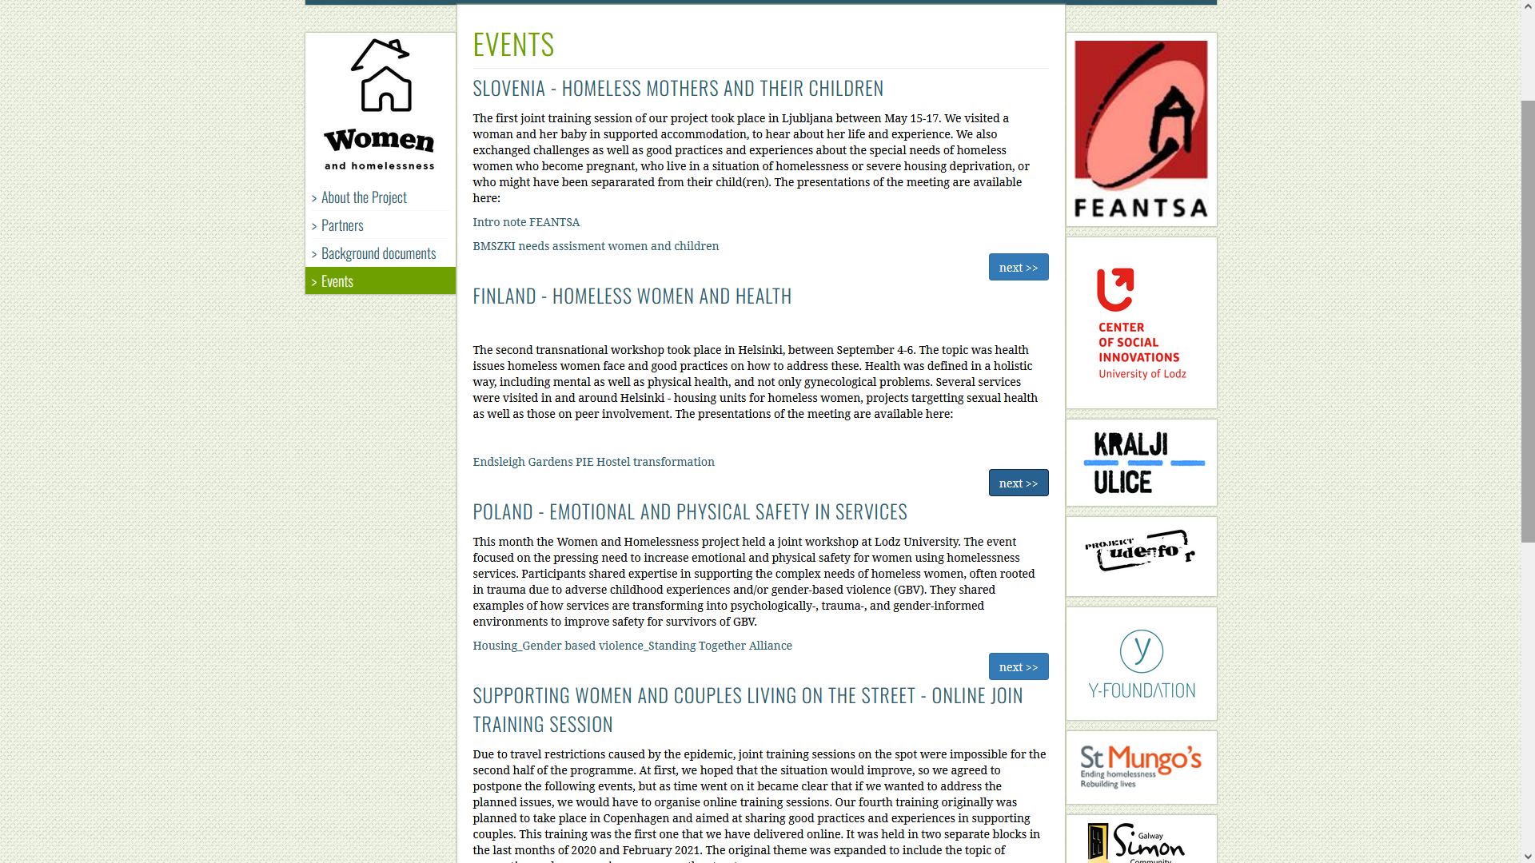
https://bmszki.hu/en/erasmus2

Slide 8
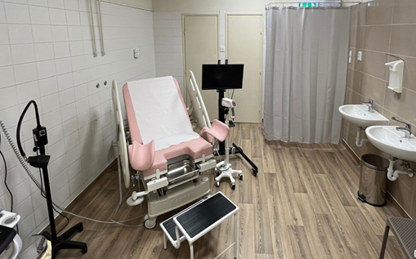
The rationale for Trauma-conscious Gynaecological service for homeless women
According to the results of our women needs assessment survey, 2 from 3 women have not been in gynaecological examination or breast checkup in at least two years.
From other research we know that at least in half of the cases women’s homelessness is a result of some sort of abuse - intimate partner violence, even sexual abuse.
Social workers who assisted women in case management or counselling reported that many spoke of poor experiences accessing traditional health services.
There was no regular collaboration between state-operated gyneacological clinics and social services. The stigmatization could only be reduced when social workers accompanied women to examinations.

Slide 9
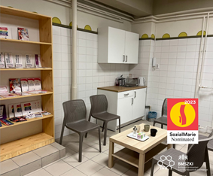
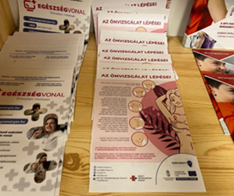
The aims of the Trauma-conscious Gynaecological Service
As a response, in 2021 we decided to set up a gynecological service so that homeless women
●can access the annually recommended gynecological and breast screening,
●with social workers support in access to further treatments or necessary operations, they would not have to suffer from untreated gynecological problems,
●can access birth control or any other necessary medications more easily,
●get proper medical attention when expecting a baby (It is a long term plan as we need to claim permission for that kind of service. For these more equipment and collaboration with other health providers needed).

Slide 10
Collaborations in service creation
●Budapest Bike Maffia and Levente Bicskey: Fundraising, social media campaign and construction work. (BBM is a non-profit organisation of cyclists. It consists of non-professionals who do charity work supporting the activities of social workers.)
●Emma Association and Dr. Judit Győrfy: Training for social workers of BMSZKI services and for the staff of the gynaecological clinic. (EMMA Association is a national women’s organization, which works for the fundamental rights and societal equality of women, paying special attention to gender-based oppression and violence against women during the childbearing and childrearing period.)
●Sober Babies Association: Cooperation in the development of the professional program and protocols and making connections to their health professional network. (Sober Babies is an NGO supporting pregnant women who struggle with substance abuse.)

Slide 11
Ensure access to genealogical care - the first step
A women reference network has been created.
Social workers in the network have gone through in a 3-day skill development training that aimed to involve the topic of intimate health in counselling and casework. (One professional from each service where we support women attended.)
The training was held by professionals of EMMA Association.
The content:
How to talk about sexual functioning with each other and with our customers
The female psychosexual development
Traumatic experiences on women’s life pathway
Signs of retraumatisation, the effect of our own traumatic experiences
Good practices for interviews, communication techniques
Mapping resources in a strength based approach

Slide 12
The Gynaecological Service setup - the second step
The service is open 3 from 4 Friday in a month
We can accept 12 women per day (6 hours shift)
○Only women (and their children) can enter the service.
The staff consist only of women
Social and health professionals work together in the service
1 doctor and 1 assistant work together in the surgery
2 social workers work in shifts. Their main roles:.
Accepting the customers, reducing their feelings of anxiety.
Supporting patients who need further treatment or other assistance. They can be contacted outside of the opening hours to talk further about their gynecological health, or even accompany them to the hospital.
Social workers of BMSZKI services can directly book an appointment for their clients for the examination at any time. Women can book an appointment for themselves by calling the service during opening hours.

Slide 13
Trauma Informed and Women-centred Care - Foundations
Initial training for staff about trauma
What is trauma?
What different kinds of trauma are there?
PTSD and its signs, how to recognise, how to respond?
Triggers
The susceptibility of women, especially those who are experiencing homelessness at the same time
The role of hierarchy vs. partnership or ‘circling’
Plan of regular team meetings and supervision groups
An opportunity for all team members
Provided and supported by a professional supervisor
on a monthly or bi-monthly basis

Slide 14
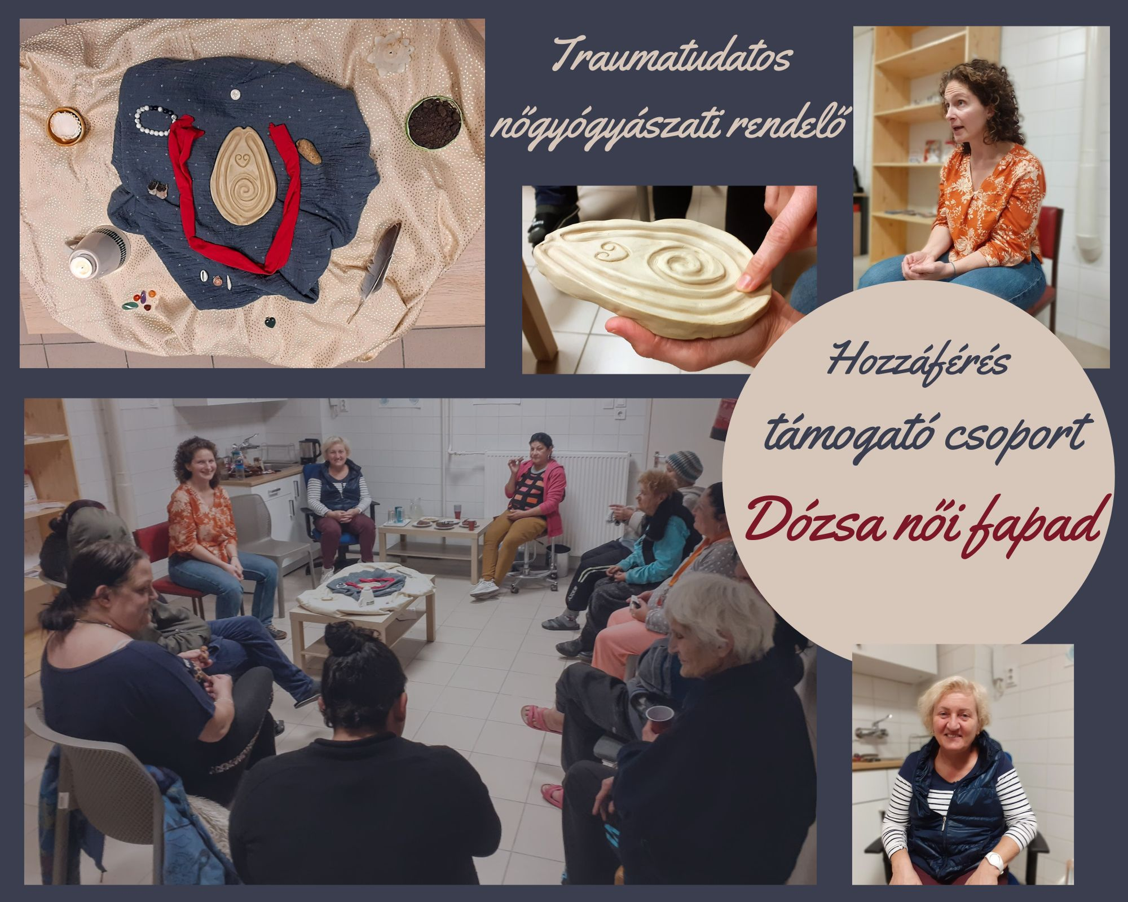
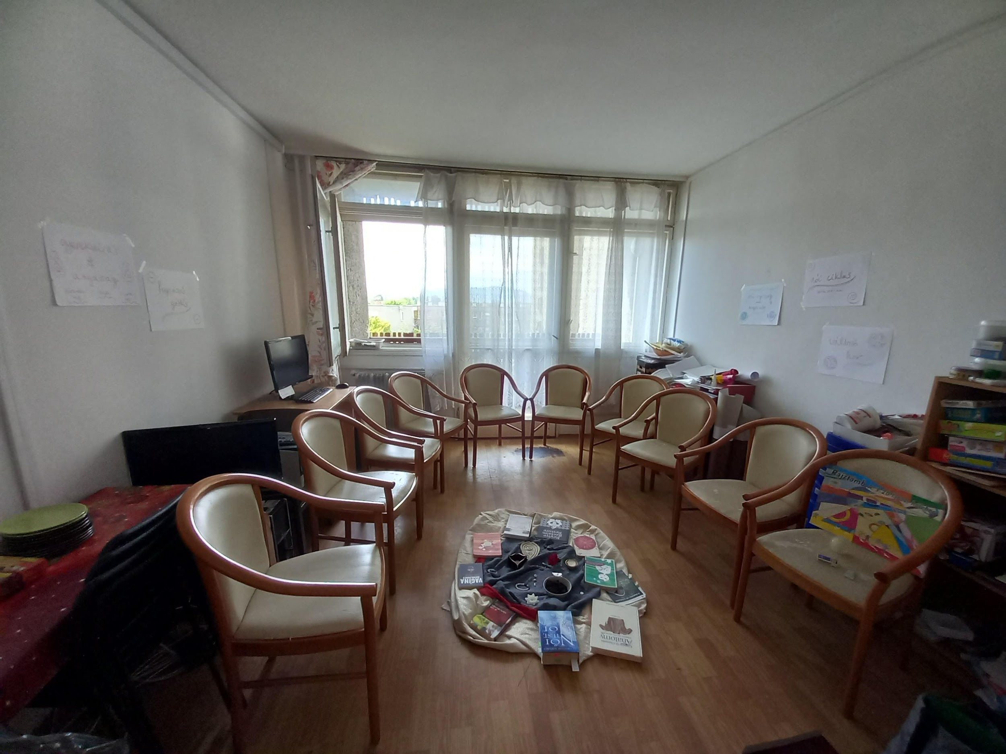
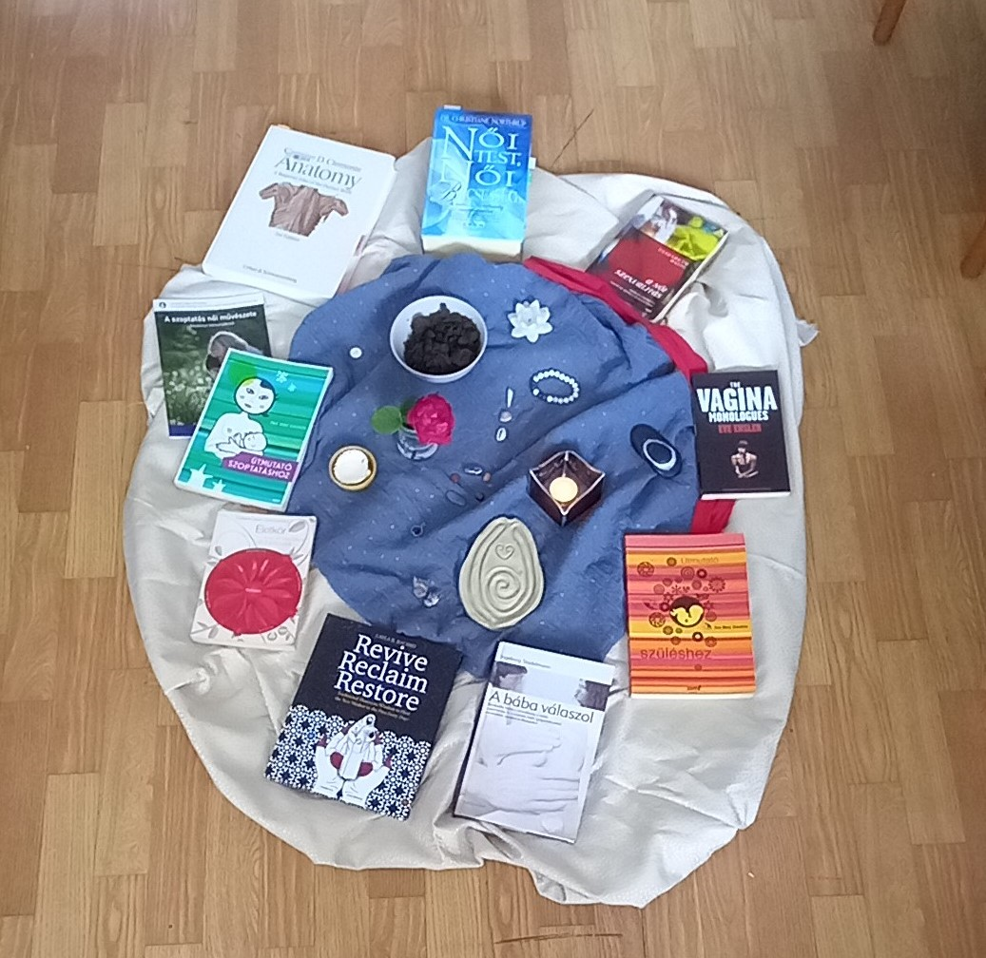
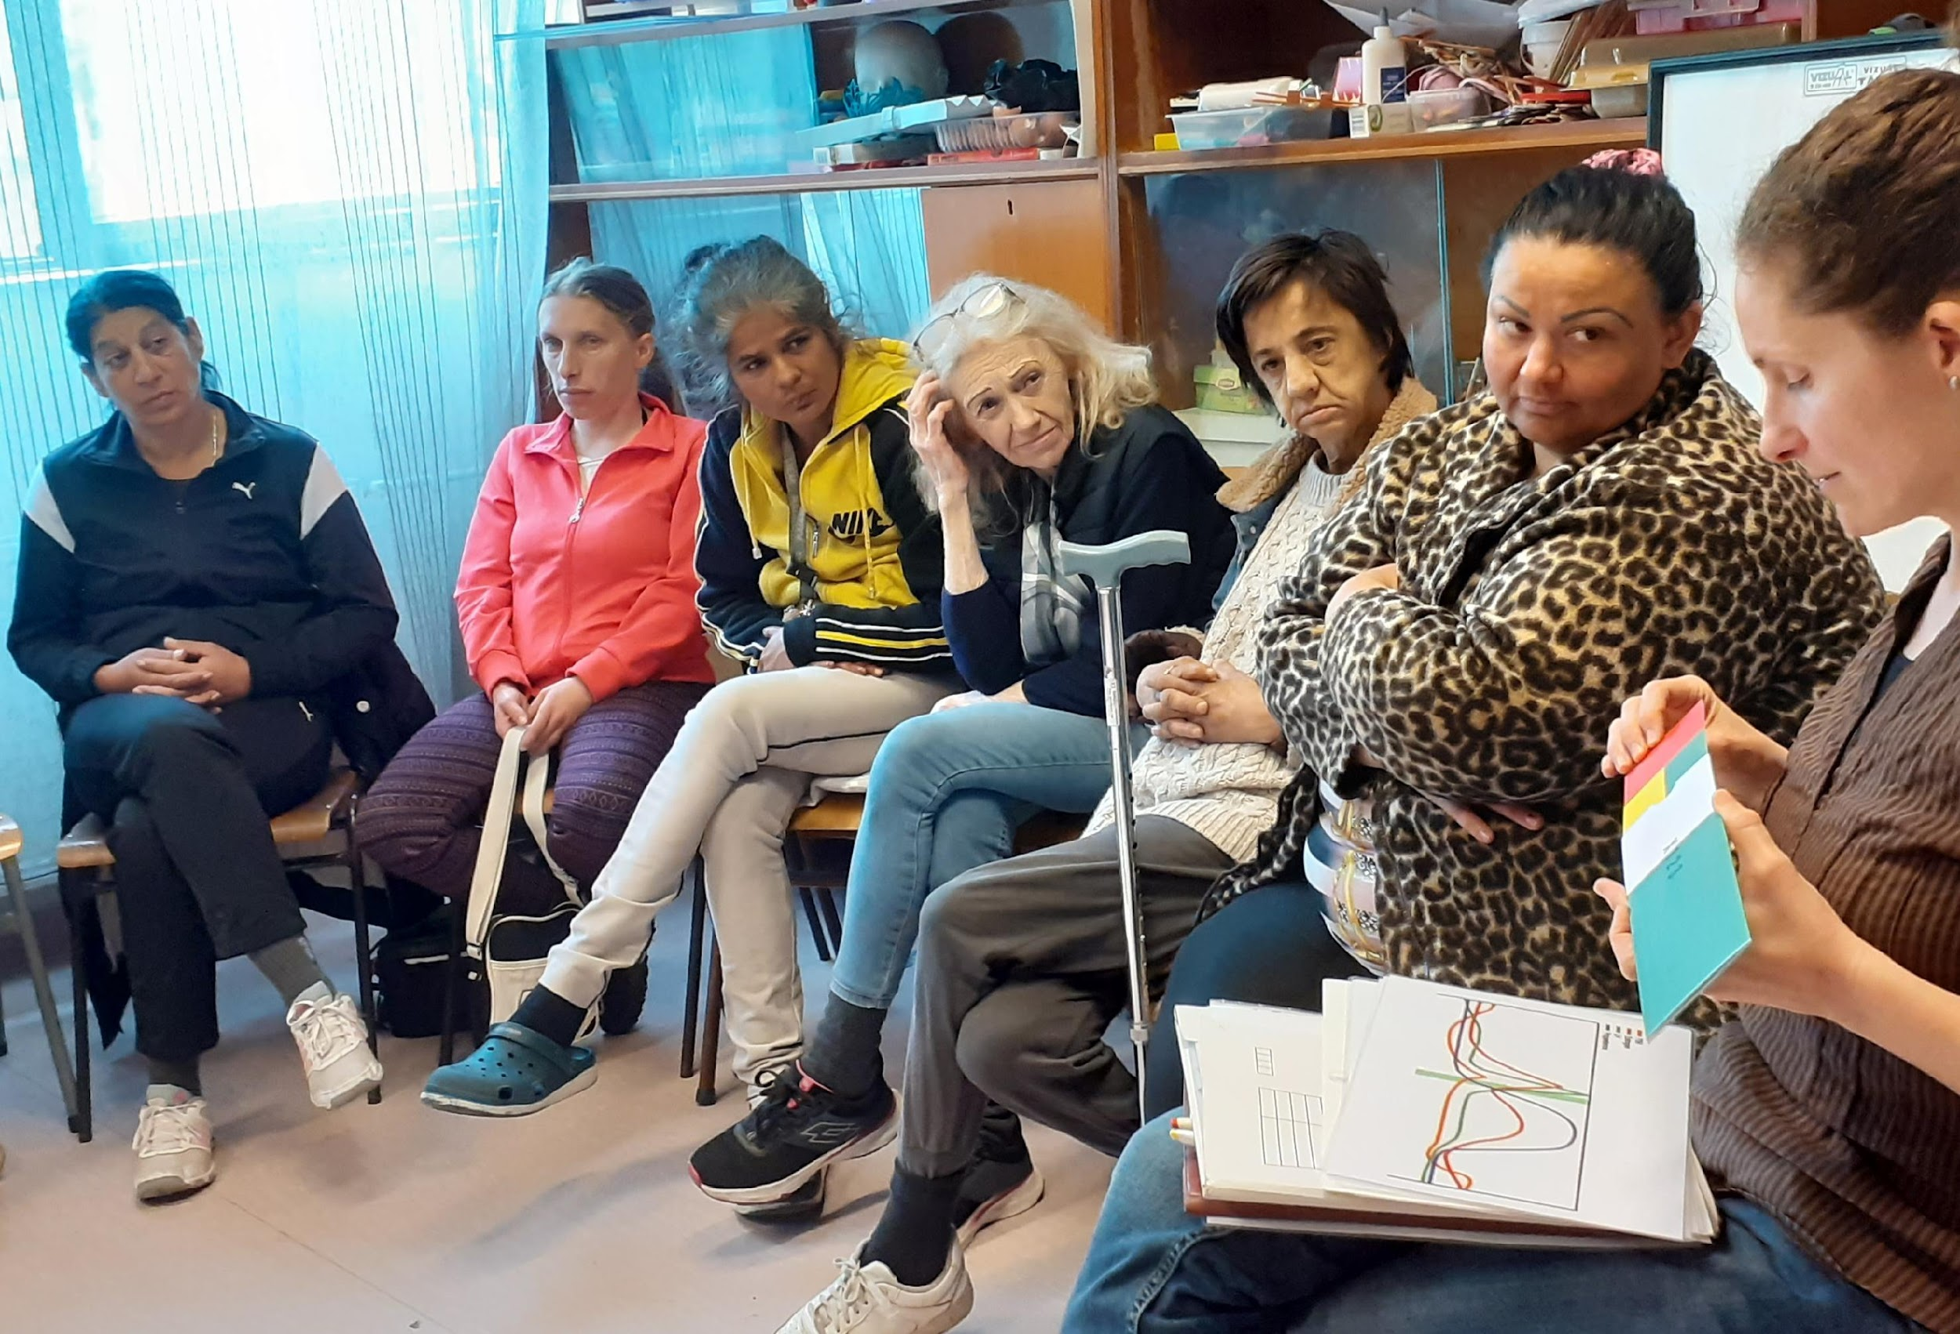
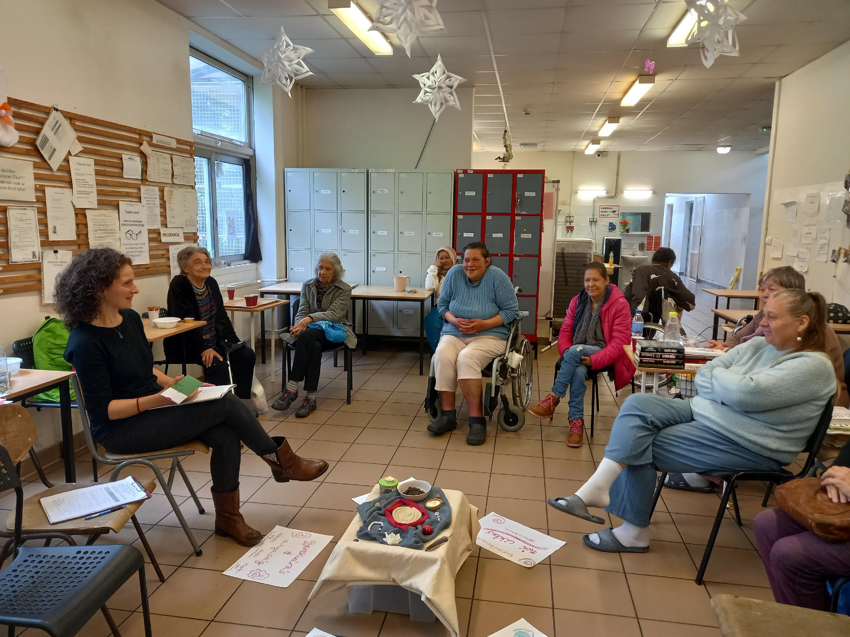
Groups for Women on Women’s Health

Slide 15
Groups for Potential Clients on Women’s Health
8 shelters
18 groups
Over 100 women – between Aug and Dec 2022
Topics included:
Introduction of the practice and its staff
Women’s health & the significance of preventive check-ups
Feminine cycle – medical terms, endocrinology, psychology, nature, etc.
Female anatomy
Sexuality
Family planning and contraception
Childbearing – pregnancy, birth, breastfeeding, postpartum care
Health of the perineum and incontinence
Peri menopause, menopause and post menopause

Slide 16
Trauma Informed and Women-Centred Care -
In Practice
Respectful care
The impact of trauma on individual’s neurological, biological, psychological, social and spiritual development
Being aware of the inequality of power : partnership / circle vs. hierarchy
Providing sufficient information for an informed choice
Deep listening without judgement
Control, right and possibility of making a decision about their own body
Presence, support and attention

Slide 17
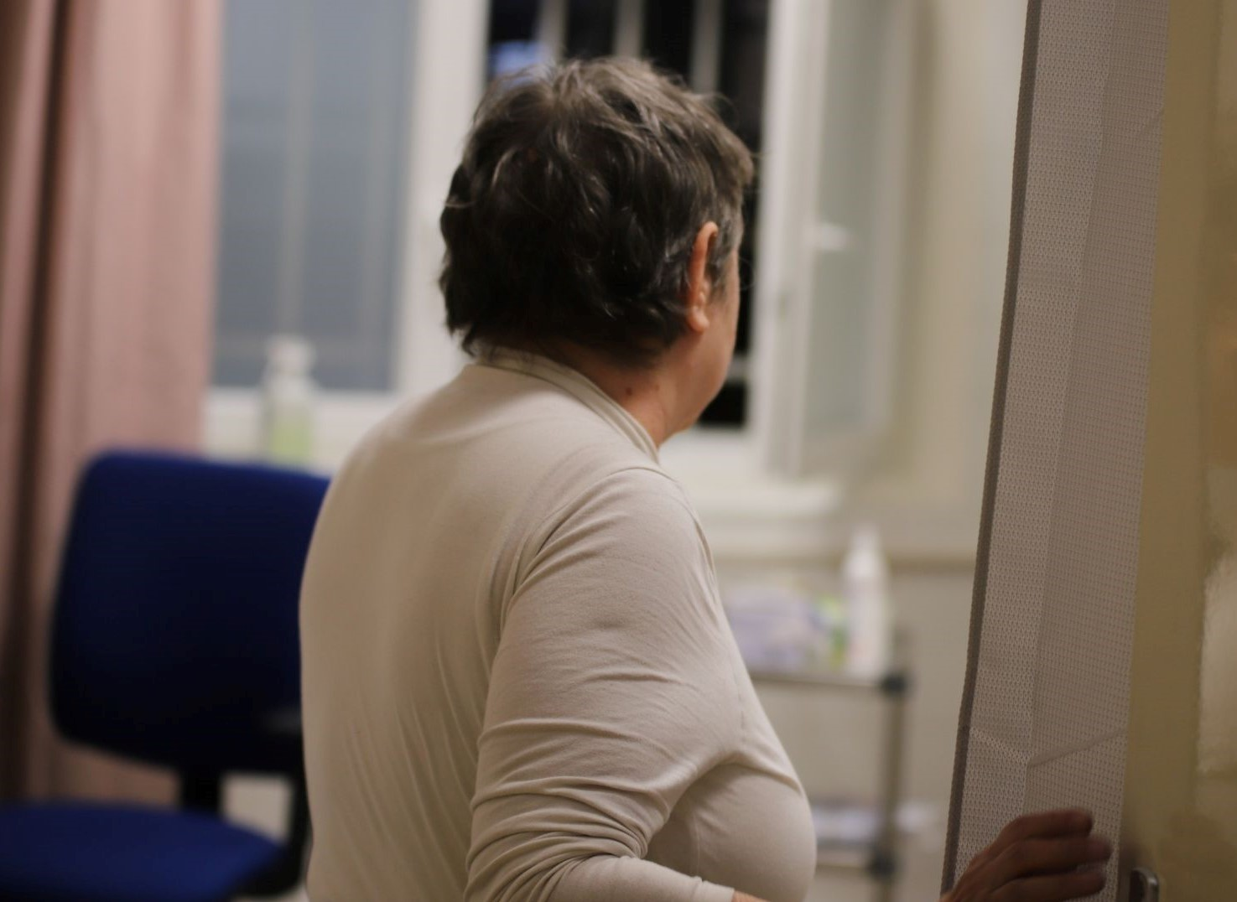
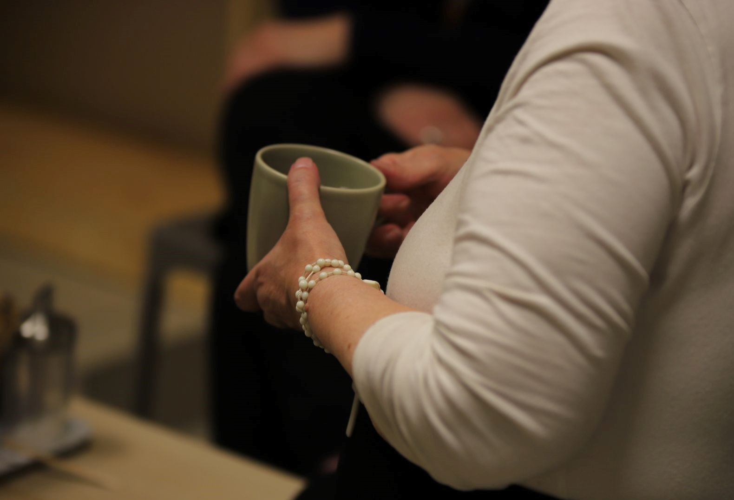
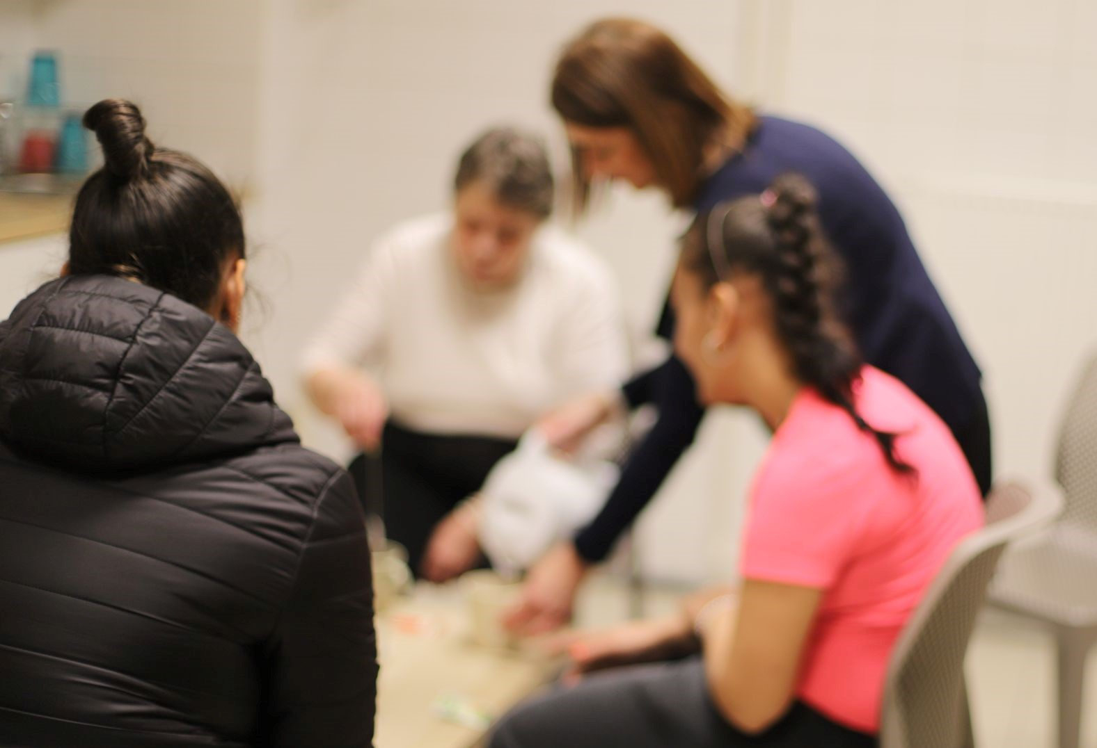
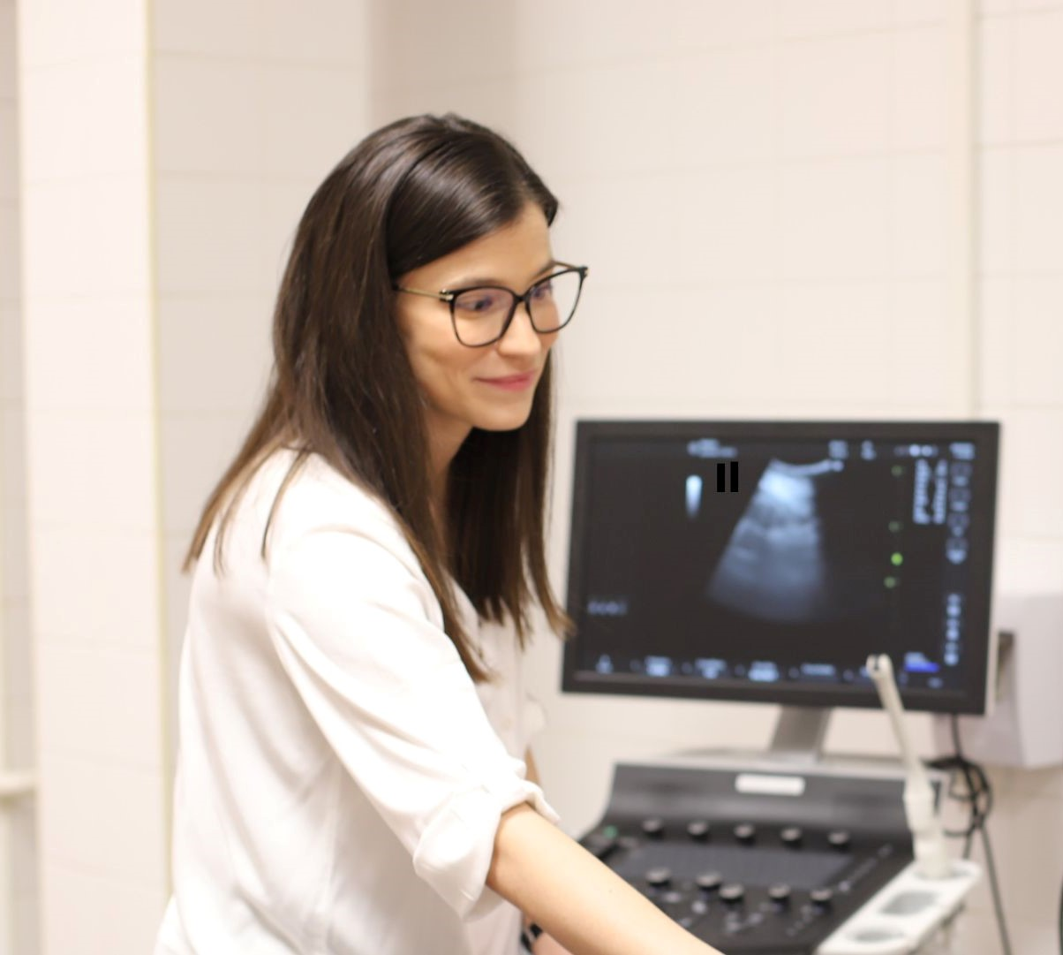
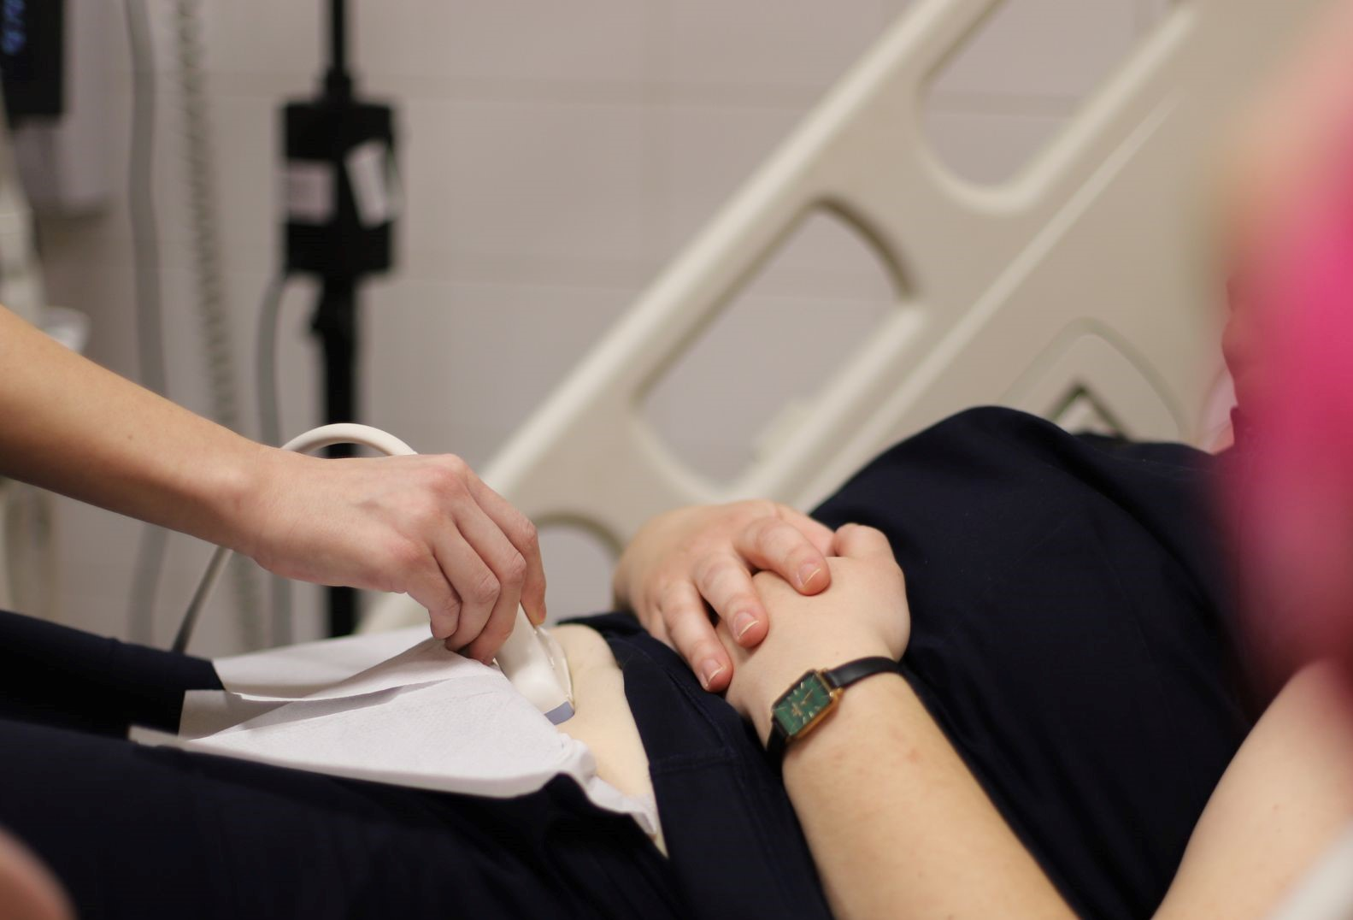
Tour of the Practice & Introduction of the Team

Slide 18
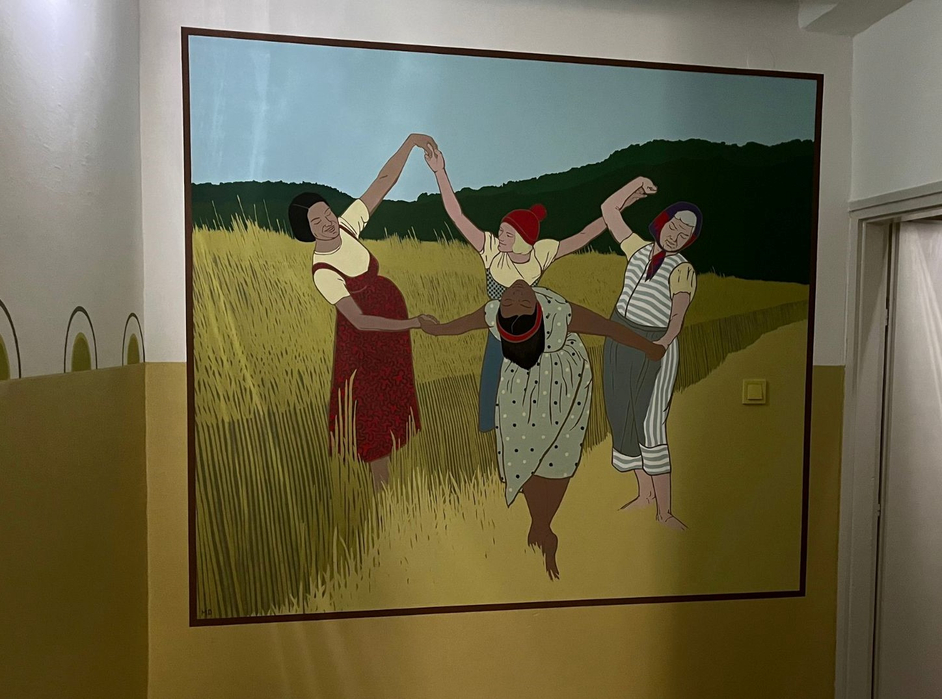
The Practice - The Way in

Slide 19
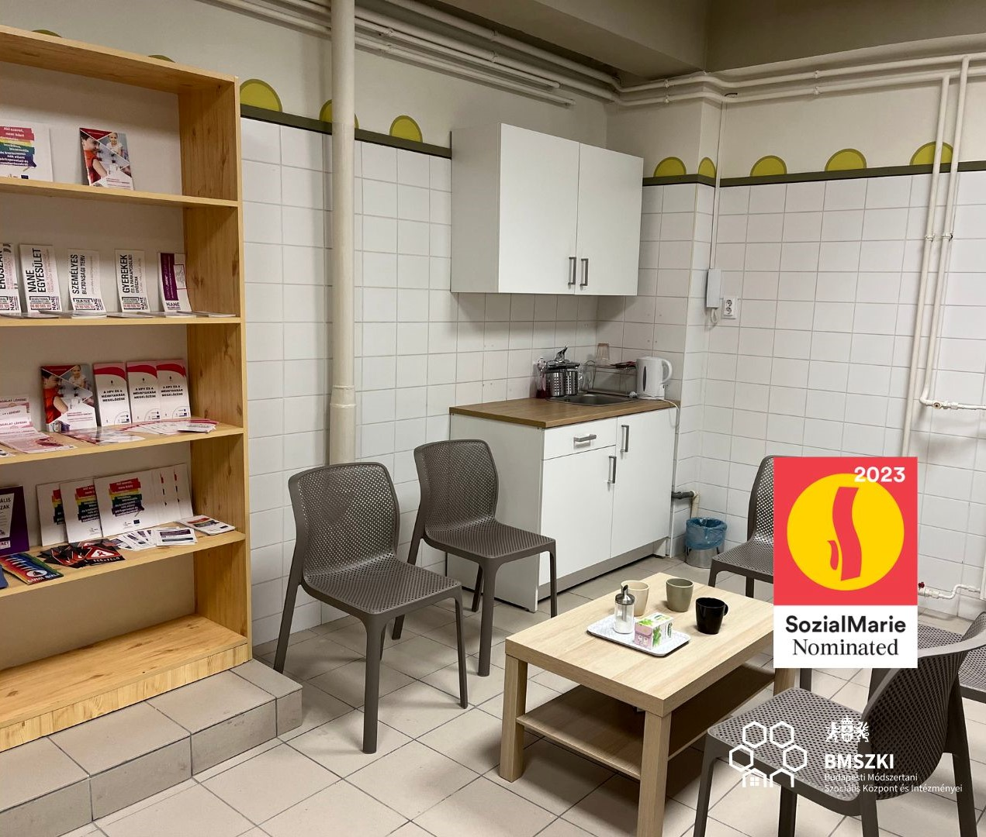
The Practice - the Waiting Room

Slide 20
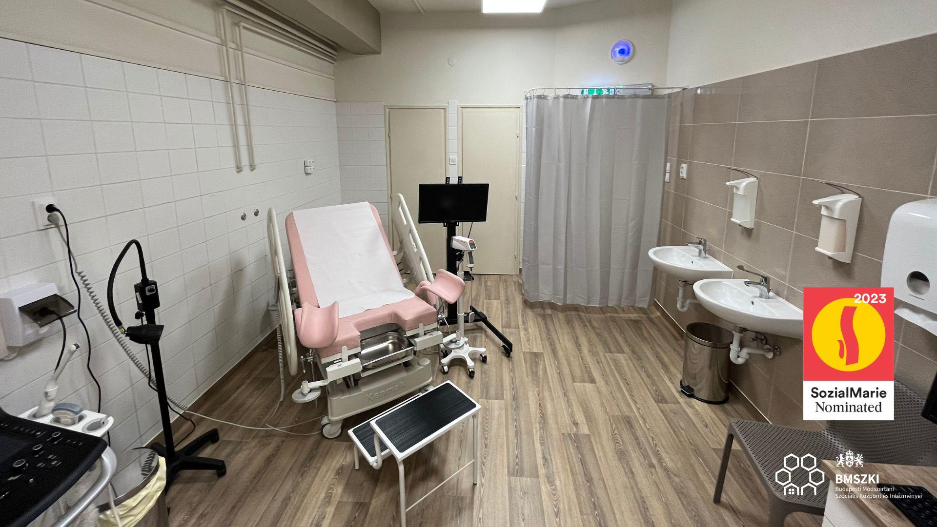
The Practice - The Examination Room

Slide 21
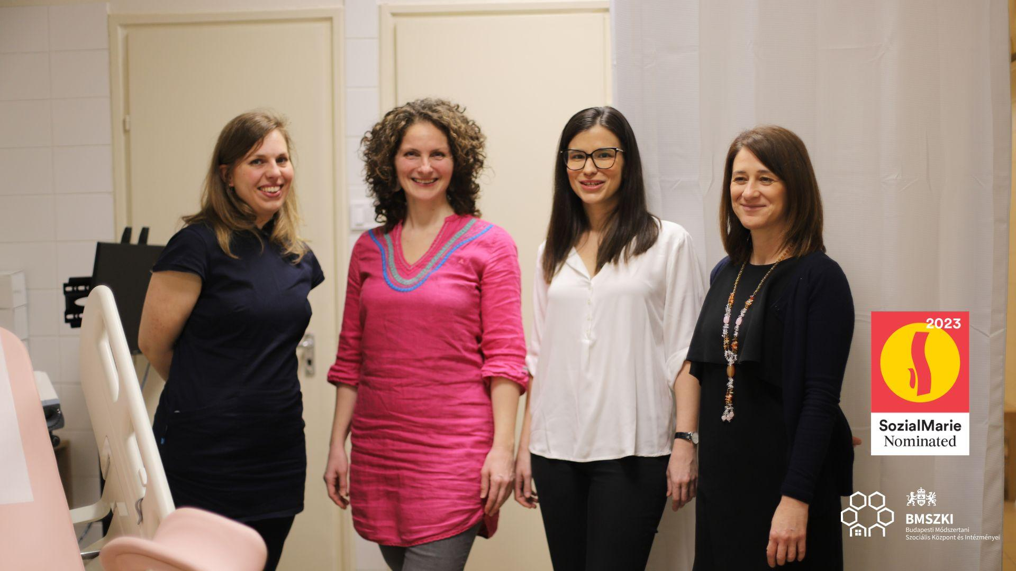
The Team

Slide 22
Future challenges and opportunities
Continuous training of new staff
Regular supervision
Funding
Opening service for other target groups

Slide 23
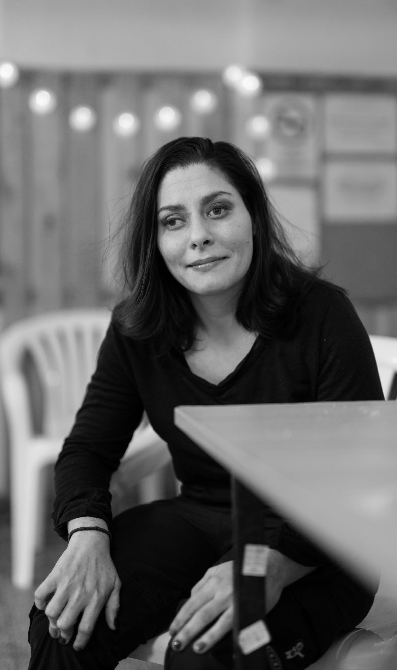
Small group discussion - Trauma informed working
Introduce your organization/workplace from the trauma-informed angle
Where do you see space for improvement?
Some concrete areas to think about:
building trustful relationships
feeling of physical security (space)
relieving anxiety (emotional security)

Slide 24
Small group discussion - Networking
Management
Networking for trauma informed working
Sustainability
Health care access of homeless women - what can we do?
Field workers
What is needed for you to be able to work in a (more) trauma informed way
on a personal level?
on a team level?
What is the (possible) role of a practitioner in helping homeless women access health care (good practices)?

Slide 25
Feedback
https://flinga.fi/s/FYXYKC7

Slide 26
Thank you!

