Slide 1
Loneliness
Maria Degerman
2.6.2023

Slide 2
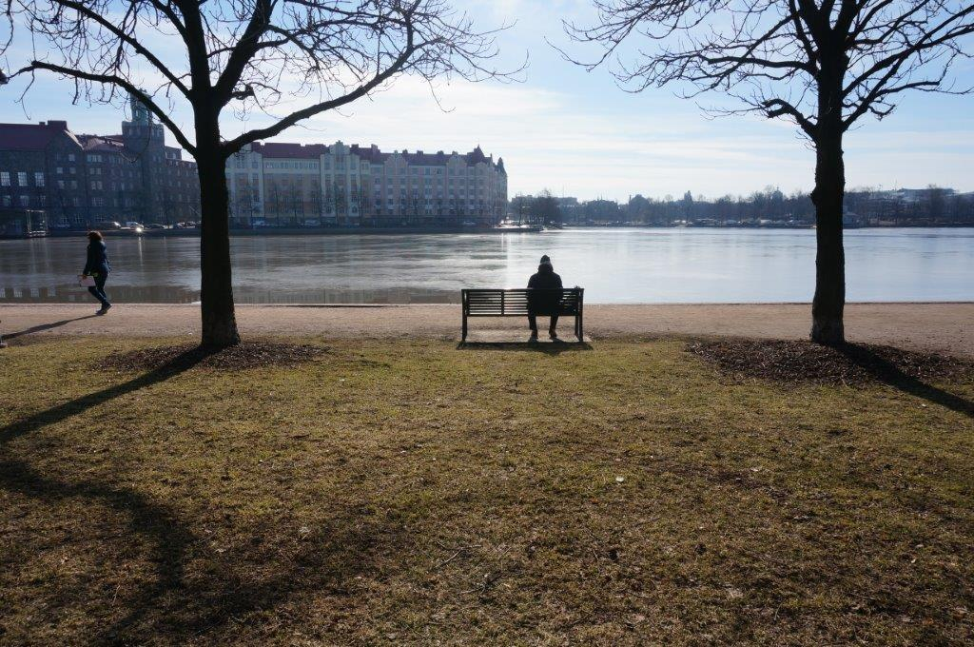
Loneliness touches
Especially prolonged loneliness
Many health problems increase
People isolate themselves from others and overreact to feedback

Slide 3
Loneliness can be difficult to identify
Loneliness is not a human characteristic, it is not visible
Loneliness can be the root cause of other problems
Loneliness means you don't have enough or the kind of relationships you want

Slide 4
Loneliness is associated with shame
Clients are shy to talk about loneliness
Workers are afraid to ask -or is it that asking is too difficult?

Slide 5
Social loneliness

Slide 6
Emotional loneliness

Slide 7
Difference between social and emotional loneliness?
Social loneliness Giving opportunities
Emotional loneliness Interaction training

Slide 8
We can all do something to reduce loneliness

