Slide 1
Preventing homelessness by housing advice
The Housing Finance
and Development
Centre of Finland

Slide 2
ARA implements housing policy
ARA implements government housing policy, aiming for sustainable and affordable housing
grants government grants, subsidies and guarantees related to housing and construction of housing
guides and monitors the use of ARA housing stock
is involved in housing development projects
manages expert tasks and information services related to housing and housing markets, and carries out related research
oversees building energy performance certificates.

Slide 3
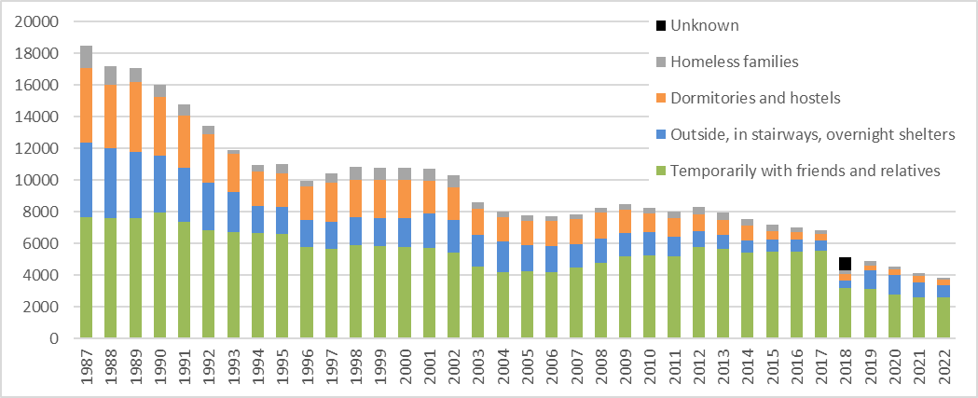
Number of Homeless 1987-2022 in Finland
Please note: In 2018, the City of Helsinki specified its procedure of compiling statistics on homelessness. Due to this change, the numbers are not comparable to previous years.

Slide 4
Housing advice for all
Housing advice is a preventive service that aims to tackle issues before they turn into a crisis
An efficient way to prevent homelessness
Professional housing advisors help clients with rental depts, defaults, housing disorders etc.
The main job of housing advisors is to prevent evictions
In 2023 ARA has given out grants to hire 66 housing advisors to municipalities all over Finland
ARA has given out grants to municipalities and housing companies for starting and developing housing advice services from 2009
Our aim: everybody is entitled to receive housing advice regardless of where you live

Slide 5
Housing advisors
Most often housing advisors in Finland have a bachelor’s degree in social services
Housing advisors work in municipalities, NGOs or in housing companies
Housing advisors aim to help clients before the problems need to be addressed by social work
On the other hand housing advisors might find clients who are in need of a more severe intervention
referral to a different service
Housing advisors work together with the client, housing providors, NGOs and social work
Role as a ”bridge builder”

Slide 6
Examples of reasons for seeking help from a housing advisors origin: Maura Tiuraniemi, Akseli Kiinteistöpalvelut
Applying for a home
Homelessness
Unsuitable home
Financial problems
Payment plan
Over indebtedness
Rental debt
Taking care of your home
Changes in life situations (divorce etc)
Health problems
Gambling
Problems maintaining finances
Small income
Problems maintaining finances
Old age
Substance abuse
Defective skills in finding a home
Mental and substance abuse problems
Debt
Housing disorders
Mental health problems
Cultural conflicts
Worry about a neighbour
Dispute between neighbours
Community quarrels
Notes:
Lisää vuokravelka

Slide 7
Most common reasons for seeking help from a housing advisor
1. Rental payment problems
2. Rental debt
3. Needing help finding a new home
4. Housing disorders
5. Eviction threat
6. Problems maintaining a clean home, hoarding
7. Homelessness
8 & 9 Advising with housing
10. Neighbour arguments
11. Crisis
12. Rent is too high
13. Eviction notice
14. Changing homes
15. Cultural conflict

Slide 8
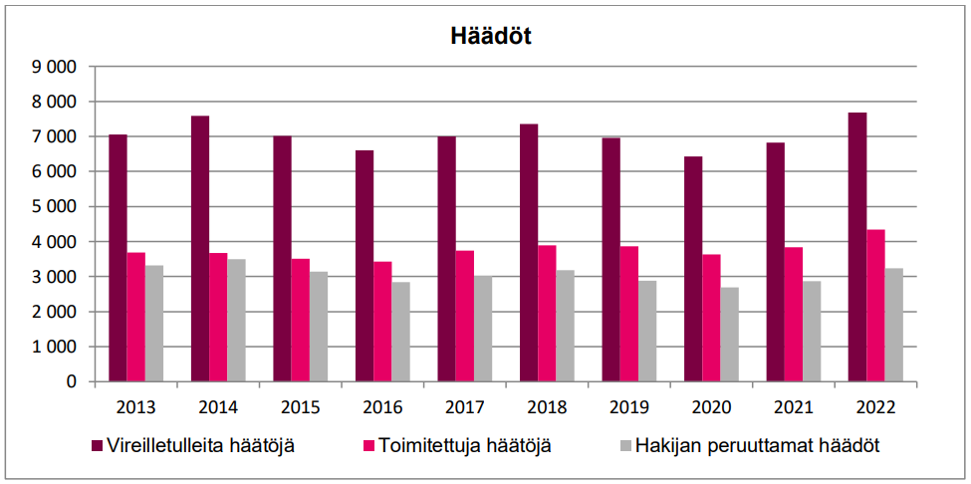
Number of evictions in Finland in 2022
Red: number of pending evictions
Pink: number of actualized evictions
Grey: cancelled evictions

Slide 9
The study of eviction costs in Finland
Eviction costs can range from 1 600 € to 21 400 €​
Average cost of an eviction 6 300 €
+average rental debt 4 300 € ​
= 10 300 € loss of income for housing company​
The whole process from the first rental debt to evicting the tenant to getting a new tenant can take as long as 8 months
Housing advice has been proven to be very cost effective when preventing evictions
Finding out how expensive evictions are will hopefully motivate housing providers to work preventively.

Slide 10
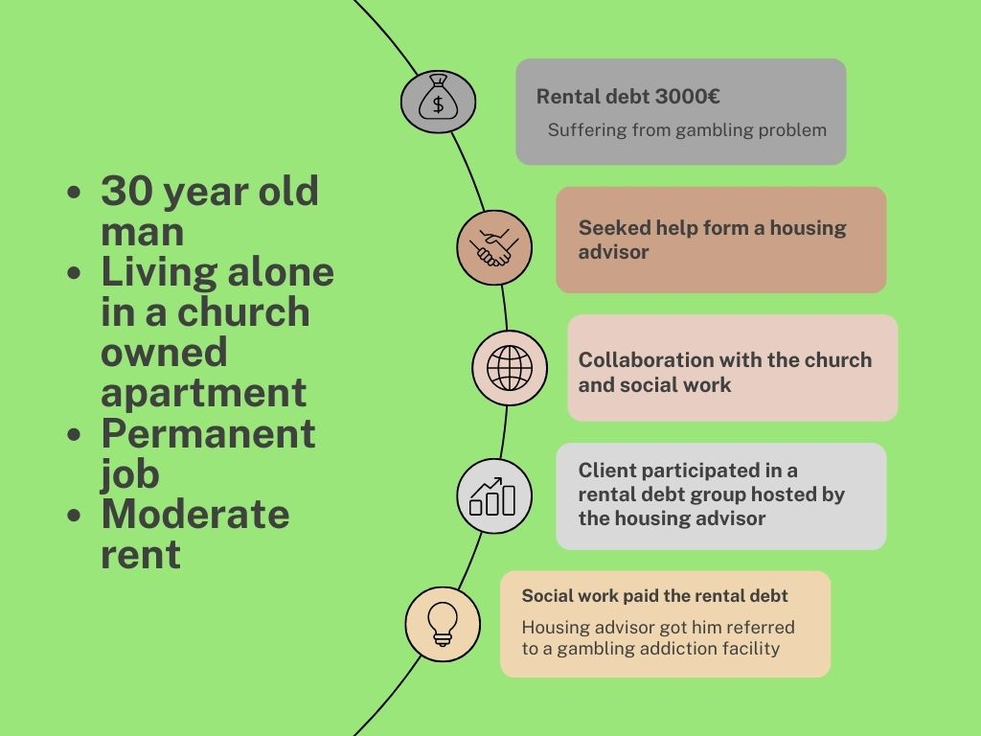

Slide 11
Legislating Housing Advice
Housing advice is one key method Finland is using to halve and eradicate homelessness
The law makes it possible to give housing advice to everyone regardless of where or how they live
Ministry of Environment drafted a 5-year law for housing advice for 2023-2027
Aim is to improve the availability of housing advice in Finland by ARA’s grants
part of the Programme of Prime Minister Marin’s Government
At the moment, providing housing advice is voluntary for municipalities.

Slide 12
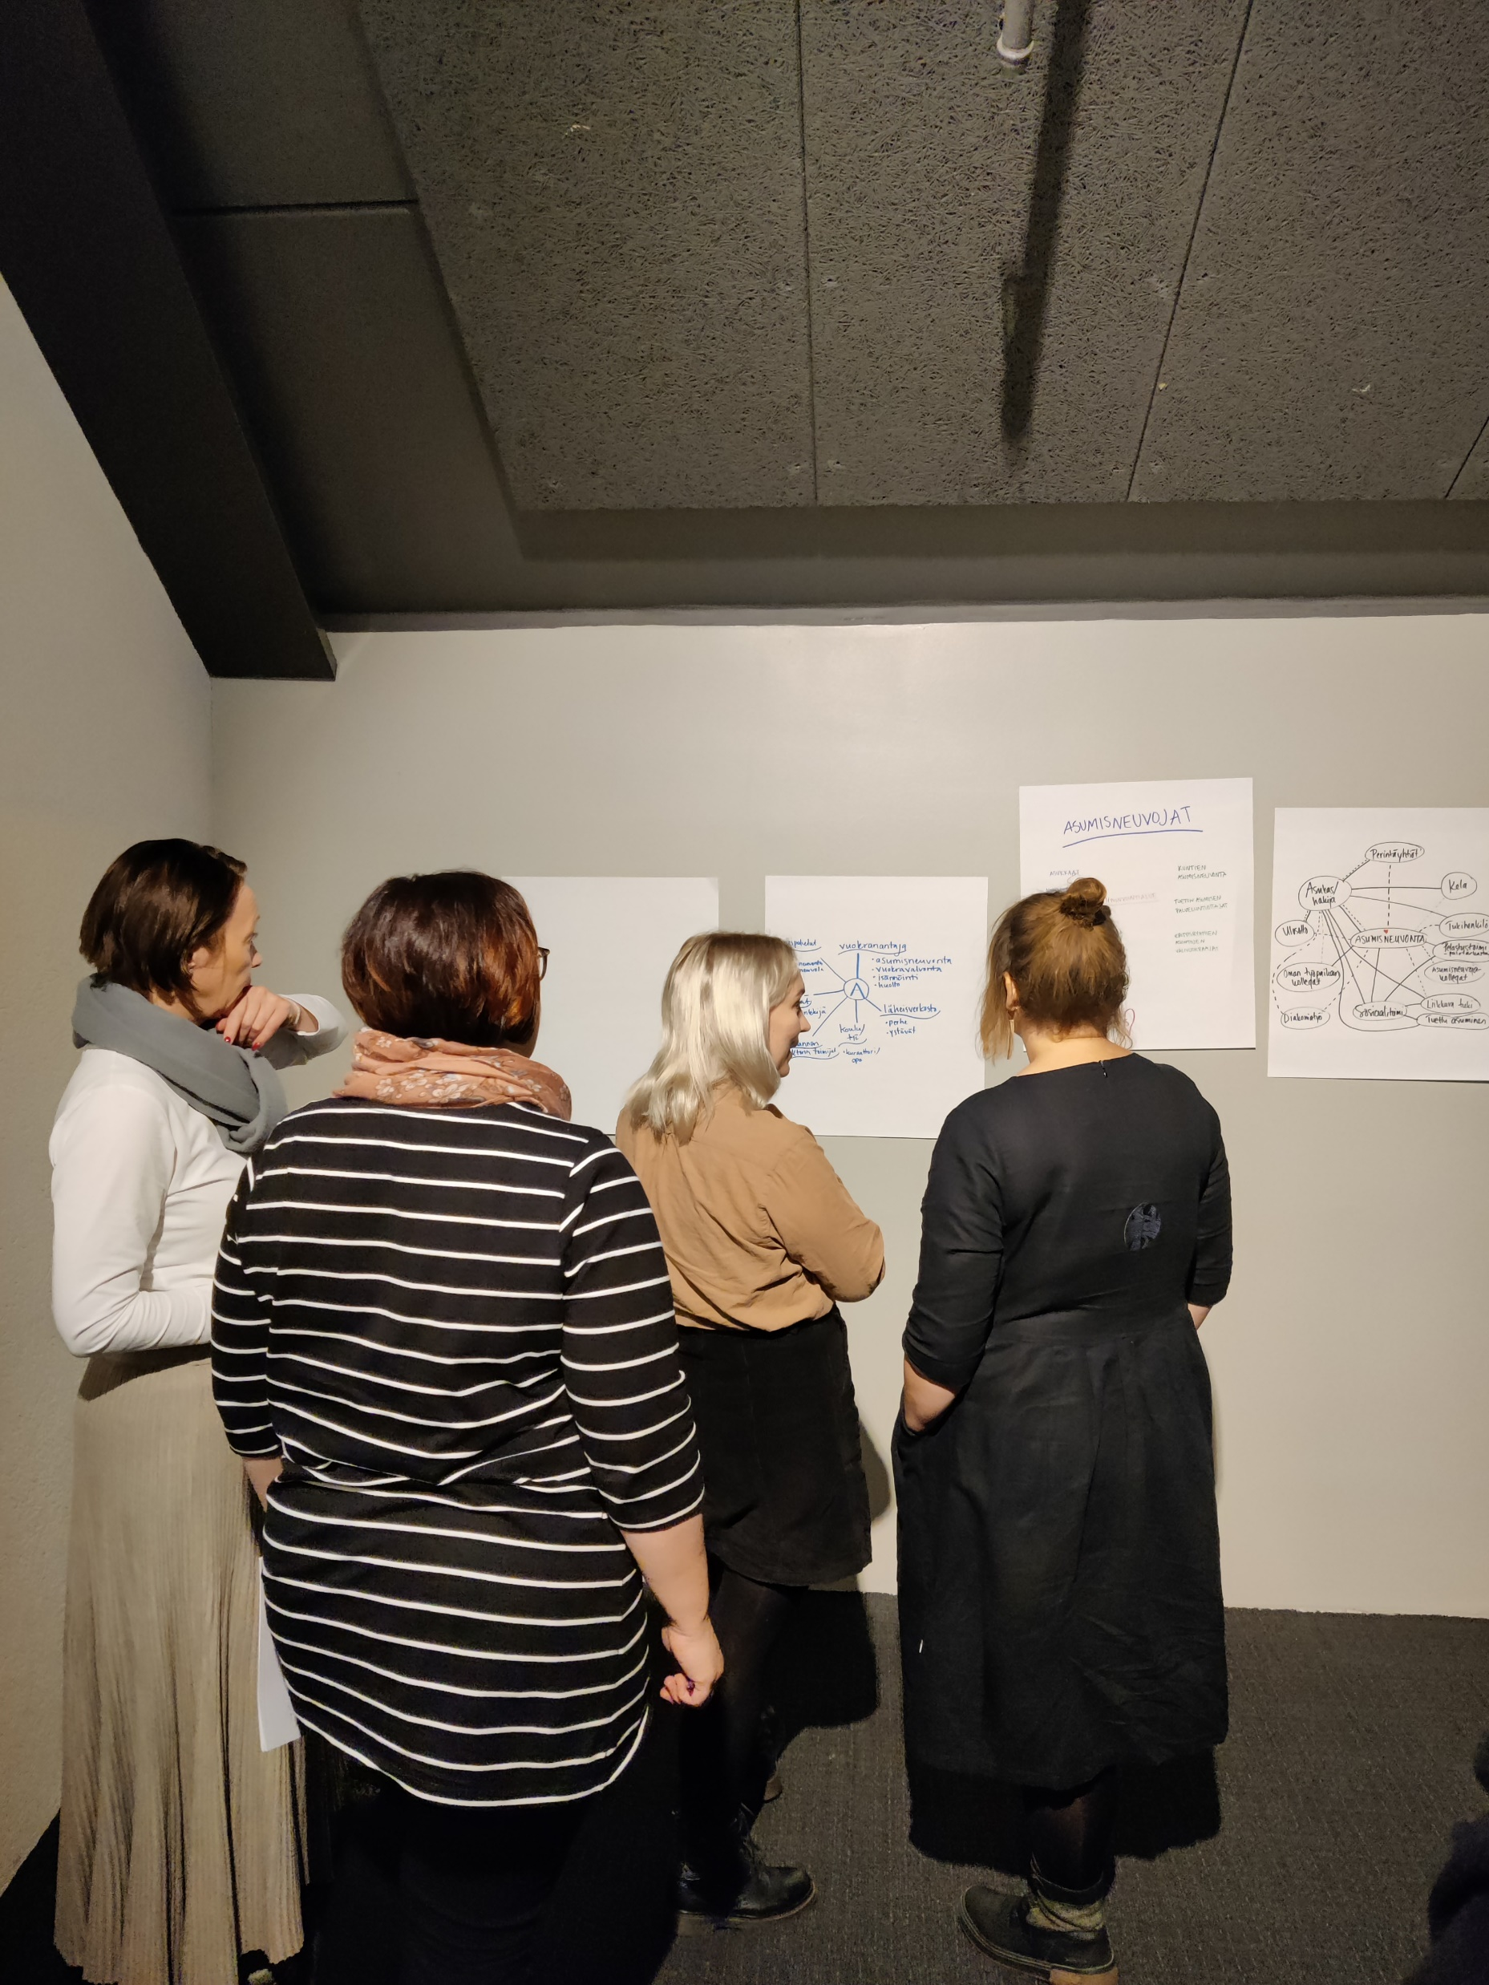
How does ARA support housing advisors?
Training sessions open for all housing advisors
Sessions consist of housing advisors presenting their working methods and/or expert lectures
Subjects are determined by the housing advisors, e.g. collaboration with social workers; clients with mental & substance abuse problems etc.
Network of housing advisors facilitated by ARA and a team of housing advisors
The goal is to get to know each other, exchange ideas and get peer support
ARA also arranges training to new housing advisors that have been hired with the grant given by ARA.
Notes:
Mirka

Slide 13
Thank you!
Vilja Kamppila & Mirka Järvinen
asumisneuvonta@ara.fi

