Slide 1
The Cost of Living Crisis and Homelessness
Nicholas Pleace
European Observatory on Homelessness

Slide 2
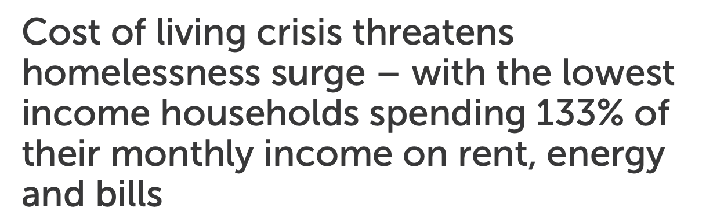
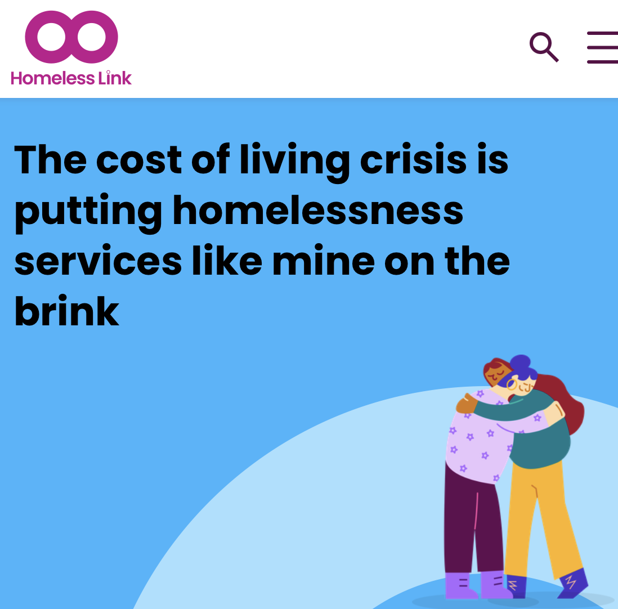
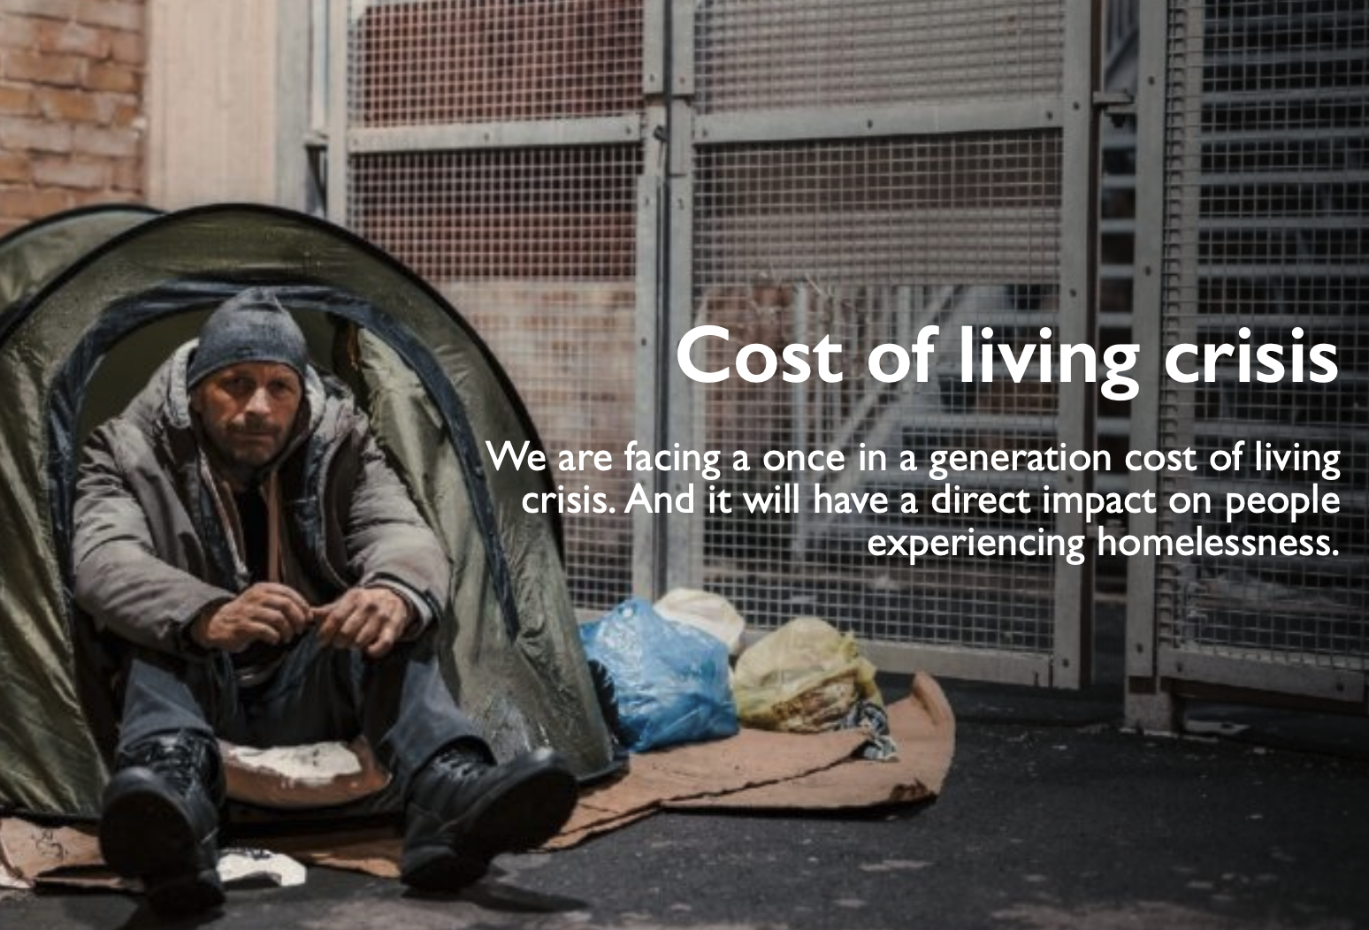
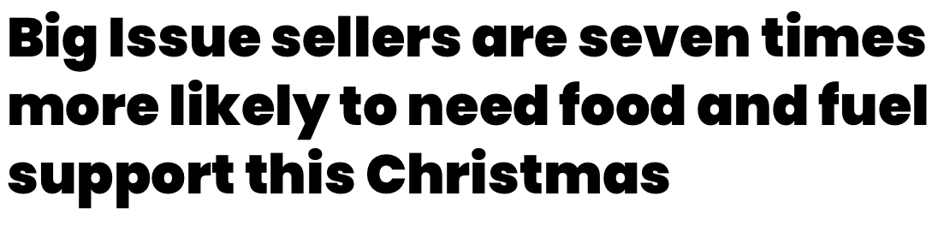
Overview
There are many forms of homelessness
Sometimes associated with multiple and complex needs
Often associated with social issues like domestic abuse
But always with poverty and particularly with extreme poverty

Slide 3

Dimensions of the cost of living crisis
Effects are not even across EU Member States
Different policy responses to fuel poverty risks
Different effects on the supply chains and costs of food
Differences in housing markets and whether and to what extent social housing and welfare benefits to assist with rent and mortgage costs are available
Wider differences in inequality, health and welfare systems

Slide 4
Effects on homelessness
Compound effects, it is the combination of after housing cost poverty, food insecurity and fuel poverty that is important
All dimensions of overarching poverty
Risks can be looked at in two ways
  Causation and prevention
  Reduction and pursuit of the European Platform to Combat Homelessness Goals

Slide 5
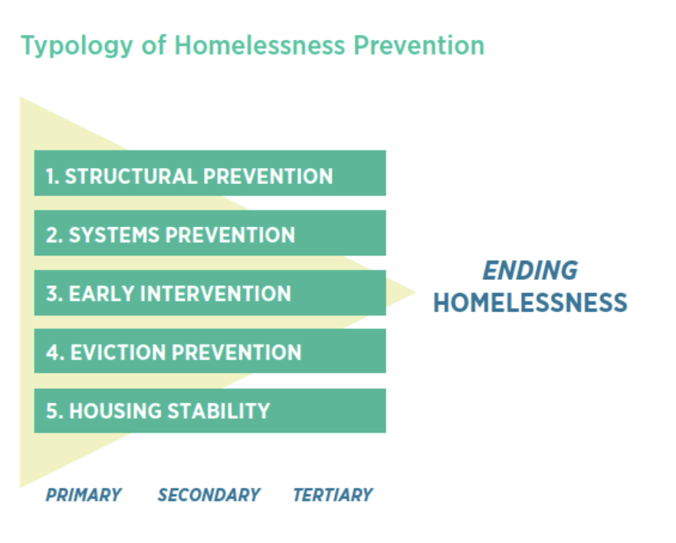
Prevention
Higher rents and higher mortgages mean more evictions
Eviction does not automatically mean homelessness, but clearly a risk
Compound effects of higher housing, energy and food costs
More people living with net negative incomes which again means more risks of eviction

Slide 6

Reducing and ending homelessness
Harder to find affordable, decent housing to resettle people into because housing costs are too high and (where it exists) pressure on social housing increases
Undermines all housing-led and Housing First services
Undermines all staircase/linear supported housing
Individuals and families trying to exit homelessness face higher housing costs
And a greater risk of net negative incomes causing repeat homelessness because housing, energy and food costs are all increasing at once

Slide 7

Risks to services
Real risks that increases in energy, food and wider inflation has and will cause at least some European homelessness services to close their doors
Even if energy costs stabilise and fall back, as now seems to be happening, they are still much higher than before
Same story for food costs for some services
But of course one of the main issues here is staffing and volunteer time, can services pay enough to retain their staff and can they count on people volunteering?

Slide 8
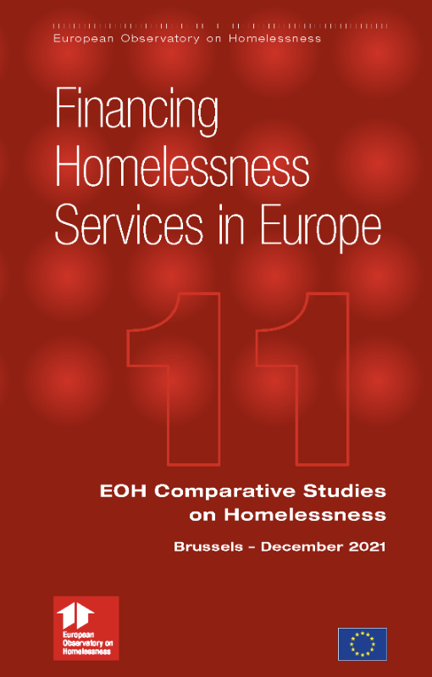
Solutions
The reality is that European homelessness services are all too often precariously and insufficiently funded
Too often do not have reliable sources of funding for sustained periods making it hard to plan
And often there is just not enough money
Homelessness services are too often disproportionately vulnerable to the cost of living crisis
Fixing the funding of all European homelessness services, not short term measures, is the best answer

Slide 9
Thanks for listening
Professor Nicholas Pleace
Interdisciplinary Research Champion
Director, Centre for Housing Policy
School for Business and Society
Notes:
In Slide Show mode, select the arrows to visit links.

