Slide 1
Ukrainian refugee crisis: Situation in Poland
ROZWIĄZANIE PROBLEMU BEZDOMNOŚCI JEST MOŻLIWE!

Slide 2
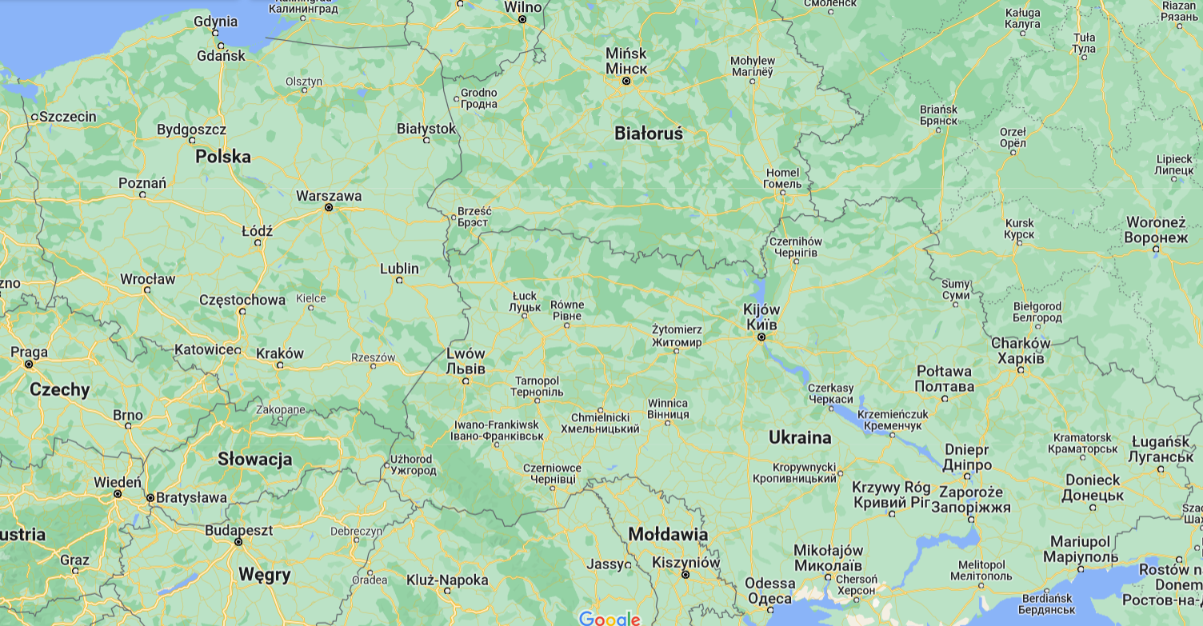
14 million people fled their homes in Ukraine
Up to 7 million left for neigbouring countries
3.6 million went to Poland
UNHCR estimations
Gdansk
Szczecin
Poznan
Warsaw
Chernihiv
Lodz
Sumy
Wroclaw
Lublin
Lutsk
Rivne
Kharkiv
Katowice
Poltava
Rzeszow
Lviv
Krakow
Kyiv
Kramatorsk
Dnipro
Ivano-Frankivsk
Uzhhorod
Mikolaiv
Melitopol
Kherson
Mariupol

Slide 3
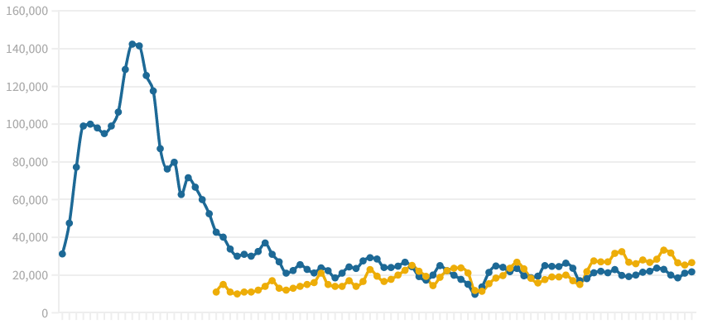
Refugees influx
Current influx: ca. 20,000 people / day
Est. 0.3 - 0.4 million
Feb Mar Apr May
3.6 million
refugees
Other neighbouring countries:
unknown
1.0 million
0.9 million
0.7 million
0.5 million
0.4 million
0.03 million
& others
1.1 million registered with Polish personal ID numer (PESEL)
Significant number unregistered living with pre-war diaspora
Estimated 1.5 - 2.0 million refugees currently in Poland
Est. 1.6 million went back
but inclunding some of the estimated 1 million pre-war diaspora who went to fight
ROZWIĄZANIE PROBLEMU BEZDOMNOŚCI JEST MOŻLIWE!

Slide 4
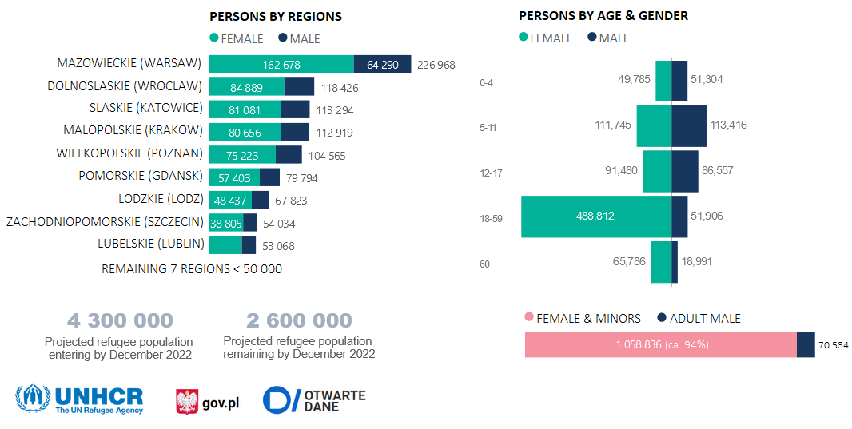
Key population statistics
ROZWIĄZANIE PROBLEMU BEZDOMNOŚCI JEST MOŻLIWE!

Slide 5
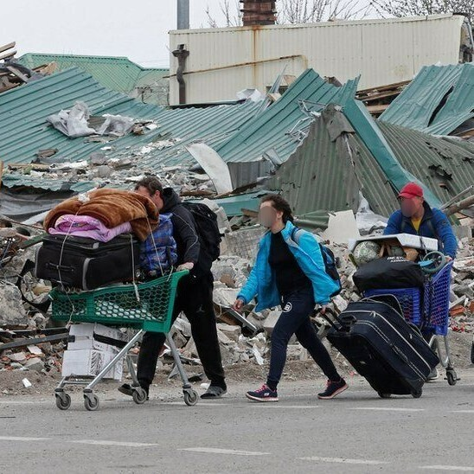
Initial response
Great citizens’ solidarity (housing, volunteers, in-kind, money)
Reception & information at railway/bus stations
In-kind suport for refugees and for Ukraine:
food, hygiene products, baby products, toys, mobile phones, equipment for disabled, medicines, paramilitary gear - helmets, bulletproof vests, dressing etc.
Temporary shelters (currently 1-2% refugees):
railway stations, school gyms, sport & exhibition halls, commercial spaces (largest: 5 000 beds), many others incl. homeless infrastucture; no open-air refugee camps
Social, medical, psychological and legal support
Relocation & housing:
private cars
solidarity housing
hotels and other tourism infrastucture
Ukrainian diaspora
…only partially traced
Homeless people helping; refugees helping
ROZWIĄZANIE PROBLEMU BEZDOMNOŚCI JEST MOŻLIWE!

Slide 6
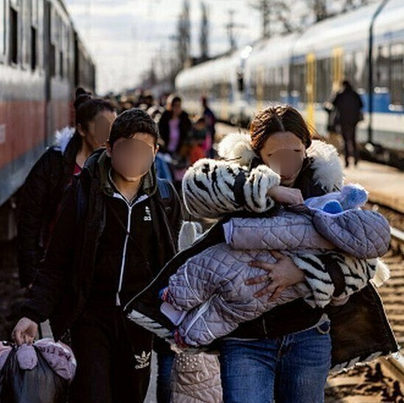
Public authorities’ reaction
Open border, no visa or COVID-19 control (Schengen)
Legal stay for 18 months (notification to border guards)
Polish personal ID number
Access to labour market, health care & medicines, education and child care, social welfare benefits (500+) - equal as Polish citizens
Infolines in Ukrainian & Russian
Relocation - special trains & buses (within PL and to EU), free travel on express trains, public transport in most cities
One-off allowance for each refugee - €60
Financial suport for solidarity housing - €8/d, 120 days
Easier procedures to access/provide aid and other services (including public procurement)
Financial suport for NGOs
Regional/municipal coordination
ROZWIĄZANIE PROBLEMU BEZDOMNOŚCI JEST MOŻLIWE!

Slide 7
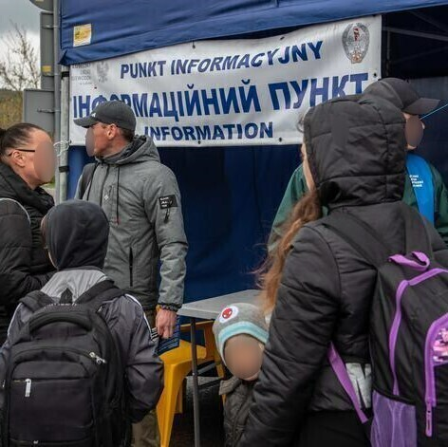
Needs & problems
Most needed now:
Information & counselling
Multi-disciplinary support for vulnerable (probably majority)
Housing (& services)
Staff
PTSD
People with chronic diseases, disabilities, mental problems, social exclusion (Roma refugees!)
Children without guardians
Child care / Education (only partly possible online)
GBV and other family disfunctions
Difficulties at labour market in smaller municipalities
"Over-education"
Low interest in learning Polish
Est. 10% in employment
Voluntary help and financing streams shrinking
ROZWIĄZANIE PROBLEMU BEZDOMNOŚCI JEST MOŻLIWE!

Slide 8
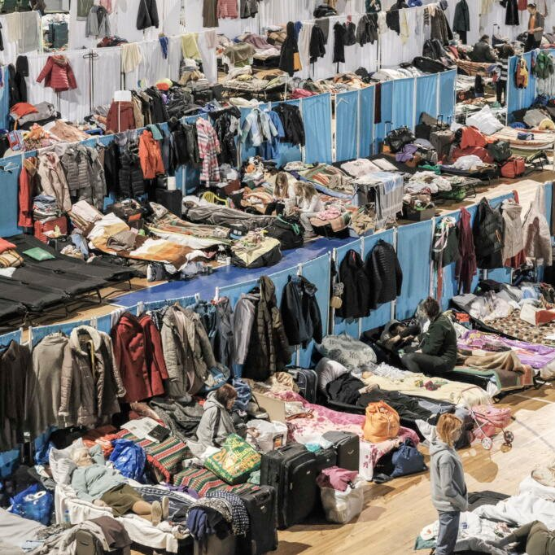
Housing situation
Housing situation in PL grim even before the war
No major government/municipal initiatives (SRAs announced as response, but so far it didn’t happen)
NGOs capable only of minor housing initiatives
Still waiting for EU’s response (where is CARE?); UNHCR active
Fatigue among solidarity host families
Hotels want to host tourists for summer
Rents went through the roof (25-33% in first 2 weeks), private rental market drained, affecting PL citizens too (+ inflation)
…political problem!
Minimum wage is not enough to pay rent in major cities
Refugees staying in temporary shelter much longer than planned, esp. vulnerable groups;
Number of people returning to temporary shelter raising
Major humanitarian crisis still possible
So far no rough sleeping refugees reported (but…)
Influence on Polish homeless population (housing, charity)
Growing number of rough sleepers and extremely poor in housing
ROZWIĄZANIE PROBLEMU BEZDOMNOŚCI JEST MOŻLIWE!

Slide 9
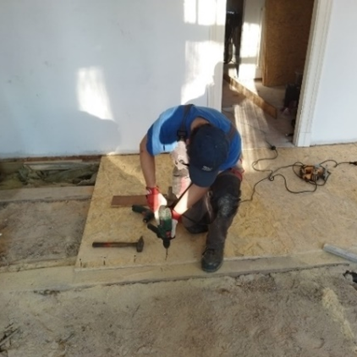
What we do now?
Reception
Shelter & housing:
beds in existing homeless shelters & hostels
temporary shelters for refugees (running or providing on-site services)
existing supported housing usage
renovating municipal stock & unused buildings (v. small numbers!)
Food, clothes, other in-kind help (incl. to UA)
Social, legal, medical, psychological suport
Language courses, translations
Day-care for children, education support
Ambulance transports for ill, disabled, wounded (incl. from UA & to EU)
Employment aid (also in refugee services & social enterprises)
Integration & cultural events
Fundraising
Ideas for mid/long-term solutions
ROZWIĄZANIE PROBLEMU BEZDOMNOŚCI JEST MOŻLIWE!

Slide 10
UNHCR WG-H advocacy outline
Challenges in housing context: (1) rising cost of construction; (2) narrow rental market; (3) long waiting list for social housing – will cause tensions if focus is only on refugee housing
Mid-term housing options:
social rental agency: encourage this option with municipalities
incentives for land/property owners to make their investment properties available to refugees
housing subsidies / supplements at national level
readaptation of old/vacant buildings
Longer-term housing options and advocacy points (new construction):
use existing housing stock that is empty or underutilized
flats for land mechanism – municipality may sell land to a developer and a developer can provide flats to the municipality
more partnerships between public sector and private developers; encourage central government to provide incentives to developers (e.g. low-cost long-term loans); faster administrative procedures for faster housing construction
any new housing stock should be connected to education, job, health and other services to provide access to livelihood opportunities
better inter sectoral coordination
ROZWIĄZANIE PROBLEMU BEZDOMNOŚCI JEST MOŻLIWE!

Slide 11
Thank you for your attention jakub.wilczek@tpba.pl
ROZWIĄZANIE PROBLEMU BEZDOMNOŚCI JEST MOŻLIWE!

