Slide 1
Climate Change, homelessness and health
Dr Shakoor Hajat
Centre on Climate Change and Planetary Health
London School of Hygiene & Tropical Medicine
shakoor.hajat@lshtm.ac.uk

Slide 2
Climate change and homelessness
Migration
Exposure
Identified by IPCC as emergent climate risk
Loss of homes/livelihoods due to extreme weather events, water stress, crop failure, sea-level rise
Cross-border migration and implications for host countries on European agenda
Most climate-related displacement likely to be internal
Poorest groups may not be able to relocate, so consequences for trapped populations also very important
People who are homeless are those most exposed to ambient temperature and other weather conditions.
Existing physical and mental health problems
Reduced access to healthcare services
Very limited evidence-base of health impacts of climate variability and climate change in homeless groups

Slide 3
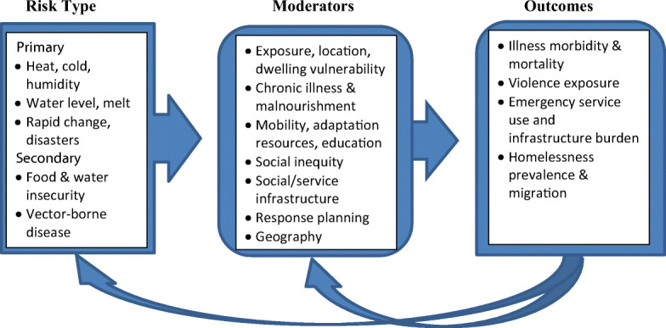
Hypothetical model for climate, homelessness and health pathways
Kidd et al,
J Urban Health

Slide 4
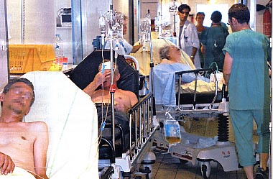
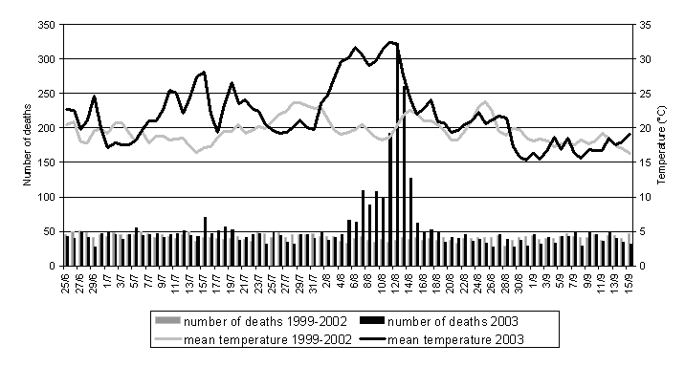

France, August 2003 ~15000 excess deaths
(~70,000 in Europe) Robine et al
European summer temperatures for 2003 to become the norm by 2030s

Slide 5

Vulnerability to heat and cold exposure
Both heat and cold responsible for considerable annual health burdens in the general population in most countries.
Heat illness heightened by common risk factors:
- underlying physical and mental health conditions
- drug and alcohol dependencies
- lack of access to air-conditioned environments
- social isolation
Homeless groups largely neglected in public health protection plans.
Exposed to increasingly higher ambient temperature, particularly in big cities.

Slide 6
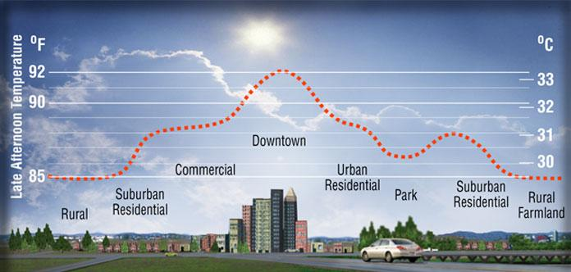
The Urban Heat Island Effect

Slide 7
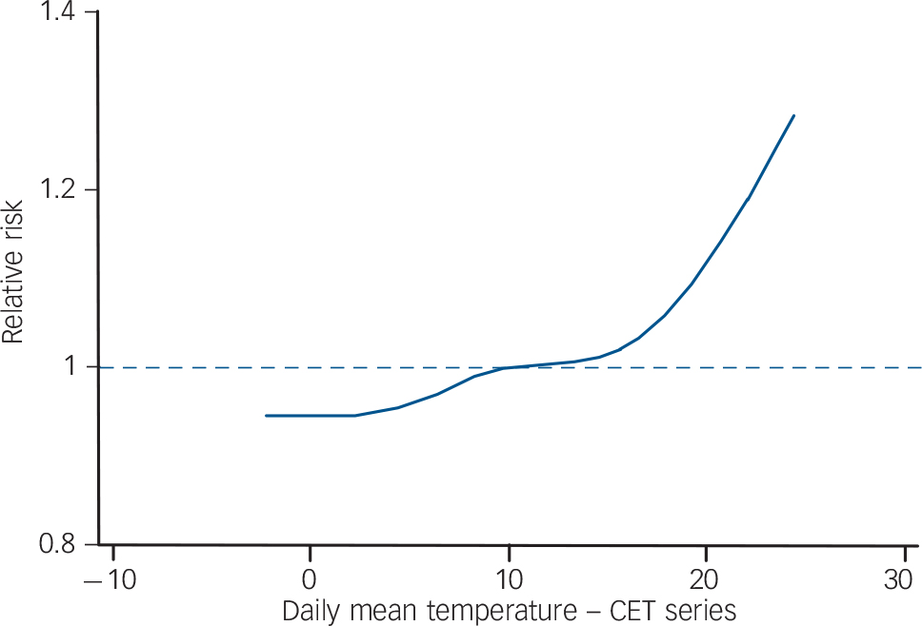
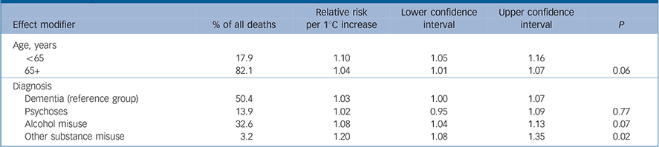
Heat-related deaths in people with psychosis, dementia and substance misuse
Epidemiologic analysis of deaths in England in patients with psychosis, dementia or substance misuse
Data from a nationally representative primary care cohort study.
Younger patients and those with a primary diagnosis of substance misuse had greatest mortality risk
Page et al,
Br J Psychiatry

Slide 8
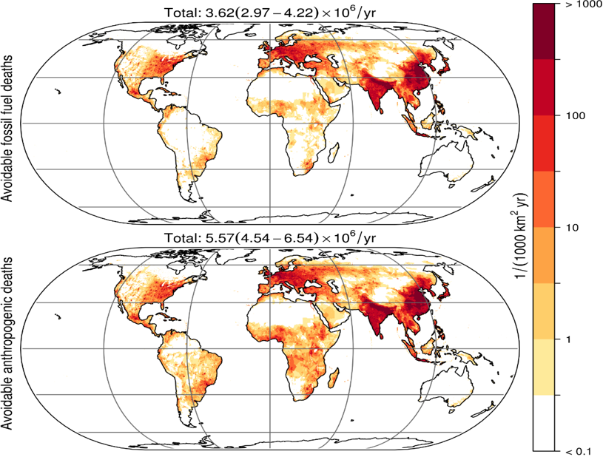
Health co-benefits of decarbonizing the world economy-millions of deaths averted annually (Lelieveld et al, 2019 )
Phase-out of fossil fuels would avoid excess mortality of ~350,000 persons/year in EU-28

Slide 9
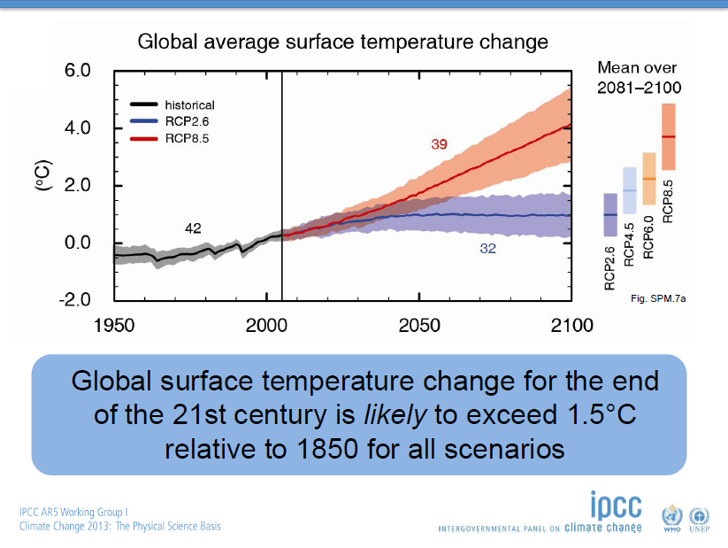
Global average surface temperature change

Slide 10
Policy implications of climate-related migration and exposure in homeless populations
Climate change adaptation measures are an essential complement to emissions mitigation policies.
Housing is a key determinant of general health and climate change resilience. Once lost, problems in all areas compound
Costs and complexities of intervening increase rapidly the further systems engage along the time course. Prevention far more efficient than crisis response
Concrete steps include the development of a national housing strategy, enabling and incentivising cross-sectoral and jurisdictional collaborations
More immediate measures should include improving the quality of temporary accommodation, the provision of warming and cooling centres, and public access to clean drinking water
Organisations working with homeless need to be funded and enabled to coordinate outreach activities during extreme weather
Important to recognise local contexts

Slide 11
Climate change and homelessness
Globally, climate change is contributing to the prevalence of homelessness through housing loss, migration, poverty, and other intersecting stressors (e.g. conflict)
Homeless/vulnerably-housed populations are disproportionately exposed to climatic events, but currently lack of empirical evidence of climate impacts on such groups
Homeless often overlooked in public health measures, disaster planning and other risk mitigation efforts (e.g. green urban infrastructure). Inclusion and equity in crisis response requires advocacy
Efforts to intervene should concentrate on systemic responses to inadequate housing
Transition to green economy provides opportunities as well as risks for homeless groups

Slide 12
The Global Climate-Homelessness Network
A network based out of the Centre for Addiction and Mental Health in Toronto, Canada that focuses on the health implications of climate change for homeless and precariously housed populations globally.
Objective of the network: provide policy, service, and research direction drawing on the best available evidence and expertise.
Members are experts in policy, service and system design, and policy leadership.

Slide 13
The Global Climate-Homelessness Network – Areas of Concentration
Main issues:
  Exposure (e.g., heat, cold, air pollution)
  Migration (e.g., loss of housing, food and water insecurity)
Key activities:
  Academic publications (e.g., systematic reviews, commentaries)
  Think tanks
  Dissemination (newspaper articles and blogs, webinars, and conferences)
  Response framework development
  For more see: https://www.homelesshub.ca/climate-homelessness

