Slide 1
FEANTSA Conference 2022 Working with cities: housing solutions to specific urban challenges Newcastle’s rights based approach to preventing homelessness

Slide 2
“Newcastle’s approach has prevented over 24,000 households from becoming homeless since 2014.”
Judging panel, World Habitat Gold Award 2020

Slide 3
We have not used B&B to meet our statutory homeless duties since 2006 – prevention saves lives & money

Slide 4
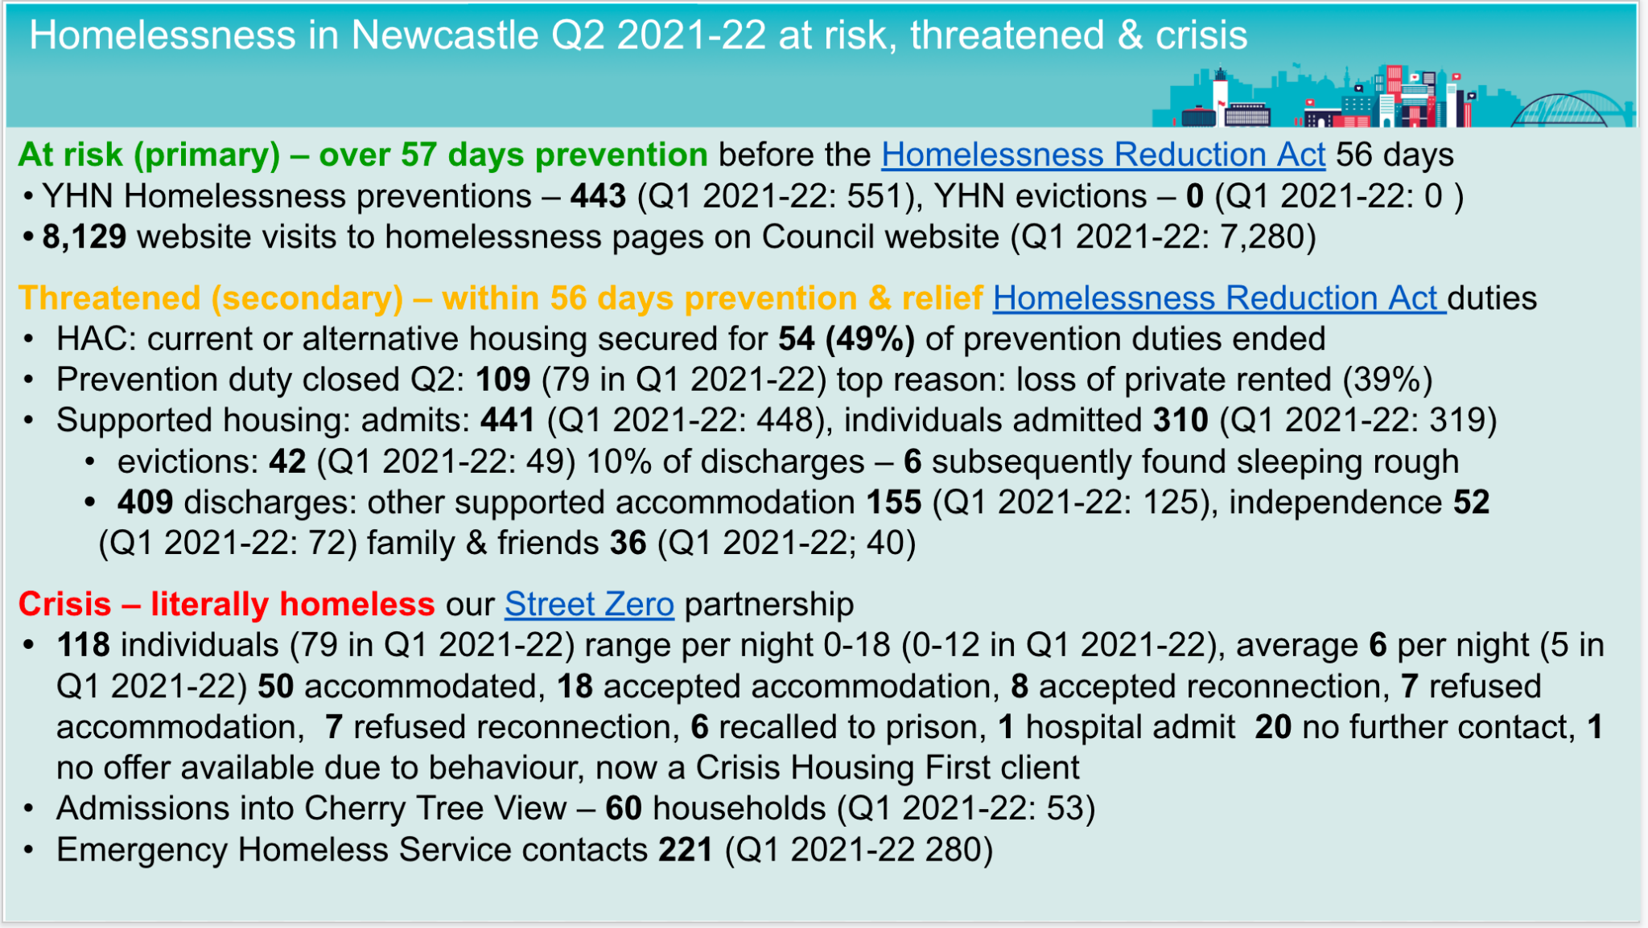
Newcastle context
December 2021, children in temporary accommodation
Birmingham
7,735
0.6% of population
Manchester
3,506
0.6% of population
Newcastle
41
0.01% of population

Slide 5
Newcastle context
Why prevention matters to mitigate poverty & trauma related crisis
Annual loss in working age benefits
£105m
Estimated by the end of 2026-27
Reduction in Newcastle City Council’s budget
£345m
Estimated by 2023
Residents fed by the West End Foodbank
51,371
2021
Residents on Universal Credit
33,869
47% increase from Mar 2020 to Feb 2022
The challenges for a city of 300,000 & the role of the local state as the national state withdraws

Slide 6
We aim to make it everyone’s business to prevent homelessness & financial exclusion
By coordinating support for residents to have the foundations for a stable LIFE
L
Somewhere to Live
Suitable & sustainable homes
I
An Income
Financial stability
F
Financial inclusion
Life without excessive debt
E
Employment
Inclusive economy

Slide 7
“The lived experience of homelessness & inadequate housing, challenges the very core of what it means to be human, assaulting dignity & threatening life itself”
- Leilani Farha

Slide 8
A change in theory
From responding to current crisis -> Preventing a future crisis
From a welfare safety net to catch people when they fall to preventing people from falling

Slide 9
A change in practice
Make prevention visible, timely & consensual
Learning from every crisis, knowing people’s names, understanding their problems, incentivising prevention, matching supply to demand & facilitating fairness
Adopting local policy eg no evictions into homelessness & Standard Financial Statement to meet local aims & context

Slide 10
How we do it
Committed political leadership
Set the right conditions & incentivise partnership working
Understand demand & be guided by evidence
Deliver flexibly & be proactive & innovate
Have a curious & questioning mindset – focused on the best outcomes for people

Slide 11
How we do it
Committed political leadership
Set the right conditions & incentivise partnership working
Understand demand & be guided by evidence
Deliver flexibly & be proactive & innovate
Have a curious & questioning mindset – focused on the best outcomes for people

Slide 12
Committed political leadership & resource allocation
27,789 council homes, 764 supported housing rooms, 99 dedicated move on flats, daily outreach
Clarity of purpose & aims
Off the street
Rare, no one sleeps rough or returns to the street
Into a home
Brief, no B&B, limited time in homelessness accommodation
Sustain a home
Nonrecurring, no evictions into homelessness
Notes:
Committed political leadership
Political leadership [insert 30 words]
Politically controlled housing stock [insert 30 words]

Slide 13
How we do it
Committed political leadership
Set the right conditions & incentivise partnership working
Understand demand & be guided by evidence
Deliver flexibly, be proactive & innovate
Have a curious & questioning mindset – focused on the best outcomes for people

Slide 14
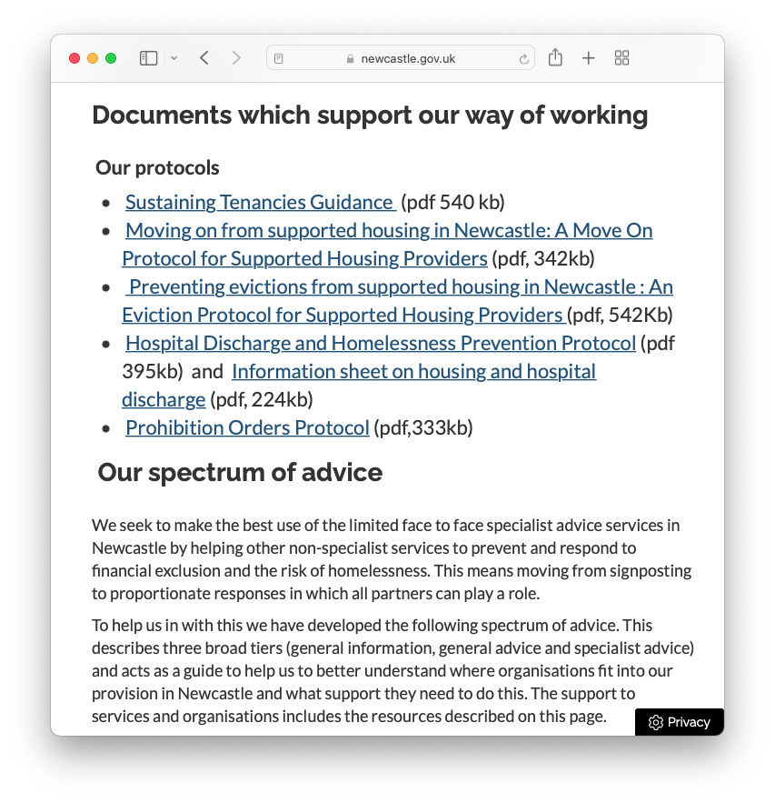
Align budget process & develop citywide consensus
Provide policies, protocols & infrastructure support
Governance at the strategic, delivery & case levels –panels for collective decisions, compromise & learning
[image goes here]
Notes:
Set the right conditions and incentivise partnership working
Align budget process - to support vulnerable and prevent crisis
Develop citywide consensus - Routinely monitoring and reviewing with partners to identify opportunities for improvement and innovation
Provide protocols - agreed ways of working that give consistent governance and practice
Provide infrastructure support - information, training and workforce development to help partners who are not specialists in financial inclusion and homelessness prevention to identify risk and act to prevent crisis, rather than just to refer to crisis services

Slide 15
How we do it
Committed political leadership
Set the right conditions & incentivise partnership working
Understand demand & be guided by evidence
Deliver flexibly, be proactive & innovate
Have a curious & questioning mindset – focused on the best outcomes for people

Slide 16
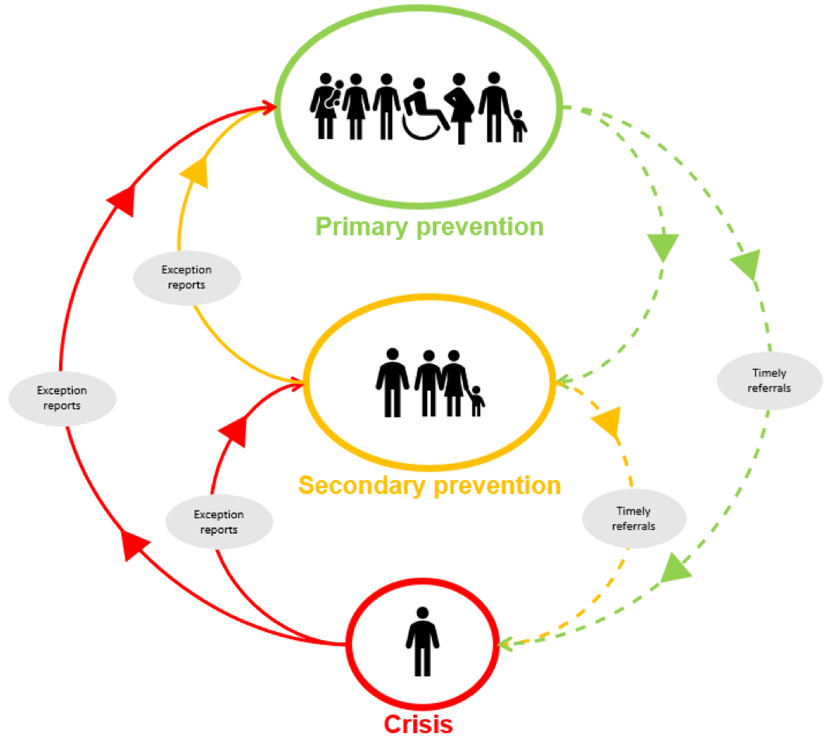
Segment need to understand demand & supply at the case, delivery & strategic levels
Maximise the value of touch & trigger points
Quarterly reviews & feedback loops for learning to find prevention opportunities
Notes:
Understand demand and be guided by evidence
Segment need - to provide proportionate, personally relevant and cost-effective responses
Understand local impact - considering the balance of individual, systemic & structural causes of exclusion based on context and LIFE courses.
Maximise the value of touch points & trigger points - to continually learn and improve
Collaborating to prevent crisis: information, training, research, reviews, policy, protocols, commissioning & governance
Targeting specialist advice & support
Feedback loops exception & escalation reports, to identify prevention opportunities
Catching residents if we fail to prevent crisis & learn

Slide 17
Complex systems
Understanding & connecting with residents' touch & trigger points in 2021-22
Residents advised
27,555
Homelessness prevention cases
4,569
Residents helped to secure funds
19,360
To secure £20,276,427
Debt advice cases
3,452
Website visits
92,994
Info subscribers
3,586
Individuals found sleeping rough
250
YHN evictions from 27,000 tenancies
0

Slide 18
How we do it
Committed political leadership
Set the right conditions & incentivise partnership working
Understand demand & be guided by evidence
Deliver flexibly, be proactive & innovate
Have a curious & questioning mindset – focused on the best outcomes for people

Slide 19
Provide accessible, coordinated information & advice services
Adapt core council services & provide targeted support
Learn from crisis & pilots, to find what works
The Active Inclusion multidisciplinary team
Somewhere to live
An income
Financial inclusion
Employment opportunities
Housing Specialist
Lucy L
Welfare Rights Specialist
Jo
Debt & Budgeting Specialist
Lucy K
Employment Specialist
Denise
Early Help Specialist
Sultana
Notes:
Deliver flexibly and be proactive
Provide universal, open access, information and advice services - to prevent residents becoming more vulnerable and catch residents who are ‘not known’ to be at risk
Adapt core council services and provide targeted support - to shield the most vulnerable and to prevent crisis
Provide systematic exception reporting & feedback loops - to support collective reviews of why we haven’t prevented financial exclusion or homelessness

Slide 20
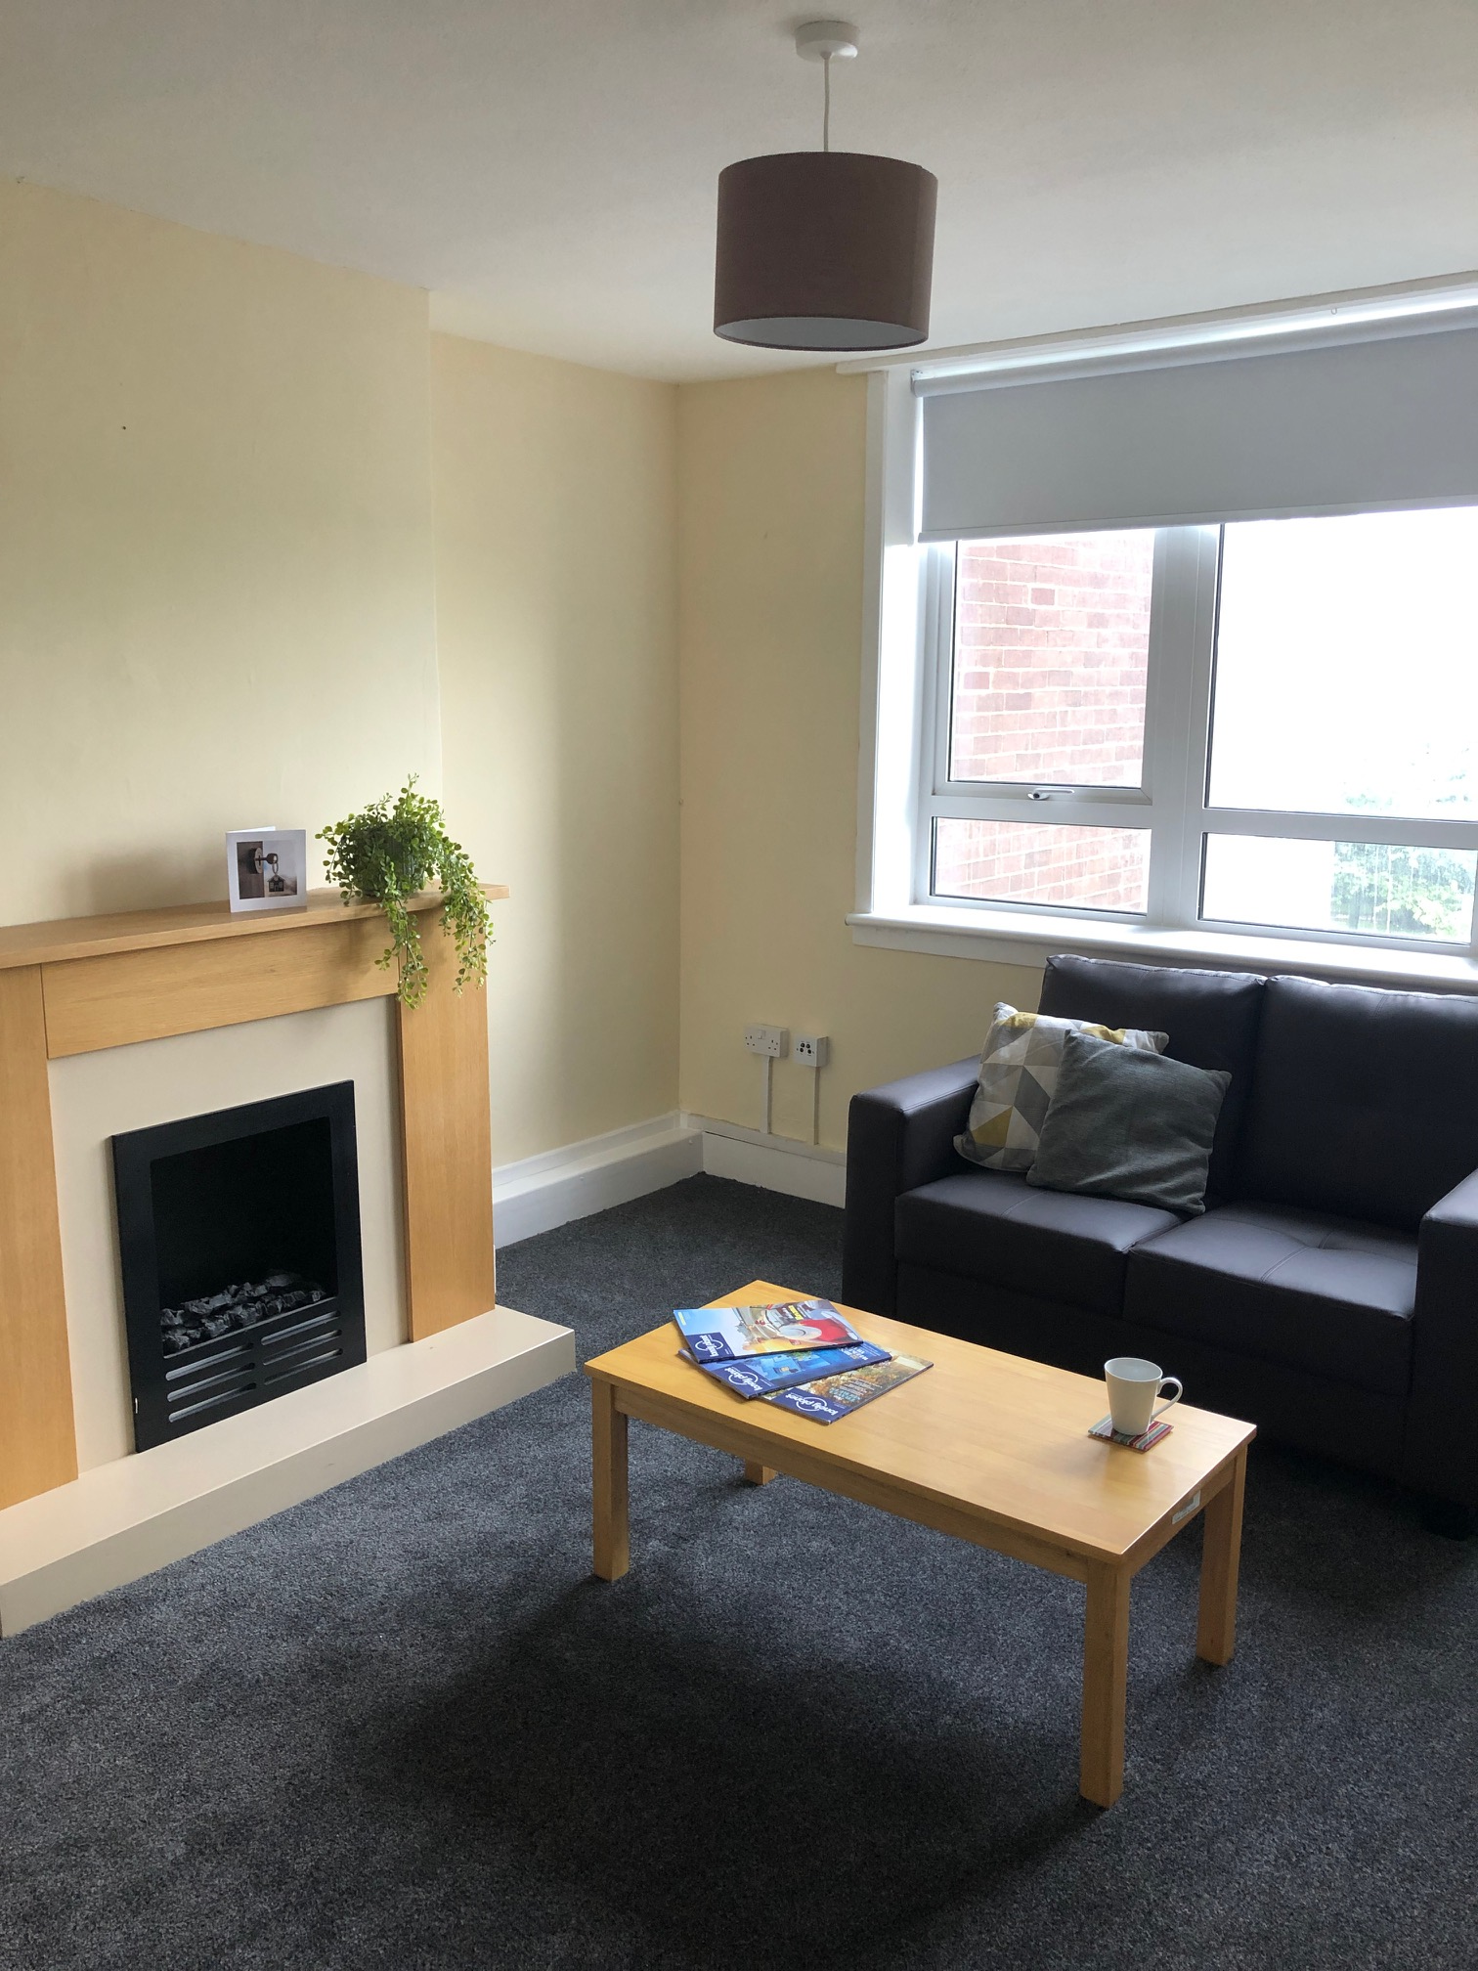
Bringing back long term voids – ready for living
‘I feel like I have a home for the first time since I was 16 or 17’ ‘M’ age 35
Started Jan 2021
Average void time 3.1 years, rent loss £647,732
40 voids, 38 in multistorey blocks & 2 flats, 10 more planned
Weekly allocation meetings: shared decisions, compromises & learning
1:10 ratio of support workers to customers
Client led & psychologically informed
Just 4 terminations from the project

Slide 21
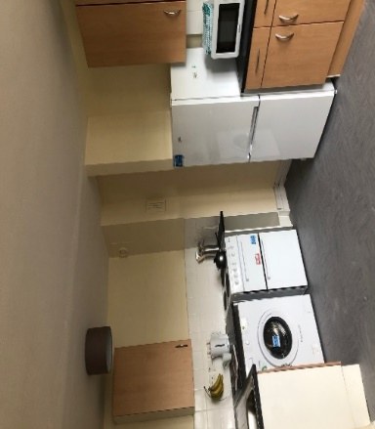
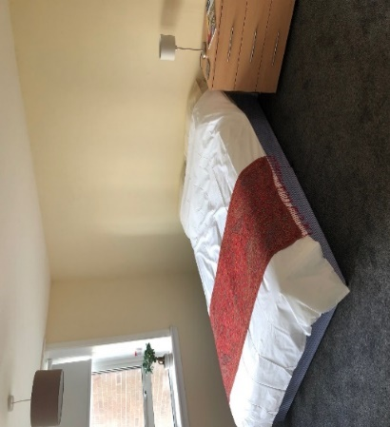
Rough sleeping: good quality homes & support
Weekly Move On Panel
Hostel referred B to RSAP who believed that B would benefit from own accommodation
Unable to have contact with child due to accommodation
I just want a place of my own where I can see my child
History of placements in short term relief accommodation
YHN RSAP Support & Progression Worker
Motivational support
Contacted B to offer property, reluctantly agreed to view the property, seeing it furnished & decorated reduced some of his concerns about moving in
Assisted B to set up the tenancy & how to manage the bills now living independently
Supported B at child protection meetings where it was agreed contact with child could go ahead now he had a safe independent place to live
Enrolled on DWP Work Programme
History of rough sleeping
I’m ready to live on my own, but nervous about coping
Non qualifying for YHN
Living in hostels is difficult as I’m trying not to drink / use drugs anymore
Mental health issues
Substance misuse issues
Offending background
4 months on
Offered a job at the end of Work Programme
Opened first bank account & obtained id
Mental health has stabilised
Has daily contact with child
“ his child coming home has been the motivation he needed & RSAP has meant that this is now possible”

Slide 22
How we do it
Committed political leadership
Set the right conditions & incentivise partnership working
Understand demand & be guided by evidence
Deliver flexibly, be proactive & innovate
Have a curious & questioning mindset – focused on the best outcomes for people

Slide 23
Abstract, distant & contested to visible, timely & consensual
Sense Making
Weekly sign off advocacy partners & voluntary groups
Homeless & Financial Inclusion Quarterly Reviews
Exception reporting / reviews & complaints / escalation process
Panels
Move-on,
Sustaining Tenancies
Housing First,
Complex Case
CHI
what works trailblazer
Touch & trigger points – where people go
Case based: named real people, in real time
Conclusive
Proactive
Accountable
Structured
Learning loops not silver bullets
Mindsets, policies & services

Slide 24
Cherry Tree View
Cherry Tree View
“A place of comfort & kindness… the facilities were not shared & I had freedom to be alone & collect my mind & thoughts”
Notes:
Have a curious and questioning mindset
Follow the thread back and for between the case, management and strategic levels.
Identifying potential risk related to demand and act to prevent crisis with urgency and tenacity
not everyone has the how do you get a quart into a pint mindset eg if a caseworker is supporting a large family and we haven’t got enough large family accommodation then prioritising what can be done to solve the problem.
Mindsets that are outcome focused, conclusive and want to bridge the gap between the policy statement and actions to make a material difference to residents.

Slide 25
Newcastle’s rights based approach to preventing homelessness
Committed political leadership
Set the right conditions & incentivise partnership working
Understand demand & be guided by evidence
Deliver flexibly, be proactive & innovate
Have a curious & questioning mindset – focused on the best outcomes for people

Slide 26
Thank you.
neil.munslow@newcastle.gov.uk
Links:
Heriot-Watt: Homelessness Prevention in Newcastle
Homelessness & Rough Sleeping Strategy
Homelessness
Financial Inclusion
Email: activeinclusion@newcastle.gov.uk
Neil Munslow

