Slide 1










Mental Wellbeing of Frontline Workers
FEANTSA POLICY CONFERENCE 2022
Towards a Vision for Ending Homelessness

Slide 2
What is Trauma Informed Practice?
Trauma-informed care practice training attempts to reframe client behaviour relative to trauma and its impact, while increasing staff awareness of their behaviours, attitudes and values.
Trauma-informed services understand the widespread impact of trauma, including the individual psychological changes that trauma survivors may endure, and such services incorporate this understanding and awareness into daily working practices and organisational standards.

Slide 3
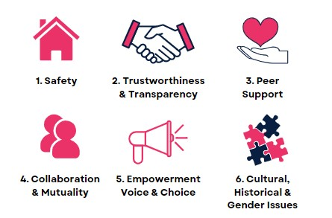

WHAT IS TRAUMA INFORMED PRACTICE?

Slide 4
WHY DID NOVAS IMPLEMENT TIP?
ACES, Trauma and Irish people in homeless and drugs services
13% of people in general population have 4 or more ACESs but 77% of homeless population in research
35% - 42% childhood sexual abuse
71% - 74% substance misuse in the family home
Significant levels of adult domestic violence survival (96%) among women using services

Slide 5
WHY DID NOVAS IMPLEMENT TIP
Why, despite our best intentions, and desire to heal, do we still get it wrong so often?
How do we miss trauma triggers and so fail service users with the most needs?

Slide 6
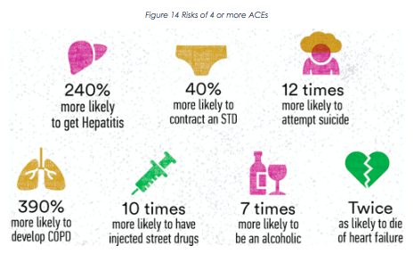
RISK ASSOCIATED WITH 4+ ACES

Slide 7
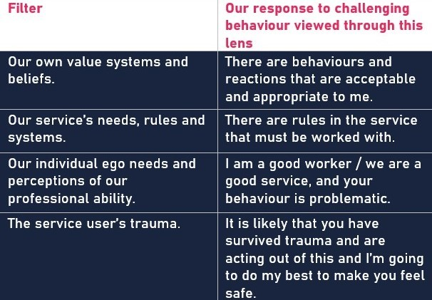
ADDING THE TRAUMA FILTER

Slide 8
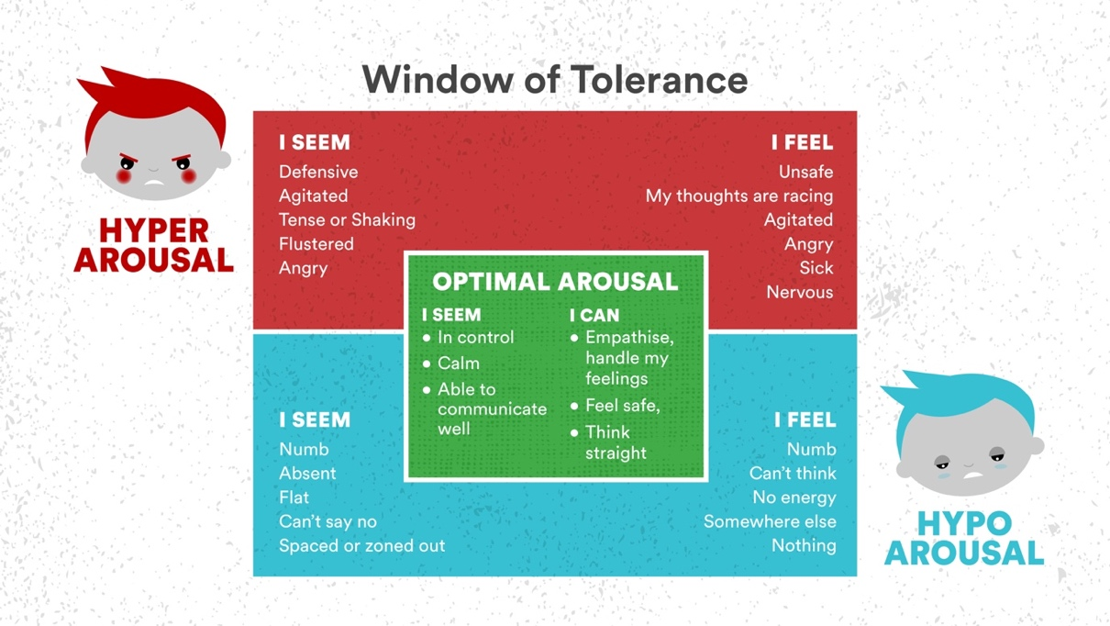
ADDING THE TRAUMA FILTER

Slide 9
TRAUMA INFORMED PRATICE DEVELOPMENT TIMELINE
2021 –
  TIP Refresher training developed for frontline staff
  TIP Service Champions recruited
2022 –
  TIP service champions trained and programme rolled out (ongoing)
  TIP manager training development (Summer 2022)
  Development and ratification of TIP standards (ongoing, close to completion)
  First service Audit (July 2022)
2017 – Trauma Informed Practice social enterprise & training development
2018/2019 – All NOVAS staff trained in TIP.
2020 –
  NOVAS TIP training developed and delivered online
  TIP Steering Committee established

Slide 10
HOW DOES TIP IMPROVE STAFF WELLBEING?
Confidence to deal with challenging behaviour
Opportunity to recognise own trauma, ACE’s, triggers
Recognition of own windows of tolerance
Created a culture of reflection – post-shift, supervisions, team meetings, report
writing & data collection
De-personalised behaviour of clients – understanding of trauma induced behaviours
Created a culture were other supports such as PFA, EAP, Supervisions (direct & external clinical) &
Peer Support are more readily accessed by staff
Reduced number & severity of incidences in low-threshold services

Slide 11
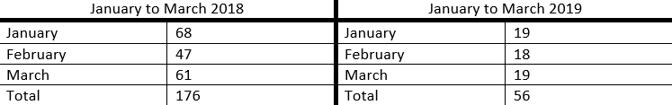
MCGARRY HOUSE INCIDENT LEVELS PRE AND POST TIP

Slide 12
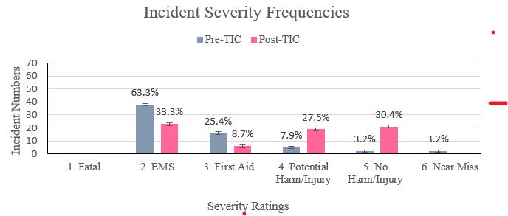
ABIGAIL WOMENS CENTRE PRE AND POST TIP
Third point of measurement of the implementation and efficacy of TIP, up to two years post training
Q4 2020

Slide 13
RETROSPECTIVE OUTCOME EVALUATION
At least 70% reduction in:
Reduction in taking client-related difficulties personally (71%)
Increased confidence in working with service users in distress (86%)
Increased ability to connect with service users in distress (91%)
Increased feelings of compassion towards service users (79%)
Increased ability to separate difficult behaviours from the person (86%)
Increase in feelings of self-compassion (86%)
Increase in being able to pause and reflect (87%)
Increased ability to stop and think before responding (80%)
Increased trust in own instincts / gut (80%)
Increased respect for service users by the team (70%)

Slide 14
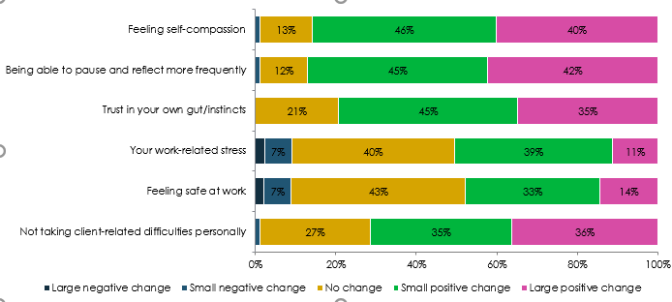
PERCEIVED CHANGES IN ONES FEELINGS ABOUT ONESELF

Slide 15
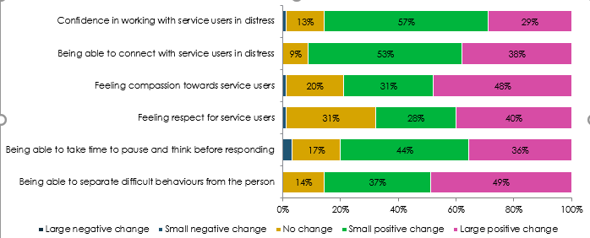
PERCEIVED CHANGES IN RELATION TO STAFF RELATIONSHIPS WITH CLIENTS

Slide 16
THANK YOU FOR YOUR TIME!
ANYONE HAVE ANY QUESTIONS?

