Slide 1



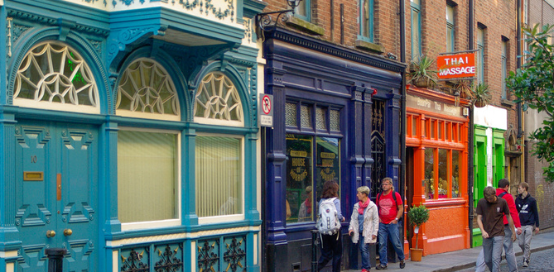

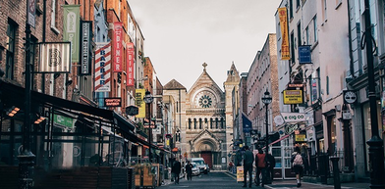
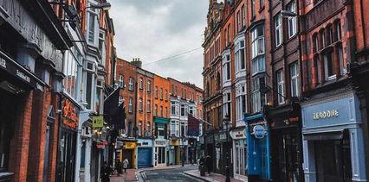

Obstacles to access to housing for irregularly-residing migrants with Housing First profiles
Mauro Striano, Outreach Worker, Infirmiers de Rue
FEANTSA POLICY CONFERENCE 2022
Towards a Vision for Ending Homelessness

Slide 2

Street Nurses
  Social and health organisation that uses hygiene and health as entry doors to access to housing
  Multidisciplinary team: nurses, social assistants, social workers, a general practitioner, and a management team
  1 of the 5 Brussels Housing First providers
  Field work:
    Outreach department: intensive health, social and administrative support of people sleeping rough in order to find stable housing
    Housing department: creation of housing solutions and Housing First support
    My way: social reintegration and well-being for patients who are stabilised and prevention of homelessness

Slide 3
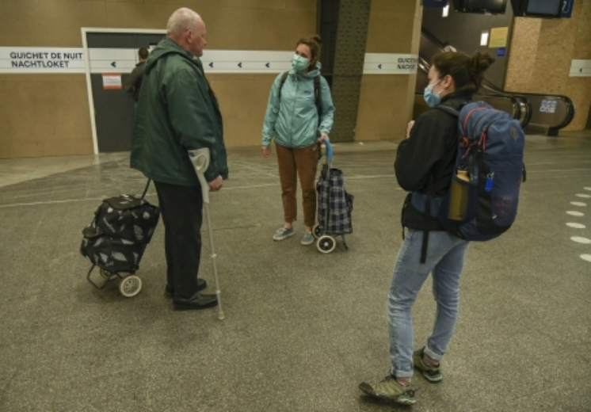
Which profiles?
  Flagging → pre-support → support
  Vulnerability criteria used to identify the most vulnerable:
    Gender
    Age
    Hygienic conditions
    Presence of a chronic disease
    Presence of a mental health issue
    Addiction
    Number of years in the street

Slide 4
Homeless migrants and housing solutions
  Affordable housing solutions captured mainly through social rental agencies and social housing providers
  It depends on the administrative status:
    Third-country nationals and mobile EU citizens with a residence permit: same possibilities as Belgian citizens
    Third-country nationals and mobile EU citizens without a residence permit (max 30% of our patients): emergency accommodation

Slide 5
Regularisation is the key
Case study: Tadeusz
More than 70 years old, arrived in Belgium in 1984, registered in a municipality for almost 5 years, his asylum demand was rejected. First order to leave the territory in 1989.
Worked in Belgium several years without a contract. Lived in an apartment but did not register, then homeless since 2007.
Demand of regularisation in 2009, rejected in 2015.
He could register as EU citizen but lack of address. And even if he had an address: difficult to be registered as job seeker, given his age.
Regularisation for health reasons?
Third-country nationals: mainly rejected asylum seekers or people who entered irregularly. Ways to regularize:
  For exceptional reasons
  For serious health reasons
EU nationals: in theory simpler because of EU free movement law but in practice, for IdR patients, difficult to fulfil the 2004/38 directive criteria → same ways than for TCNs

Slide 6
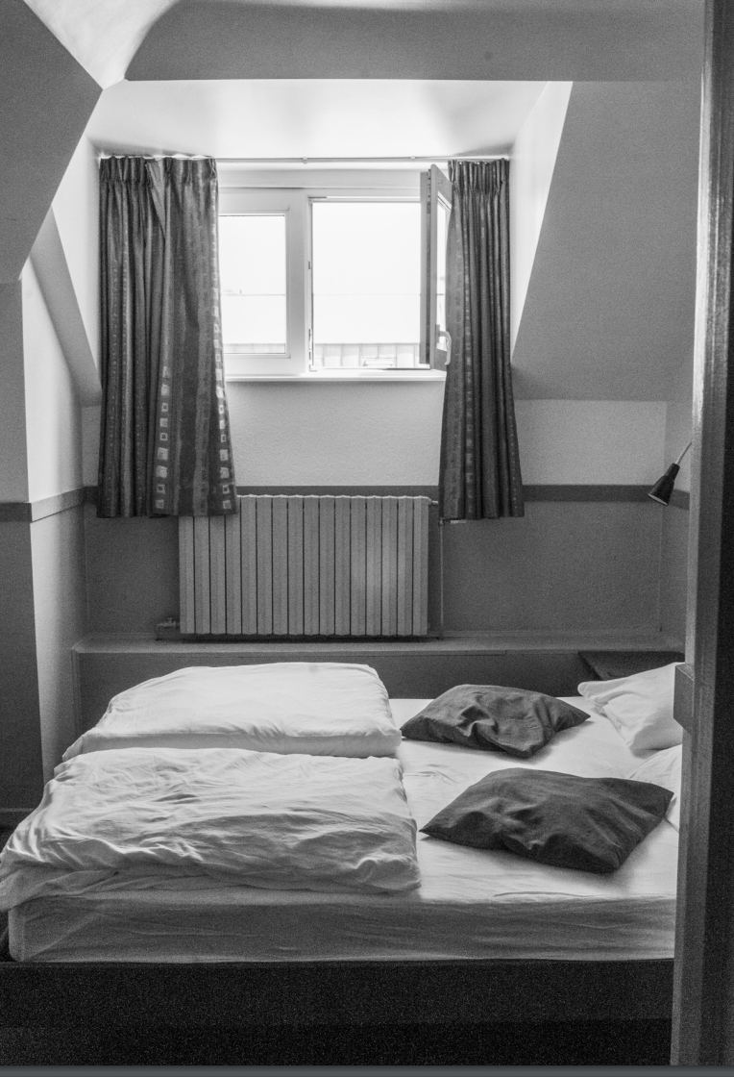
Use of hotel rooms during COVID
Because of the pandemic, use of hotels to host homeless people
June 2020: at least 800 people. One year later 700 people.
In the beginning, low threshold access: no need for an income nor for a residence permit → accessible to irregularly-residing migrants
Positive impact on living conditions and easier for professionals
But no way to register in the hotels –> not possible to regularise the administrative status
Photo: Chloé Thôme

Slide 7
Use of hotel rooms during COVID
Tendency for irregularly-residing migrants to stay for longer periods in the hotels and no way out
Moreover, very challenging to provide support for beneficiaries with Housing First profiles
In June 2021 policy change to get access to hotels: need for an income
Nuanced impact of use of hotel rooms for irregularly-residing migrants, particularly those with Housing First profiles

Slide 8
Transit housing
  Issue project: in the first phase, use of social housing that needed renovation and was provided for free
  One of the target group: beneficiaries with no income, including EU nationals and TCNs with no residence permit
  Useful particularly for mobile EU citizens to access social rights
  But: would that fit with people with different kinds of vulnerabilities and who do not qualify within the scope of directive 2004/38?

Slide 9
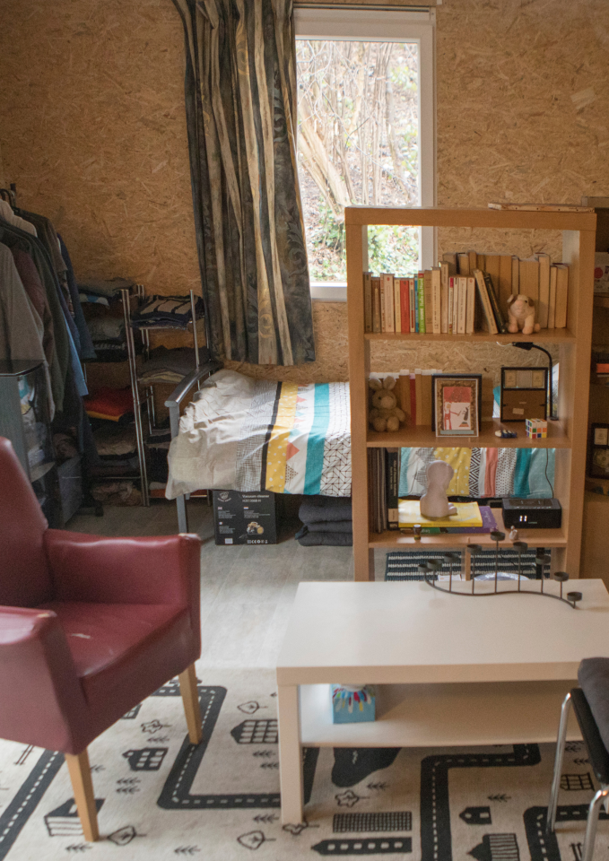
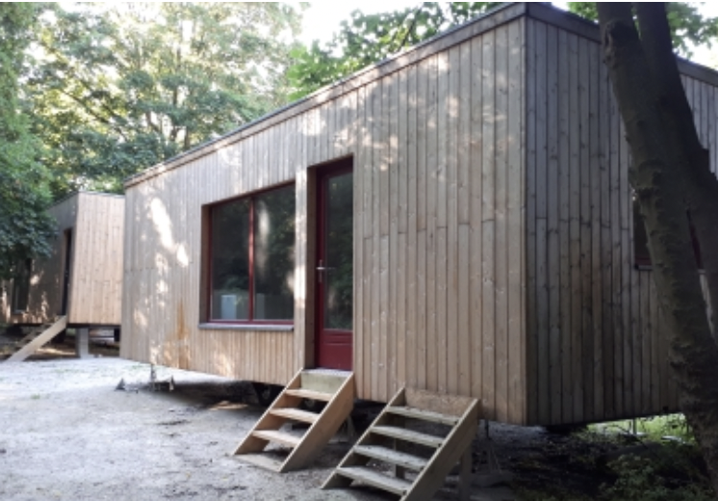
Modular housing?
    Owned or managed by IdR → possibilities to make derogations for irregularly-residing migrants
    Small rent
    Same problem than transit housing: which profile can benefit from this housing solution?

Slide 10
Conclusions
  Available housing solutions are not adequate to irregularly-residing migrants with Housing First profiles
  Regularisation is key to provide housing to our patients
  Available regularisation procedures do not fit with the profiles of our patients
  Need to reflect at EU level about ways to provide solutions for irregularly-residing migrants with very vulnerable profiles in EU migration law and in EU free movement law

