Slide 1
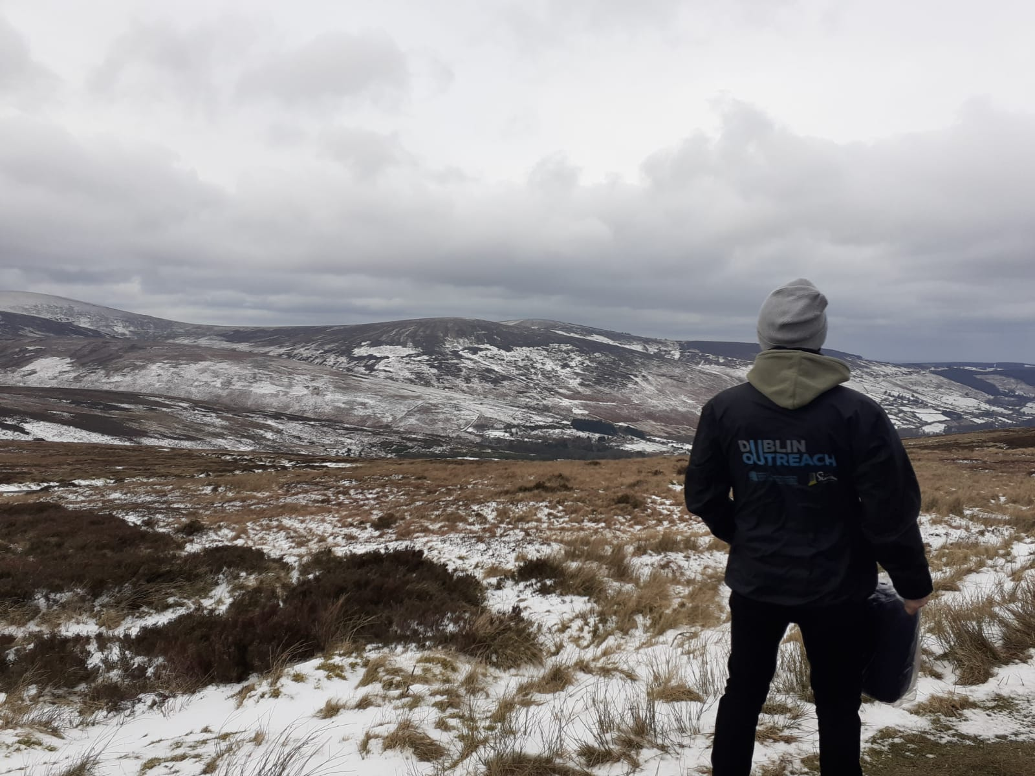

Slide 2
Overview
History
Opening Hours
Team structure
Funding

Slide 3
Rough Sleeping in Dublin
Latest count 94
Tents
4 local authorities= Dublin Region Homeless Executive
Everyone can get placed, even for emergency period

Slide 4
7am-9.30am
Checking hot spots, assertive engagement, alerts.

Slide 5
9.30am -7pm
Alerts
Phone queries
Housing Applications
Appointments
Mobile Health Unit (Wednesdays)
Visiting services
Regional visits
Updating PASS and logs

Slide 6
7pm-1am
Mobile Health Unit (Tuesday and Thursday)
Alerts
Booking beds
Nightly Count

Slide 7
Numbers
1.921 people placed directly in emergency beds in 2021 (placed by Outreach in ring fenced beds).
Over 5,000 contacts per year- 2019,2020 and 2021.
Alerts LAs: 120-150 per month

