Slide 1
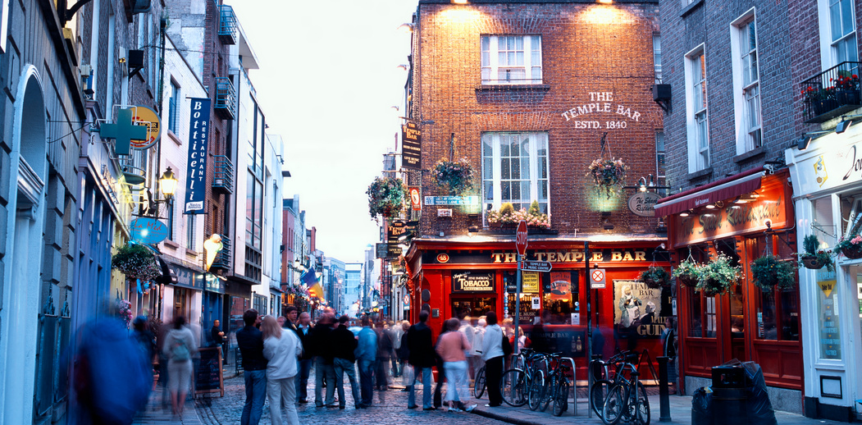
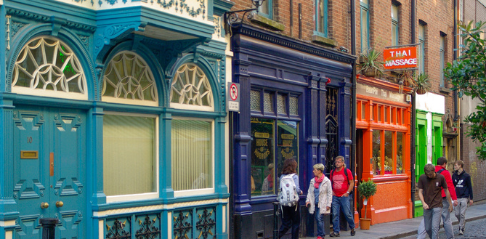
Working with Cities Housing Solutions to Urban Challenges
FEANTSA POLICY CONFERENCE 2022
Towards a Vision for Ending Homelessness

Slide 2
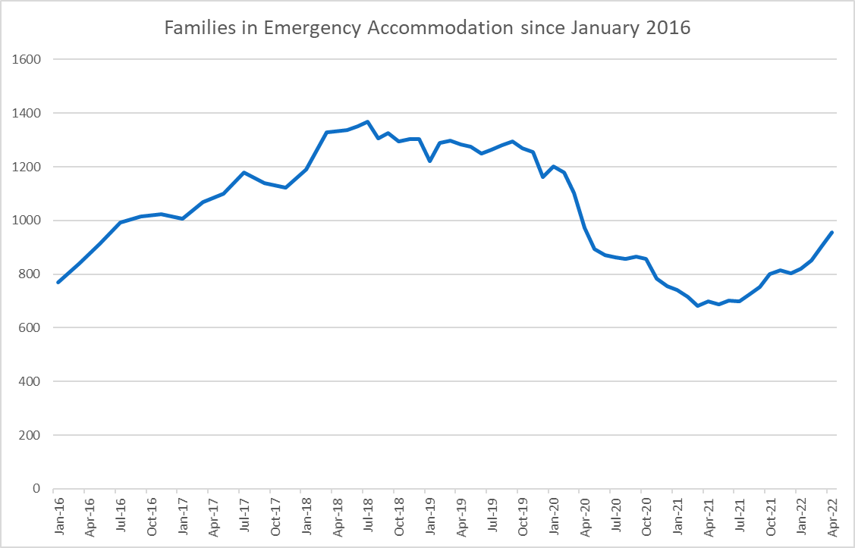
Family Homelessness –
Dublin Region
Peak Family Homelessness: 1,367 July 2018
Lowest Number of Families in Emergency Accommodation 681 May 2021
COVID Effect – Moratoria on evictions, Short Term Lets, Lettings

Slide 3
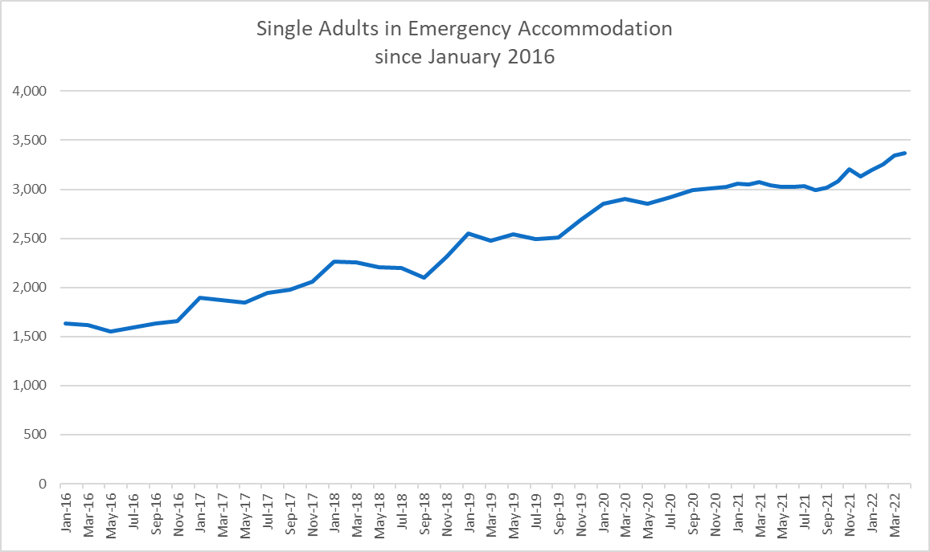
Single Person Homelessness – Dublin Region
Steady Increase- Not affected By COVID
More Presentations from Family Home
General Unaffordability of 1 bedroom Accommodation

Slide 4
Scale of Homelessness in Dublin
3
Families in EA – April 2022:
956 families (1,626 adults and 2,209 children)
Dublin Region | New Family Presentations | Family Exits to Tenancies | New Single Presentations | Single Adults to Tenancies
2018 | 1,112 | 780
2019 | 1,031 | 1,137 | 1,870 | 575
2020 | 699 | 1,220 | 1,660 | 1,006
2021 | 749 | 695 | 1,827 | 950
2022 to April 30th | 325 | 129 | 678 | 195
Single Adults in EA – April 2022:
3,365

Slide 5
Primary Housing Solutions for People Experiencing Homelessness in DCC
Approved Housing Bodies
Stock acquired or built by not for profit sector, regulated.
Nominations from SH lists
Private Rental with Support of (Homeless) Housing Assistance Payment:
Upfront payment of Deposit & 2 months’ in advance to Landlord
Placefinders’ Fee
Up to 50% discretion to increase level of housing supports offered.
Local Authority Stock –
Target turnaround of Void Properties
Increased CBL
Prevention Lettings to Older Persons
CAS & Acquisitions
Special Purpose Capital Assistance to Approved Housing Bodies e.g. Young People Leaving Care and LA/ AHB acquisitions for Homeless, Traveller, Disability
Long-Term Leasing
Different views on VFM but EA comparison – Human and Financial Benefits

Slide 6
How Families Exit Homelessness to Tenancies in Dublin
FAMILIES | HAP / PR | LA (incl LTL) | AHB | LTA – Families | Total
2018 | 450 | 183 | 143 | 4 | 780
2019 | 468 | 416 | 236 | 15 | 1,135
2020 | 727 | 222 | 184 | 87 | 1,220
2021 | 479 | 85 | 122 | 8 | 695
% | 56% 2,124 | 23% 706 | 18% 685 | 3% 114 | 3,816
SINCE THE BEGINNING OF 2022 FOR EVERY FAMILY EXITING HOMELESS SERVICES TO A TENANCY THERE ARE 3 FAMILIES ENTERING HOMELESSNESS AND OVER A MUCH LONGER PERIOD OF TIME, FOR EACH SINGLE ADULT WHO EXITS HOMELESSNESS TO A TENANCY NEARLY 4 NEW PEOPLE ENTER EMERGENCY ACCOMMODATION FOR THE FIRST TIME.

Slide 7
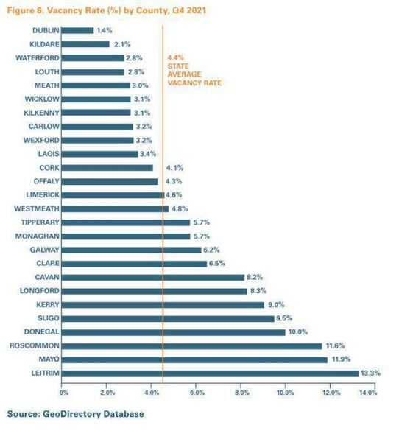
Can Vacant Properties be part of Ending Homelessness?

Slide 8
Bringing Vacant Stock Back into Use – National Policy
Housing For All: Pathway 4 Addressing Vacancy and Efficient Use of existing Stock:
Repair & Lease – Targeted at owners who cannot afford/can’t access funding to bring up to standard for rental. Repairs paid for upfront, made available for social housing for a minimum of 10 years, cost 80% market rent. A ‘loan’ rather than grant. (DCC: >5).
Buy & Renew - Capital programme to bring properties back to residential use. DCC acquired 68 between 2018 – 2021, 32 currently in process and 27 under refurbishment. Excellent response to dereliction.
CPO (Housing Agency to support Local Authorities – Templates, training) Main use is for Derelict sites/properties. (May include missing roof or floor structures, boarded up window openings, damage (Fire/ASB)
Fair Deal (caps, rental income exemptions)
Vacant Property Tax under consideration, not for revenue yield but for activation of housing.
Extension of Planning Regulations to exempt certain vacant commercial premises from requiring planning permission to change of use for residential purposes to 2025. e.g.Pubs.

Slide 9
Bringing Vacant Stock Back into Use – Dublin City Council
Vacant Homes Officers in each Local Authority
Establishing Level of Vacancy – Different measures used: CSO, Geodirectory, Vacanthomes.ie and Local information.
Record of 783 based on analysis of data sources Dublin City Council’s Housing Department has undertaken 427 site inspections with a further 36 inspections scheduled and 17 title searches currently in progress.
A recurring pattern each year is the high volume of Planning permissions in comparison with sites under construction. E.g. Q1 2021 Planning Permission for 22,972 residential units in the city and 5,316 under construction. (DCC CDP)
Living Over the Shop DCC will actively encourage the development of residential accommodation over existing commercial premises. There is a considerable amount of vacancy and underutilised floorspace on the upper floors of commercial premises that have the capacity to contribute significantly to the housing stock of the city. Residential accommodation should seek comply with the relevant standards for apartments. However, in certain instances and where a building is a protected structure, relaxations of these standards will be considered. (DCC CDP)
Notes:
4 Dublin Local Authorities – this includes only Dublin City Council.

Slide 10
Challenges
Opportunities
Establishing Vacancy can be complex (unoccupied for 6 months or longer)
- if the property is not registered with the Land Registry - the vacancy is disputed
In an urban context much less vacancy.
The majority of the properties inspected require considerable resources to return to use ( time, finance, labour)
Properties may be subject to probate/legal disputes
Long term Care/Nursing home & Lien on Property Title– this is being addressed.
Owner intends to sell on open market and is waiting for opportune time to sell.
Increase the Supply of homes to Households who are experiencing homelessness.
Human and Financial Cost to Each and Every Household in Emergency Accommodation.
Revitalise derelict and neglected buildings in cities/town centres.
Skilling of Staff in Administrative Process becomes easier over time
Development Plan & National Policy Support

Slide 11
Mary Hayes
Director – DRHE
mary.hayes@dublincity.ie

