Slide 1
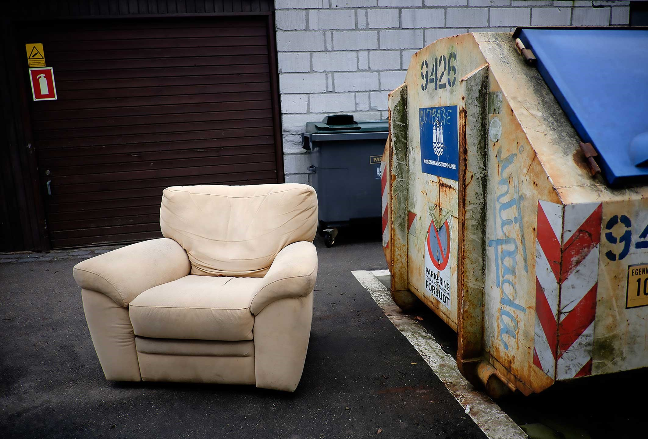
Measuring homelessness – experiences from Denmark
Lars Benjaminsen
The Danish Center for Social Science Research
FEANTSA Policy Conference Dublin 2022

Slide 2
Key aspects
The connection between the definition of homelessness and the measurement – how can we measure different homelessness situations?
How do we collect data on ‘hidden homelessness’?
What are the implications of ‘time’ – point in time counts vs. continuous measurement?
What information do we get from different types of data – and from combining different types of measurement?

Slide 3
The Danish example – two main data sources on homelessness
National homelessness counts – point-in-time count during a ‘count week’ – week 6 in february every second year since 2007
National statistics on shelter use – continuous registration of all shelter users nationwide throughout the year – since 1999

Slide 4
The Danish homelessness count
Definition of homelessness:
Conceptual definition:
As homeless are regarded people who do not have their own (owner or rented) dwelling or room, but who stay in temporary housing arrangements, or stay temporarily and without a contract with family, friends or acquaintances. As homeless are also regarded people without a place to stay on the following night.

Slide 5
Operational definition – homelessness situations
Category | Homelessness situation
1 | Stay overnight in the street, a stairway, a shed or the like
2 | Stay overnight in an emergency night shelter
3 | Stay overnight in a homeless shelter
4 | Stay in a hotel due to homelessness
5 | Stay temporarily and without a contract at family, friends or acquaintences
6 | Stay in temporary transitional housing without a permanent contract
7 | Release from prison within a month without a housing solution
8 | Discharge from hospital or treatment facility within a month without a housing solution
9 | Other

Slide 6
Count methodology
Extended service based count
Not only homeless services but also a wide range of other welfare services
Homeless shelters, street outreach teams, psychiatric treatment facilities, addiction centres, municpal social centres, jobcentres, emergency departments, counceling services, etc.
Two-page individual questionnare (paper or electronic version) for each homeless person that these services are in contact with or otherwise know is homeless during week 6.
Unique identifiers: ”Personal numbers” (Central Person Register identification number) and initials, birthdates – control for double counts

Slide 7
Overall trend, count data

Slide 8
Profiling of people in different homelessness situations
 | Mental illness (Pct.) | Substance abuse (Pct.) | Either/or (Pct.) | Both (Pct.)
Rough sleepers | 64 | 70 | 87 | 44
Night shelter | 58 | 74 | 87 | 38
Homeless shelter | 57 | 73 | 87 | 40
Hotel | 58 | 50 | 78 | 24
Family and friends | 55 | 57 | 77 | 30
Short term transitional | 59 | 49 | 85 | 24
Release from prison | 36 | 80 | 82 | 33
Discharge from hospital | 97 | 60 | 100 | 58
Other | 62 | 61 | 79 | 40
Total | 59 | 66 | 84 | 38

Slide 9
Second data source: Shelter data
Continous registration of shelter users all year round
Mandatory across all homeless shelters operating under § 110 in the Social Service Act.
Nationwide database in Statistics Denmark
Additional information on situation upon discharge etc.
No profiling information – but linking to other administrative data possible

Slide 10
Trend in shelter use

Slide 11
Important learnings from using multiple data sources
By only counting shelter users we miss out more than half of the people in homelessness
Almost 3 times as many shelter users over a whole year than in a week
There is a considerable turn-over in shelter users during a year
We have no yearly figure that includes all homelessness categories….since we cannot count homelessness all year around….

Slide 12
What is missing in the Danish data collection?
Individual flow/tracking data across services/the welfare system
E.g. data on what happens to people after a shelter stay – is their situation solved – or not?
Some data exists on local level – but it is not systematic, standardised and centralised – it is not collected/available on national level
This is a missing link to understanding interventions and a missing piece of information in solving homelessness

