Slide 1
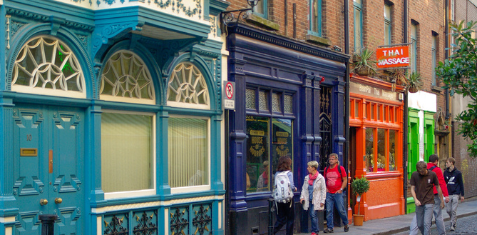
LGBTIQ Youth Homelessness
FEANTSA POLICY CONFERENCE 2022
Towards a Vision for Ending Homelessness

Slide 2
LGBTIQ+ ?
Iesbian
gay
bisexual
transgender
intersex
questioning
queer

Slide 3
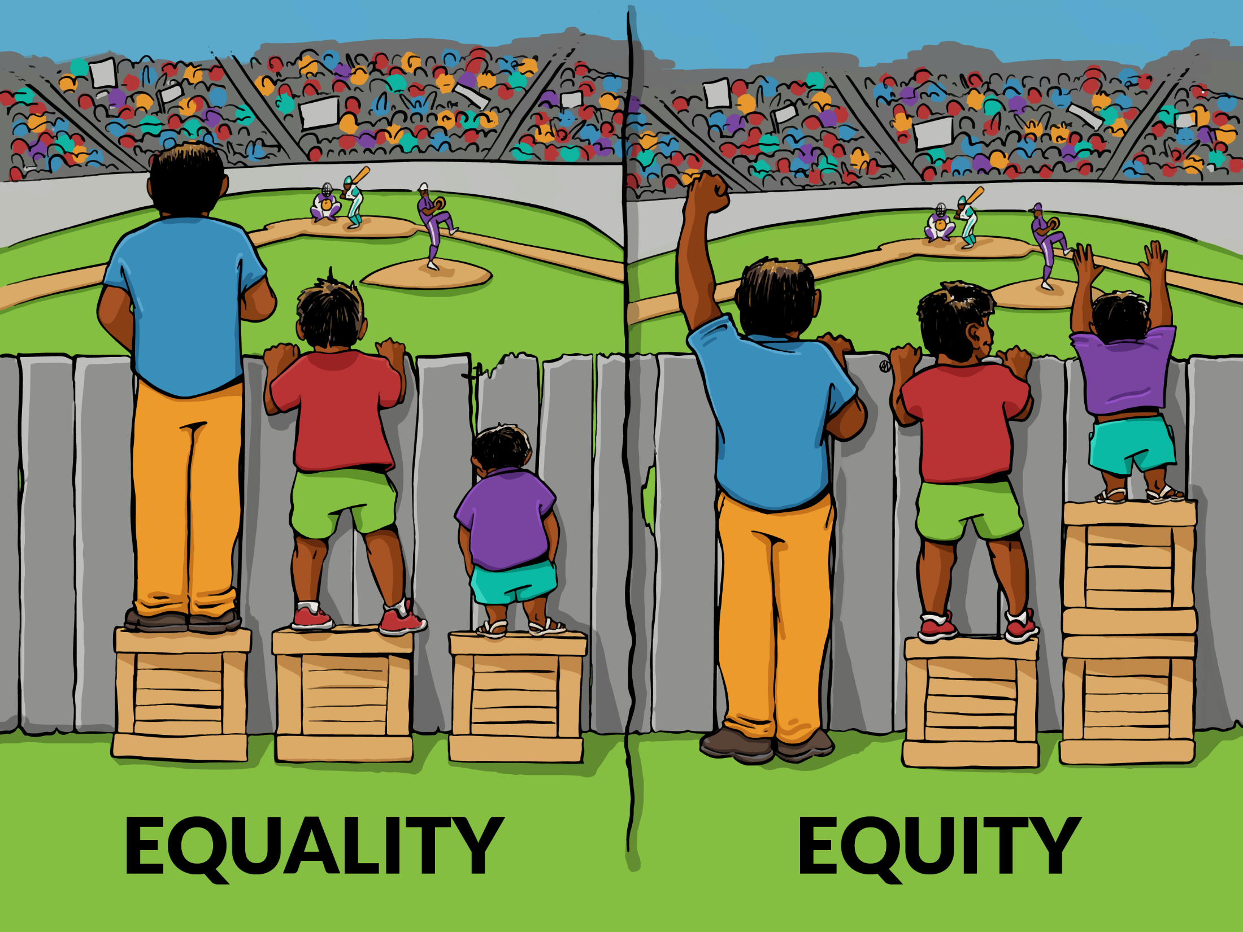
If we want the same then why
SPECIAL TREATMENT?!
Special services
Special language
Special programs
...and not equal?

Slide 4
WHAT IS AFFECTING LGBTIQ+ (YOUTH)
BULLYING
BEING REJECTED BY THEIR PRIMARY FAMILY
MINORITY STRESS
SYSTEMIC DISCRIMINATION

Slide 5
MINORTIY STRESS
greater risk for mental health issues
greater risk for health issues
greater risk for housing exclusion and homelessness
SPECIFIC TO MINORITY GROUPS
CHRONIC
SOCIALLY CONDITIONED

Slide 6
SAFE(R) SPACE FOR LGBTIQ+ YOUTH
NOTHING ABOUT US WITHOUT US
VISUAL REPRESENTATION OF INCLUSIVITY
DON‘T ASSUME WE ARE ALL STR8 AND CIS
REFLECT ON HETERO- AND CISNORMATIVTY OF THE LANGUAGE YOU USE
ZERO-TOLERANCE FOR DISCRIMINATION AND/OR VIOLENCE – ALSO ON PAPER (BUT NOT JUST ☺)

Slide 7
SQVOT
@ Ljubjana Pride
THE ISSUES:
Invisible homelessness (staying with friends, daytime homelessness)
Neglect by parents
Housing alone is not enough
Counseling
Prevention work
Short-term emergency accomodation
Community work
Advocacy and research

Slide 8
EMERGENCY ACCOMODATION
PROS:
Flexible
Safe
More than housing
Needs no funding
2-3 weeks in the homes of volunteers
7 different accom. – 10 hosts
Not only housing but safe space for social interactions
Trained and educated hosts
CONS:
Short-term
High-risk for the hosts

Slide 9
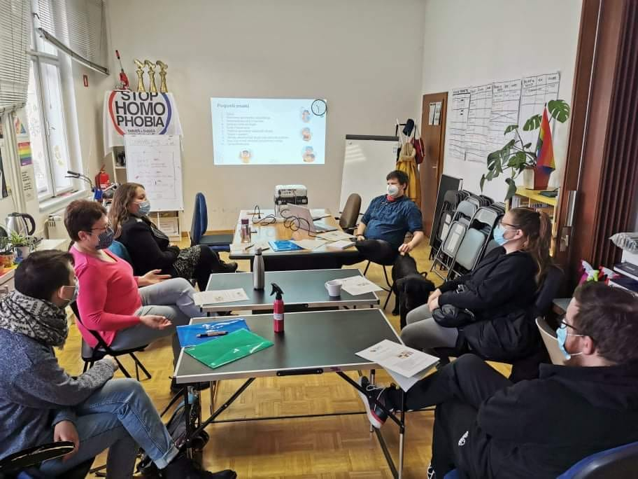
SQVOT HOSTS <3

