Slide 1



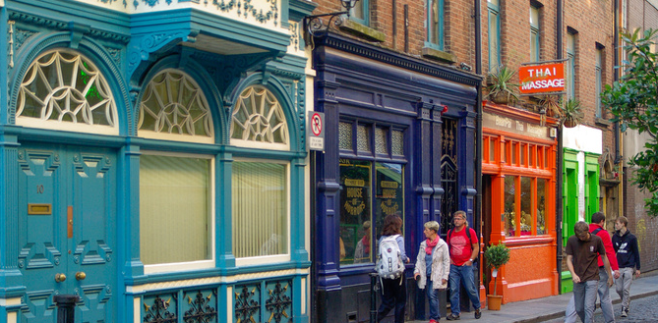




Challenging measures that criminalise homelessness
FEANTSA POLICY CONFERENCE 2022
Towards a Vision for Ending Homelessness

Slide 2
Welcome | Speakers
Céad míle fáilte – one hundred thousand welcomes!
Karen Golden, CEO Galway Simon Community
Matthew Downie MBE, Chief Executive Crisis
Elisabet Kass, Knowledge and Rights Officer at Compasset

Slide 3
Measures
Perceptions
Legal Context
Tackling Root Causes
Role of Europe
Begging
Rough Sleeping

Slide 4
Historical Context
Vagrancy laws introduced following the Napoleonic War
  Mobile population soldiers and sailors being discharged with nothing
  Inward migration
  “Settled order” found these people threatening, they were a burden, not contributing
In parallel – police force evolving
Drive for respectability as 19th Century went on…..
Perception of urban issue, in fact largely rural…..
  migration from the country to the cities….
  also, those travelling around for picking harvests etc
39,000 prosecutions per annum prior to WW I under Vagrancy Act
  vast legal resources…… court time, police time, prisons
Dan Snow's History Hit: History of Homelessness on Apple Podcasts
Professor Nicholas Crowson - Department of History - University of Birmingham
Nick Crowson — University of Birmingham

Slide 5
Historical Context
Post second world war, the tramp is no more according to workhouse returns after the war
In 50s, single vagrancy continues
Late 60s, term drops out of use
Single homeless
Less stigmatisation
Use of Act diminishes
Averaging 2,000-3,000 prosecutions through 50s/60s/70s – still jailable
Dan Snow's History Hit: History of Homelessness on Apple Podcasts
Professor Nicholas Crowson - Department of History - University of Birmingham
Nick Crowson — University of Birmingham

Slide 6
Historical Context in Ireland
The Vagrancy Acts applying in Ireland had their origins in the statutes of the Westminster Parliament regulating the activities of vagabonds, beggars and idle persons in England.
Statutory attempts to deal with this class of persons in England, from the Statute of Labourers in 1349 down to the Vagrancy Act 1824, which repealed all previous statues on the subject
Report on Vagrancy and Related Offences 4 (lawreform.ie)

Slide 7
1542
A statute of the Irish Parliament applied to Ireland an English statute of 1530
Very severe punishments
  Whipping
  Being put in stocks
  Having one or both ears cut off
  Branding
Report on Vagrancy and Related Offences 4 (lawreform.ie)

Slide 8
1635
In 1635, a statute “for the erecting of Houses of Correction and for the punishment of rogues, vagabonds, sturdy beggars and other lewd and idle persons” was passed.
A House of Correction was to be erected in each county in Ireland “to set the said rogues and other idle and disordered persons on work”.
Persons liable to punishment under this Act of 1635 were:
Report on Vagrancy and Related Offences 4 (lawreform.ie)

Slide 9
1635 Act - rogues, vagabonds and sturdy beggars
“all persons calling themselves scholars, going about begging”
“all idle persons going about in any county either begging or using any subtle craft, or unlawful games or plays, or feigning themselves to have knowledge in physiognomy, palmistry, or other like crafty science, or pretending that they can tell destinies, fortunes, or such other like fantastical imaginations”
“all persons that be to utter themselves to be proctors, procurers, patent-gatherers, or collectors for gaols, prisons or hospitals”
“all fencers, bear wards, common players of interludes, and minstrels wandering abroad”
“all jugglers, wandering persons, and common-labourers, being persons able in body using loitering and refusing to work for such reasonable wages as is taxed and commonly given in such parts where such persons do or shall happen to abide or dwell, not having living otherwise to maintain themselves;
“all persons delivered out of gaols that beg for their fees or otherwise travel begging;
“all such as shall wander abroad pretending loss by fire or otherwise”
“all such as wandering pretend themselves to be Egyptians or wander in the habit, form or attire of counterpart Egyptians”
Report on Vagrancy and Related Offences 4 (lawreform.ie)

Slide 10
1824 Vagrancy Act
The Vagrancy Act 1824 originally applied only to England.
The Prevention of Crimes Act 1871 extended to Ireland and Scotland the application of section 4 of the 1824 Act, which provided for the punishment of certain classes of persons as “rogues and vagabonds”.
Report on Vagrancy and Related Offences 4 (lawreform.ie)

Slide 11
1847 Vagrancy (Ireland) Act
The oldest Act still in force which was passed specifically to deal with the punishment of vagrants in Ireland is the Vagrancy (Ireland) Act 1847, which recited that it was “expedient to make further provision for the punishment of beggars, vagrants and persons offending against the laws enforced for the relief of the destitute poor in Ireland”.
This Act included not only the traditional offences committed by vagrants, previously contained in Tudor legislation (such as begging and sleeping in outhouses),
but also quite different categories such as
  offences against the Poor Law;
  offences of a kind which professional criminals might commit (such as loitering with intent to commit an arrestable offence);
  and those offences against public decency and morality (such as offensive behaviour by prostitutes and indecent exposure) which were of relatively recent origin
Report on Vagrancy and Related Offences 4 (lawreform.ie)
Vagrancy (Ireland) Act, 1847 (irishstatutebook.ie)

Slide 12
In practice….
Not used assertively or consistently
Councils control their own areas under bye-laws – rough sleeping/drinking alcohol in public
Too ‘politically sensitive’
Generally ‘softer approach’ taken
A number of different laws
Joint Policing Committees (JPCs)
Gardaí receive training on empathy and homelessness
‘A lot of guards fundraise for the homeless…..’
Evidence in court e.g. staying at Homeless Hostel
Court may seek an understanding of root cause of offence
Financial penalty – ‘what’s the point? If they can’t pay, then they go to prison…..’
Outside shops… can be an issue where retailers are paying very high rates etc
RepoPublic order offences (citizensinformation.ie)

Slide 13
Begging
Criminal Justice (Public Order) Act 2011, Section 2
  “Section 2 Begging Act”
  Aggressive
  Blocking an Entrance
  ATM
Limited prosecutions under this Act in Galway
Very low % of people experiencing homelessness are begging
But very high % of those begging are homeless
Children Act 2001
  An offence to have a child begging
  Child Protection Services

Slide 14
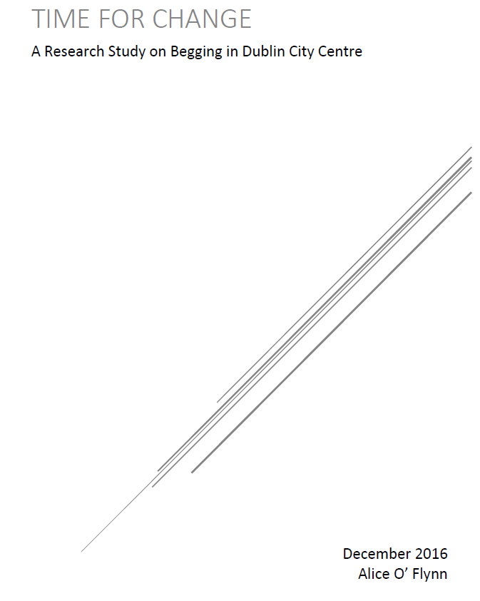

Slide 15
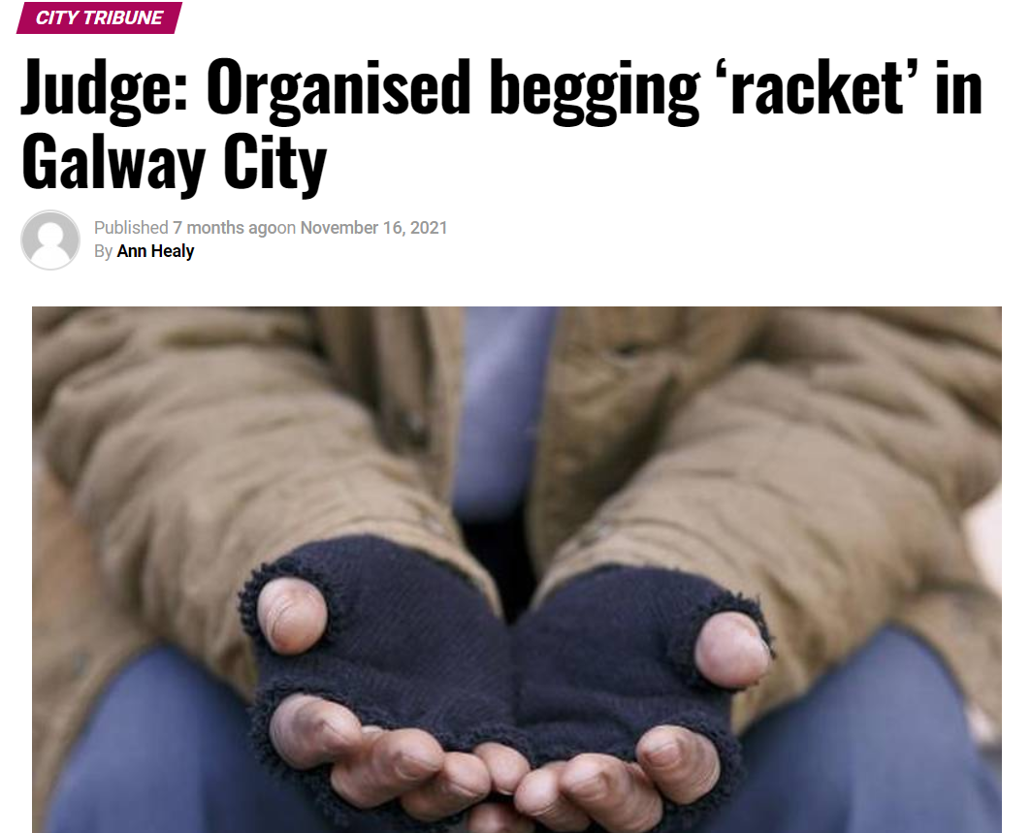
Judge: Organised begging ‘racket’ in Galway City – Connacht Tribune – Galway City Tribune:

Slide 16
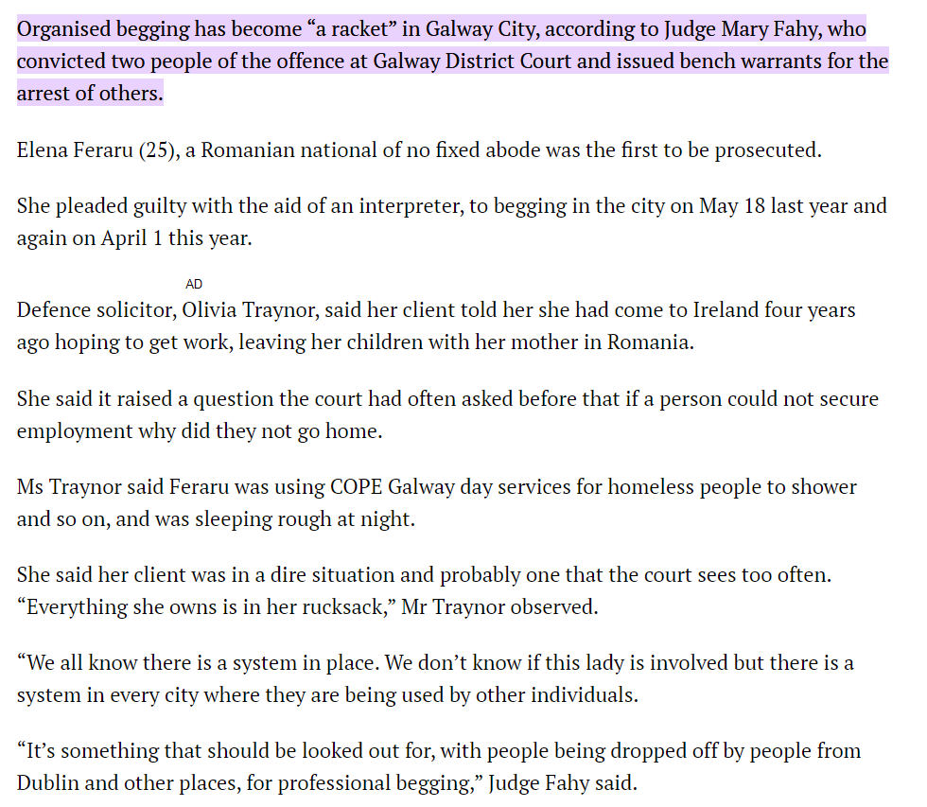
Judge: Organised begging ‘racket’ in Galway City – Connacht Tribune – Galway City Tribune:

Slide 17


Trash, Traffic and Tramps
‘undesirables loitering in businesses’
‘not fair to businesses trying to recover from the pandemic’
Conflation of rubbish and homelessness
Galway Talks with Keith Finnegan Wednesday 1st June 2022 - Galway Bay FM

Slide 18
Rough Sleeping
‘Don’t believe rough sleeping is an offence’
Local Authorities control their own areas under bye-laws
Not prosecuted in Galway, may be different in other areas
‘Wouldn’t entertain that …….’
‘Won’t come down on anyone down on their luck’

Slide 19
Rough Sleeping
Health Act 1953
Housing Act 1988
Childcare Act 1991
Housing (Miscellaneous Provisions) Act 2009
Housing Act allows Local Authorities to provide housing for homeless people
Enables a LA to provide a homeless person with money to pay for accommodation

Slide 20
Street Drinking
Drinking in certain areas – Local Authority Bye Laws
Criminal Justice (Public Order) Act 1994, Intoxication in Public
Gardai will only get involved where they become a danger to themselves or others, more often themselves….
They will bring them back to the station to dry out
On prosecution, €100 fine
6 months to pay
Failure to pay => Enforcement process (can take years)
May be given more time
Probation Act Section 1.1
  No fine or conviction
  Unless in contempt of court

Slide 21
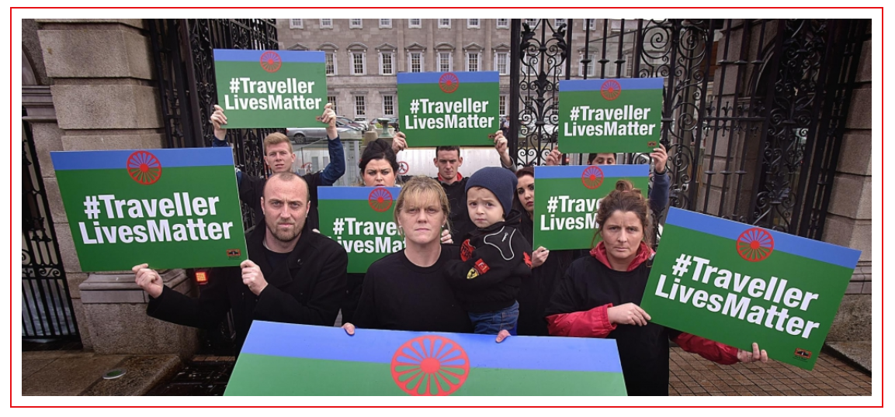
Travellers
Policing Travellers: Ireland’s Deeply ingrained Racial Divide - European Roma Rights Centre (errc.org)

Slide 22

View from front line Services…
Where State doesn’t invest, charities pick up - changes social cohesion
Shunting people into vulnerable and invisible situations can increase risks
Not visible solved
‘Othering’, deserving and undeserving
Middle class go home, drink wine
Homeless live in public, totally different perception of drinking
Business community pressure

Slide 23
View from front line Services…
Begging can be a symptom of having no other way to make a living
Urban folklore of the ‘black merc’
Discharge from prison into homelessness => higher recidivism
Harm reduction vs penalising
Looking at root causes vs behaviours
Clients being supported, plan in place => fewer custodial sentences
For many we support, end of their interaction with criminal system
Importance of solving problems, not pushing everything underground

Slide 24
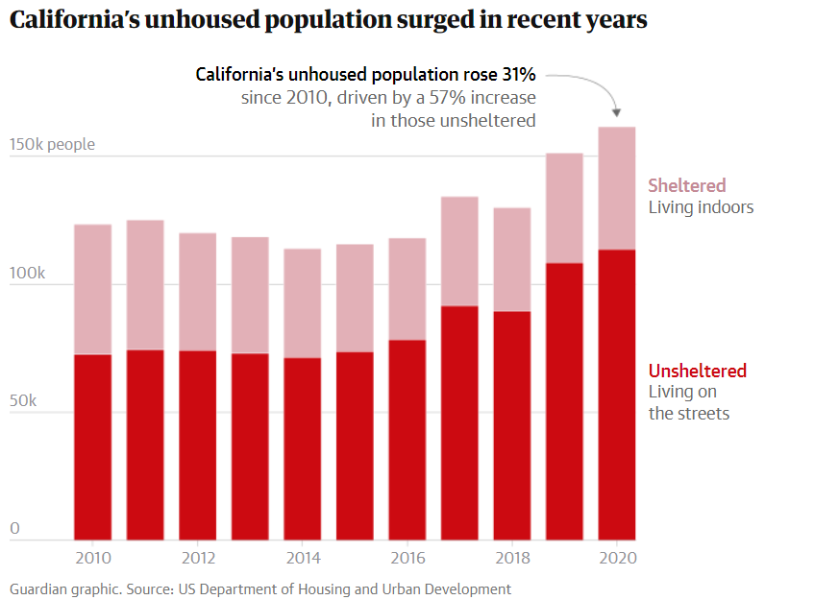
California
Fifth largest economy in the world
  deaths of people on the streets are rising;
  college students are living in their cars;
  more elderly residents are becoming unhoused;
  encampment communities are growing at beaches, parks, highway underpasses, lots and sidewalks.
Homelessness has become the top issue in political races.
In response, governments across the state are increasingly cracking down on people sleeping outside.
‘We have failed’: how California’s homelessness catastrophe is worsening | California | The Guardian

Slide 25
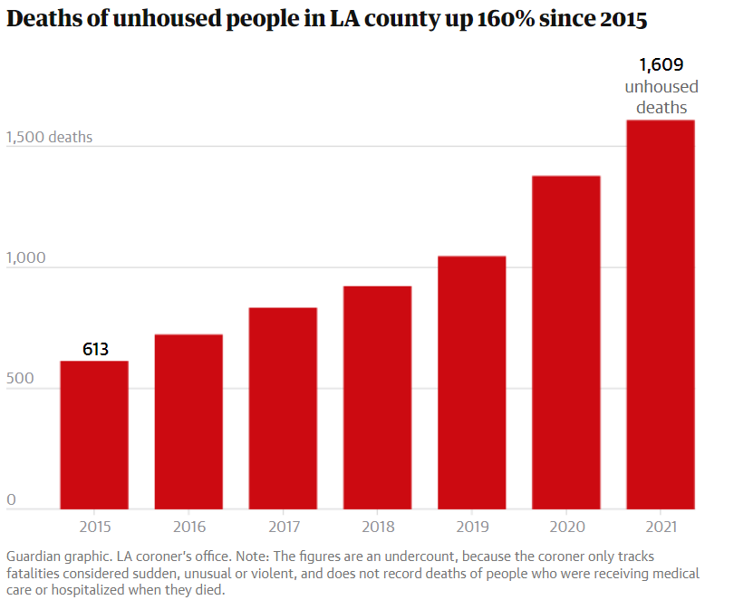
California
UCLA research on the residents of one LA encampment found that people cited a range of factors that led them to become unhoused, including
  eviction,
  job loss,
  domestic violence,
  former incarceration,
  family conflict and
  low wages in gig economy jobs.
‘We have failed’: how California’s homelessness catastrophe is worsening | California | The Guardian

Slide 26
The crackdown on tent living and fear of possible forced treatment [for people with mental health issues] can lead people to scatter into more hidden locations where it can be harder for them to access services and get into programs, advocates say.
California
“Using law enforcement to respond to houselessness is both counterproductive and ineffective,” said Eve Garrow, policy analyst and advocate at the ACLU of Southern California. The expansion of criminalization is overwhelming.
“And people are experiencing compassion fatigue, and they want something done. Local public officials are responding with what they see as ‘quick fixes’ that aren’t fixes at all and are completely misguided.”
“Unhoused people are blamed for every social ill,” said advocate Theo Henderson.
“There’s an uptick in burglaries, and then the response is, ‘Can we get the unhoused removed?’
Every unhoused person has those stories – as soon as something happens, here comes the police looking at them as the prime suspect.”
‘We have failed’: how California’s homelessness catastrophe is worsening | California | The Guardian

Slide 27
Questions
FEANTSA POLICY CONFERENCE 2022
Towards a Vision for Ending Homelessness

