Slide 1
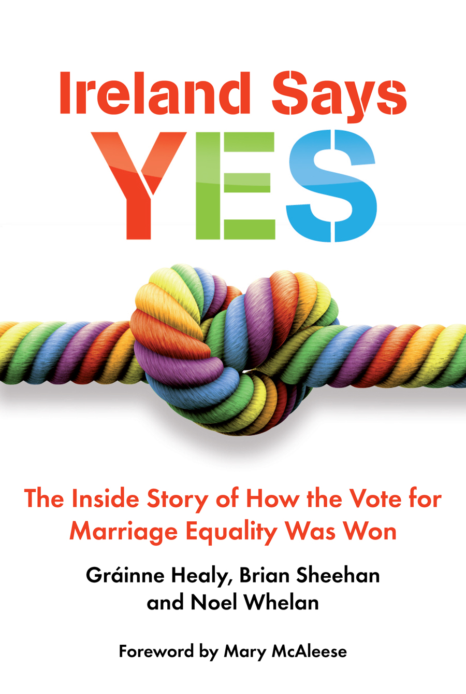
Dr Gráinne Healy – Chairwoman of Marriage Equality, Co-Director of Yes Equality
FEANTSA workshop 3 June 2022
Building Blocks for a Right to Housing Campaign
Merrion Press, 2016
Story of 105 day campaign – on back of a decade of advocacy

Slide 2
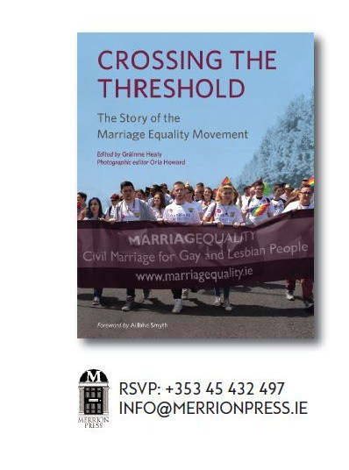
Story of the marriage equality movement over a decade

Slide 3
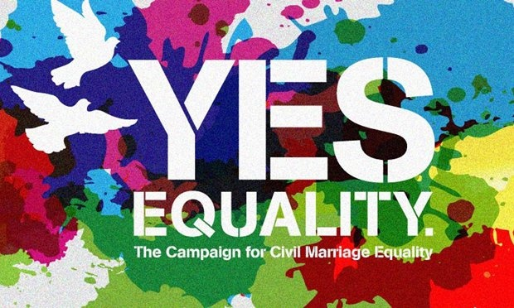

Slide 4
https://search.yahoo.com/search?fr=mcafee&type=B211IE0D20140711&p=gaze+film+yes+equality
Recall The day the votes were counted on May 23rd 2015 -

Slide 5
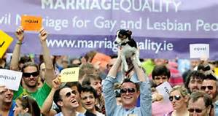

Slide 6
Yes Equality was 100 days long, preceded by a decade of advocacy (court case – ME strategic pillars of communications, mobilisation of public support, mobilisation of political support, and building alliances)
2. Building guiding team – Marriage Equality to Yes Equality – differing strategies, uniting as one campaign (GLEN and Marriage Equality and Irish Council for Civil Liberties)
3. Getting the vision right – reflecting the values of Irish people (research and focus groups)

Slide 7
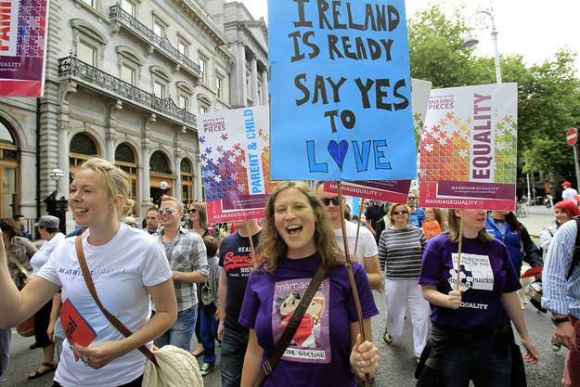

Slide 8
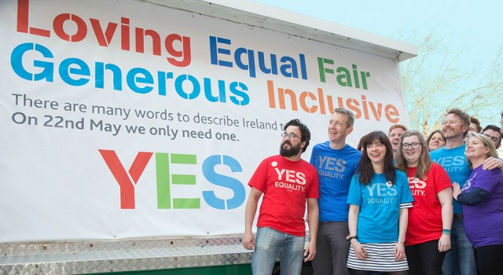

Slide 9
4. Communicating for buy in – Missing Pieces (Fagan 2009, Voices of Children, 2011) - research – conferences – posters/publicity – media training – use social media – make the case
5. Empowering and mobilising actions – ‘Out to your TD campaign’ – LGBT marches for marriage – Political lobbying – using international pressure – Constitutional Convention (2013)
6. Yes Equality ‘I’m voting yes can I tell you why?’ – Yes Bus, badges, posters, canvassing, media messages from those who could change hearts and minds of million in the middle

Slide 10
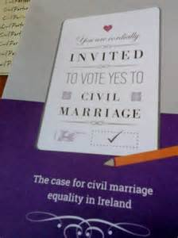

Slide 11
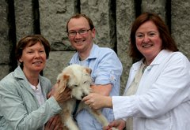
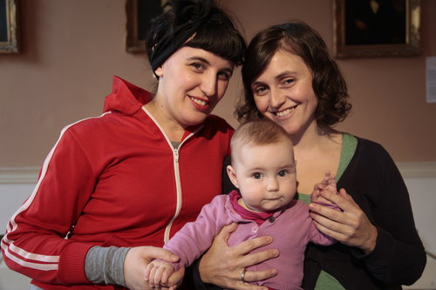
LGBT families – early images for visibility

Slide 12
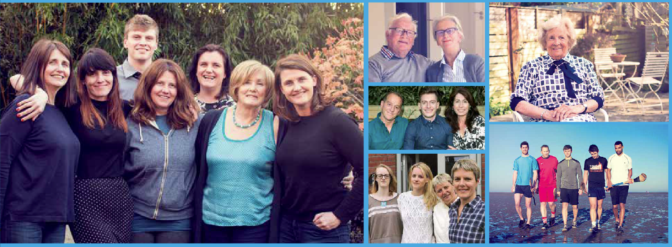
Later images – lgbt embedded in their families and communities – not the usual spokespersons – note ages, gender, rural and urban

Slide 13
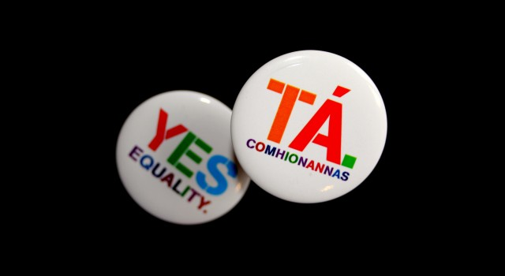

Slide 14
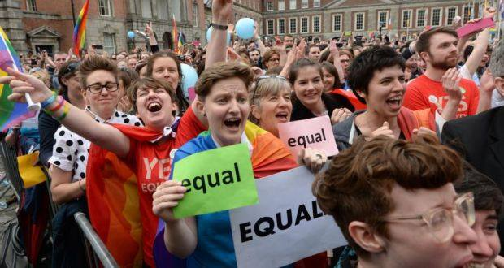

Slide 15
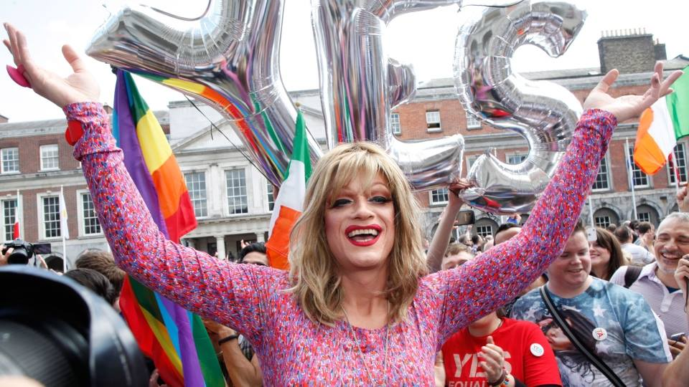

Slide 16
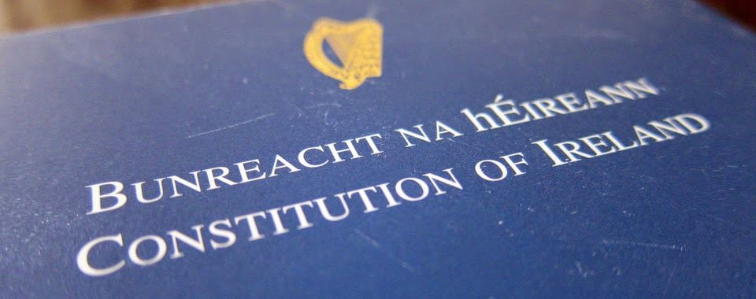
Inserting into the constitution the equal right to full marriage for same-sex couples. Providing full constitutional protection for same-sex couples and their families.

Slide 17
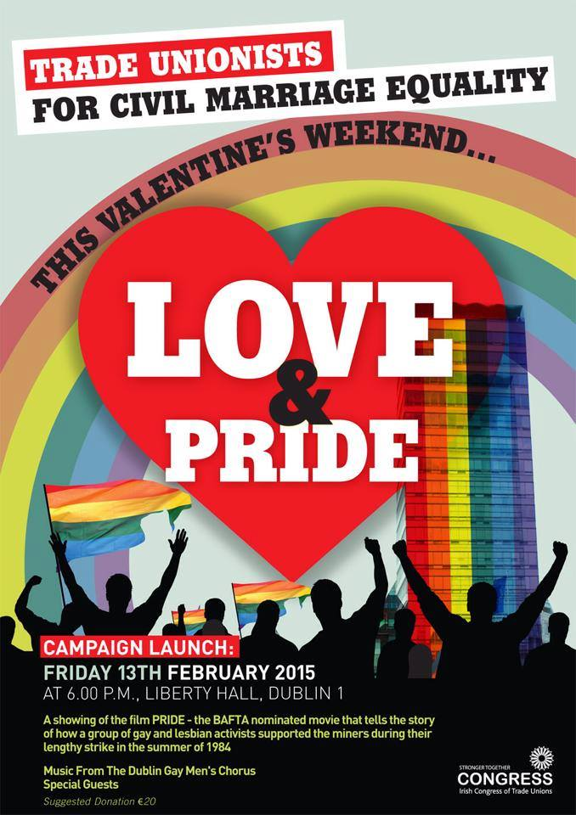
Building communities of action

Slide 18
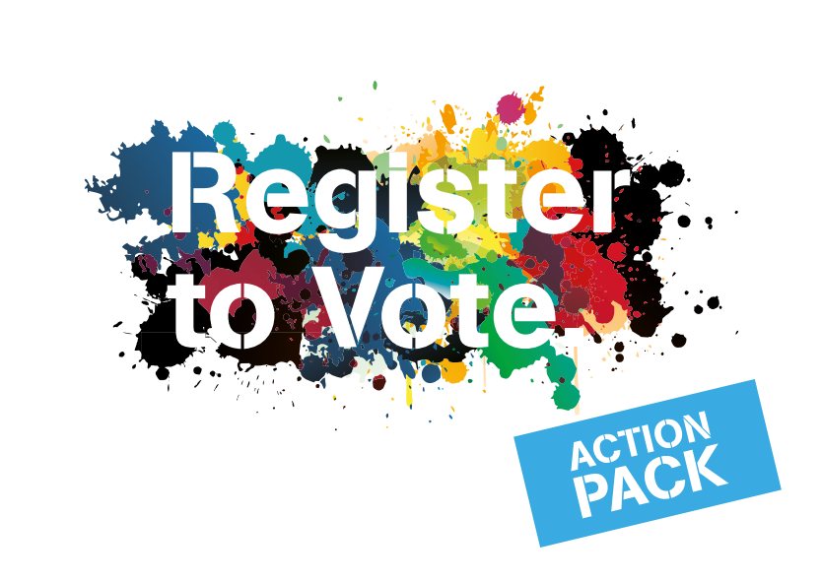

Slide 19
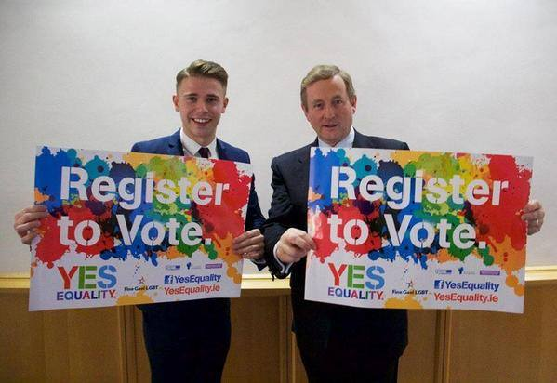
Mobilising youth vote - with then Prime Minister Enda Kenny

Slide 20
Building civil society allies, business, professionals, diversity champions

Slide 21
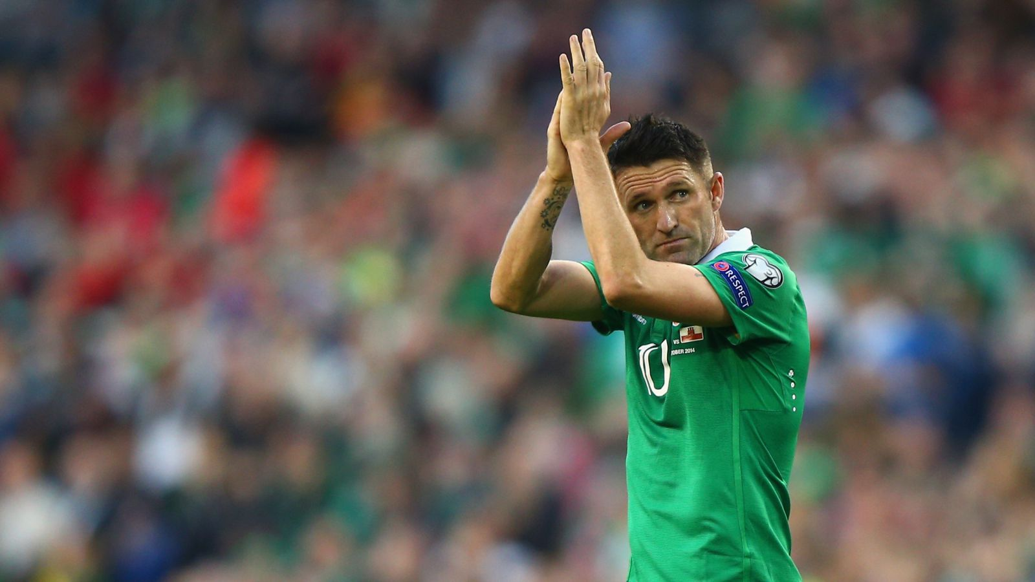
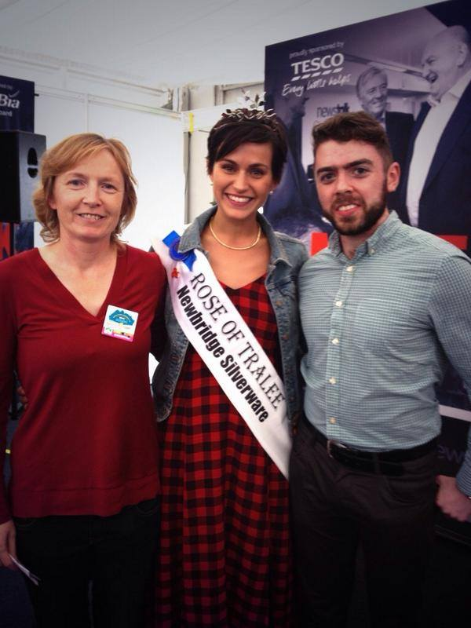
Champions

Slide 22
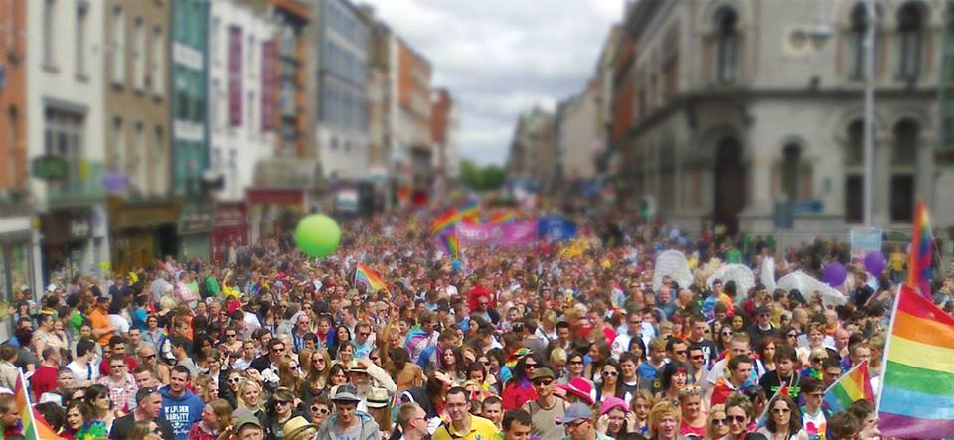
Moving the million in the middle – to vote yes – same million – different issue

Slide 23
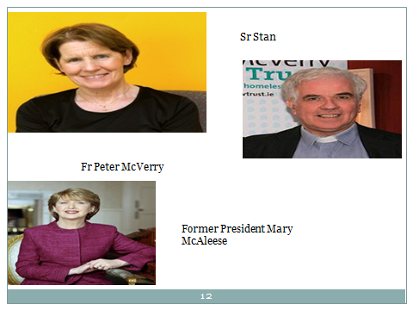
Champions

Slide 24
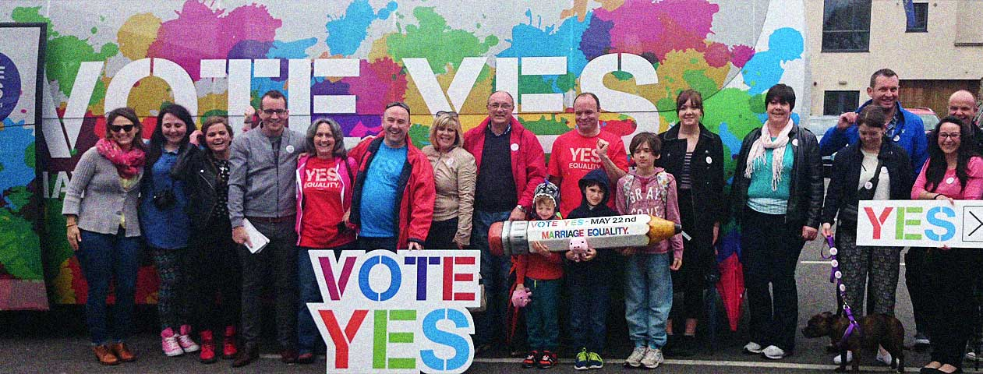
7. Keeping up momentum is crucial in a winning campaign

Slide 25
Champions
Drag comedy star Mrs Brown

Slide 26
Yes Equality Logistics • 5000 Posters erected across the country • 500,000 badges (TA and YES Badge) • 1.3m household leaflets delivered to 1.1m homes • 465,000 lapel stickers • 1,420,000 flyers • 6300 T-shirts • 800 Hi Viz Vests • 2,300 Tote Bags. • Over 70 local canvassing groups established around the country • 1 pop up shop at Stephen’s Green Shopping Centre staffed by volunteers • 300 businesses large and small formally joined the campaign. • The Yes bus travelled 11,000 Kilometres, 80 Locations, 26 Counties, 29 days

Slide 27
Social Media Facebook: • 67k+ likes • 2.8m reach • Average of 2,000 timeline views per day
Twitter • 15k followers • 2k tweets • 155k page views in the last month • 5.7m impressions in the last month • #MarRef – 11.1m Reach
YouTube • Over 150 videos on YouTube with almost 1,000,000 views Instagram • 7,000 followers

Slide 28
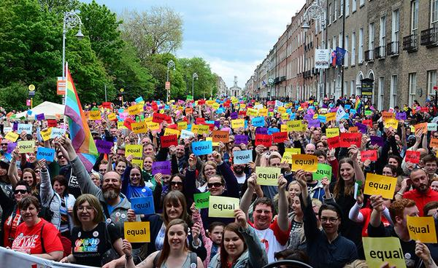
3 C’s of winning campaigns – Clarity, Capacity & Chronology
It’s about equality

Slide 30
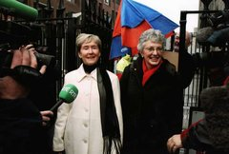
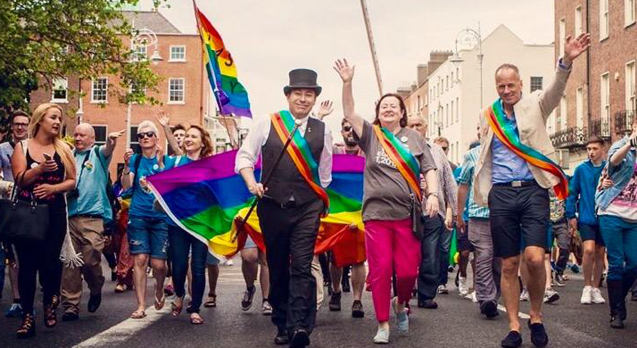
From KAL Court Case in 2003 to Celebratory Pride 2015
Katherine Zappone & Ann Louise Gilligan
Pride Marshalls 2015
Irish Council for Civil Liberties (Mark Kelly)
Marriage Equality (Grainne Healy)
Gay and Lesbian Equality Network (Brian Sheehan)

Slide 31
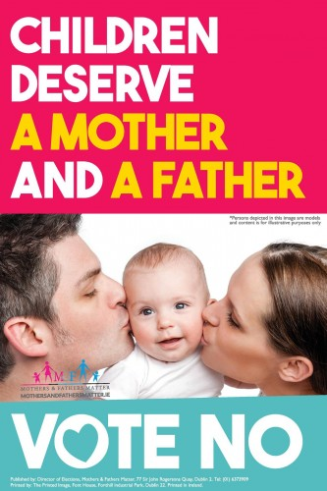
Anti LGBT family images during campaign
No narratives:
‘It will ruin our marriages’
‘What about the children?’
‘Surely Civil Partnership is enough for them?’
‘Our children will be taught gay sex in schools’
‘ It will be surrogacy and gay adoption taking our babies’

Slide 32
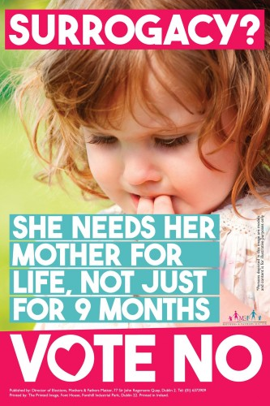
No campaign pushes fear buttons of public on children and surrogacy – if they could raise fears they could cause voters to move to a no vote.
Same people who opposed contraception, divorce, marriage equality, abortion.

Slide 33
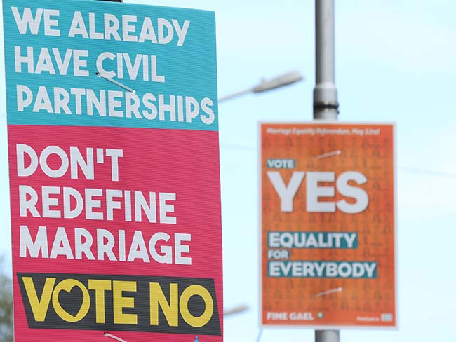
Suddenly, those who had opposed Civil Partnerships were supporting them!

Slide 34
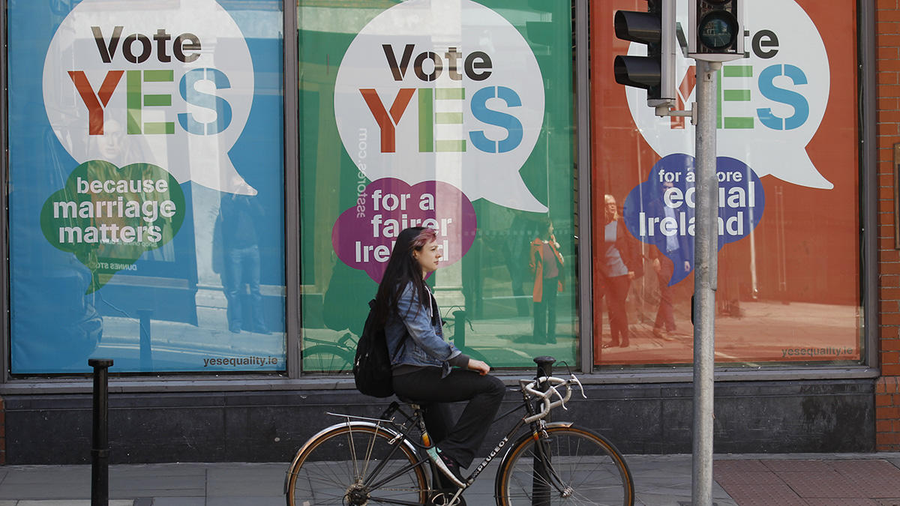
Marriage matters ….. Fairness …… equality for all our families – these are the values of Yes voters

Slide 35
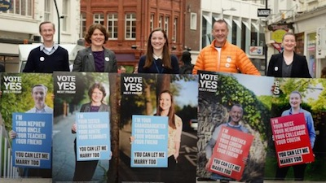
We are your teachers, sisters, brothers, sons, nieces, dads – You can let me marry too!

Slide 36
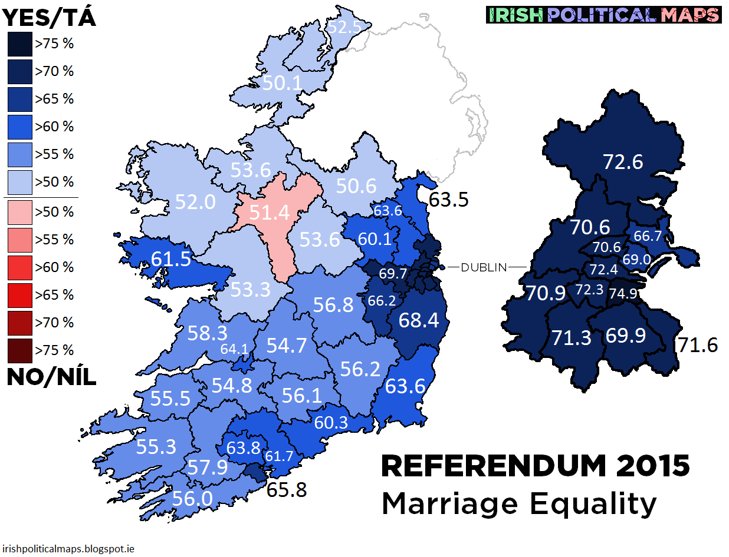
Constituency results – 62% Yes 38% No

Slide 37
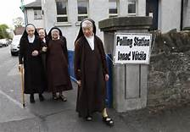
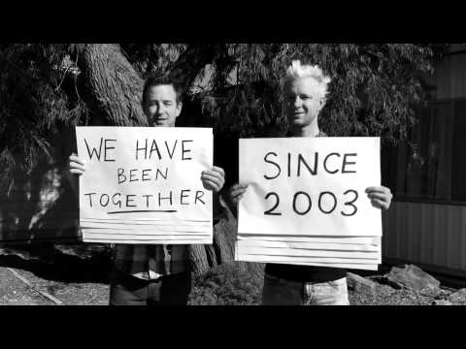
All of Irish life was mobilised
Population of just under 5 million, mostly Catholic, contraception and divorce only since ‘80’s and decriminalisation of homosexuality ‘93
Did not go head to head with people of faith – let ‘Faith in Marriage Equality,’ an inter faith group deal with church or faith based opposition
Church still reeling from sexual abuse discoveries & weakened though not yet fatally

Slide 38
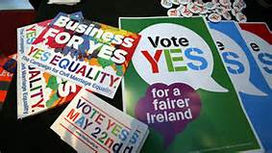
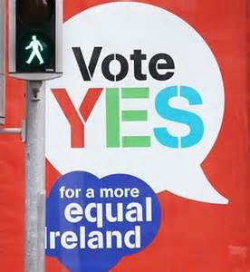

Slide 39
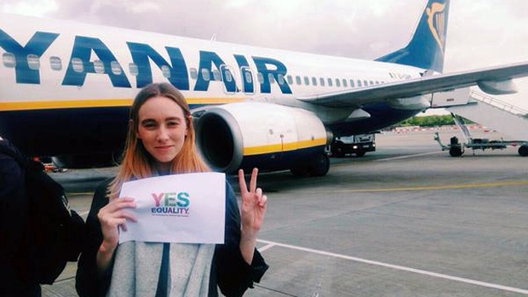
#hometovote
Spontaneous global move to get home to Ireland if you had a vote and use it for Yes

Slide 40
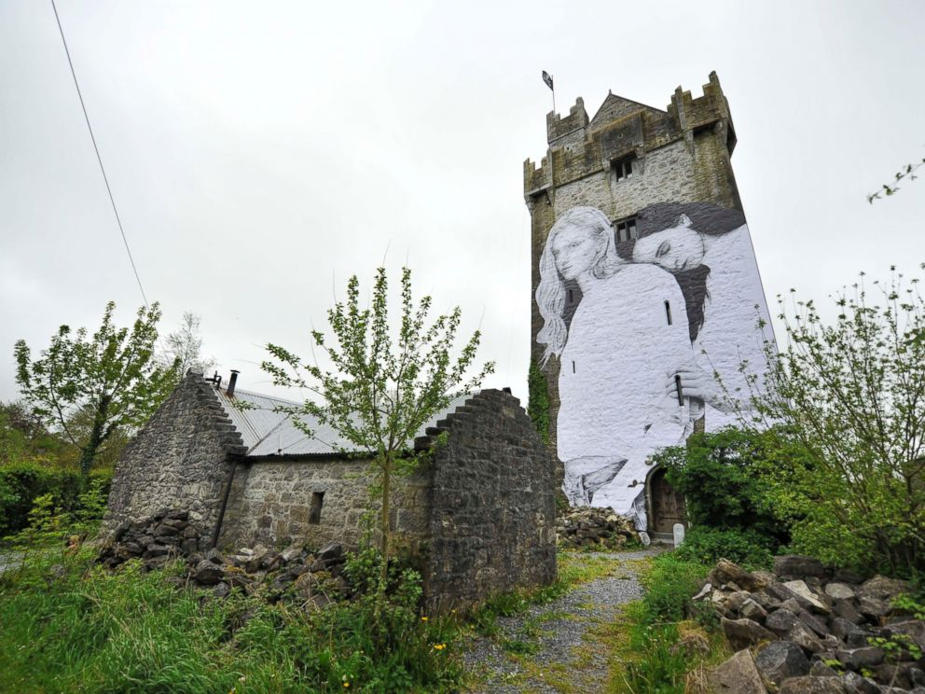
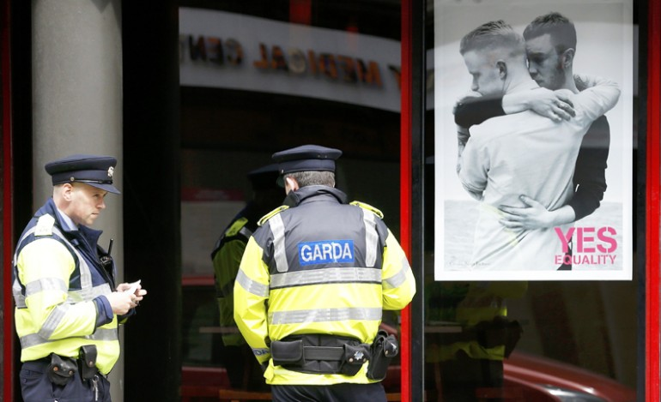

Slide 41
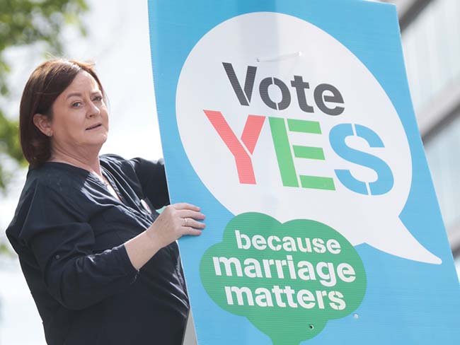

Slide 42
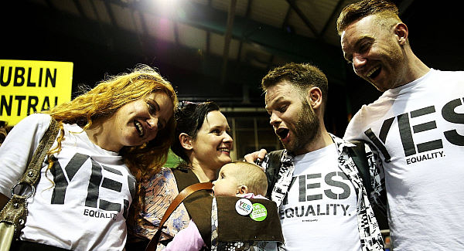
Mobilisation of canvassers across Ireland telling stories and telling why they were voting yes changed hearts and minds

Slide 43
Panti Bliss activist and drag queen speaking out against homophobia and becoming #Queen of Ireland

Slide 44
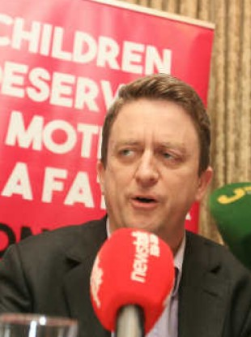
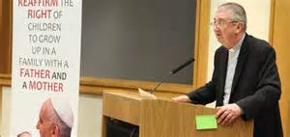
Church opposition – civil society anti marriage equality groups – Yes Equality used values of the campaign to defeat them -
Above: Archbishop Dermot Martin
Side: David Quinn of IONA right wing religious think tank – key anti abortion, anti contraception, anti lgbt rights group

Slide 45
Yes Equality campaign reflected these values at all times – positivity defeated negativity - messages and messengers were congruent – tone held throughout

Slide 46
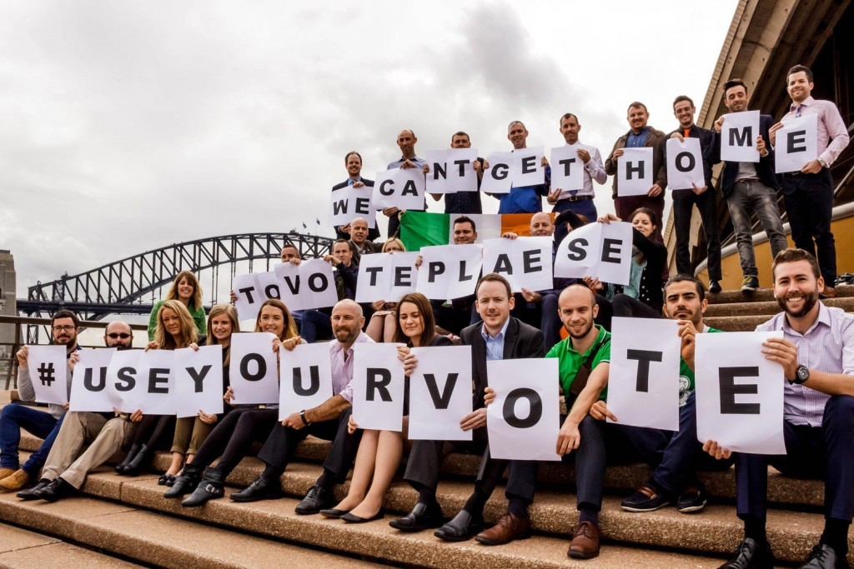
International Yes equality support – by those who could not come home to vote – no international funds allowed once date of referendum set

Slide 47
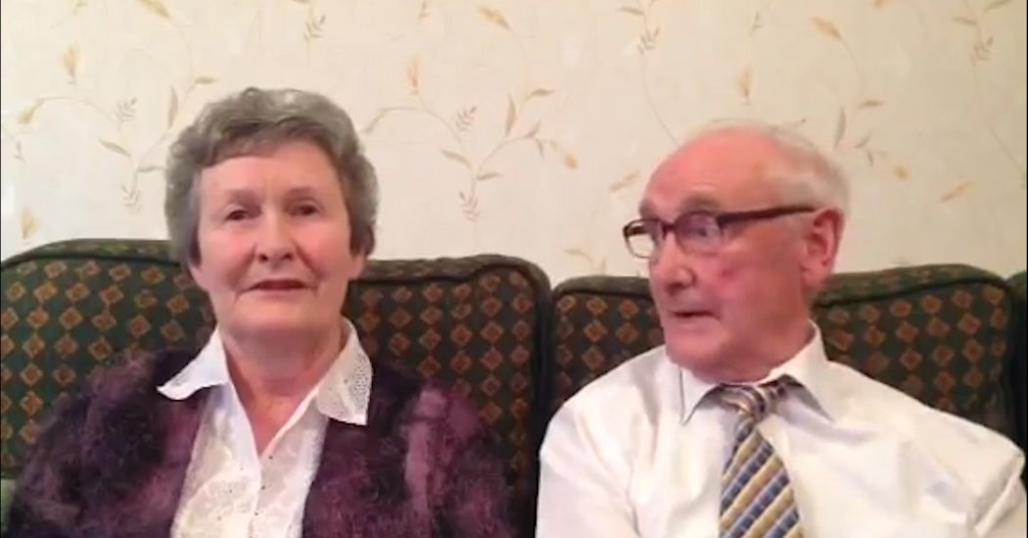
#votewithus videos went viral showing Paddy and Bridget saying why they will vote yes
Not the usual spokesperson for LGBT rights

Slide 48
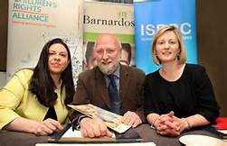
Children’s Rights Alliance – all child welfare groups and children’s rights groups got behind the Yes Equality campaign because Marriage Equality is good for children they said – result of a decade of building relationships with these influential allies paid off

Slide 49
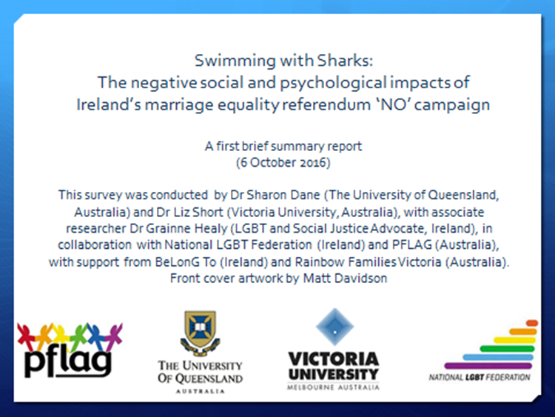
Yes Equality campaign was tough – great win 62% Yes, but No campaign tactics left their mark! (Dane, Short, Healy, 2016 Swimming with Sharks)

Slide 50
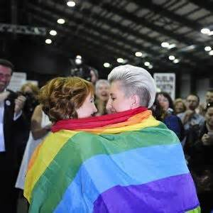
Marriage Equality built the foundations over a decade, the 100 days Yes Equality campaign got it across the referendum line - which delivered marriage for same-sex couples in Ireland
Joy on results day - Thank you Ireland

Slide 51
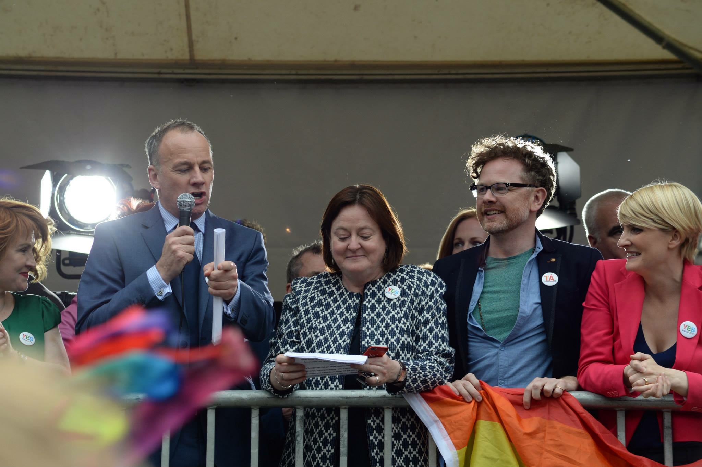
Yes Equality – two co-directors

Slide 52
10 Top Tips for campaigners for progressive causes:
Make your case – identify your campaign values & Build your base
3 C’s are crucial – clarity, capacity, chronology
Tone, tone, tone – attracts followers & allies, attracts voters, attracts media
Messenger & Message congruence
Campaigning conversations ‘I’m looking to change …. Can I tell you why?’
Personal stories move hearts and minds ‘My younger brother Gerard …. ‘
Local mobilisation – needs local leadership
Seek civil society allies – common cause/common values
Who’s leading? Clear decision-making structure
Keep your focus – ‘nothing else is our work’

Slide 53
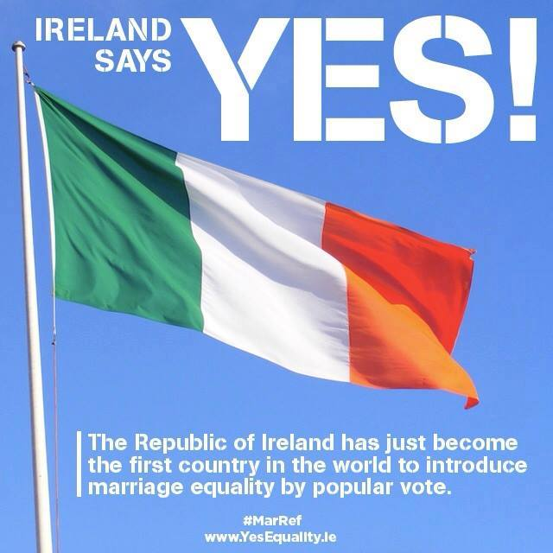

Slide 54
Dr Gráinne Healy
www.grainnehealy.ie
See Good Practice Guide on Values Based Campaigning –
Council of Europe website

