Slide 1
CHALLENGING MEASURES THAT CRIMINALIZE HOMELESSNESS: The Danish Begging Law
FEANTSA POLICY CONFERENCE 2022
Towards a Vision for Ending Homelessness

Slide 2
USER GROUP IN KOMPASSET
Destitute EU-migrants, from all over Europe. 60% Romanians, 4% Polish, 2% Spanish.
TCN with EU residency.
High percentage belong to the Roma community
Elisabet Kass, MA Anthropology of International Development
I have worked in Kompasset DanChurch Social from 2020-2022
Kompasset is a counselling and day shelter for destitute EU-migrants. It also offers winter night shelter and outreach.

Slide 3
A tightening of the begging law introduced in 2017
Criminal Code § 197
Anyone who, against a warning from the police is guilty of begging will be sentenced to prison for up to 6 months.
2) one is punished without a warning, when the offence has been committed in a pedestrian street, at stations, in or near supermarkets or on public transport
3) this should be regarded as an aggravating circumstance.
Aggravating circumstances will be punished with 14 days in prison in case of first offence

Slide 5
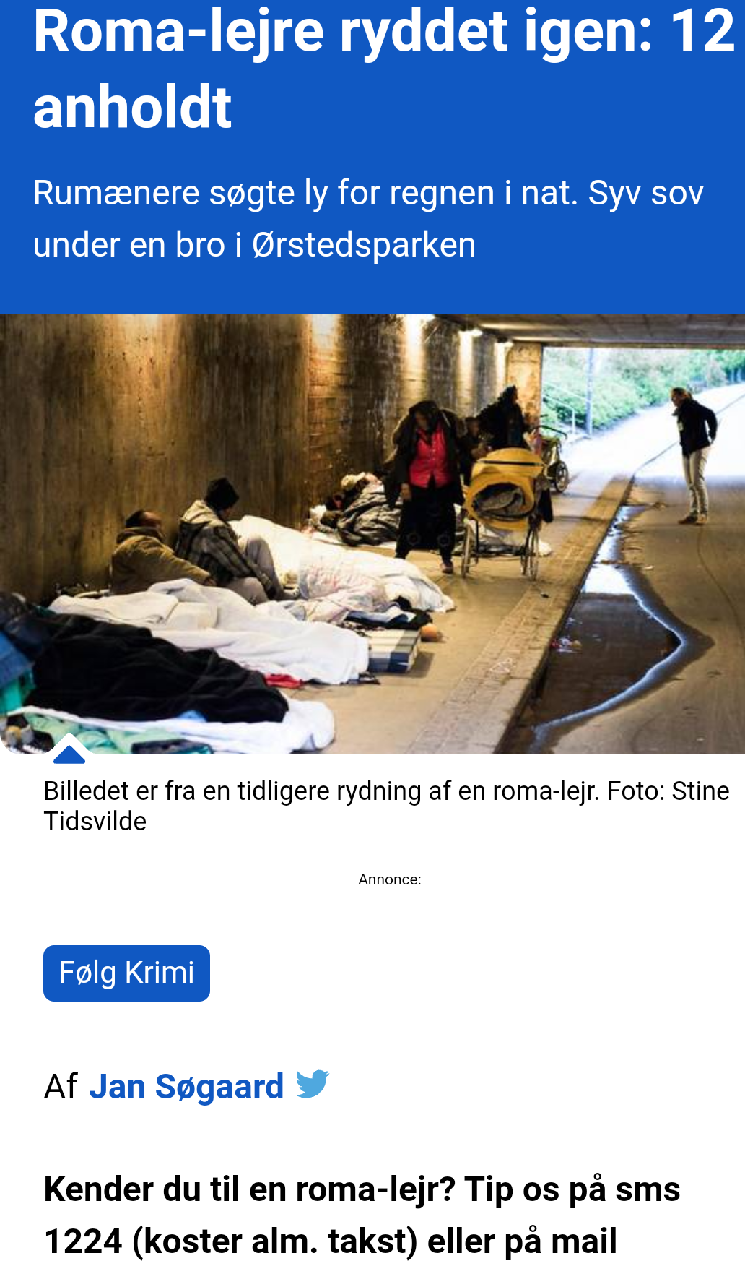
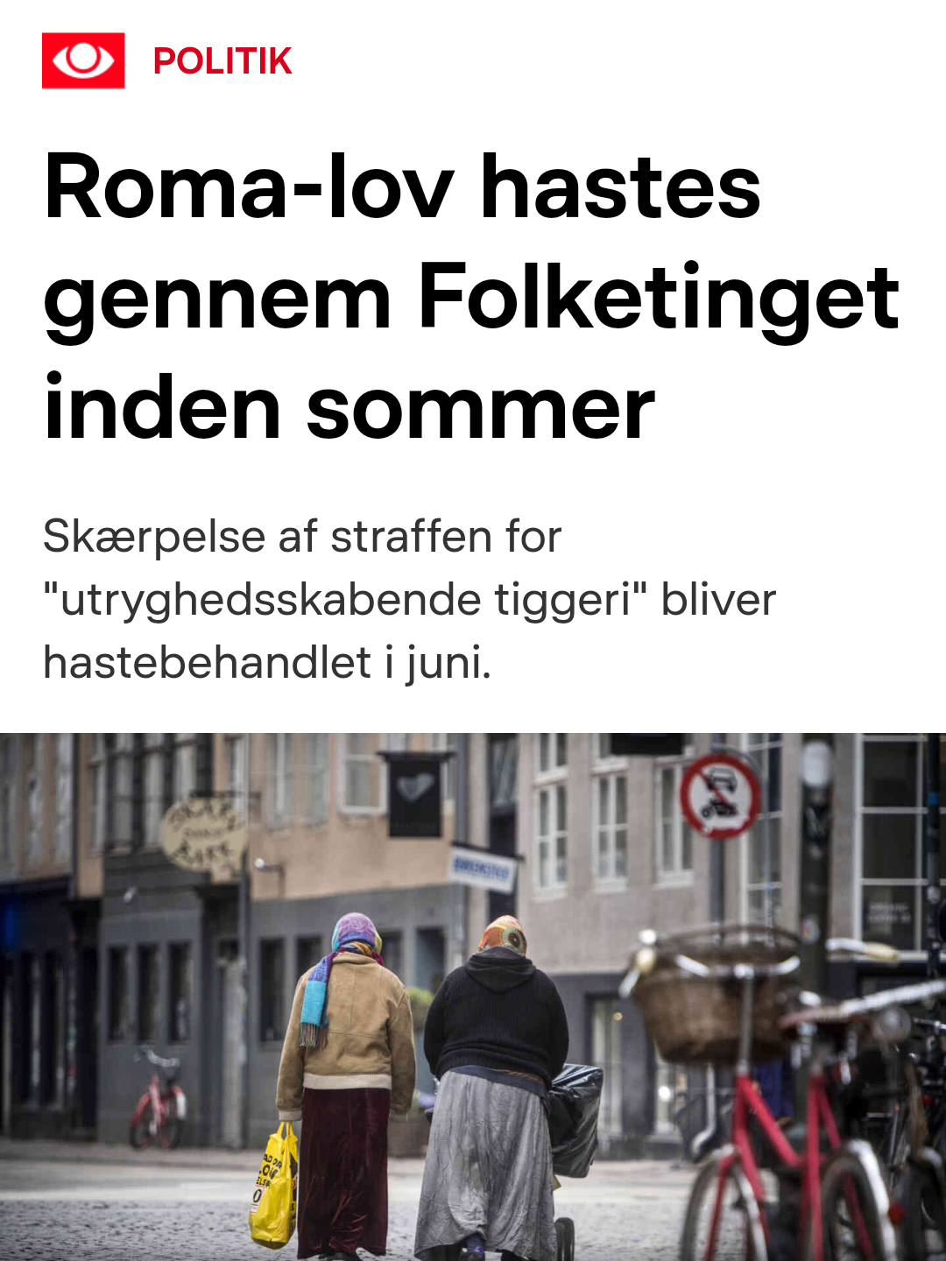
”We will not tolerate insecurity-creating roma” former prime minister, Lars Løkke Rasmussen
“[t]he government wishes to take action against travellers of a foreign origin, who camp in public places, i.e. in parks and public streets, and who, by staying there, create dangerous situations and nuisance for both passers-by and residents. [...] Some of the people who stay in “danger-creating” camps support themselves for instance, by collecting bottles and begging, and it is proposed on this basis, as well as in the face of aggressive begging, that action be taken. (Former Minister of Justice, Søren Pape Poulsen)

Slide 6
The number of § 197 convictions from 21st of June 2017-31st of December 2021 in the Copenhagen Police Department
NATIOANLITY/POLICE DEPARTMENT | IMMIGRATION CONTROL SECTION | OTHER DEPARTEMENTS | TOTAL
DENMARK | 2 | 1 | 3
OTHER NATIONALITIES | 63 | 5 | 68
TOTAL | 65 | 6 | 71

Slide 7
THE CASE IN FRONT OF SUPREME COURT
Lacatus vs. Switzerland
In January 2021, ECtHR concluded that it was a violation of Lacatus’s Human Rights article 8 to sentence her to 500 Swiss Franc, converted to five days in prison, for begging.
It did however not establish begging as a human right, but focused the specific vulnerabilities of Lacatus.
A Lithuanian citizen was convicted of begging at the Copenhagen Central Station.
3rd offence: sentenced to serve 60 days in prison and was given a deportation order with a 6-year entry ban.
The articles tried in court:
Article 8, the right to respect for private and family life
Article 10, freedom of expression
Article 3, prohibition of torture and degrading treatment
Article 14, prohibition of discrimination
The Danish Supreme Court decided to uphold the verdict and stated that the sentence was not a violation of his human rights.

Slide 8
CRIMALINISING POVERTY AND HOMELESS LEAVES PEOPLE INADQUATELY PROTECTED BY THE LAW
Common traits for those we have met in Kompasset subpoeneaed for begging:
Come from disadvanted communities
High levels of illetarcy
Some have families to provide for
Some are old or disabled
Their life situation is similar to the one of Lacatus
Many are convicted in absentia, which means that personal circumstances have not been considered in the decision.

Slide 9
CONCLUSIONS
Criminalization and penalization of poverty and homelessness only bring added stigmatization to marginalized people
We need to challenge criminalization of the majority’s concept of what and who creates insecurity in public space
Begging and rough sleeping should be met with supportive and inclusive alternatives to criminalization and penalization

