Slide 1
Opportunities and risks of the energy transition for homelessness and housing exclusion
FEANTSA Policy conference 2022

Slide 2
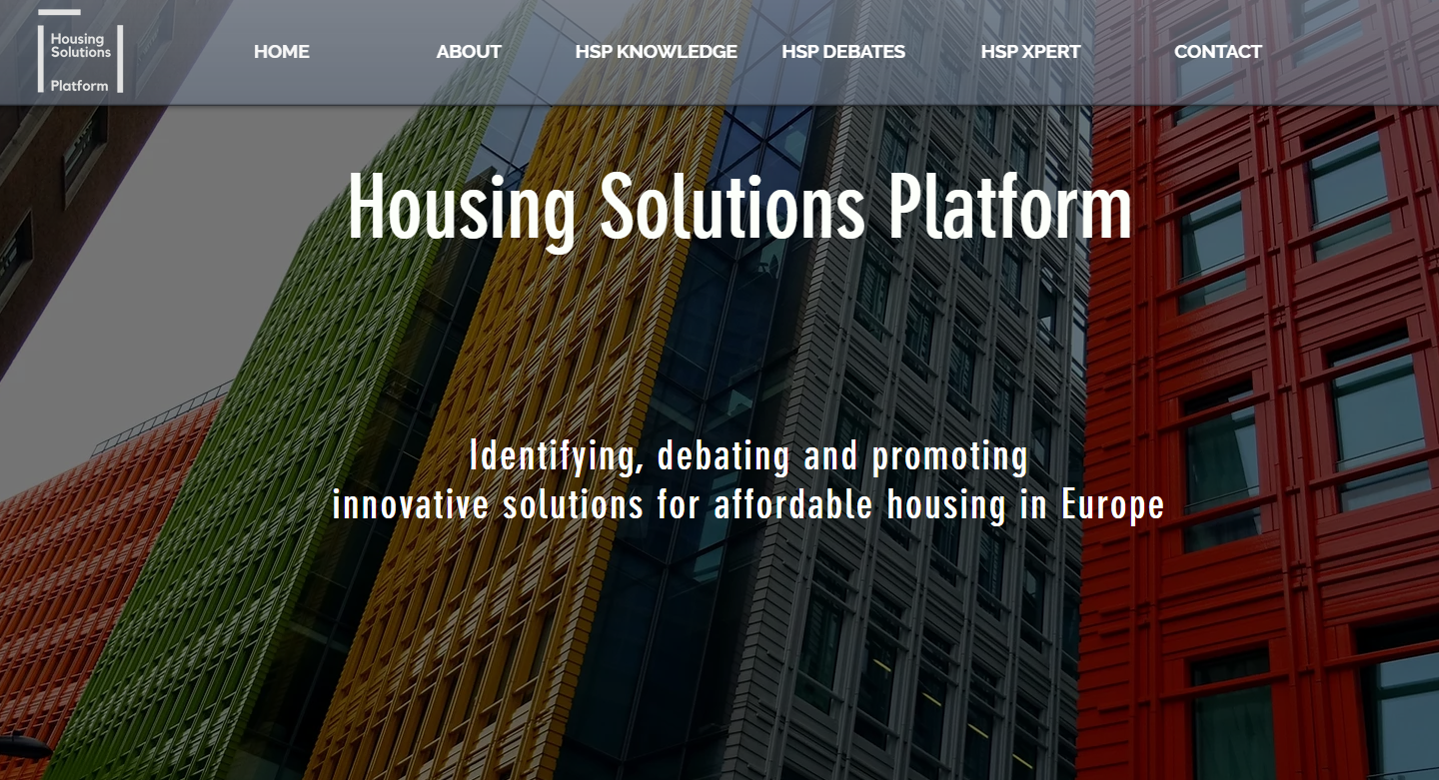
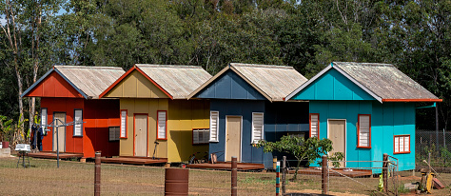

Slide 3
Structure
Overview of EU plans for climate action
Social implications: risks
What do we do? Opportunities
What’s next?

Slide 4
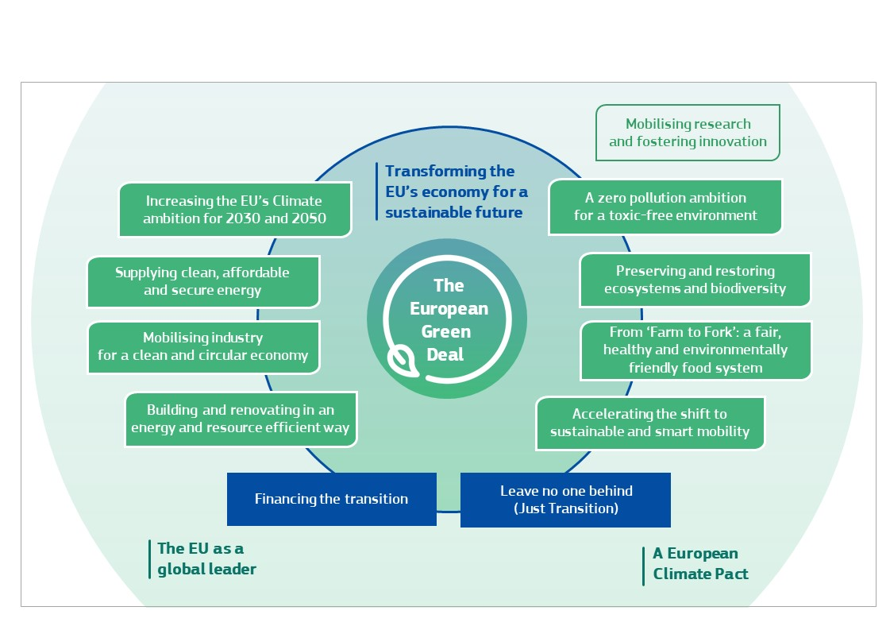
EU Climate Ambition
Green Deal goals (2020)
EU Climate law (July 2021)
an 2030 climate target of at least 55% reduction of net emissions of greenhouse gases as compared to 1990,
a legal objective for the Union to reach climate neutrality by 2050

Slide 6
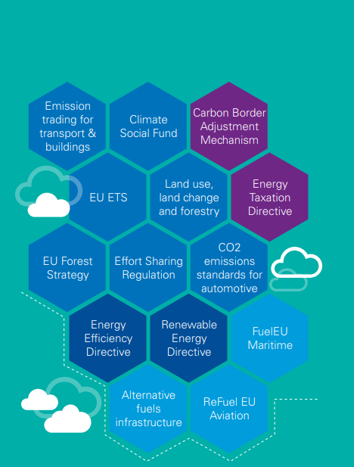
Fit for 55 package
Emission Trading Scheme extension to buildings & road transport
Energy efficiency Directive review
Energy performance of building directive recast
Social Climate Fund

Slide 7
Risk 1. energy prices
Synergies and trade offs between climate change mitigation policies and poverty alleviation.
trade-off: potential increase in energy poverty levels as a result of strong climate change action (price). ETS 2
Flemish study: ETS extension could lead to an increase of 460 euros in energy expenditure for Flemish households
Polish Economic Institute estimates an extension of the EU emissions trading system to road transport and buildings would mean an average annual increase in energy expenditure for the EU's poorest households of 44 % (EUR 373) for transport and 50 % (EUR 429) for housing .
Synergy: deep energy efficiency in buildings.

Slide 8
Renovation wave: addressing climate emission & energy poverty!
Renovation wave:
Improved thermal comfort
Lower energy use & therefore costs
Reducing health risks – cold or damp homes
Reducing carbon emissions

Slide 9
EPBD
Introduction of minimum energy performance standards (MEPS)
for new buildings,
Existing buildings undergoing major renovations,
for the replacement or retrofit of central building elements like heating and cooling systems

Slide 10
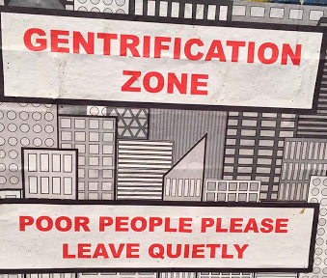
Risk 2. Housing prices
Basic perspective: increase in house prices & homelessness for 10 years (rents up by 16%, while house prices have gone up by 42%. )
The ‘win-win’ cannot always be assumed
Who finances the renovations?
Rising rents & “Green gentrification”
Upfront costs
For instance when financing is based on rent increase based on expected energy savings … but
Not accurate estimations
Consumers take some of benefits in increased comfort
may go from heating one room to all home

Slide 11
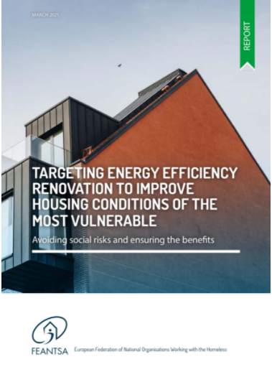
Gothenburg
Unaffordable rent levels
Gdansk (Letnica)
Regeneration displacing the existing population
Notes:
42 % of multi family homes built during the 60s – Swedish million home program
A study considered costs based on data from six pilot retrofitting projects, together with
projections up until 2026, and an assessment of what the impact would be if this was paid for
through rent increases. Analysis of the pilots showed that the financial
model of paying for renovation through increased
rents is regressive, leading to rent levels that are
unaffordable for all those earning less than 60% of
the median income in Sweden, which would mean
that a significant proportion of current residents
could no longer afford to live there.

Slide 12
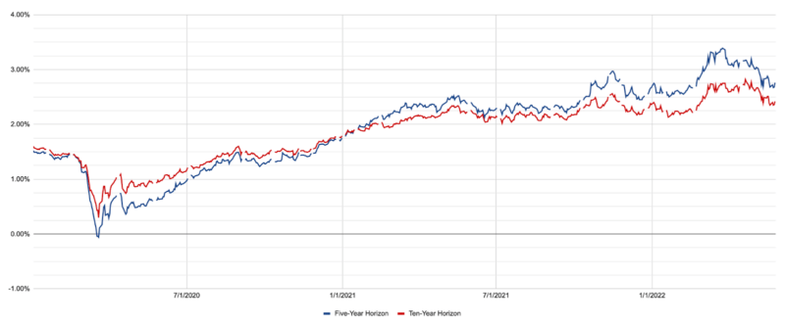
Risk 3. Inflation
Price of materials
Electricity
All commodities

Slide 13
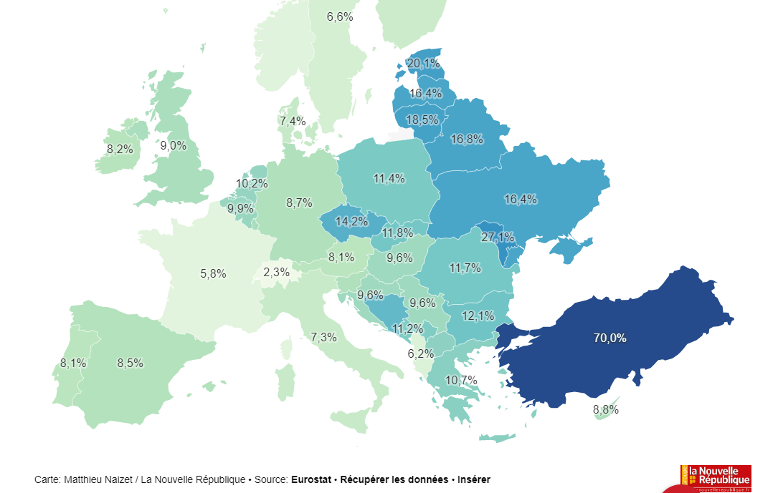

Slide 14
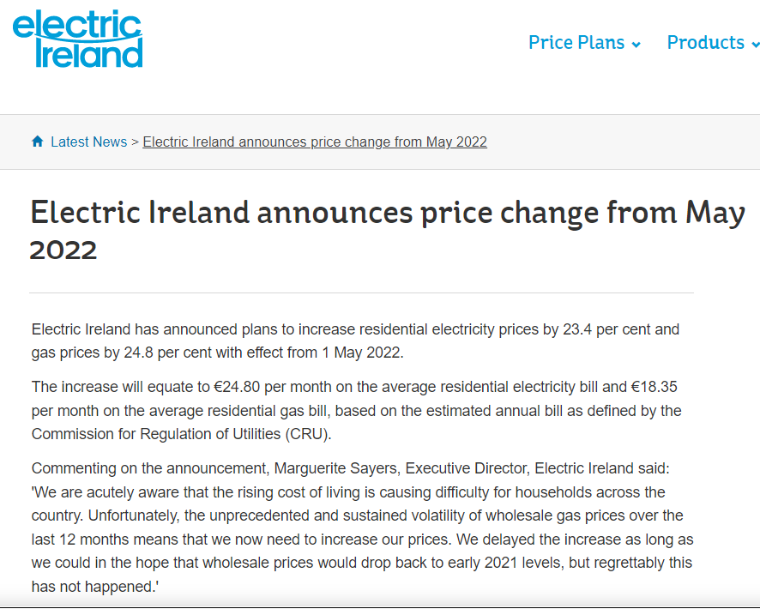
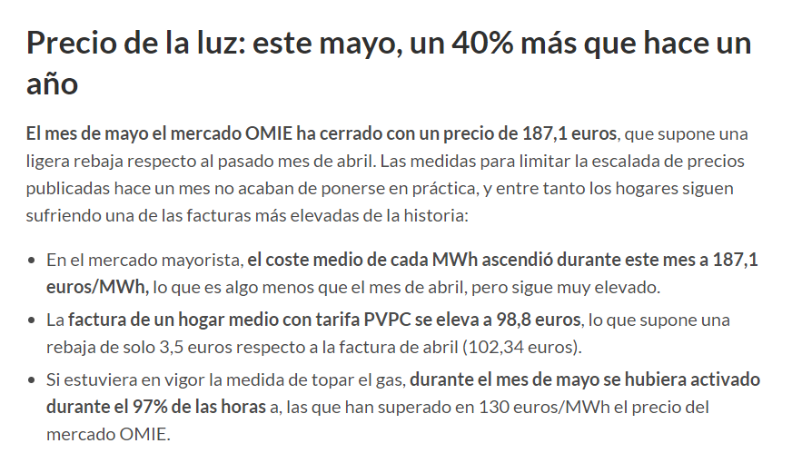

Slide 15
“We should come out of the inflation peak at the end of 2023. But then we will have a structurally higher level of inflation, around 2%, due to the very high cost of the energy transition “
French economy minister (31/05/22)

Slide 17
What do we do? How can we ensure a socially fair energy transition?
A Legislative framework: housing as a right
Rent caps
Ban on renoviction
FUNDING

Slide 18
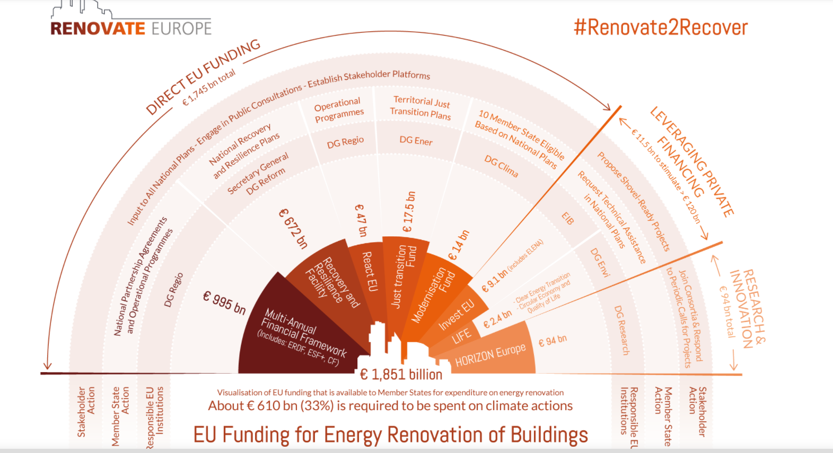
Notes:
If not targeted, low income will not benefit:
Upfront costs
Non financial capacity to reimburse a loan
Non take up

Slide 19
Opportunity 1. target funding to low-income cold homes
Prioritize retrofitting of low-income cold homes with high potential to deliver warmer homes: comprehensive package: financing + advice & guidance

Slide 20
Opportunity 2. Transformation of inadequate collective housing
Toward housing first!

Slide 21
How?
Dedicated funding: earmarked funding or a new fund
Social climate fund
Was 72 B over 7 years
Now decreased by half : direct income support + renovation
An opportunity, a need for social acceptability of the green deal

Slide 22
Adapting & planning ahead

Slide 24
Thank you!
Questions, feedback?
@ClotildeClark1
clotilde.clark-foulquier@feantsa.org

Slide 26
Small group discussion
Is climate change a priority for the homeless sector in your context?
What action are your organisation and others taking in relation to climate change?
What do you know and what do you need to know about climate change and homelessness?
What opportunities and risks regarding homelessness in the context of the energy transition?
How are your services affected by energy prices? What can be done about it?
Can FEANTSA support you in this area? What would be useful?

