Slide 1








Spotlight on the Annual Overview of Homelessness & Housing Exclusion
FEANTSA POLICY CONFERENCE 2022
Towards a Vision for Ending Homelessness

Slide 2

Who are we?
Chloé Serme-Morin – external researcher for FEANTSA
Sarah Coupechoux – Policy officer for EU affairs, Fondation Abbé Pierre (France)

Slide 3
Setting the scene
European Index of Housing Exclusion 2022
EUROSTAT / EU-SILC data Y-2
Situation of 2020

Slide 4
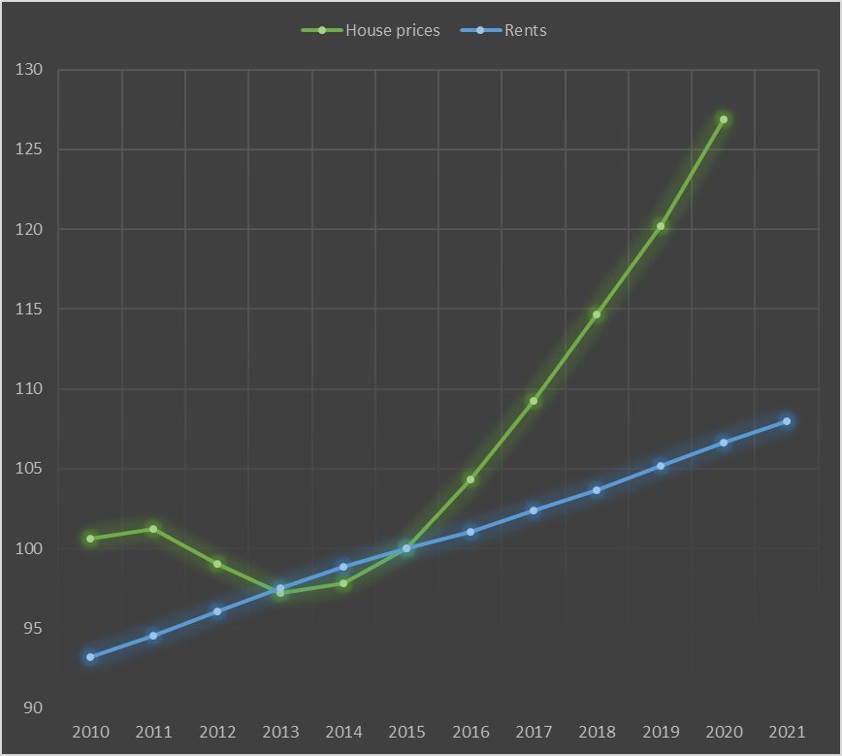
Households’ budgets under increasing pressure
Changes in in housing costs from 2010 to 2021
(EU27 index: 2015 = 100, at current prices)

Slide 5
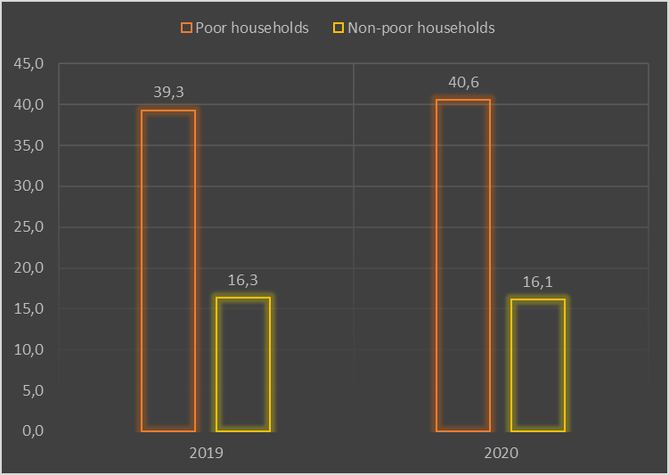
Significant housing cost overburden
Change in the proportion of households’ disposable income spent on housing costs
(EU27, %)

Slide 6
Growing indebtedness
Households in rent or mortgage arrears
(EU27, %)

Slide 7
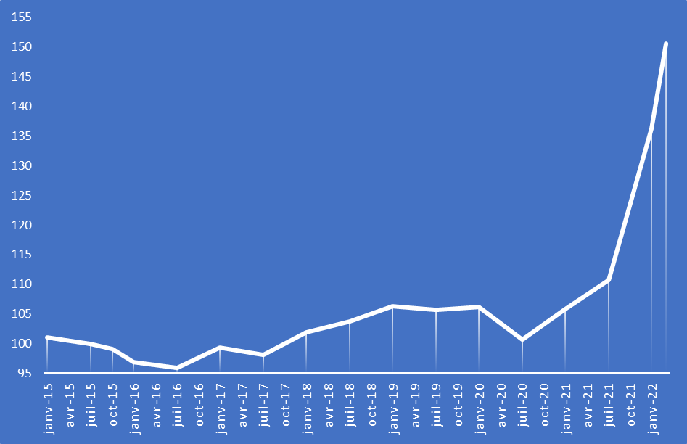
An explosion in energy costs
Monthly change in the price of electricity, gas, and other liquid fuels in the EU27
(Index, 2015 = 100)

Slide 8
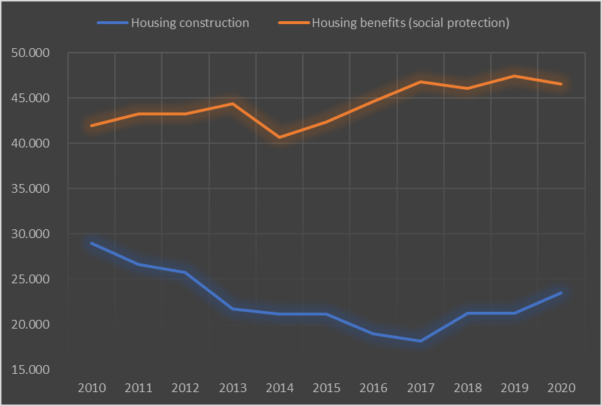
Shortage of (affordable) housing
Changes in public expenditure on housing construction and housing benefits in the EU27
(in million euro)

Slide 9
Homelessness in Europe

Slide 10
(GOOD) LESSONS FROM THE PANDEMIC
“Homelessness is the most extreme form of social exclusion and it has been growing across the EU. We must act now. The EU Platform on Combatting Homelessness will help partners to share experiences and policy measures that have worked in their regions and cities, so we can radically reduce homelessness in Europe. Housing and assisting the homeless is Principle 19 of the European Pillar of Social Rights - and it is a moral imperative if we are serious about building a fair and inclusive society.”
Nicolas Schmit, EU Commissioner for Jobs & Social Rights
Europe’s first-ever commitment to end homelessness by 2030
Using the economic recovery to tackle homelessness
Examples of the Recovery & Resilience Plans for Italy, Spain, Belgium, Portugal.
Adaptation of emergency accommodation to ensure more humane conditions
Examples from Poland, the Netherlands, Berlin, Brussels, France.
Systemic housing-led changes
New strategies in DK, DE, NL, ES, IE, (UK-Scotland)

Slide 11

CHALLENGES AHEAD
In Dublin,
in 2021,
115 deaths of homeless people were recorded.
That’s one person every three days.
This number doubled compared to 2019.
A persistent lack of adequate and affordable housing stock for housing led solutions
The reception crisis, the invasion of Ukraine & the not-so-new challenge of welcoming refugees
End of temporary protective measures taken during the pandemic: keeping people in their homes at all costs!
Example of the evolution of the nb of people in homelessness accommodation during the pandemic, IE

Slide 12
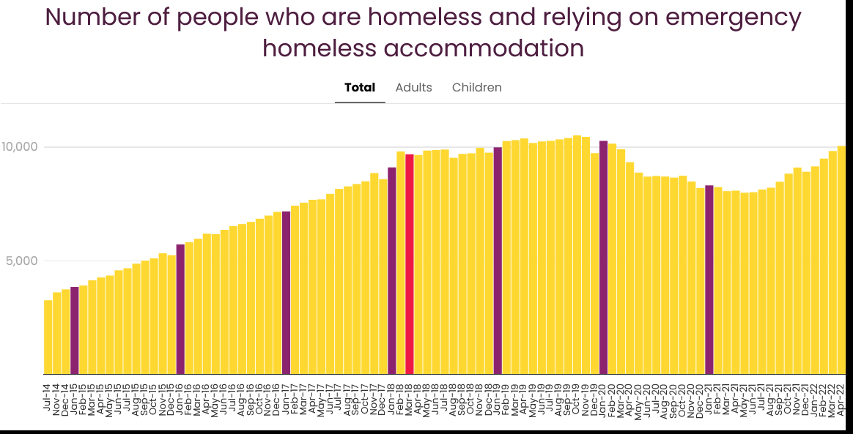
CHALLENGES AHEAD
End of temporary protective measures taken during the pandemic: keeping people in their homes at all costs!
Chart Focus Ireland / Source Irish Government

Slide 13
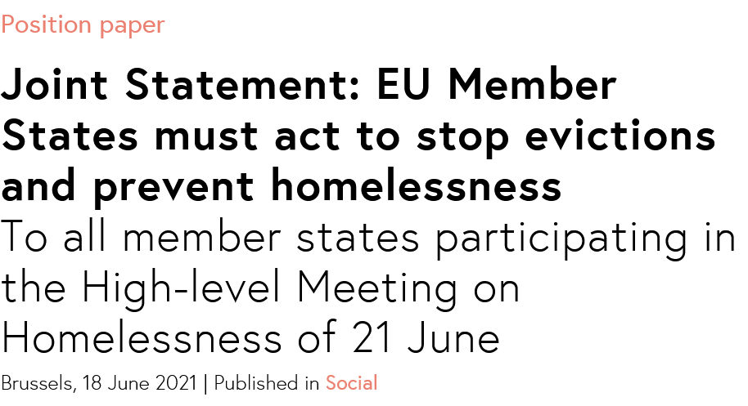
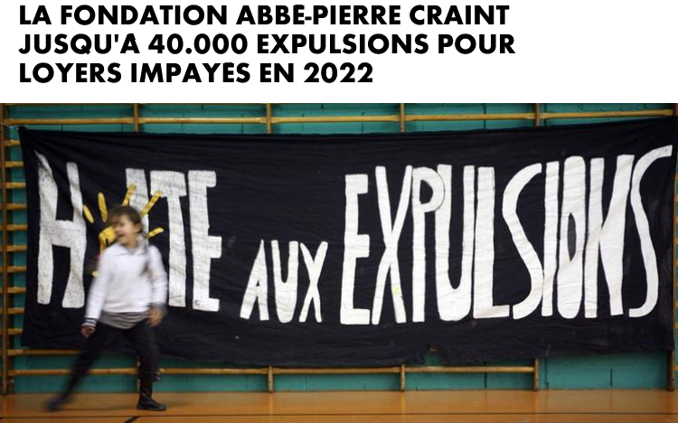
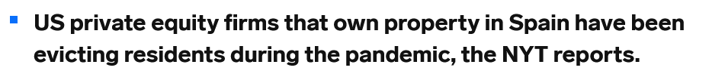
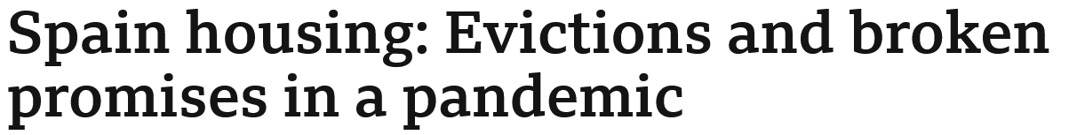
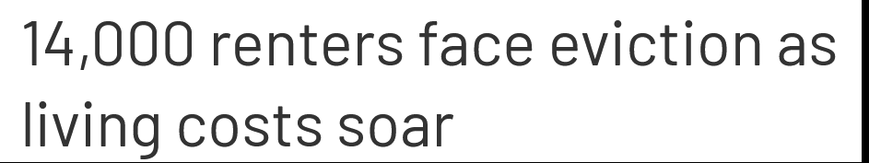

Evictions in post-pandemic Europe

Slide 14
Little-known evictions & their major social impact
Insufficient data
An accelerator of poverty and inequality
A costly phenomenon
Keeping people in their homes during the sanitary crisis
The temporary “grace period” under the exceptional protection measures adopted during the crisis
Households’ economic fragility and the increase in housing expenses
The foreseeable re-increase evictions
Prevention VS cure
5.4%.
of Europeans stated in the first half of 2021 that they risked having to leave their current housing within the next three months due to being unable to pay the rent
= at least 12 million people, a figure equivalent to the population of a country like Belgium, are living in fear of eviction due to unpaid rent
Source : Eurofound

Slide 15
SNEAK PEAK OF RECOMMENDATIONS
No one should be evicted without housing solution and become homeless
Good quality data on evictions is needed to strengthen and adapt prevention tools
Must-haves of prevention strategies
No repetition of past mistakes (post-2008)
Align the objective of fighting fuel poverty with the fight against poor housing and homelessness
Use recovery budgets as levers to contribute to the goal of ending homelessness
Precisely define the meaning and concrete obligations induced by “social impact” investment
Make the European Homelessness Platform a real tool for transforming public policies

Slide 16

Please share any questions,
remarks,
experiences!

