Slide 1
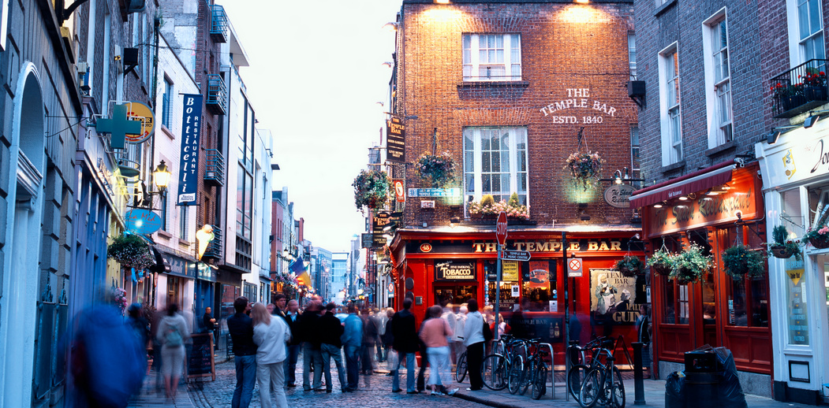


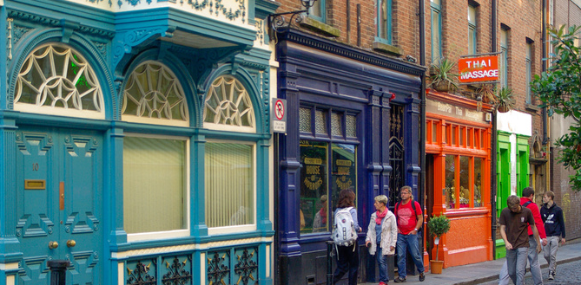

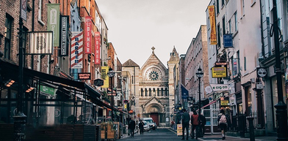
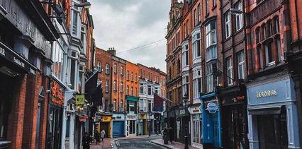

Seminar: Building blocks for a campaign on the Right to Housing
Aoife Kelly-Desmond, Mercy Law Resource Centre
FEANTSA POLICY CONFERENCE 2022
Towards a Vision for Ending Homelessness

Slide 2

Right to Housing: the Irish Context
  Recognising a right to housing in the Irish Constitution requires a public referendum
  Over 80 countries recognise a constitutional right to housing
  The right to housing is not currently recognised in the Irish Constitution
  Combined with robust protections for private property rights, that gap creates a fundamental imbalance in the Constitution

Slide 3
International context
  Ireland is party to many international instruments that recongise the right to housing or related /adjacent rights, including:
European Social Charter (Ireland has opted out of Article 31 on housing)
International Covenant on Economic, Social and Cultural Rights
Charter of Fundamental Rights of the European Union
European Convention on Human Rights
Convention on the Rights of the Child
International Convention on the Elimination of All Forms of Racial Discrimination
UN Convention on the Elimination of all Forms of Discrimination Against Women

Slide 4
  A constitutional right to housing can take many forms
  To be impactful it must be:
  -Standalone
  -Justiciable
What could better look like?
Article 43A
1. The State recognises, and shall vindicate, the right of all persons to have access to adequate housing.
2. The State shall, through legislative and other measures, provide for the realisation of this right within its available resources.

Slide 5

Thank you!

