Slide 1
Shining a Light on the Invisible
Relationships, Adversity and Psychologically Informed Environments
Dr. Adam Burley
Consultant Clinical Psychologist
NHS Lothian Psychotherapy Department
@DrAdamGWBurley

Slide 2
‘There is no such thing as a baby.’
D. Winnicott (1957)

Slide 5
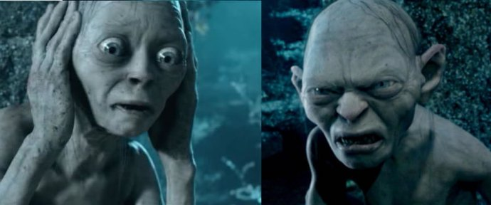

Slide 6
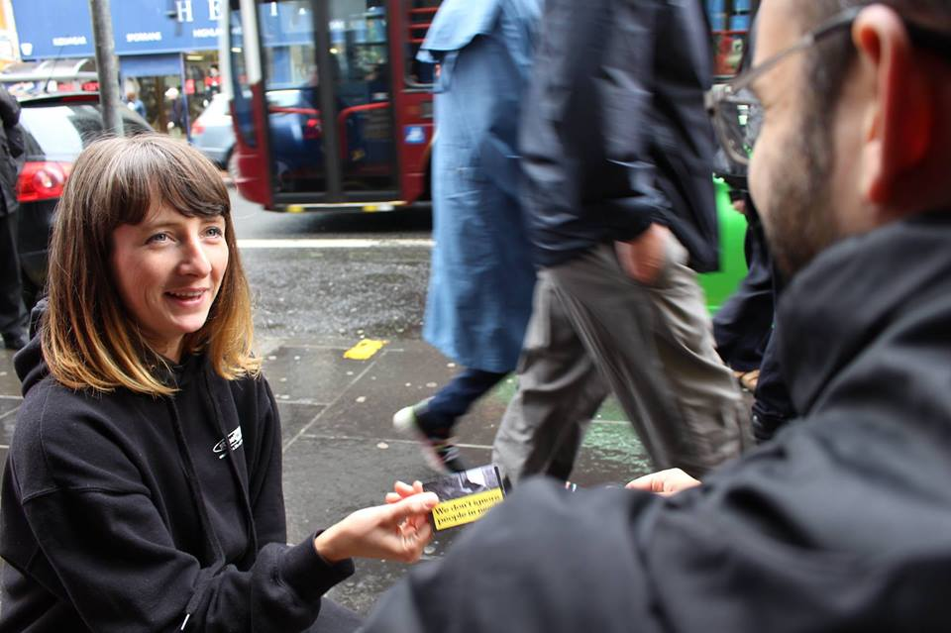
‘There is no such thing as service user / patient.’
A. Burley (2019)

Slide 12
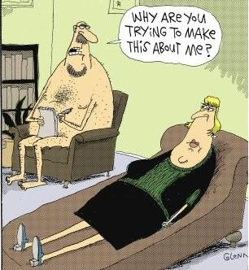
Thoughts / Questions?

