Slide 2
Involving Peers as Homeless Health Advocates
Groundswell UK

Slide 3
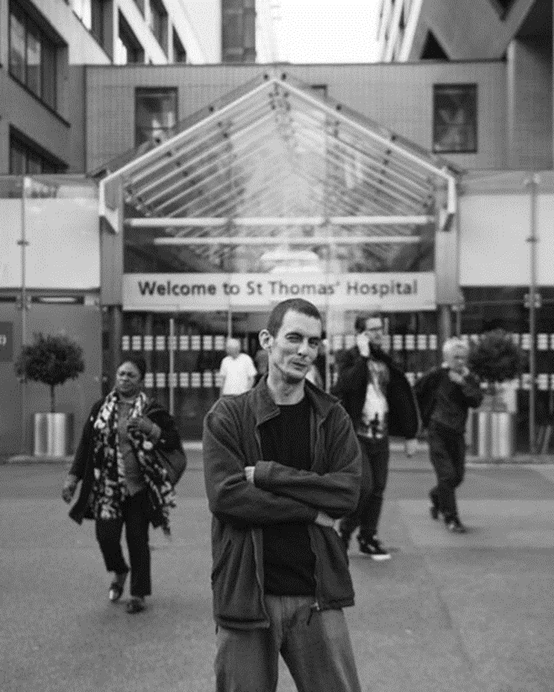
Who are Groundswell?
We enable homeless and vulnerable people to take more control of their lives, have a greater influence on services and play a fuller role in the community.
Speaking up & speaking out about homelessness

Slide 4
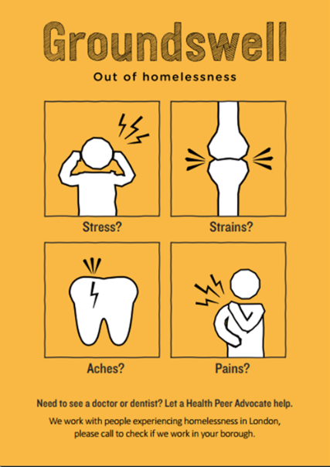
HHPA

Slide 5
Why ‘Peers’?
Speak the language!
Real understanding of the problems people face.
Peer
Homeless Person
Professional
Not an authority figure
Don’t feel judged
Re-build trust! Provide Inspiration!
“I’ve been in the system all my life, it takes a lot for me to trust people, but straight away from the word go he explained that he’s had his troubles in the past and that really broke the ice, I felt quite comfortable.” – HHPA Client

Slide 6
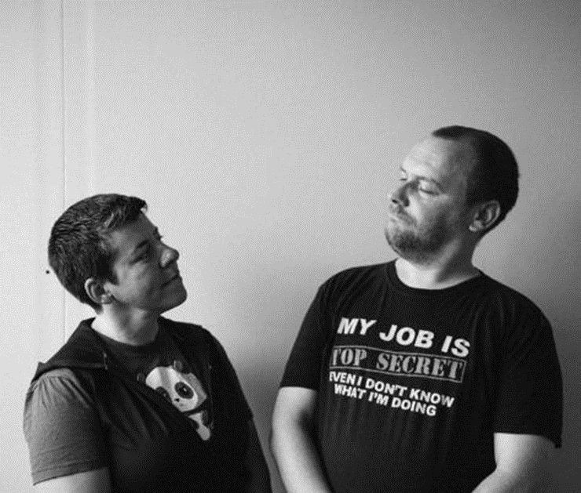
Asset Based Approach
We value the experience and skills people gain through their lives.
We take an asset-based approach - starting with the skills, experiences and knowledge that someone already has gained.
Coaching & Advocacy – not support work
“I was taught to see my past as a life-experience and in doing so have recovered lost years to hopefully benefit others.” – Peer Advocate

Slide 7
The Ideal Peer Advocate
No:
Anyone still drinking or using
Anyone too vulnerable who the work could put at risk of relapse or harm.
Anyone legally barred from working with vulnerable adults or with an offending history that suggests they’re a risk
Anyone who lacks empathy or patience
Yes:
People with lived experience of being homeless.
People with lived experience of using the health care system.
People who like working with others.
People who are good at listening and doing.

Slide 8
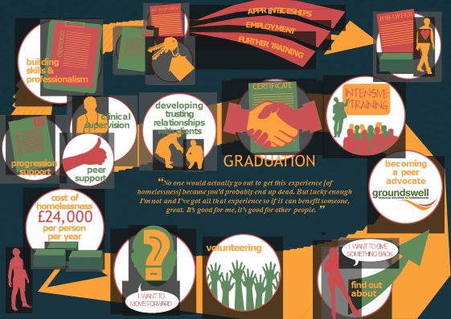
The Peer Journey:

Slide 9
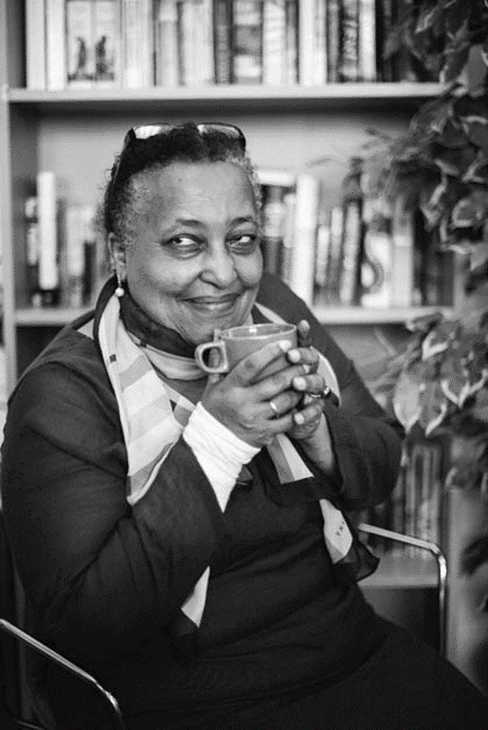
Volunteer Outcomes
Since HHPA began delivery in 2010:
128 volunteers have completed the 6 week HHPA training and gone on to become Peer Advocates
67 have got paid jobs
Including 5 who have gone on to train as nurses
“I started to build my confidence and get clean. The fact that there was a career option out there for me made a huge difference. I saw former volunteers who now had paid jobs and it was so inspiring”

Slide 10
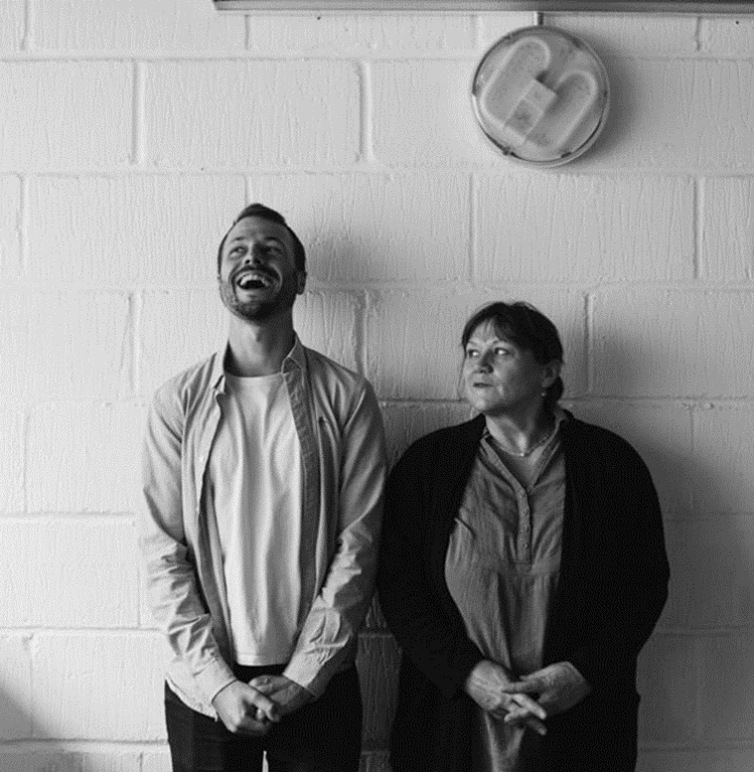
Our Learning:
How do you want people to be involved be clear what/when/where/why
Clear boundaries – it’s better to do one thing well. Don’t burn people out
Representative of people on the ground – Engaging a broad range of views by people who have recently experienced the issue. Not the same ‘tame EbyE’.
Needs to be supported. Preparing for what could go wrong.
Needs significant resource to make it effective.

