Slide 1


Slide 2

Partnership working within LGBTIQ Youth Homelessness
Gary McMillan – Project Worker/Chair person of LGBTIQ focus group at Rock Trust

Slide 3

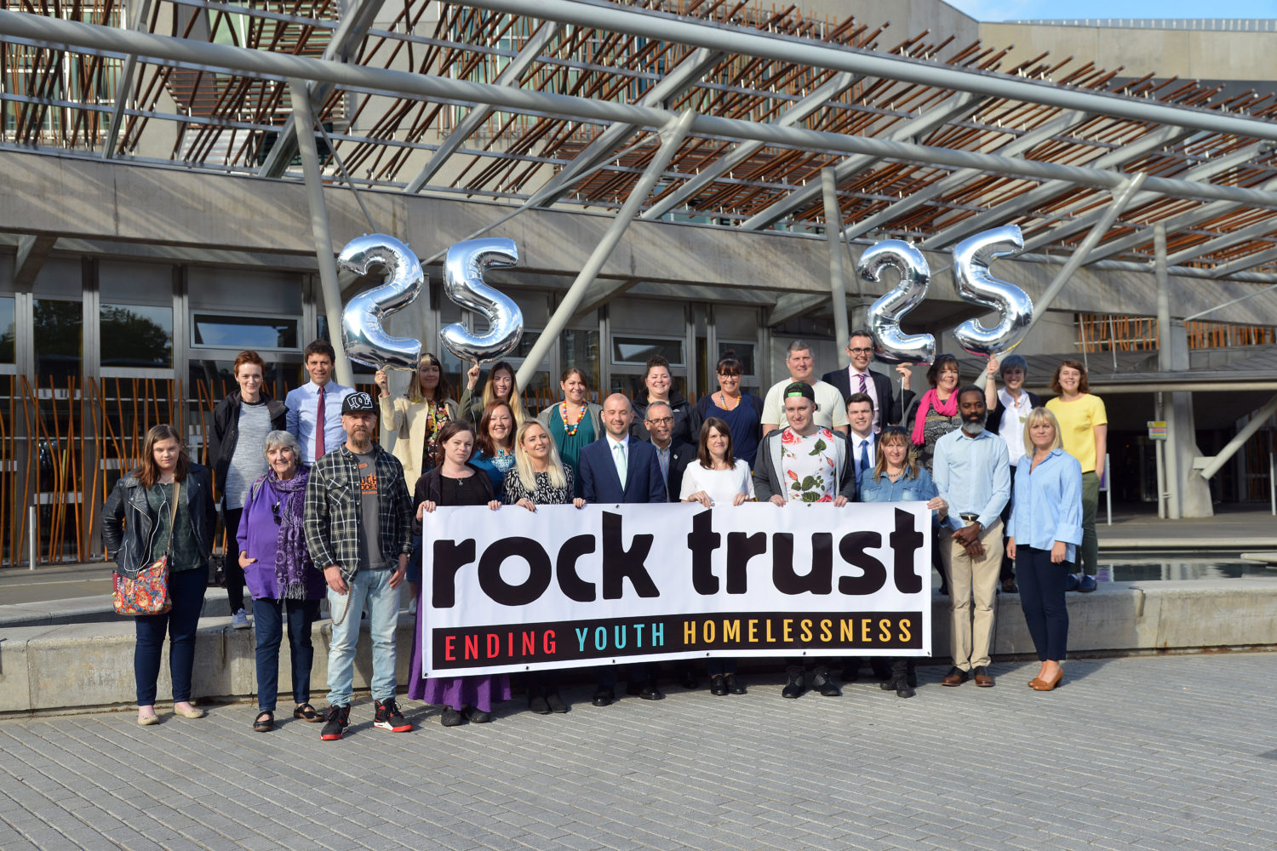

Rock Trust – Mission Statement
The Rock Trust aims to prevent youth homelessness and to support young people to build better futures

Slide 4
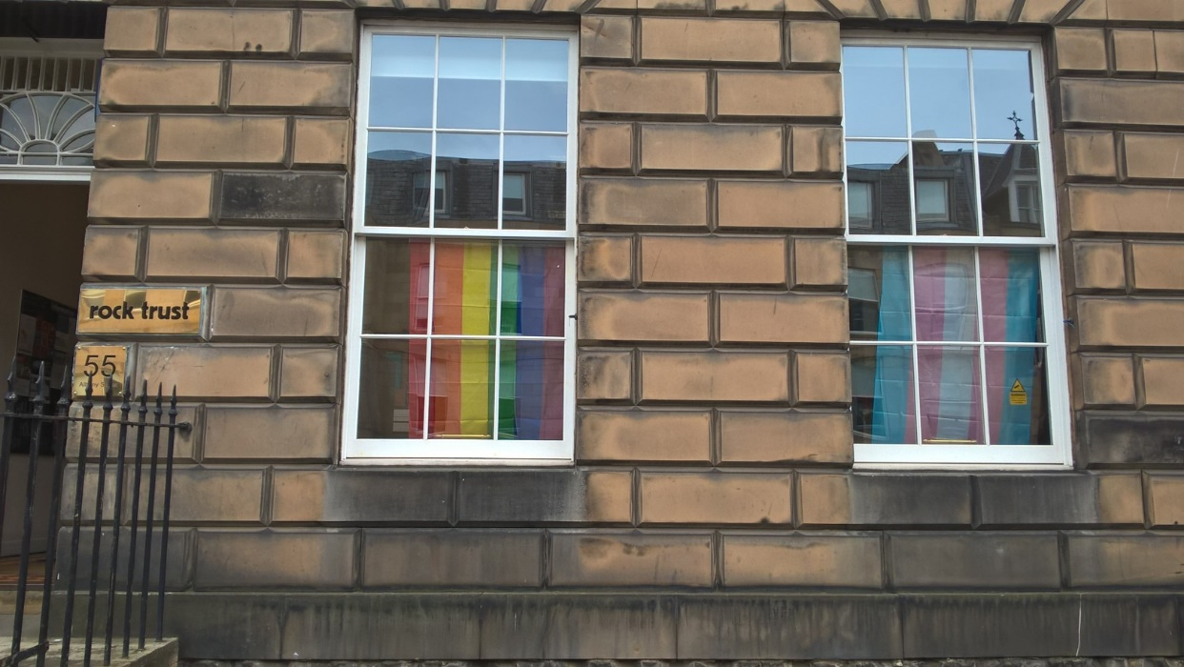
Rock Trust – About us
The Rock Trust was set up in 1991 in Edinburgh in order to do something practical for homeless young people between the ages of 16-25.
The Rock Trust has always believed that homelessness was more than rooflessness and that young people needed to be encouraged to learn social and practical skills so that they can be active participating members of their community

Slide 5
Our Services
Accommodation for up to 2 years in Edinburgh and surrounding areas.
Housing First for Youth – New Project for Summer 2019.
Group work (Cooking, Service users involvement, Employability) and one to one emergency support.
Health and Wellbeing support with Art Therapy.
Night Stop (emergency accommodation).
Specific emergency support for 16/17 year old presenting at Edinburgh Council
Volunteer/work experience opportunities.
Rent Deposit Scheme for private letting in the city.
Peer Mentoring.

Slide 6
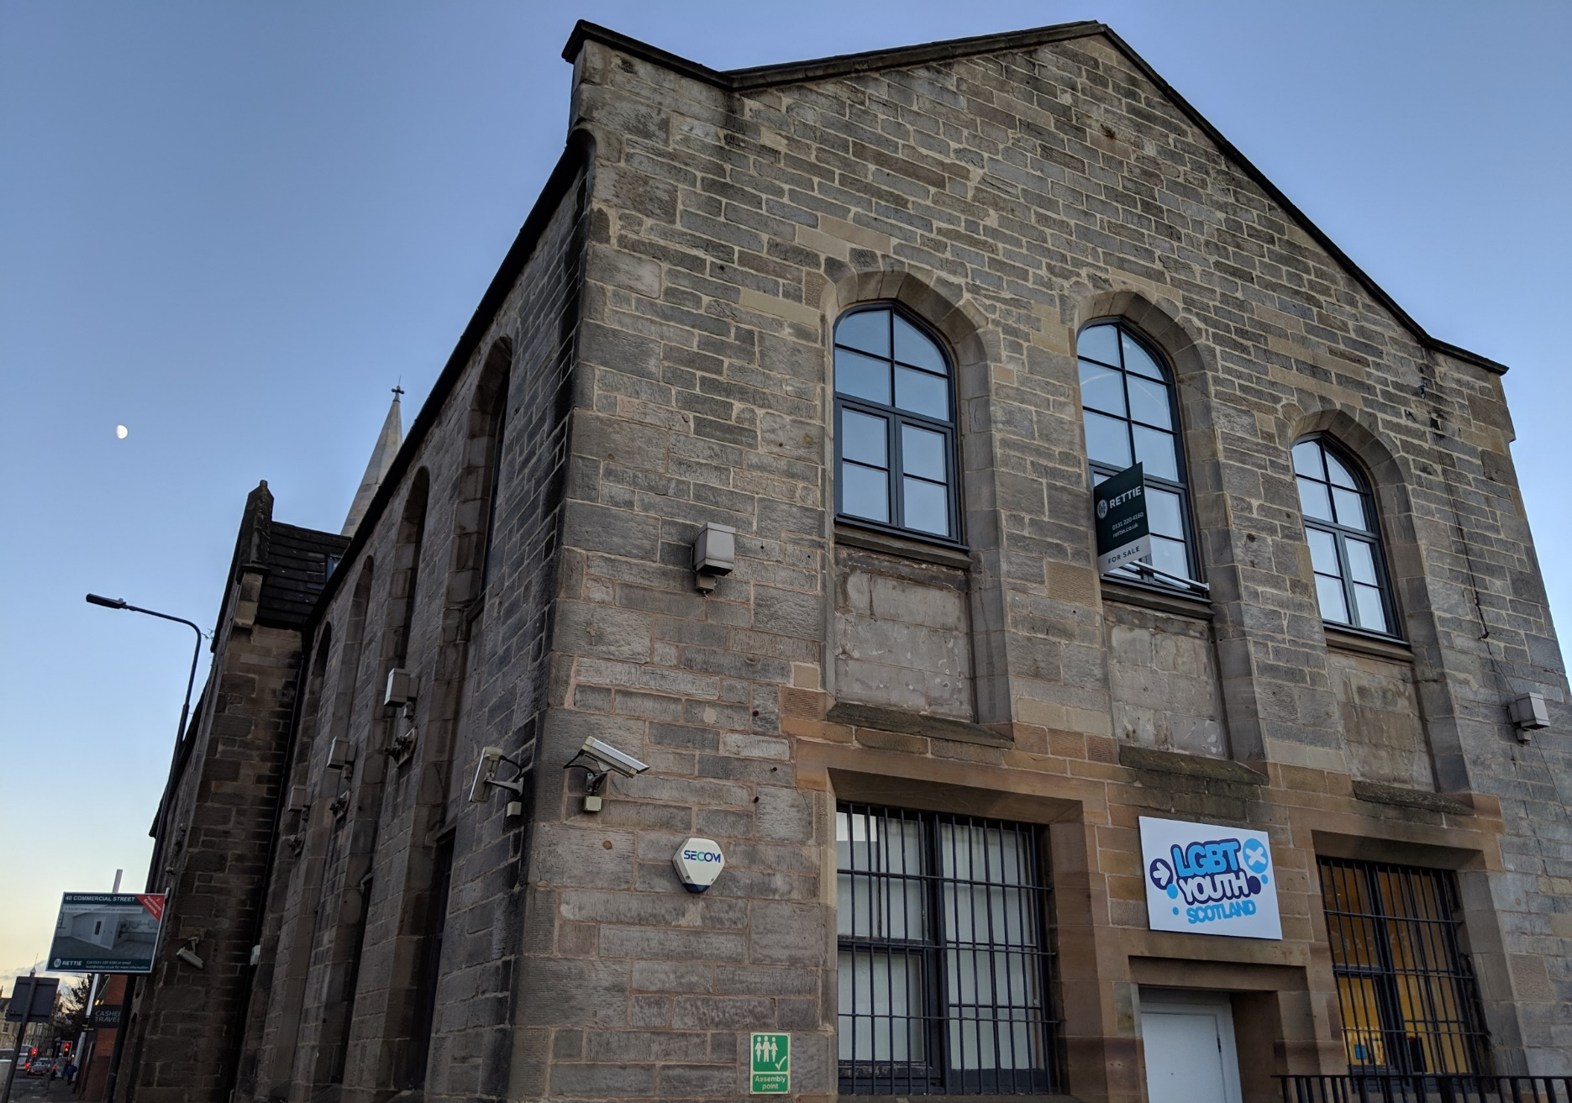

LGBT Youth Scotland
We are Scotland’s national charity for LGBTI young people, working with 13–25 year olds across the country. We also deliver the LGBT Charter programme to schools, organisations and businesses.
Our goal is to make Scotland the best place to grow up for lesbian, gay, bisexual, transgender and intersex young people. We play a leading role in the provision of quality youth work to LGBTI young people that promotes their health and wellbeing, and are a valued and influential partner in LGBTI equality and human rights.

Slide 7
Partnership Working (Rock Trust & LGBT Youth)
Rock Trust have had a long standing relationship with LGBT Youth Scotland.
LGBTIQ young people have faced and continue to face barriers in life due to being who they are and need to access homeless support agencies.
We seek guidance and support from LGBT Youth Scotland to ensure that we are as supportive and respectful to our young people.
At Rock Trust we have been able to solidify our commitment to the work we do with young people by applying for and obtaining LGBT charter awards and allow everyone who comes into contact with Rock Trust to be aware of our culture and values.

Slide 8
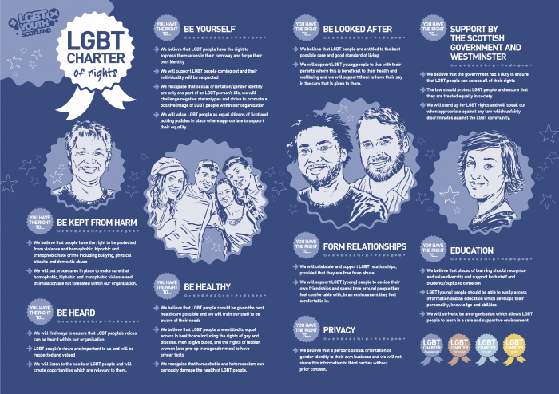
What are the LGBT Youth Scotland Charter Awards?
In 2003 a group of young people in Dumfries in South West Scotland started a small project to ensure that their rights were being met as LGBTIQ young people within the health service.
It soon became apparent that cross all areas of life they were having to be specifically “pigeon holed” into declaring their gender and identity.
With support from LGBT Youth in Scotland a programme was developed in order to support organisations to support young people as best as they can.

Slide 9
LGBT Youth Scotland Charter Award
By increasing the awareness and visibility of LGBTIQ people LGBT Youth Scotland is dedicated to ensuring that all LGBTIQ people are valued, included and supported.
The charter is in place to help demonstrate an organisation’s commitment to LGBTIQ people in their local area by supporting them to identify their rights.
By displaying the LGBT Charter of Rights an organisation sends out a positive message to LGBTIQ people in your area that they will be included, valued, supported and will be treated fairly when accessing a service.

Slide 10
Charter Mark Awards
The charter was developed in four areas in order to allow organisations of all sizes to be able to show their support for LGBTIQ people.
Foundation
Bronze
Silver
Gold
Each organisation has an appointed representative who liaises with an appointed LGBT Youth Scotland contact throughout the process to ensure they are ready to submit their folder of achievement. This is then assessed by senior managers at LGBT Youth who audit the submission to determine if the specific organisation can obtain the Charter Mark Award.

Slide 11
LGBT Youth Charter

Slide 12
LGBT Youth Charter

Slide 13

Rock Trust Bronze Award
We worked with LGBT Youth Scotland to undertake the steps towards obtaining the Bronze award in 2013 and were awarded this in 2015.

Slide 14
Rock Trust Silver Award
Following on from the Bronze award in 2016 we started the process of starting the process to obtain our Silver Charter Mark Award

Slide 15
Young People’s Survey
Question | Yes | No | Don’t Know
Do you feel that the Rock Trust is a safe environment for young people | 100% | 0% | 0%
Do you feel that the Rock Trust is an inclusive organisation | 90% | 0% | 10%
Do you feel that you can be yourself at Rock Trust | 50% | 20% | 30%
Do you feel that Rock Trust is committed to treating everyone the same | 80% | 20% | 0%
Does the Rock Trust have information/show support to the LGBTIQCommunity in their youth areas? | 80% | 0% | 20%
Would you recommend the Rock Trust to someone who identifies with the LGBTIQ Community? | 80% | 0% | 20%
Do you mask or downplay who you are when you come to the Rock Trust? | 10% | 90% | 0%
Do you feel that staff at the Rock Trust are supportive of you | 100% | 0% | 0%
If you identify as LGBTIQ do you feel supported at Rock Trust | 80% | 0 | 20%

Slide 16
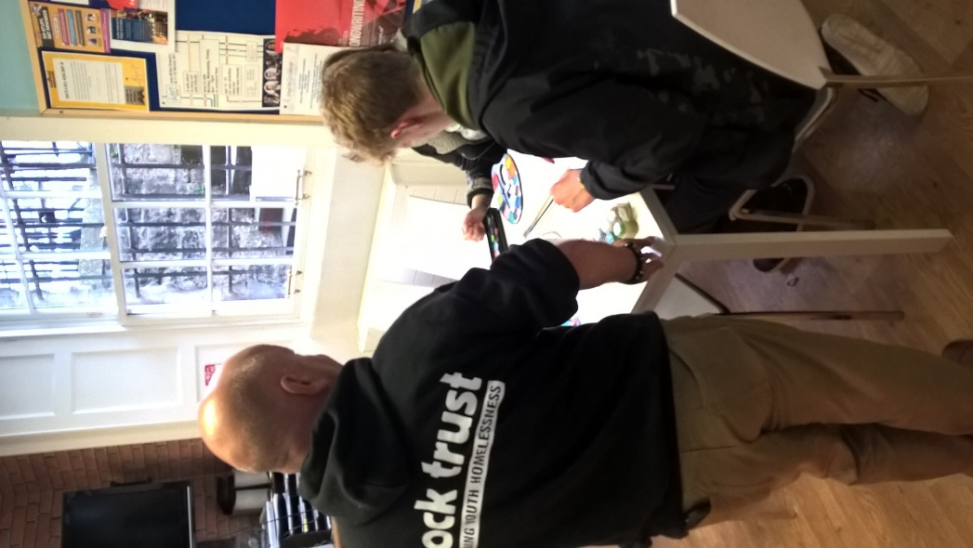
Service User Involvement
We set up a working group of young people to showcase artwork for groups and to how for Pride/LGBT History Month
Service Users are consulted on-going basis and we use groups to open up discussion and involve all young people in discussing diversity and inclusiveness

Slide 17
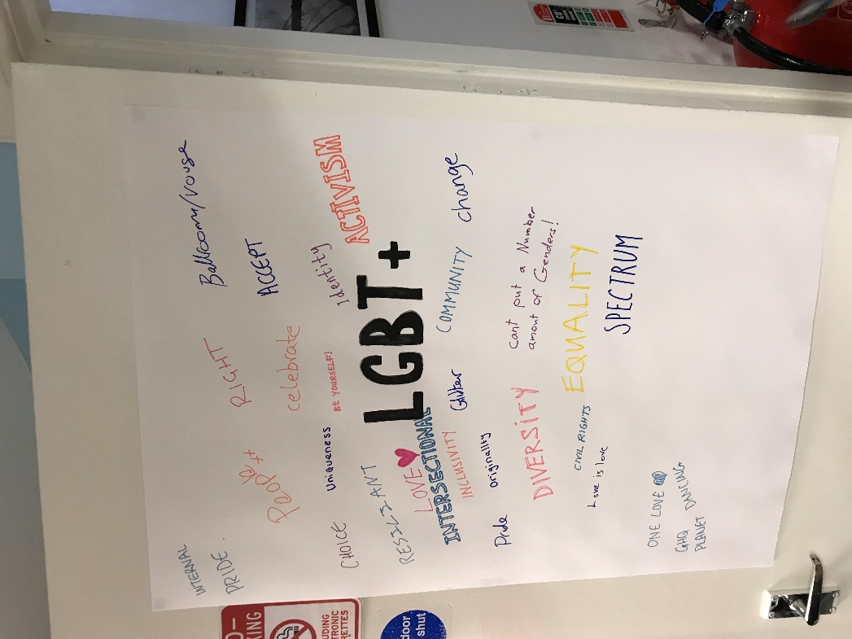
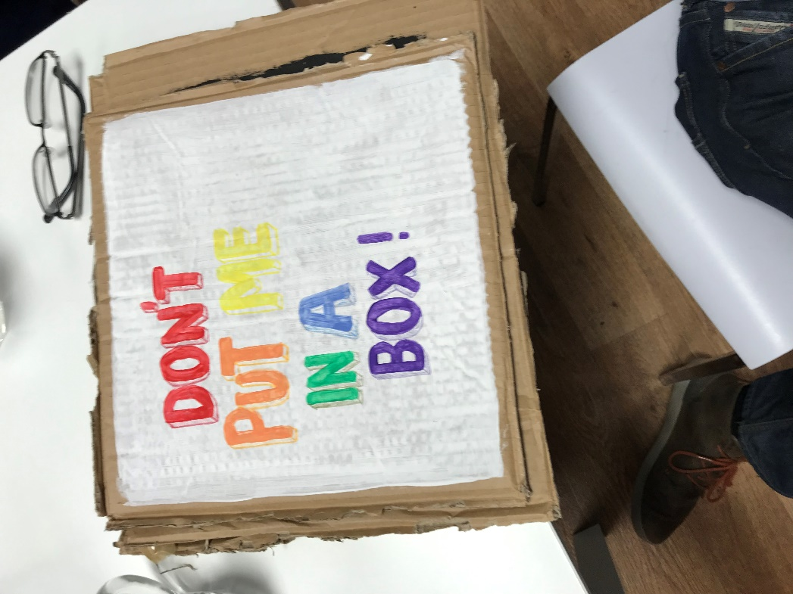

Slide 18
Service User paperwork
Service User paperwork

Slide 19
Staff Survey
We surveyed our staff on 2 areas of working at Rock Trust so that we could measure our own progression as an employer
1. Staff Diversity
2. Inclusiveness

Slide 20
Action plan for Rock Trust
Arranged for updated awareness training from our partners at LGBT Youth Scotland for all Rock Trust staff.
Make a conscious effort to have visible LGBTIQ literature and material in all areas of Rock Trust.
Re-focused our social media outlets to raise awareness amongst young people/staff and supporters of our organisation’s values.
Set up group rules for service users where we allow everyone to have a voice and we do not tolerate any form of bullying or harassment.

Slide 21
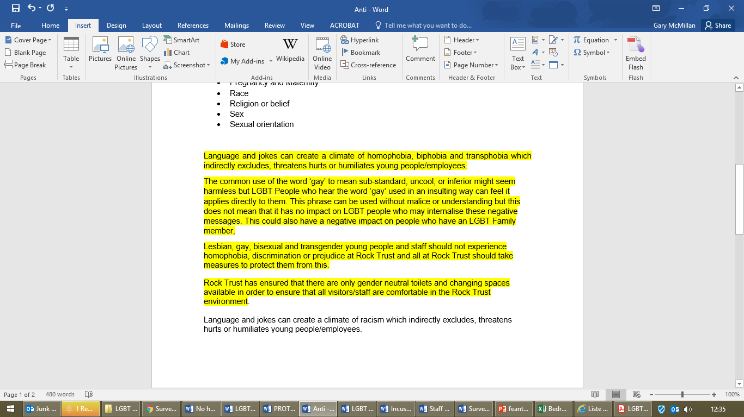
Policy and procedure adjustments
We have had

Slide 22
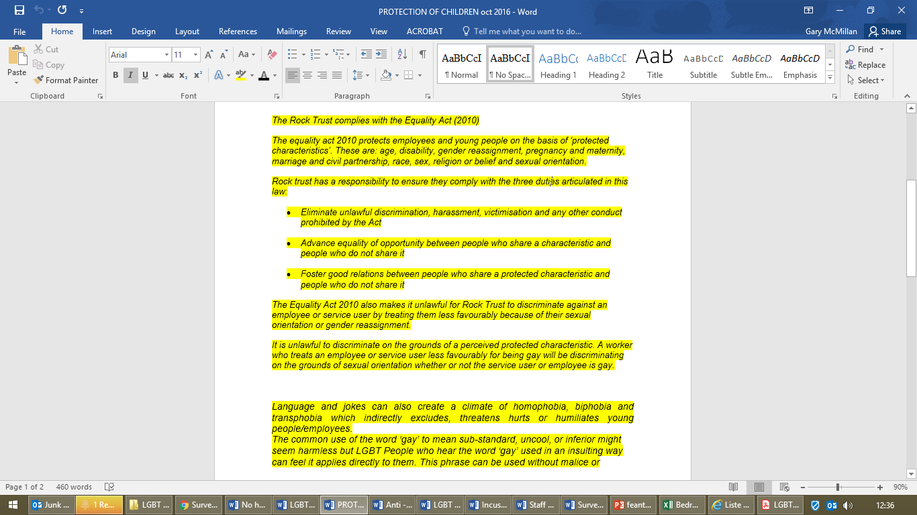
Policy and procedure adjustments
We have had updated training with LGBT Youth Scotland for staff at all levels
Made our young people more aware of our noticeboards and reception

Slide 23
Visibility
It is important that we are as visible as possible for our service users/supporters and staff and that means utilising social media, website and our physical office environment.
We use Twitter, Instagram and newsletters to also highlight the work that we do at Rock Trust.
We engage all our service users in group settings and on a one to one basis in order to discuss the LGBTIQ cultural calendar and events within this.
We have newsletters for staff and supporters on a monthly update on the LGBTIQ group at the Rock Trust.

Slide 24
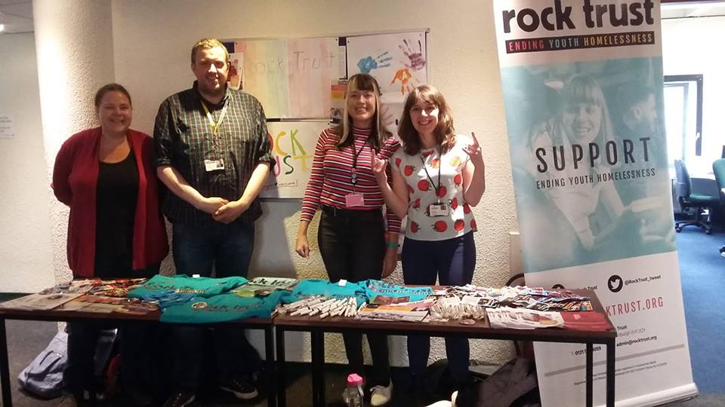
Visibility (Pride youth space)

Slide 25
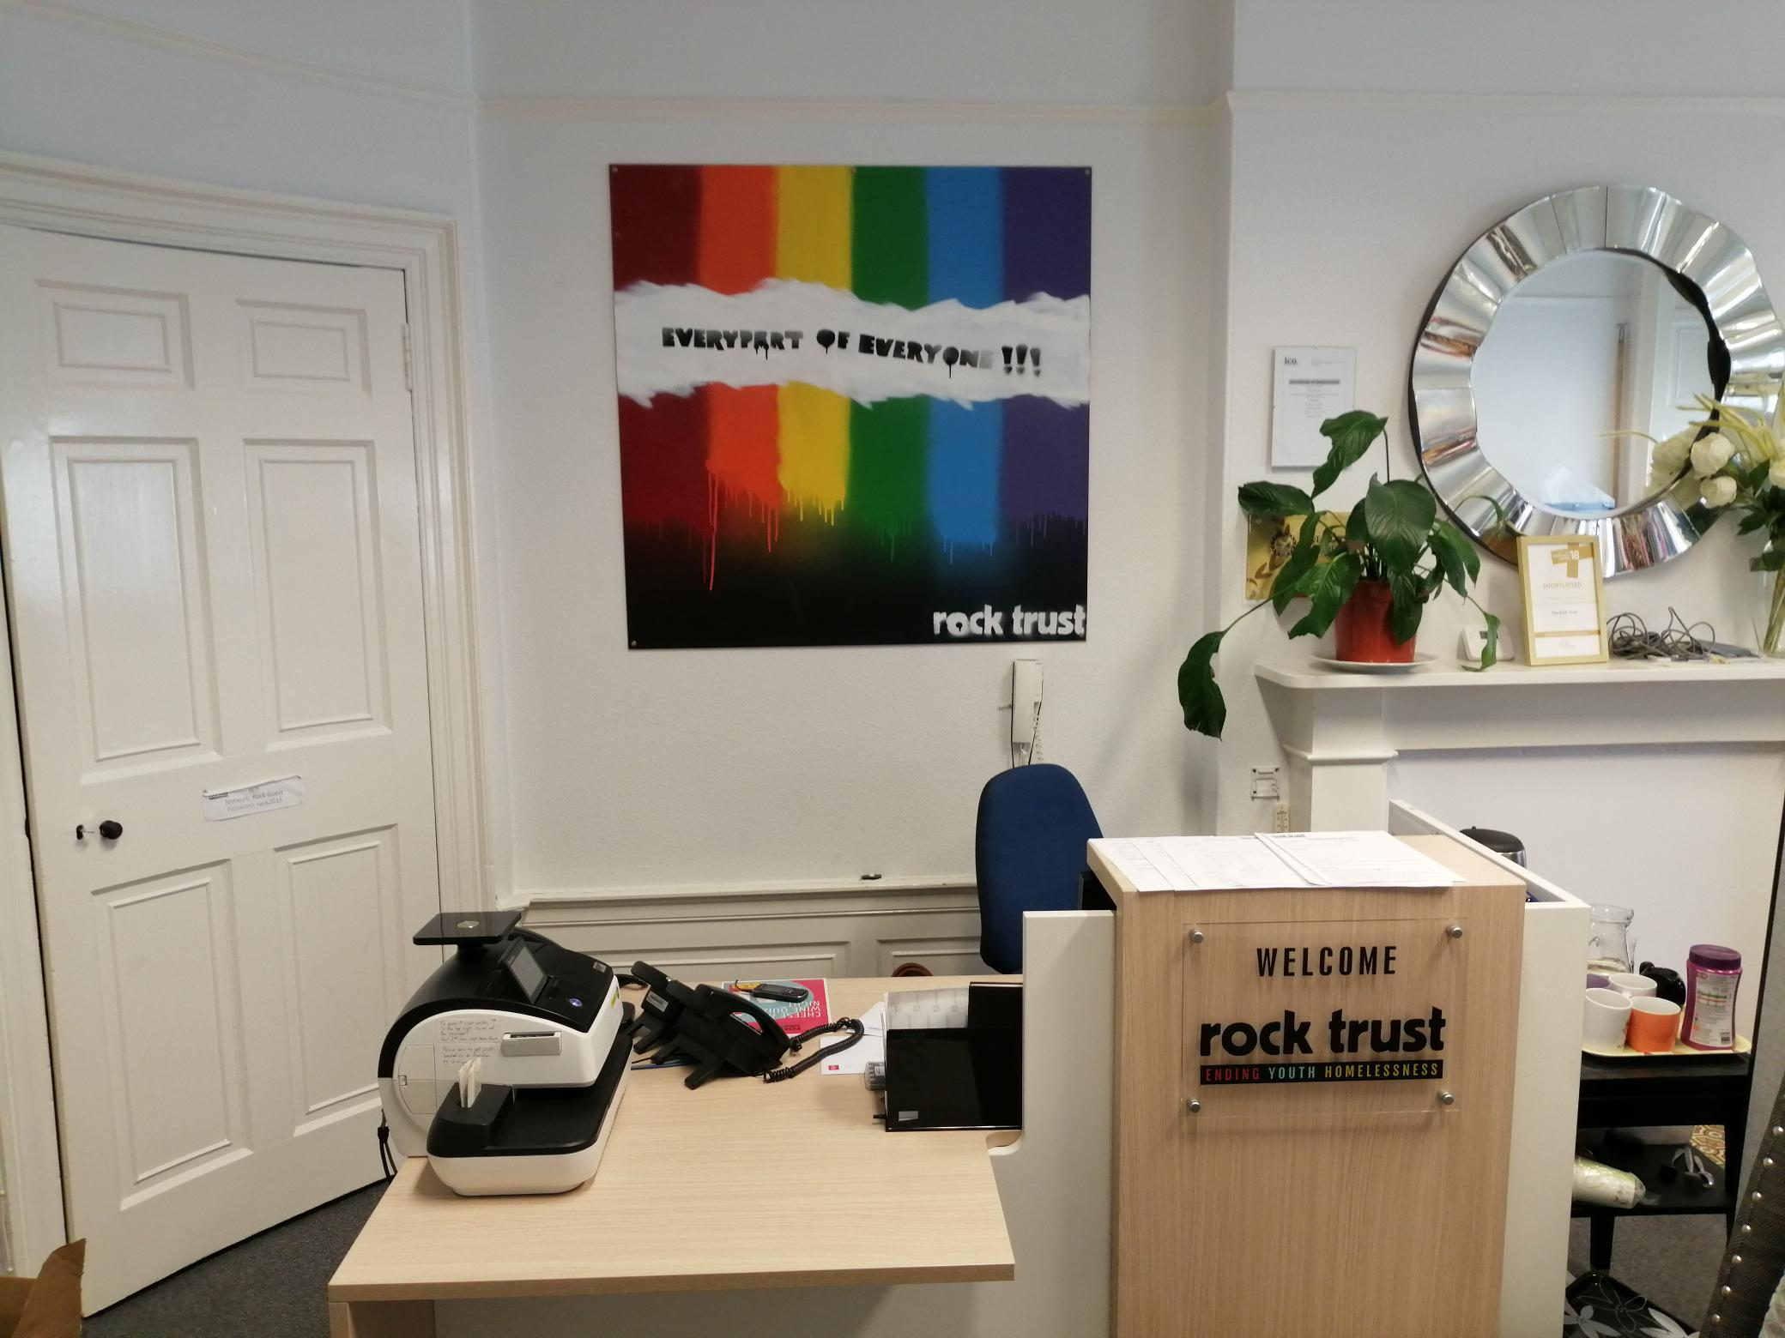
Visibility (Reception area)

Slide 26
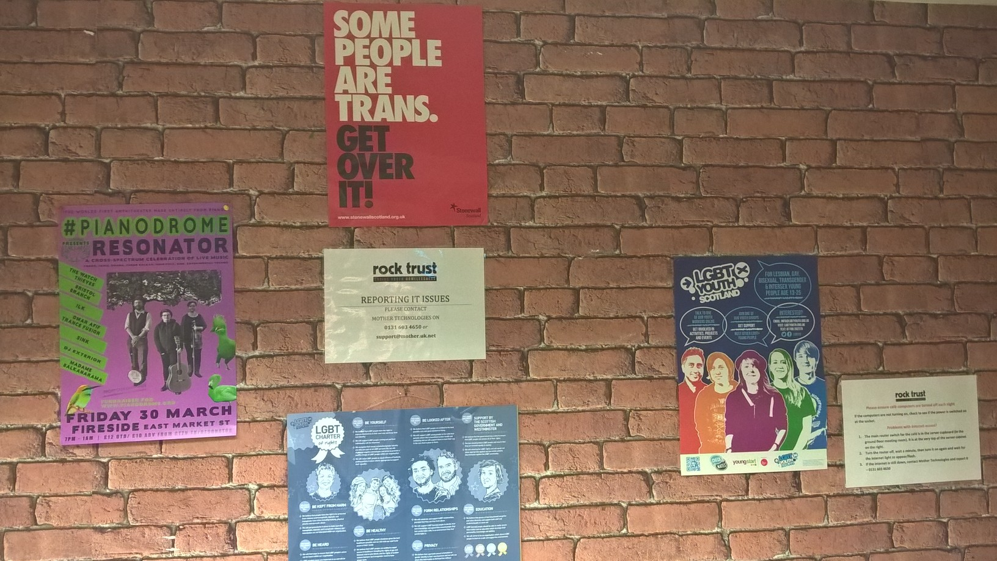
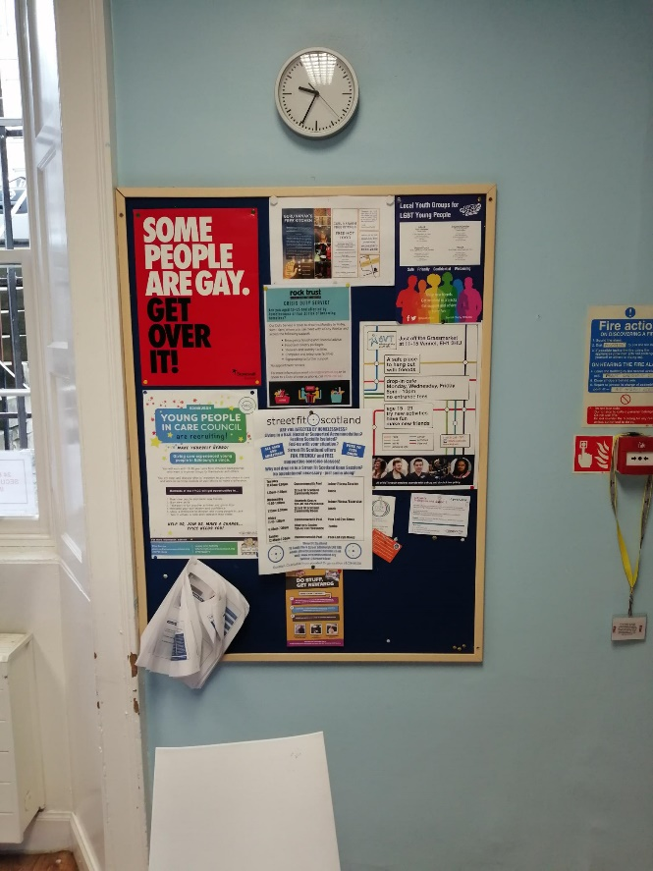
Visibility (Young People Hub)

Slide 27
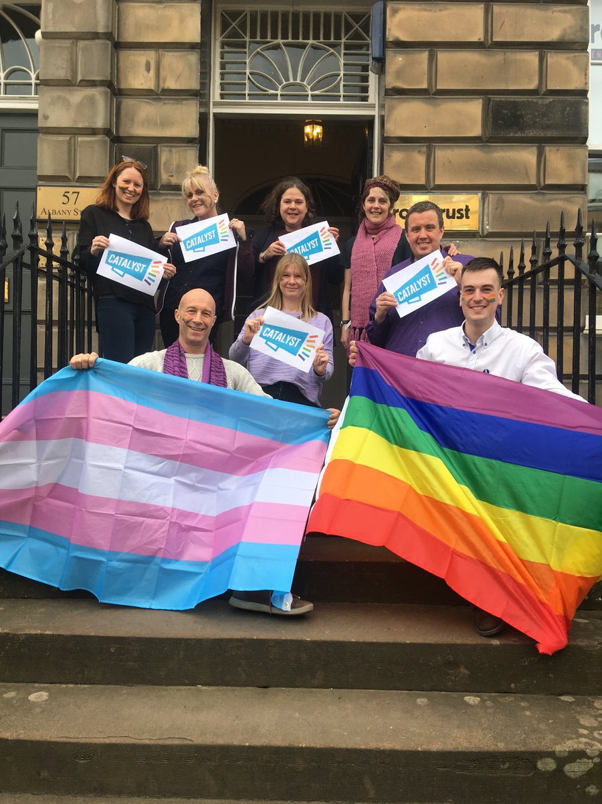
Visibility – Celebrating Purple Friday for History Month

Slide 28
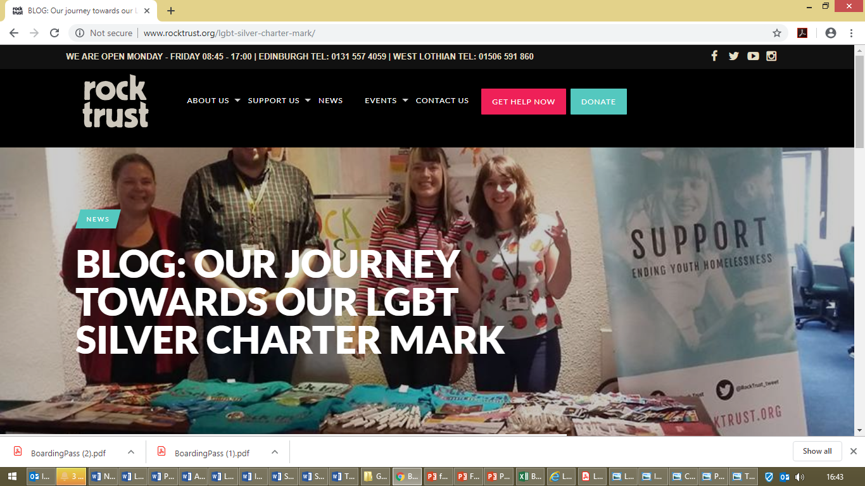
Website – Silver Charter Journey

Slide 29
Impact of Changes (Service Users)
2018-2019
21% of all duty emergency presentations were young people from LGBTIQ community.
18% of people in our supported accommodation from LGBTIQ community.
33% of Group attendees from LGBTIQ community.
Continued referrals to LGBT Youth Scotland where appropriate and Rock Trust continuing to get referrals from LGBT Youth Scotland where appropriate.

Slide 30
Impact for Staff
Any change can be difficult for an organisation and we were not alone in this at the Rock Trust but we have worked on this as follows:
Improved awareness through training that was provided for all staff at Rock Trust by LGBT Youth Scotland.
We are due to another staff survey/inclusiveness survey in September to compare and contrast last year’s results.
Our recruitment over the past 9 months has lead to candidates and staff from all different community backgrounds being interviewed/employed by Rock Trust.

Slide 31
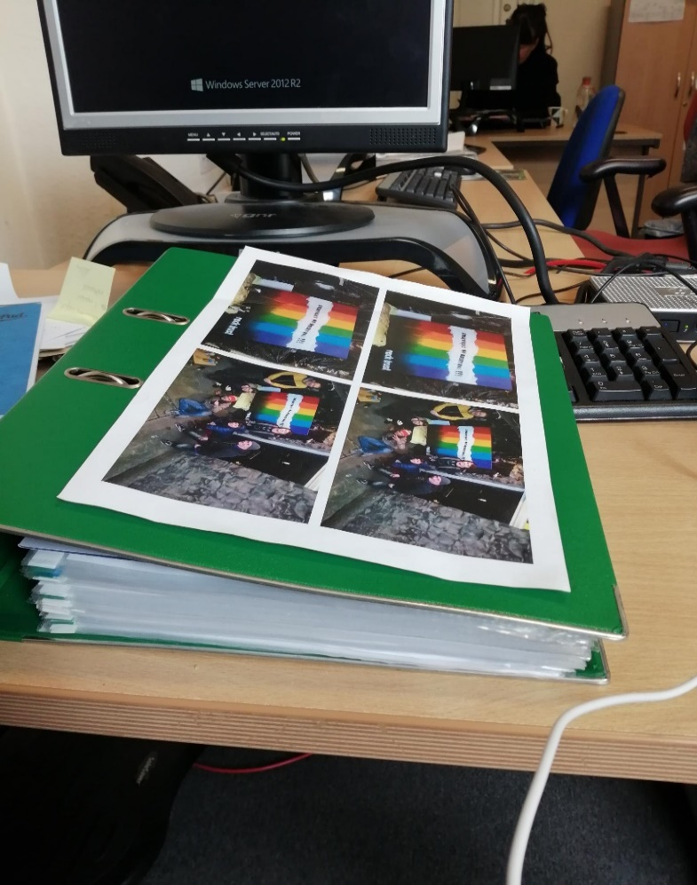

Silver Award

Slide 32
Janice Stevenson - Development Officer &
Domestic Abuse Support Worker
Our partnership with Rock Trust allows to refer our young people onto Rock trust in good faith knowing that they will not be judged, will be treated fairly and will feel safe at the Rock Trust.
We have been able to get a greater understanding of how the homelessness system works and how best we can support the LGBTIQ community in this difficult area. We look forward to a continuing relationship with Rock Trust knowing that we can safely advocate on behalf of each other.

Slide 33
Future working between Rock Trust & LGBT Youth Scotland
      With support from LGBT Youth Scotland we at the Rock Trust will be moving towards our Gold Charter award.
      Cross referrals for young people between Rock Trust/LGBT Youth Scotland.
      Rock Trust to visible at LGBT Youth events.
      Celebrate and participate in cultural calendar.
      Training opportunities for Rock Trust and LGBT Youth Scotland in each other’s organisations.

Slide 34
Jay’s Story
Up until May 2018, I had lived my whole life in a small village outside Edinburgh where everyone knew everyone else’s business. When I told my family that I am a trans man, they didn’t want to support me, and couldn’t bring themselves to accept my identity so I was asked to leave home.
I made the decision to move into Edinburgh, and only kept a roof over my head by sofa-surfing in the homes of people I knew and sometimes with people I did not know well at all. I moved around the city, often not knowing where I would go next, and not knowing what the future held for me.
I was told by a friend about the Edinburgh LGBT youth centre and was able to access support from them around my gender identity and also able to meet other people like me and see that I am not on my own

Slide 35
Jay’s Story
Through my support from LGBT Youth I was made aware of the Rock Trust and I was supported by LGBT Youth to make contact and access the Rock Trust for support with my homelessness. I was given support on how to access temporary housing, how to claim for appropriate benefit support and access to the facilities (Shower, Laundry, food and toiletries).
I started to access group work sessions at the Rock Trust and LGBT Youth and was able to meet young people in similar situations to myself. I have become heavily involved in the cooking group run by a social enterprise (Preptable) at the Rock Trust and have taken on more and more responsibility in helping to run the group each week.

Slide 36
Jay’s Story
In September 2018 I was able to secure my own 1 bedroom flat with the Rock Trust in Edinburgh. This is for up to 2 years whilst I await a home from the local council. I am living independently for the first time and as I have no family support and this was a big step for me.
However, the flat comes with a support worker who is there to guide me in how to run a flat (budget, clean, cook and keep safe) and also offer emotional support as I make the adjustment to independent living.
Through working with Rock Trust and LGBT Youth Scotland I have been able to access other opportunities and support programmes. I am working with a Health & Well-being worker at Rock Trust in which I am able to use my art work to express and discuss my feelings.

Slide 37
Jay’s Story
I volunteer my time at LGBT Youth Scotland and prove support to other young people who were like me a year ago and I have I have started a 1 year part-time training programme with Venture Scotland where I will be part of team that plans and leads a five-day expedition.
Living on my own has allowed me to start to have a relationship with my mum, and she is beginning to understand what being a trans man means to me.
I am grateful for the support given to me by LGBT Youth and the Rock Trust and as of May 2019 I have a roof over my head, supportive people around me and I can now see a future for myself.
I am starting a part-time position with Preptable where I will be working to build up by chef skills and I will continue to offer my support to other young people who need support like I once did. where I can build up my cooking skills and also be of support to other young people who are in a situation that I recognise.

Slide 38
Contact Information
gary.mcmillan@rocktrust.org
janice.Stevenson@lgbtyouth.org.uk
www.rocktrust.org
www.lgbtyouth.org.uk

