Slide 1
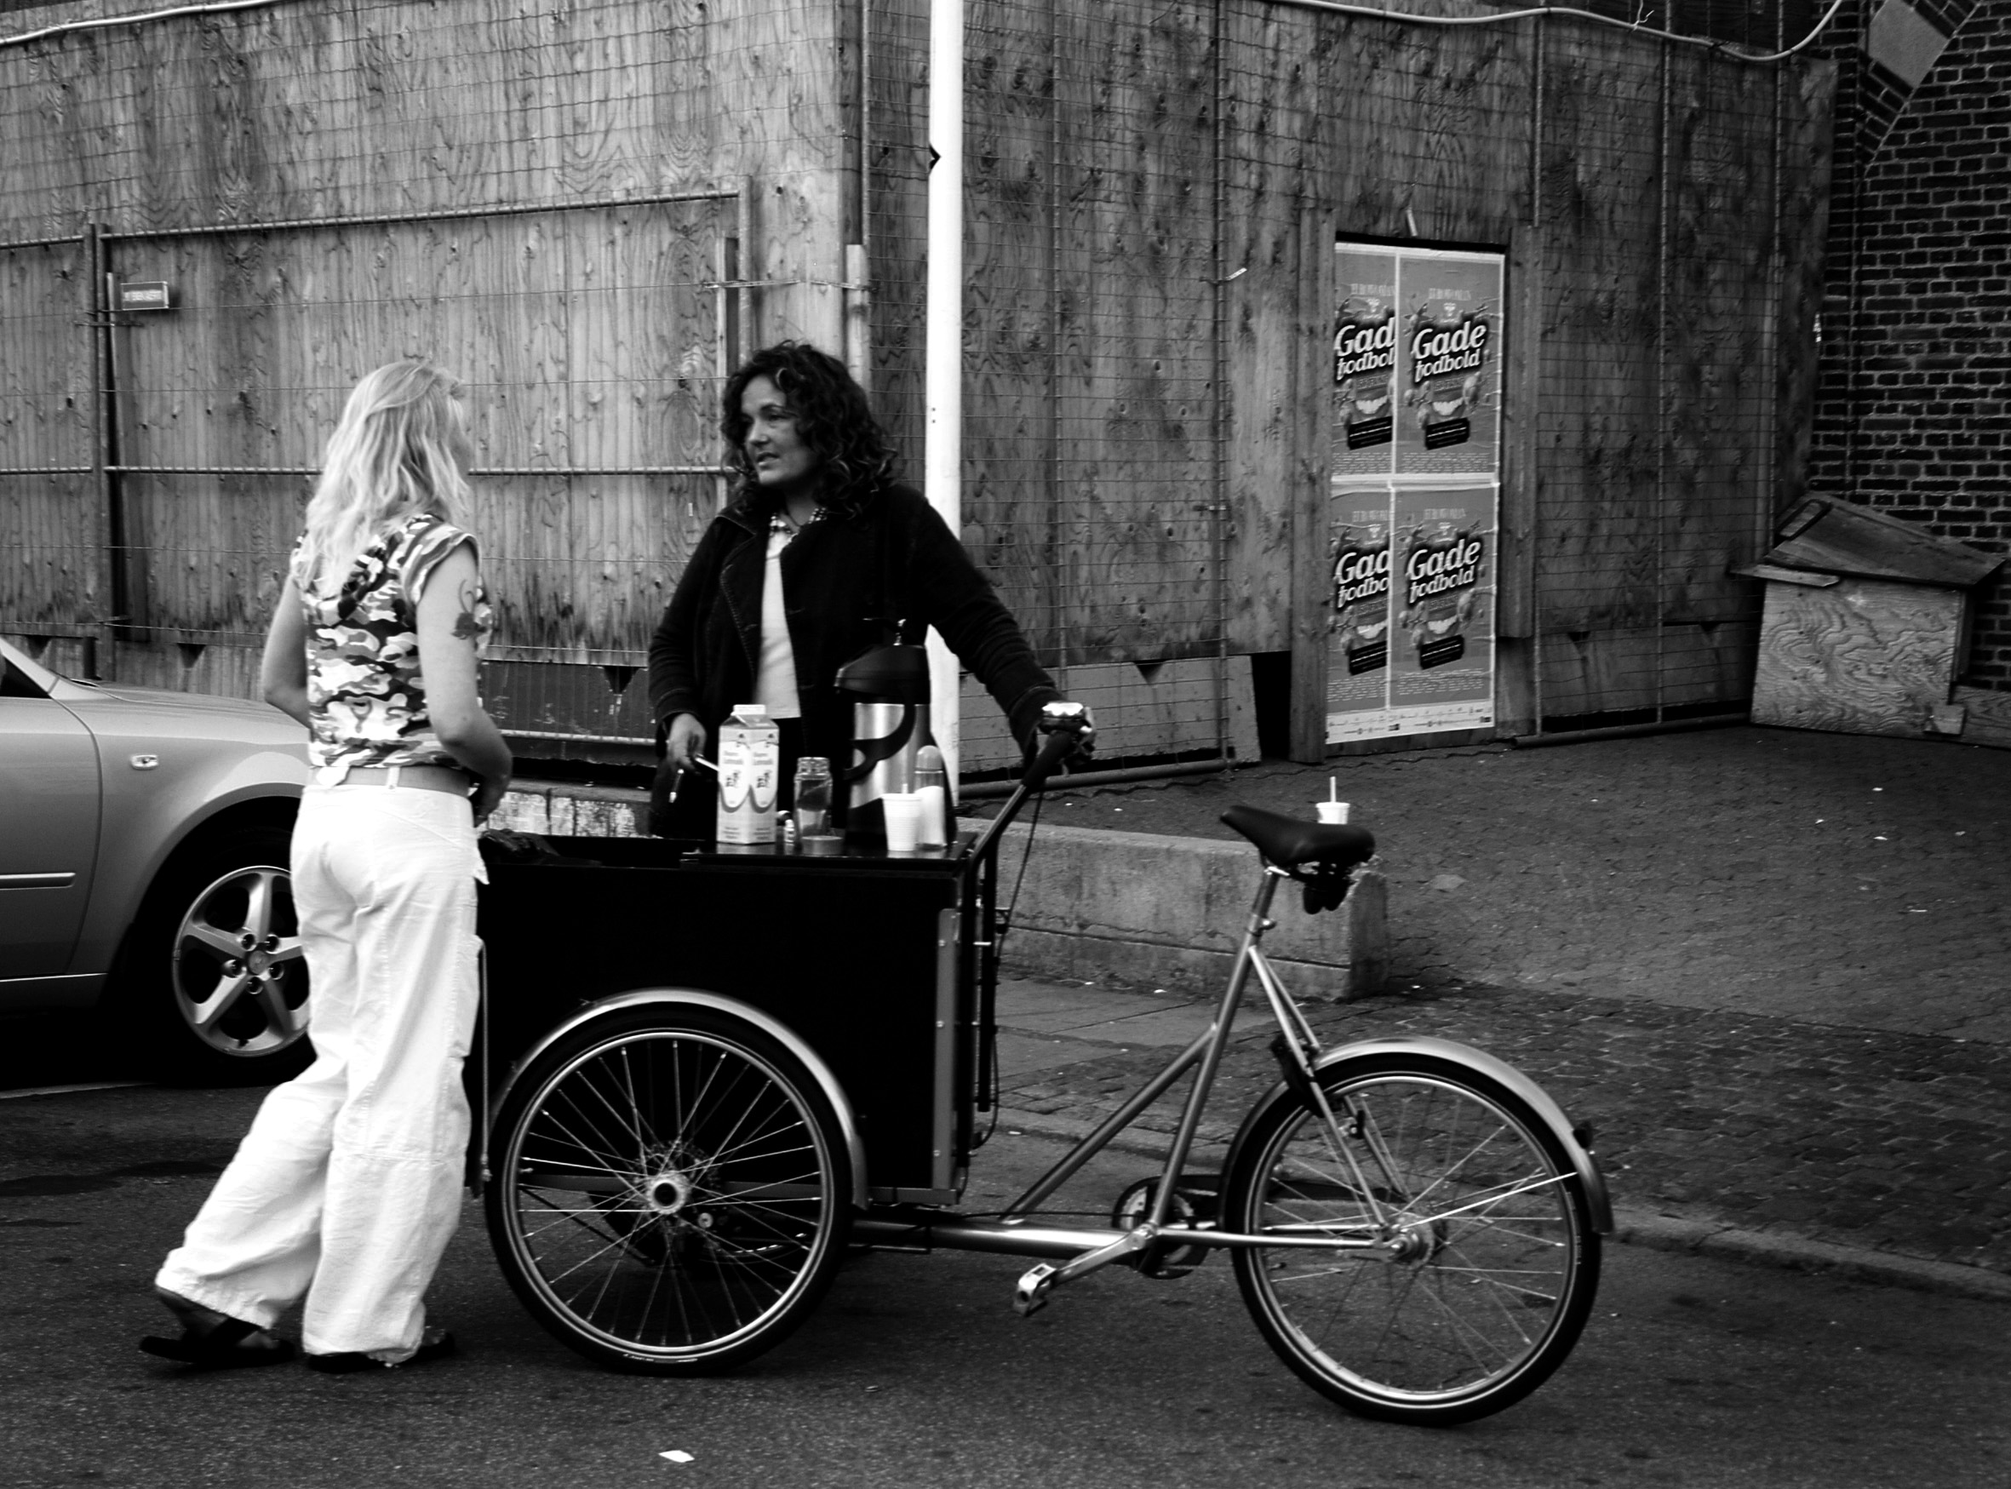
The Street Lawyers
The Street Lawyers
Gadejuristen
‘Street Lawyering’
Harm Reduction Based Outreach Legal Aid Service+
(De-facto) criminalized
PUD, HL, SW, MIGR
1.500+ cases
‘Street Lawyering’
Harm Reduction Based Outreach Legal Aid Services+
(De-facto) Criminalization
PUD, HL, SW
1.300 cases
Advocacy
7 + 40

Slide 2
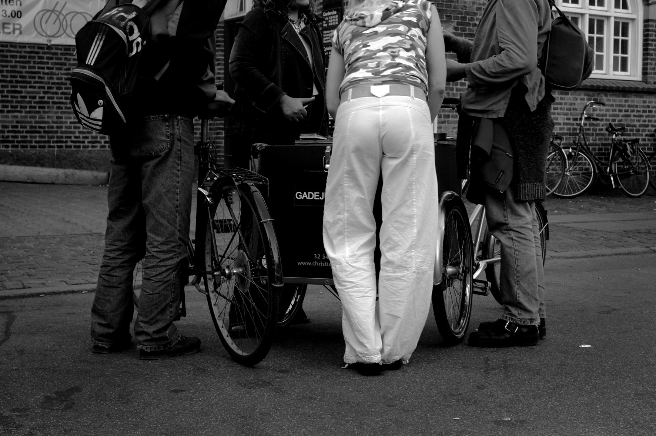
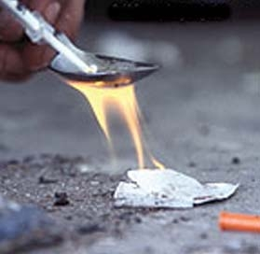
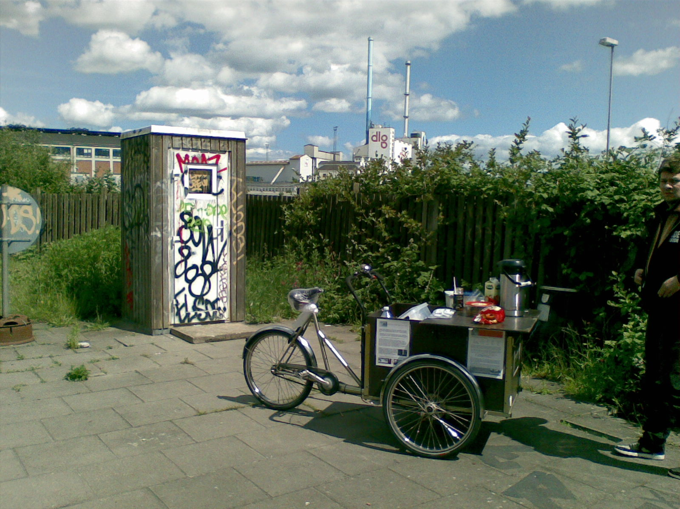
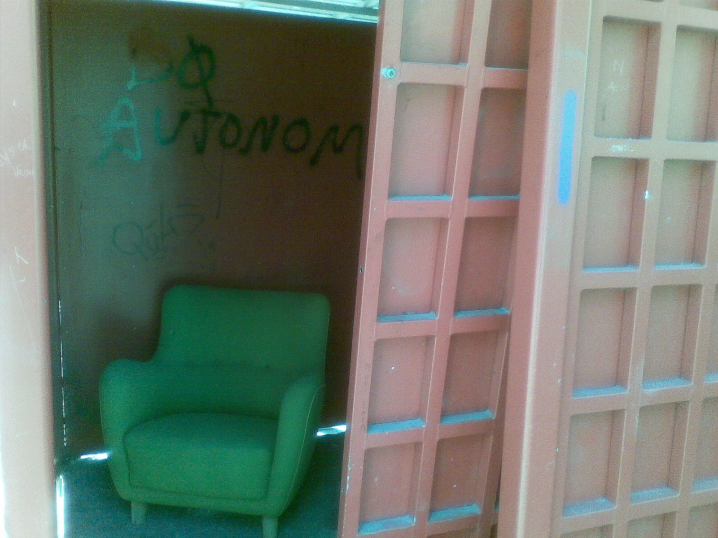
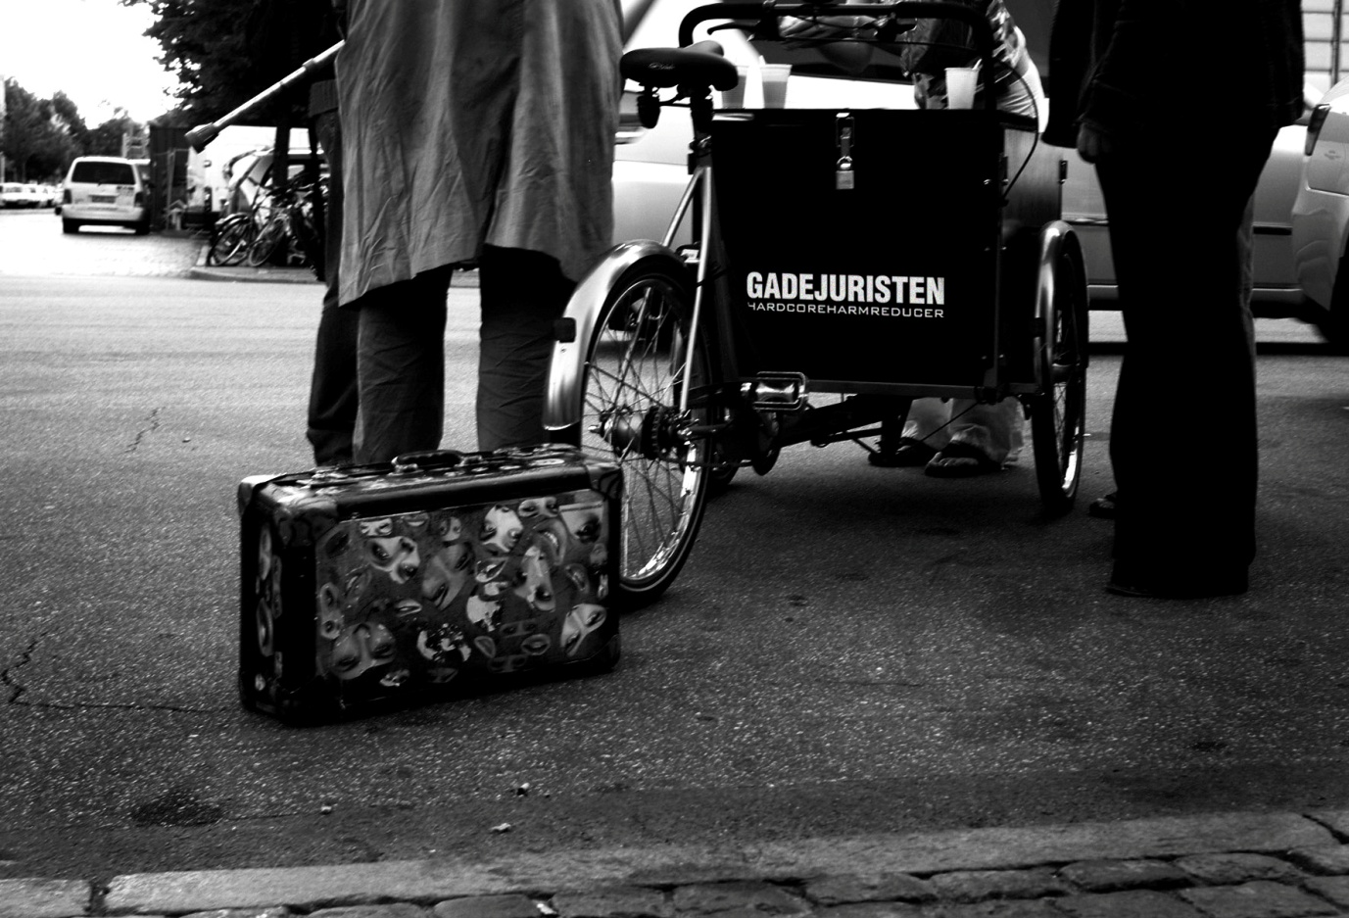
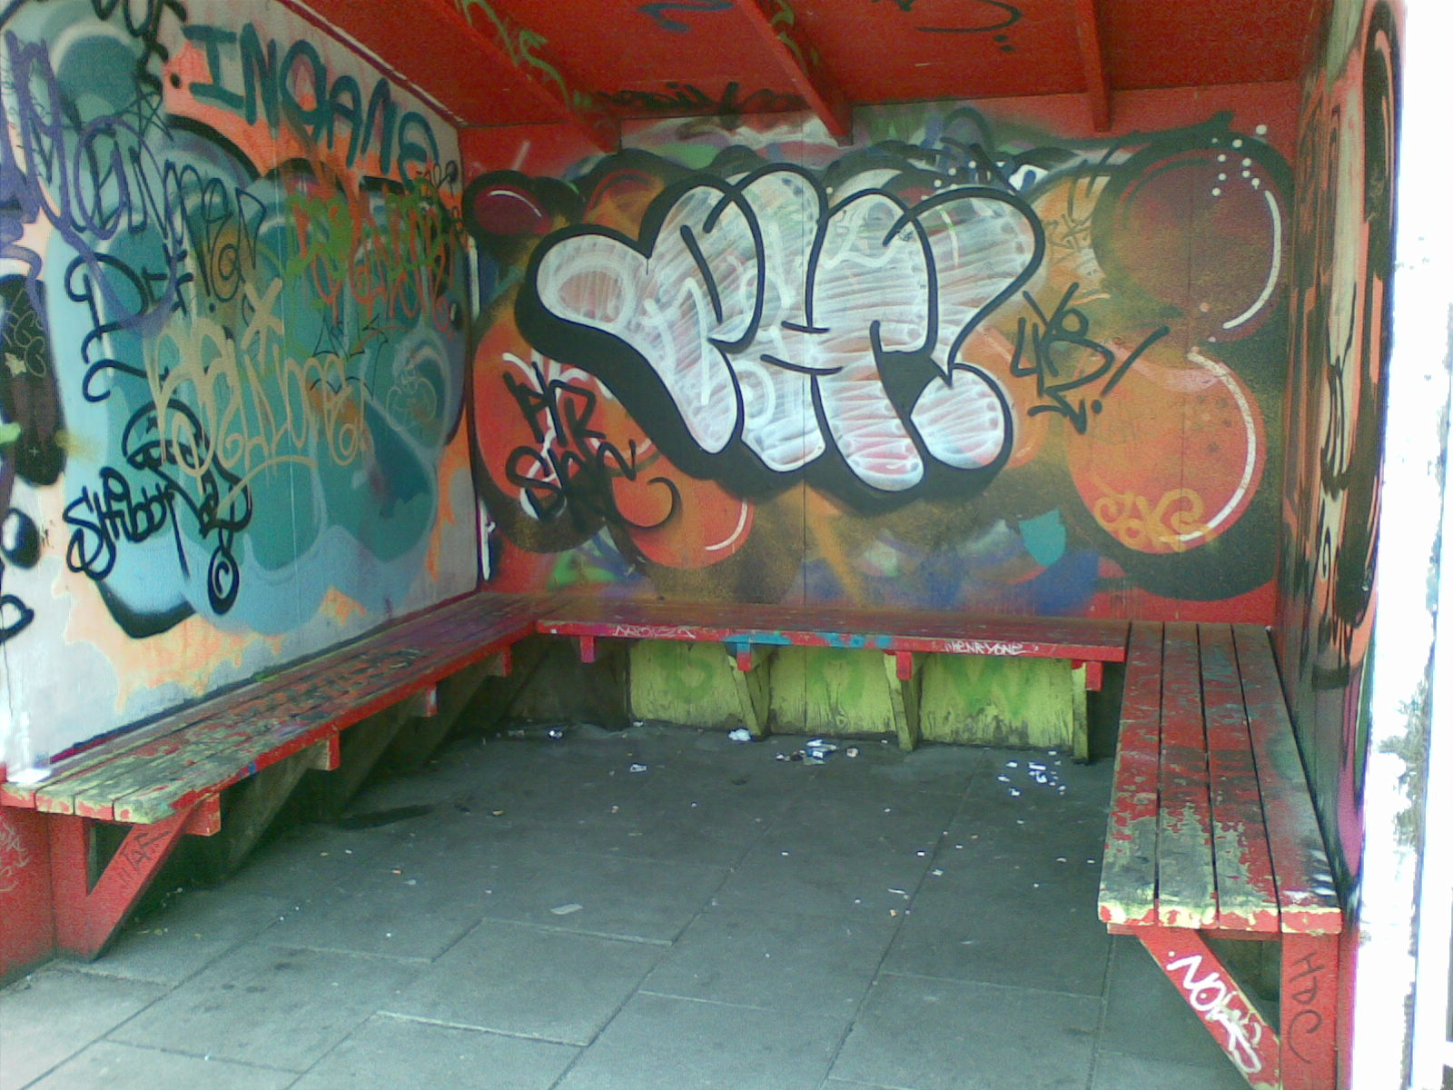
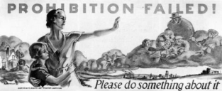
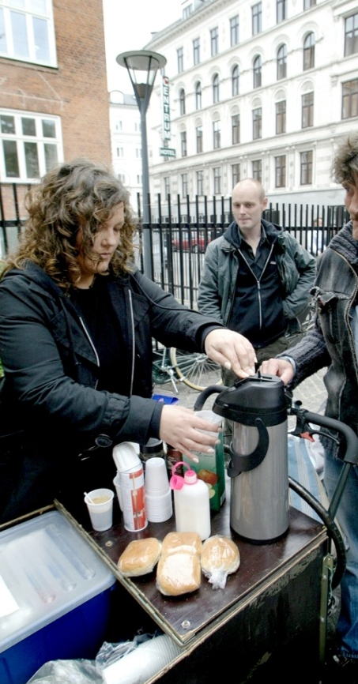


Slide 3
SEX AND DRUGS
Punishment or harmreduction

Slide 4
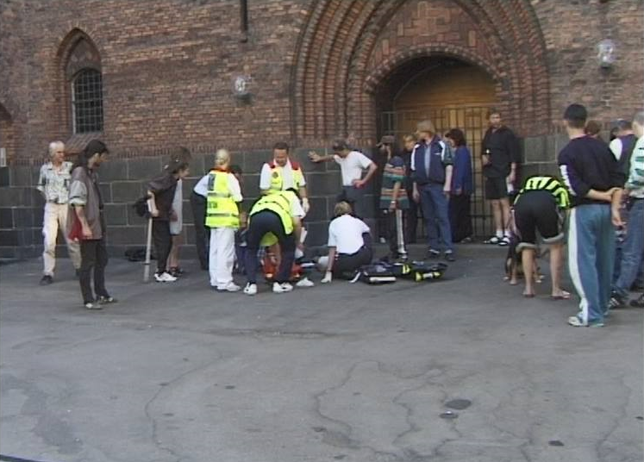

Slide 5
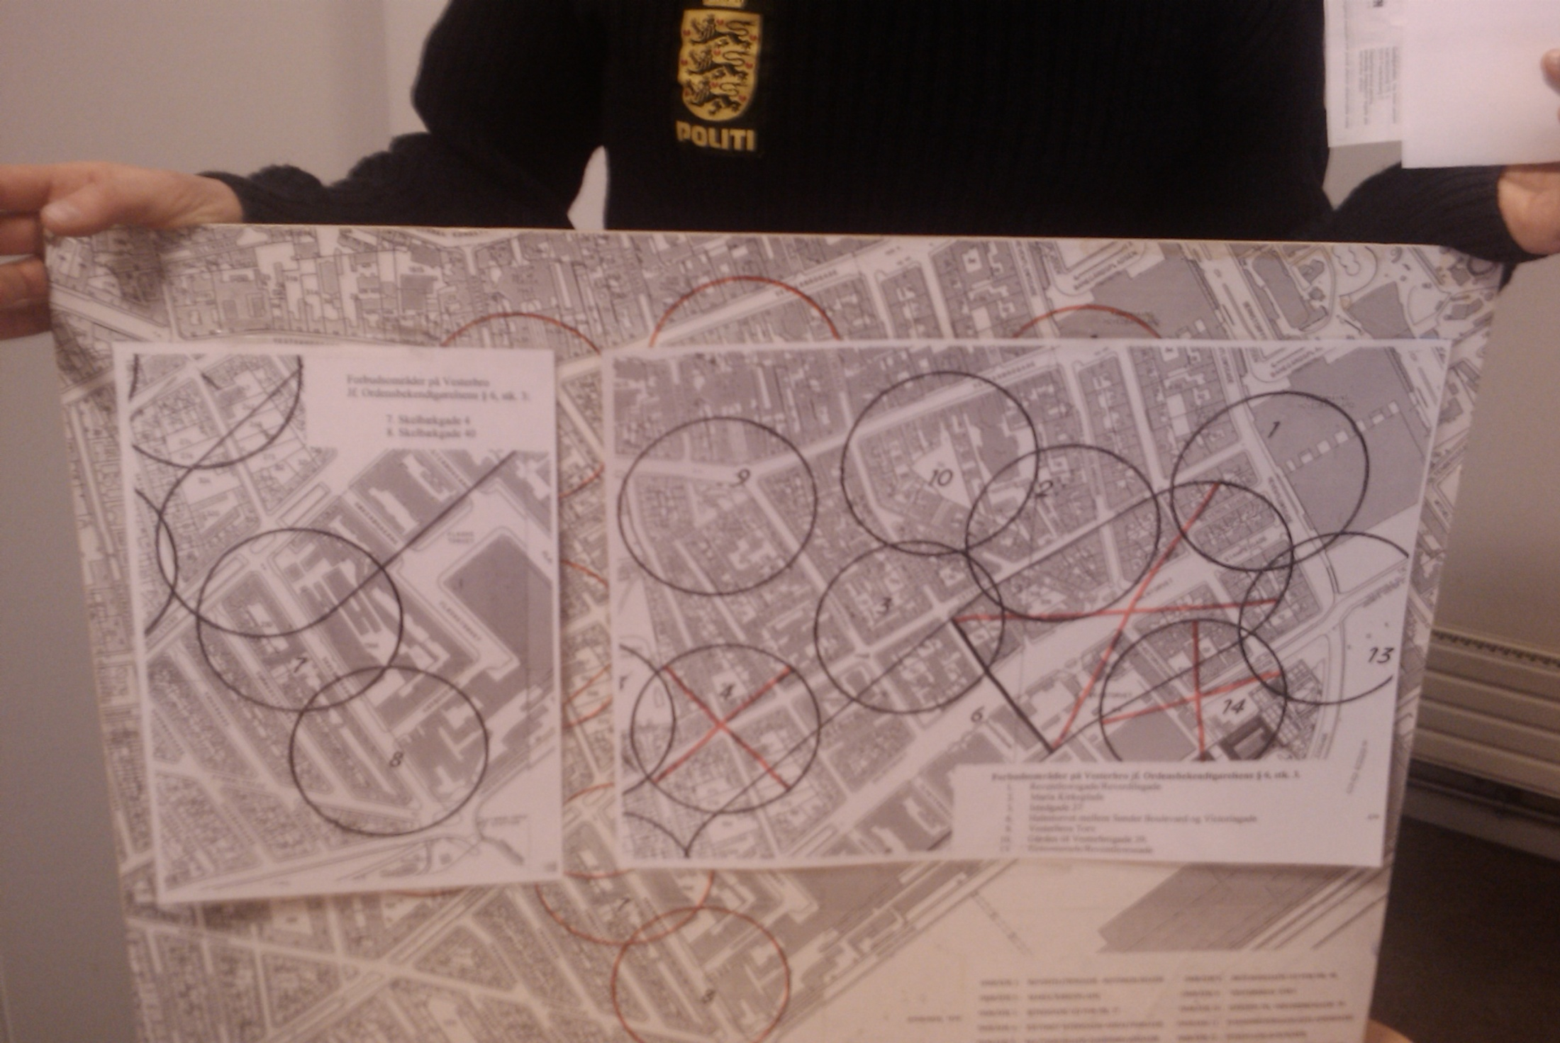

Slide 6
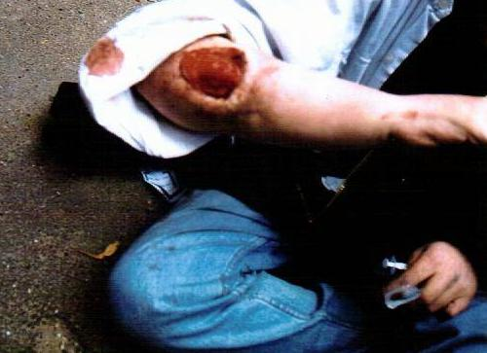
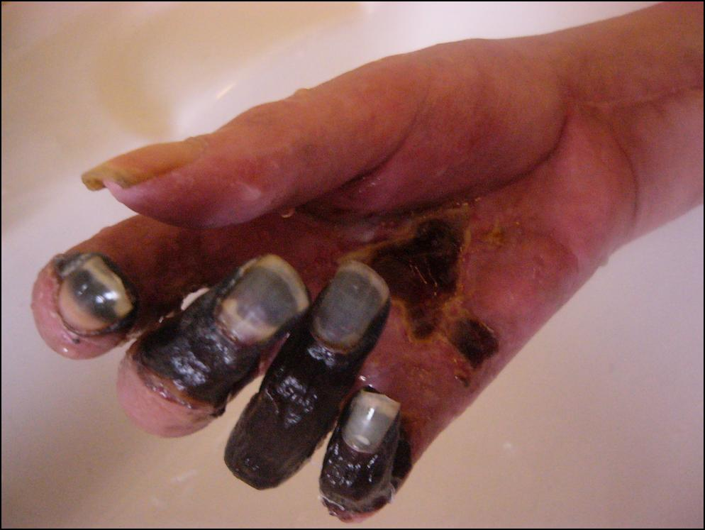
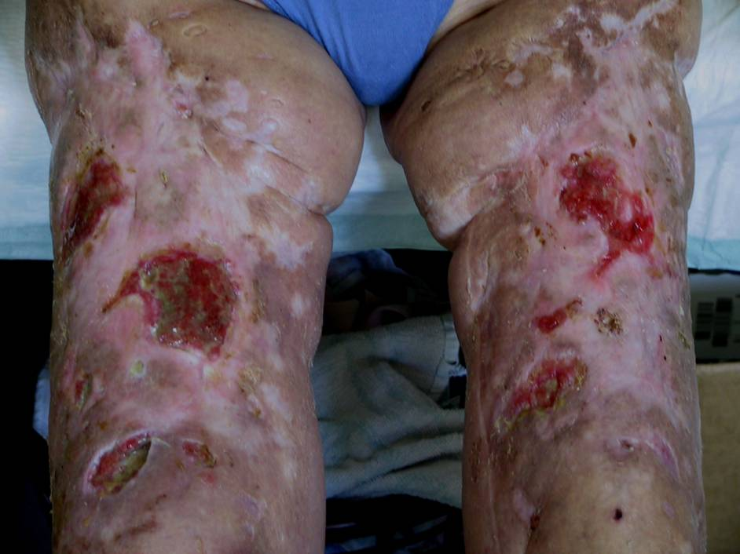
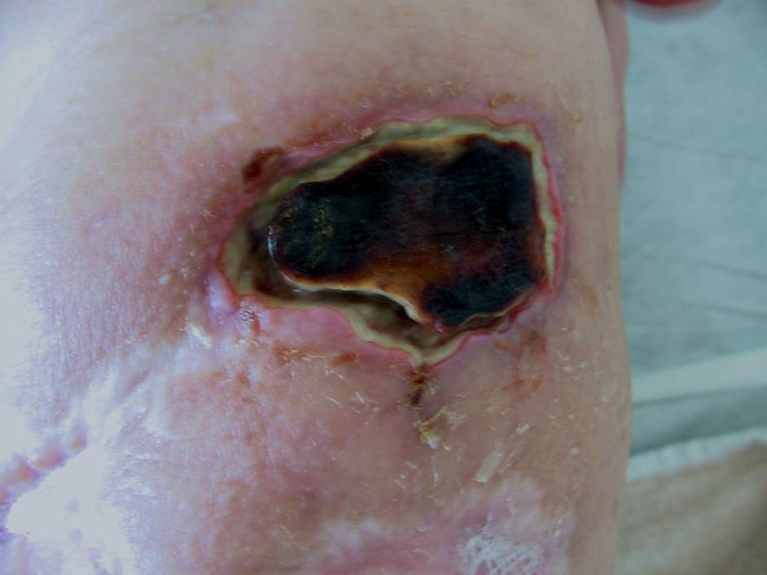
Notes:
Billederne af sår og skader er nu engang lettere at tage billeder af end det er at tage billeder af sociale forhold, psyke, oplevelsen af at sidde inde mv. Sådan er her har nogle af dem det fysisk – lige så slemt har de det på en række andre områder, er ikke alene hårdt ramt, men også bredt ramt.

Slide 7
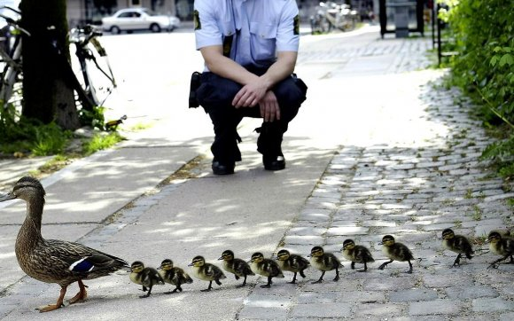
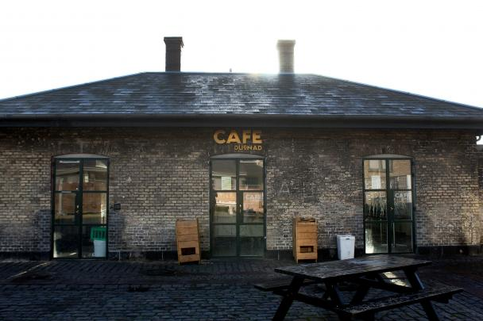

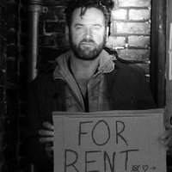
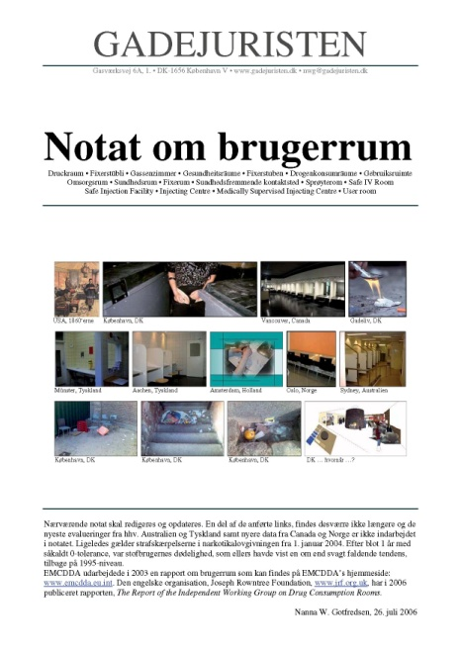
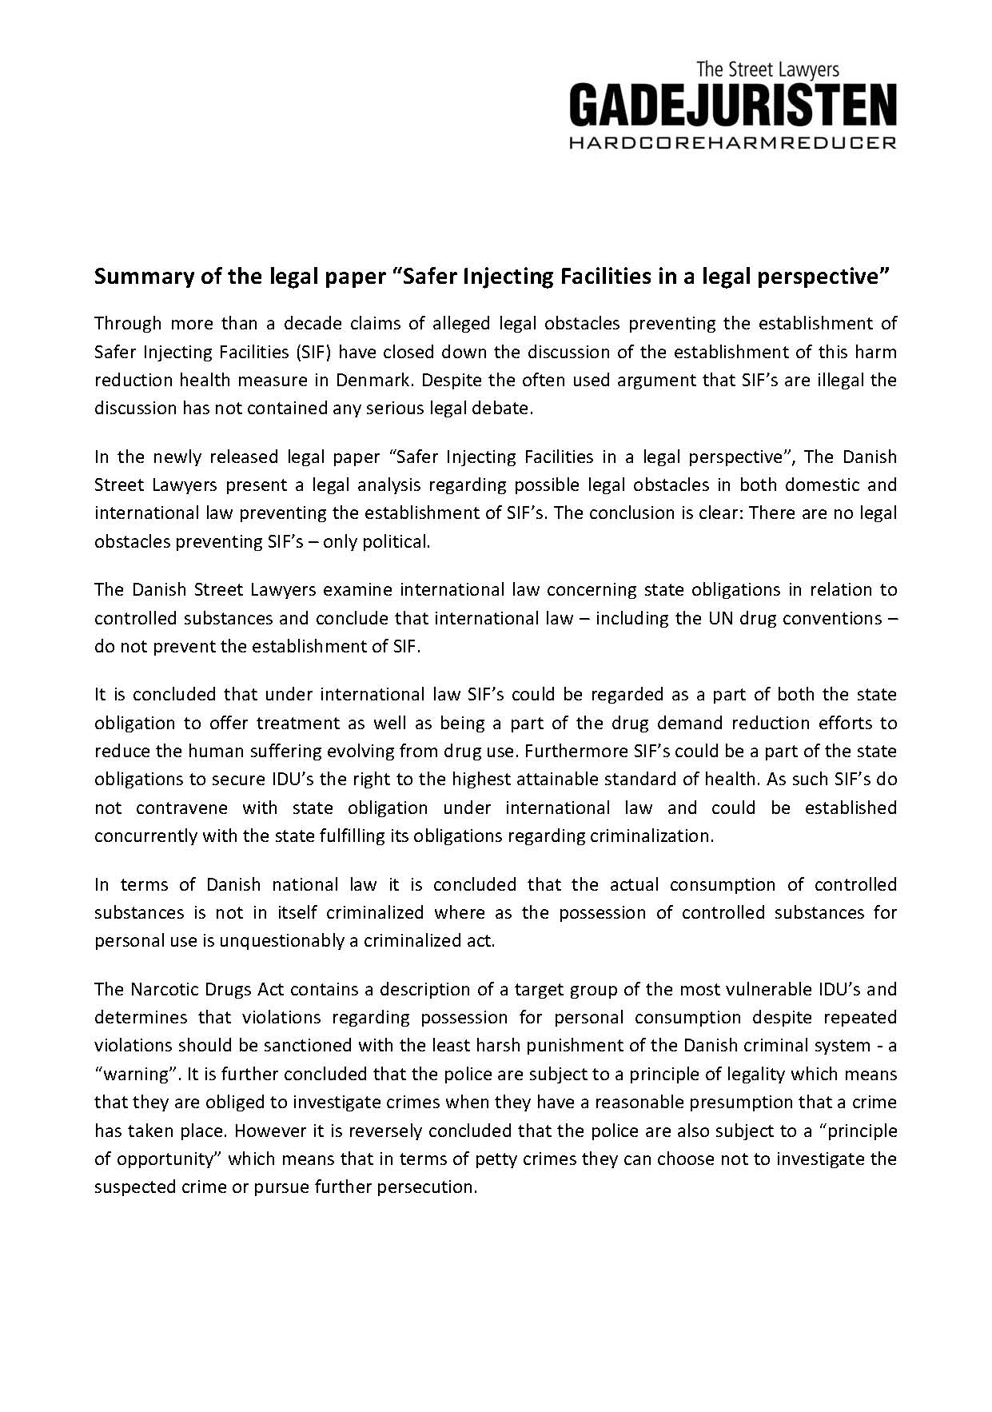
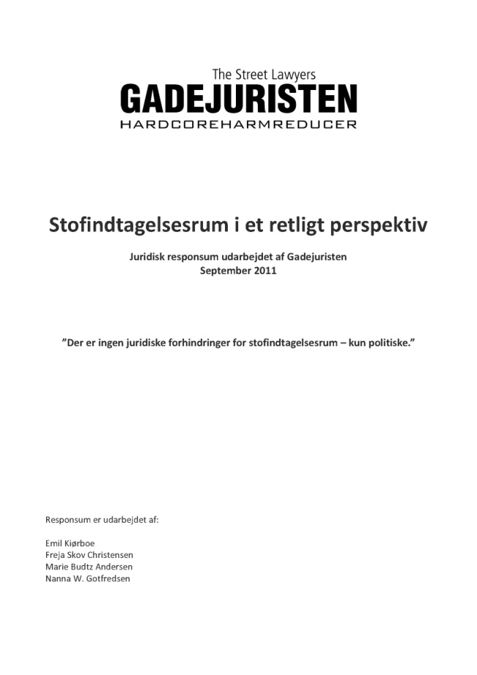
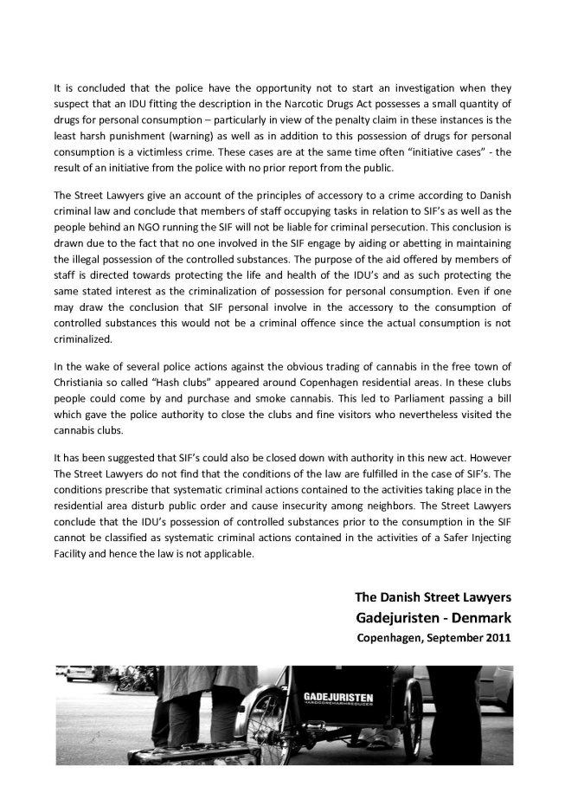
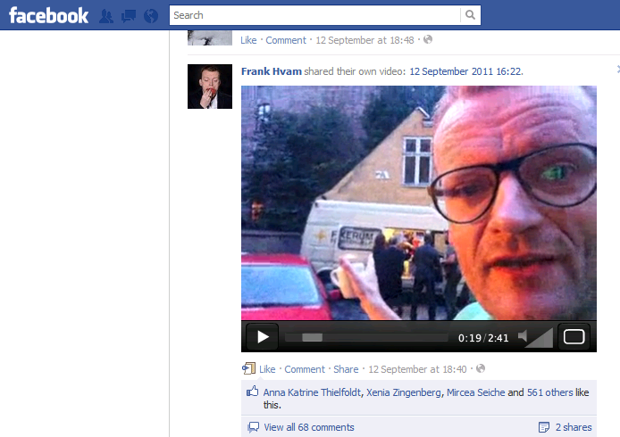

Slide 8
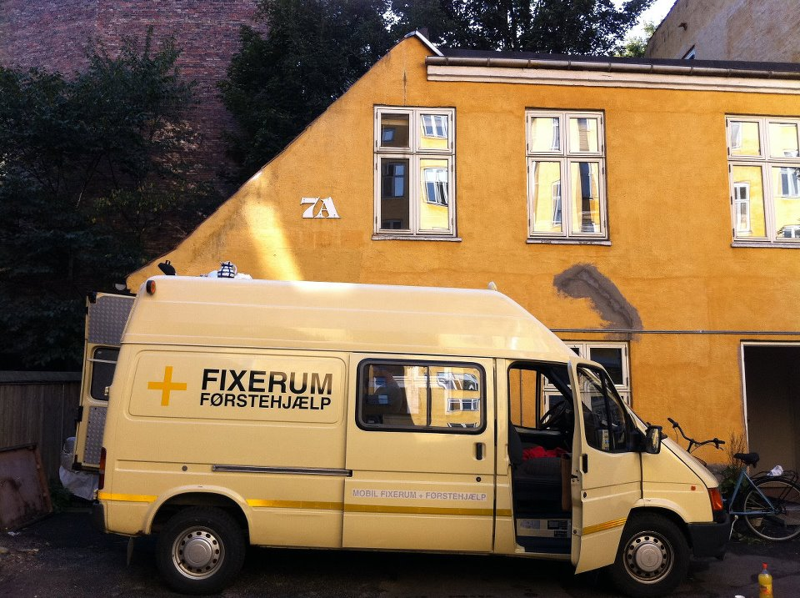

Slide 9
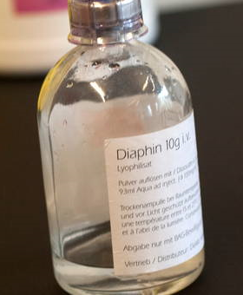
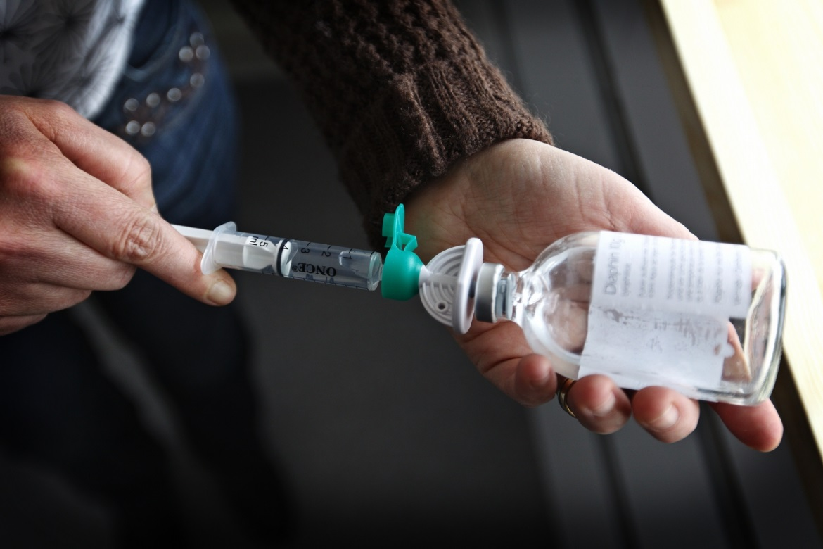
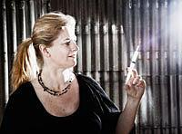
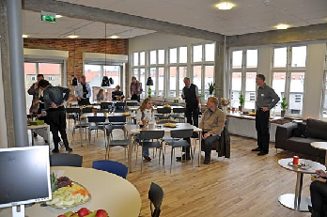
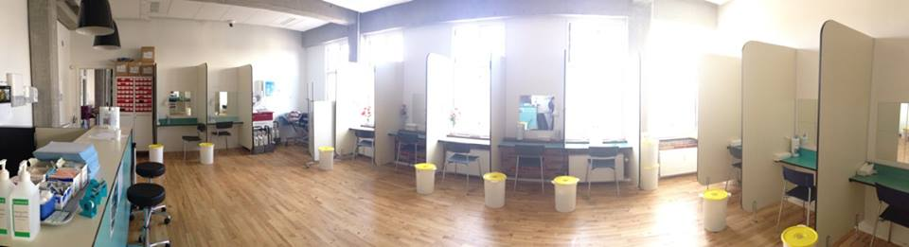
2010 – 5 HEROIN CLINICS

Slide 10
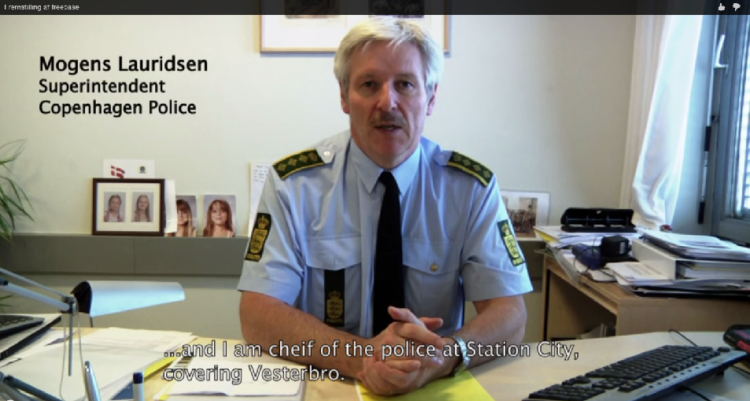
From ammonia to bicarbonate

Slide 11
Sex work
– avoided criminalising clients

Slide 12
Migrants
Punishment or harmreduction
Backdrop:
Perceived increase petty crime, begging, rough sleeping, bottles collected for recycling ect.
Local elections in 2017
Roma-bashing:
The Roma-plague, Roma-invasion ect.

Slide 13
CEU findings, April 2017
Romas on the streets in Copenhagen
Mainly Romanians
Both men and women
No regular access to water and no access whatsoever to medical services
No access to shelters (mentally disables, sick persons, drug users and lotterys
Met one Roma in a shelter
No children
No persons with disability
No trase of violence, prostitution, human trafficking or organized crime
All persons wanted a job
Language barrier
Collected bottles and scrap paper. Some begging and petty crime (as stealing food)
No protection from the Romanian Embassy
Police harassment and deportations, related to sleeping in the parks

Slide 14
No crises at the time in handling the situation of people living on the streets of Copenhagen. Nevertheless, the authorities have to get prepared for an increase influx of people and adapt their social services to meet the challenges. The administration of Copenhagen is a highly performing institution that has access to resources to effectively tackle the situation on the ground. There is no reason to believe that 150 people living in the streets can destabilize such an institution or the government of Denmark.

Slide 15
Prohibition on creating or joining ”encampment” (egnet til at skabe utryghed)” in public places
Public Order Regulation
Punished by fine, 150 Euro
Followed by a 500-1000 meter zone ban
Followed by a city ban
Egnet til at skabe utryghed – how to translate
”Egnet”: fit for, suitable for, conductive to, liable to – i.e. an abstract risc of someting happening.
”Utryghedsskabende”: 2 words in English – the last bit is ”creating”, but the first?
On a scale of: discomfort, insecure, distress, unsafe
We think discomfort is proper – government bound to disagree

Slide 16
Statute on begging
No warnings
14 days prison for first time offenders
52 convictions – no danes
(one charged)

Slide 17
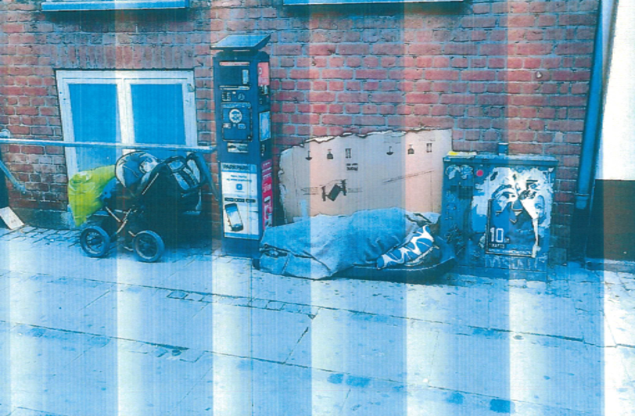

Slide 18
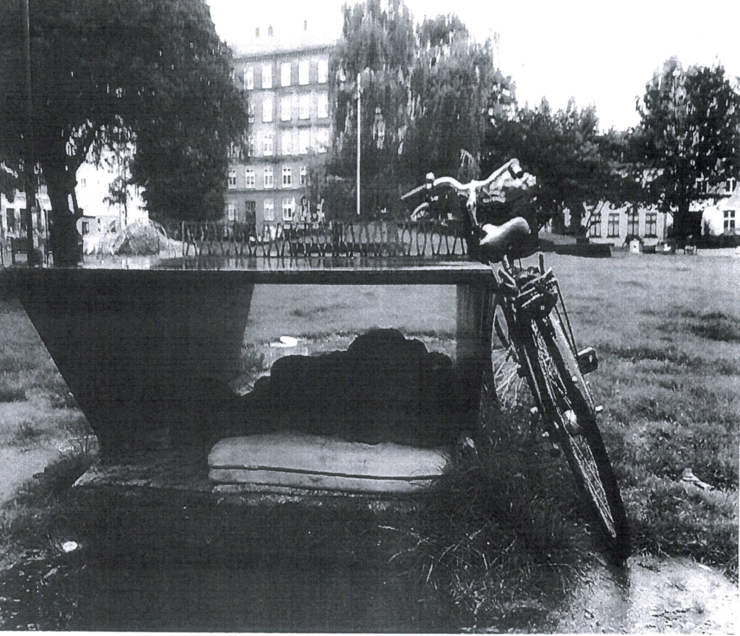

Slide 19
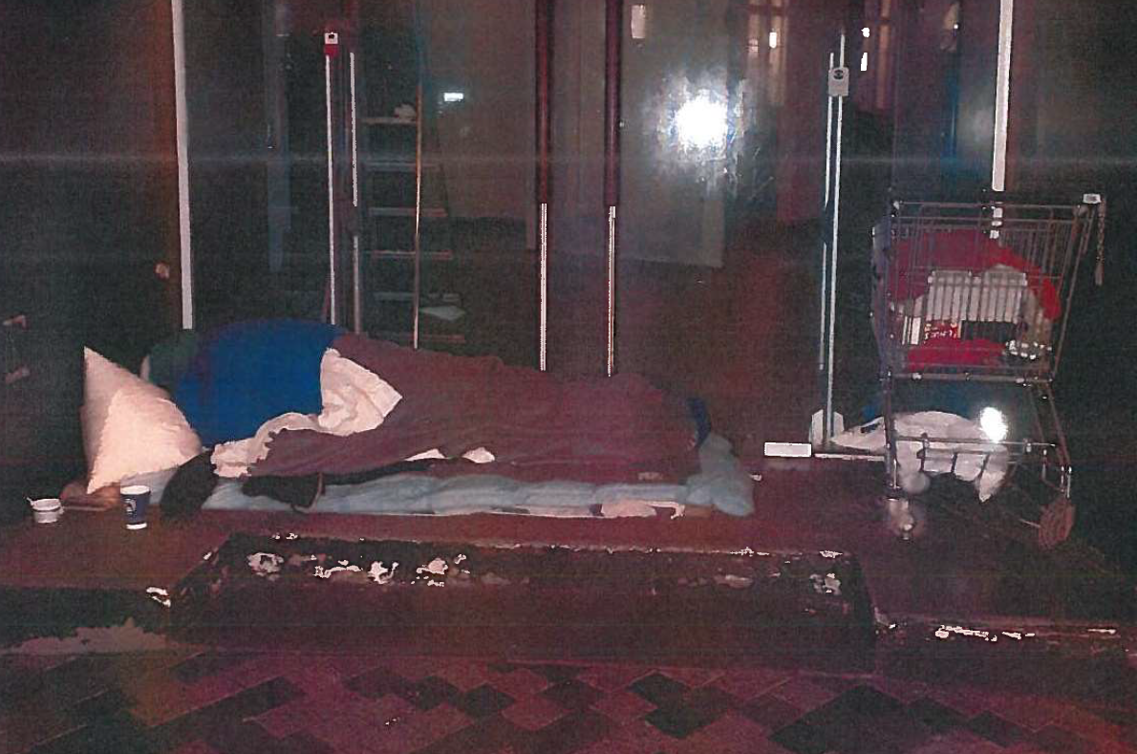

Slide 20
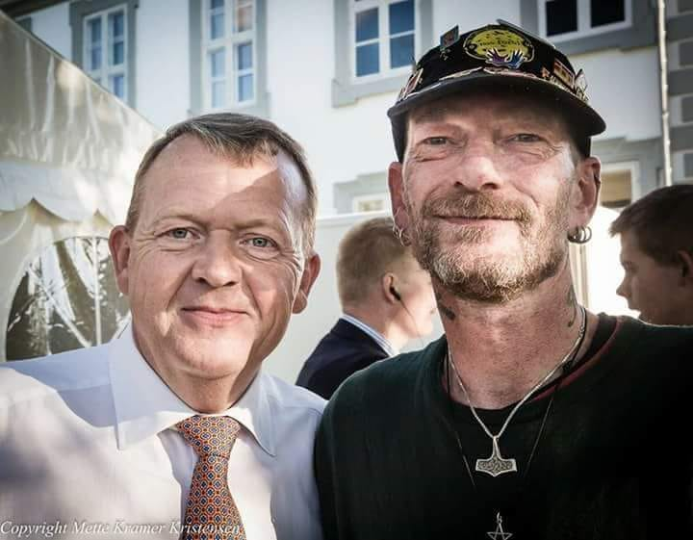
André and Morten

Slide 21
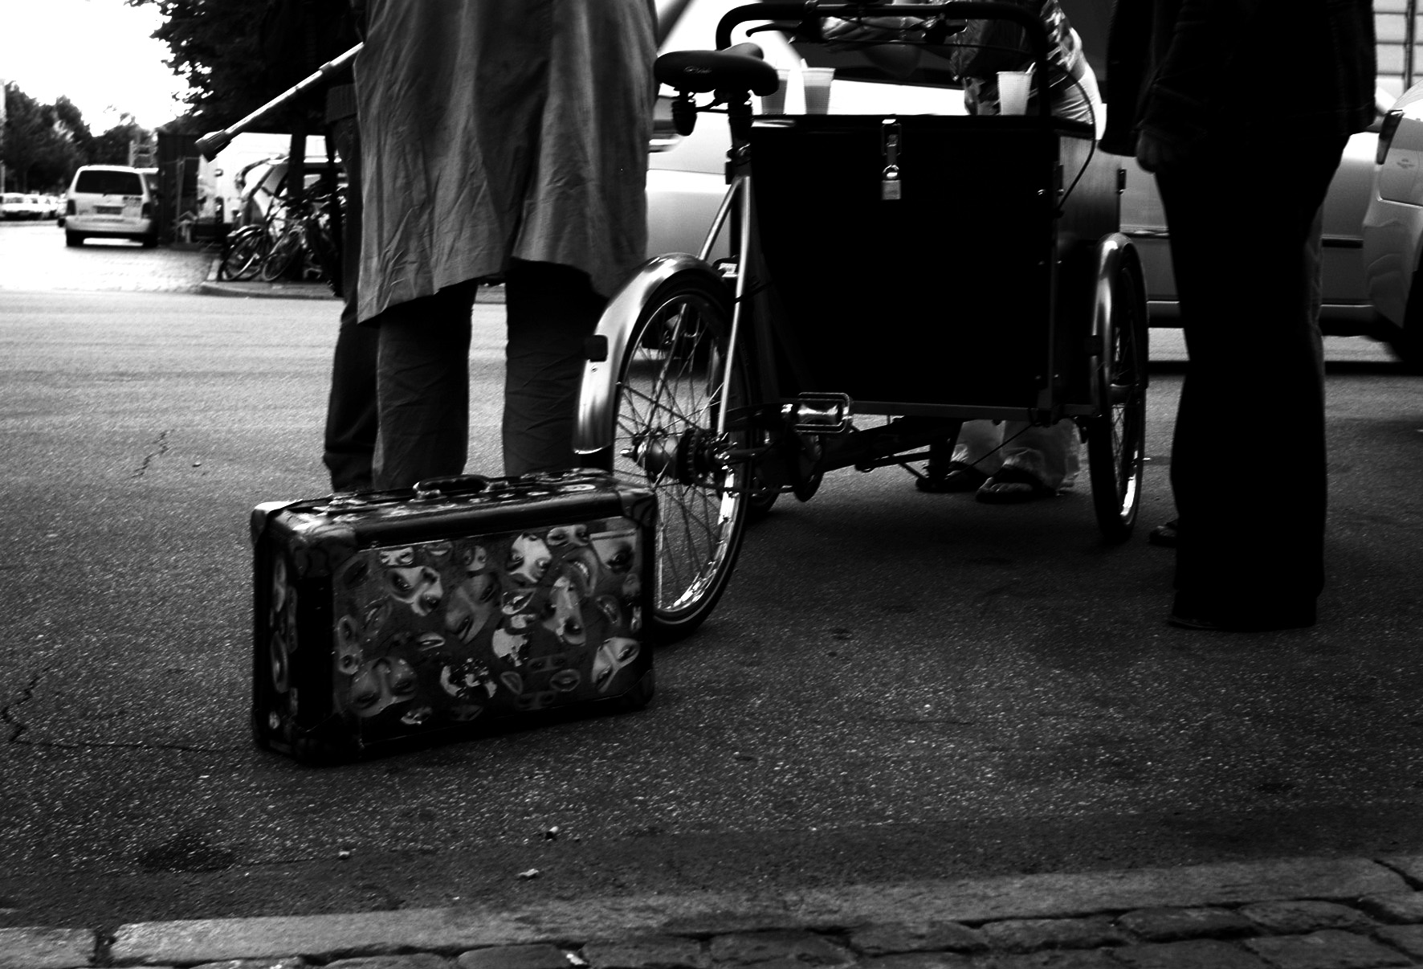

“Injustice anywhere is a threat
to justice everywhere.”
Martin Luther King Jr., 1963

