Slide 1
Supporting EU nationals to find sustainable routes out of rough sleeping
Petra Salva and
Sylvia Tijmstra

Slide 2
Context
Still much uncertainty in lead up to Brexit on 29 March 2019
  Home Office inability to cope with number applying to remain
  Settle Status scheme still in trial stage
  Some will struggle to prove right to remain
  Lack of free OISC registered immigration advice
  Impact on ability to secure/retain work and accommodation
Strong government commitment to halve rough sleeping by 2022 and end it by 2027
  £100 million fund with £5 million earmarked to support non-UK nationals to access accommodation in the UK or explore reconnection
  £26 million Controlling Migration Fund reopened with increased focus on work with non-UK nationals who sleep rough

Slide 3
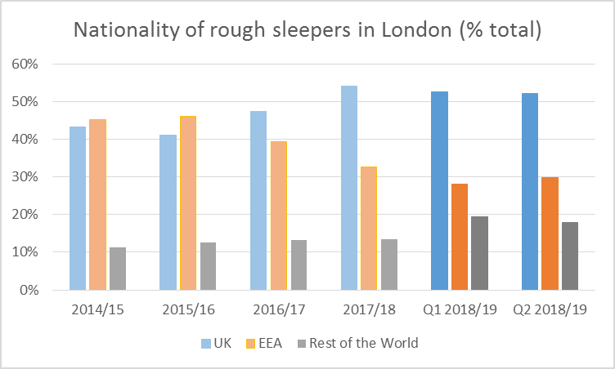
Numbers
Source: Rough sleeping in London (CHAIN reports), Greater London Authority (GLA)
Notes:
2014/15 2015/16 2016/17 2017/18 Q1 2018/19 Q2 2018/19
UK 3212 3271 3653 3862 1314 1519
EEA 3359 3669 3038 2323 702 867
Rest World 842 1006 1014 953 486 523
Total 7413 7946 7705 7138 2502 2909

Slide 4
Migrant strategy
Aim 1 – Improve our service offer to migrants
  consistency of approach through better training and awareness raising, monitoring outcomes more effectively and embedding the success of innovative projects
Aim 2 – Interconnect through effective partnerships
  extend partnerships with experts in migrant support, in particular those providing immigration advice
Aim 3 – Innovate and replicate successful service models
  extend our specialist service provision by piloting, evaluating, replicating, and achieving sustainable funding for innovative projects
Aim 4 – Influence policy and practice
Aim 5 – Involve our clients and other experts by experience

Slide 5
St Mungo’s key policy recommendations
Assertive outreach with immigration advice and employment support
  Enable informed choices about how to resolve homelessness in the UK or abroad
More and better quality supported reconnection services
  Building on Routes Home Service to provide better support for EEA nationals with high or complex including intensive voluntary reconnection support where needed
Immigration advice with accommodation
  Street Legal experience shows that combined access to immigration advice and accommodation can prevent prolonged destitution and rough sleeping
Employment support and affordable accommodation for those in work/seeking work
  specialist employment support that takes into account the specific needs of people who sleep rough, as well as any language and cultural barriers
  Basic, affordable accommodation for a fixed period of time to help those in employment or work ready to escape sleeping rough.
Notes:
Funding does not match numbers on the streets or current trends in EEA nationals sleeping rough
31% of rough sleepers in London and 16% in the rest of England are EEA nationals.
Numbers were decreasing, but rose sharply since Q1 of 2018/19

Slide 6
St Mungo’s service offer to EEA migrants
Routes Home Service
  Works with non-UK nationals and offers three streams of work:
    Specialist support for EEA nationals with high or complex needs to explore their options away from the street including access to services in the UK and their country of origin.
    Access to OISC registered immigration advice for non-UK nationals sleeping rough who require legal advice to resolve their immigration status and access services in the UK.
    Advice and signposting for services working with non-UK nationals who do not need our direct support or meet our main referral criteria

Slide 7
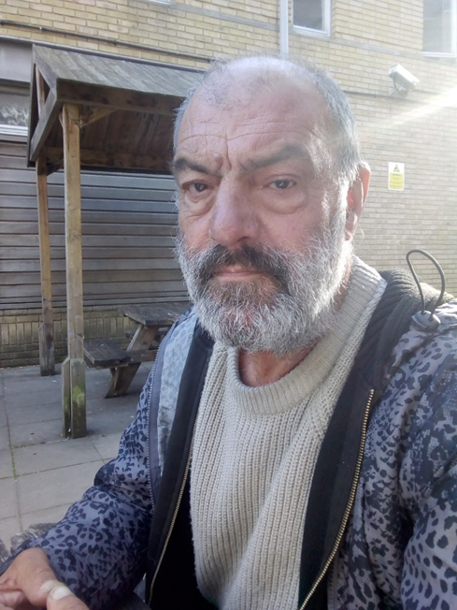
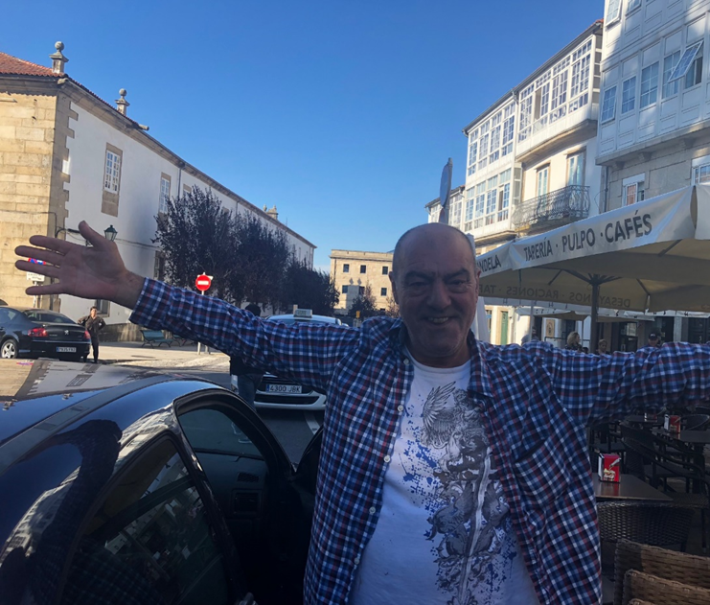
Case study Jose
Notes:
Full Mungo’s consent Case study. Jose is 67 year old. Originally from Spain, he had been rough sleeping in London for about 6 years when he was referred to Routes Home. He became homeless after separating from his wife of 33 years.
We offered him a safe place to stay while we explore his support needs, hopes and aspirations. Jose has significant alcohol use, physical and mental health needs, meaning that finding a sustainable route of the street in the UK will be difficult. So we looked at his options in Spain and put him back in touch with his family. He was reconnected to Santiago de Compostela on Monday 22nd October and is currently staying at his brother’s house. His younger brother Gonzalo was very welcoming – he met us at the airport and Jose will stay in his house as much as needed. Jose plans to find himself separate accommodation. First picture was taken when he was booked in to the assessment bed, second one minutes before the Routes Home worker leave him with his brother in Santiago de Compostela.

Slide 8
St Mungo’s service offer to EEA migrants
Street Legal
  Free immigration advice and accommodation for NRPF rough sleepers
  Currently non-EEA only, but service to be expanded to include EEA nationals in 2018/19
NRPF bed spaces
  Currently 50+ bed spaces, but looking to expand
  Inclusion pilot launched to increase 24/7 supported bed spaces
  Room2Build project to pilot affordable temporary accommodation for those who are working or work-ready
Romani support
  Continued rise in rough sleepers from Romani background
  Exploring new approaches including navigator models and accommodation-first approaches

Slide 9
Questions?

