Slide 1
Introduction
True Colors United / ILGA-Europe / FEANTSA partnership
Surveys and reports mirror our success in America:
  Elevated the issue and created a clear path forward
  Opened conversations with leaders and communities
  Shifted focus and centered LGBTQ youth
  Lead to various initiatives, including an LGBTQ prevention pilot with the U.S. Federal Government
Dr. Jama Shelton and Anthony Ritosa

Slide 2

LGBTIQ YOUTH HOMELESSNESS IN EUROPE
Presented by:
Anthony Ritosa (he/him)
Jama Shelton, MSW, PhD (they/them)

Slide 3



Survey respondents
ILGA Europe
FEANTSA
Silberman School of Social Work, Hunter College
Thank you!

Slide 4
Key Findings:
Addressing LGBTI Youth Homelessness in Europe and Central Asia: Findings from a Survey of LGBTI Organisations

Slide 5
About the Organisations: Response rates by country
Albania 2
Armenia 1
Austria 1
Belgium 5
Bosnia and Herzegovina 2
Bulgaria 1
Denmark 4
Finland 2
France 2
Georgia 2
Germany 5
Greece 2
Hungary 4
Iceland 1
Ireland 2
Italy 4
Kyrgyzstan 1
Latvia 1
Malta 1
Montenegro 1
North Macedonia 1
Netherlands 1
Poland 1
Portugal 1
Romania 5
Serbia 3
Slovenia 2
Spain 5
Sweden 3
Switzerland 1
Ukraine 1
United Kingdom 3

Slide 6
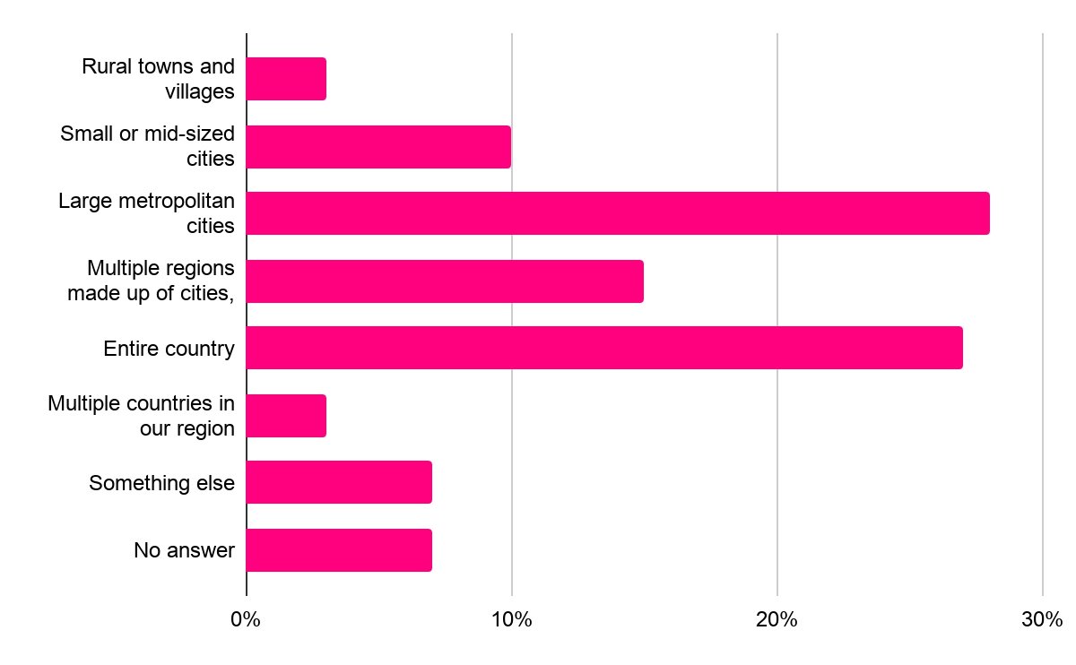
About the Organisations: Regions served

Slide 7
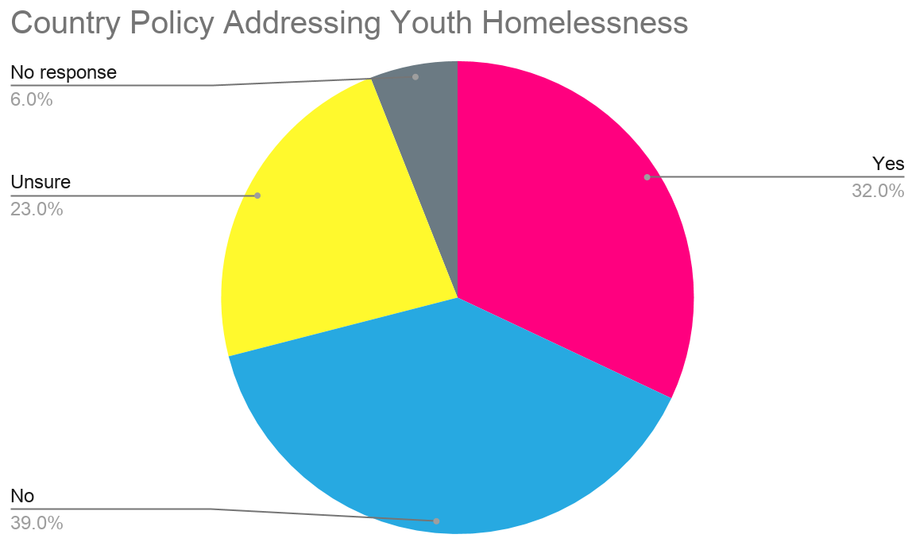
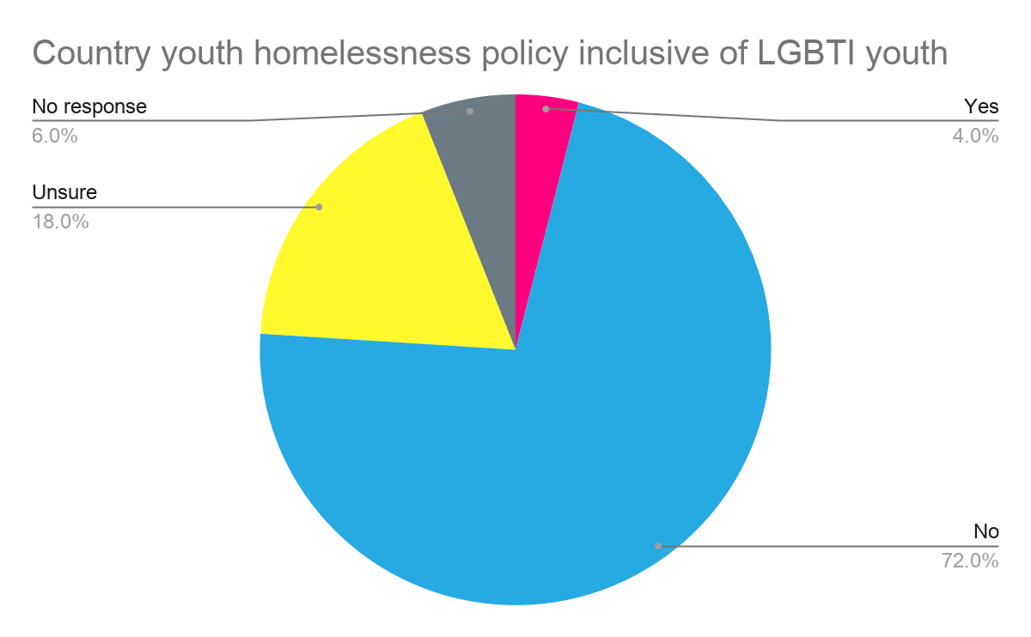
Organisational Context: Policy supports

Slide 8
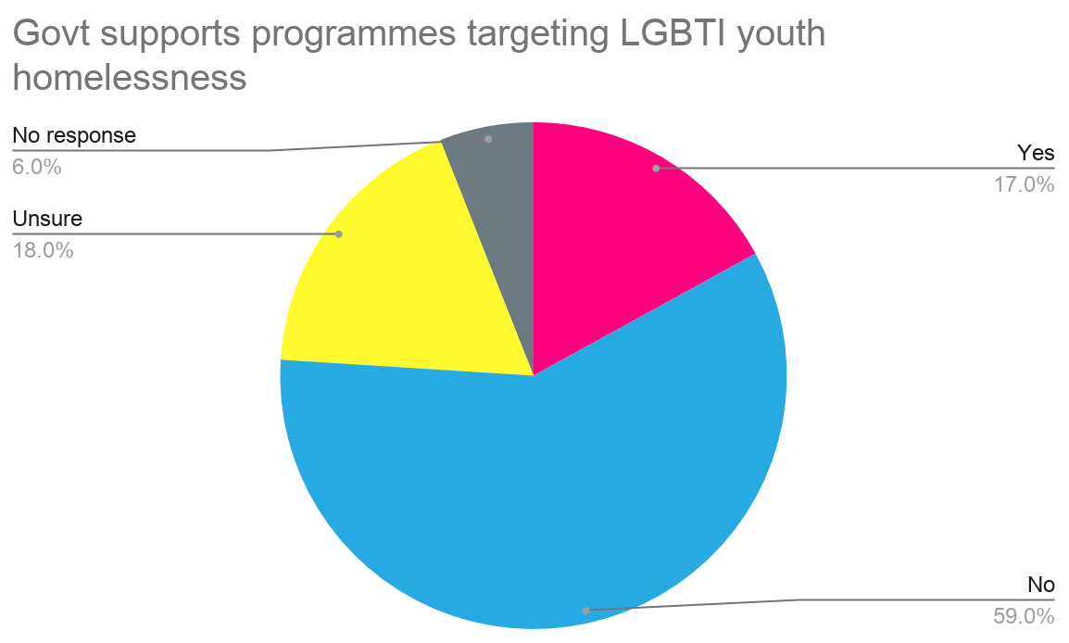
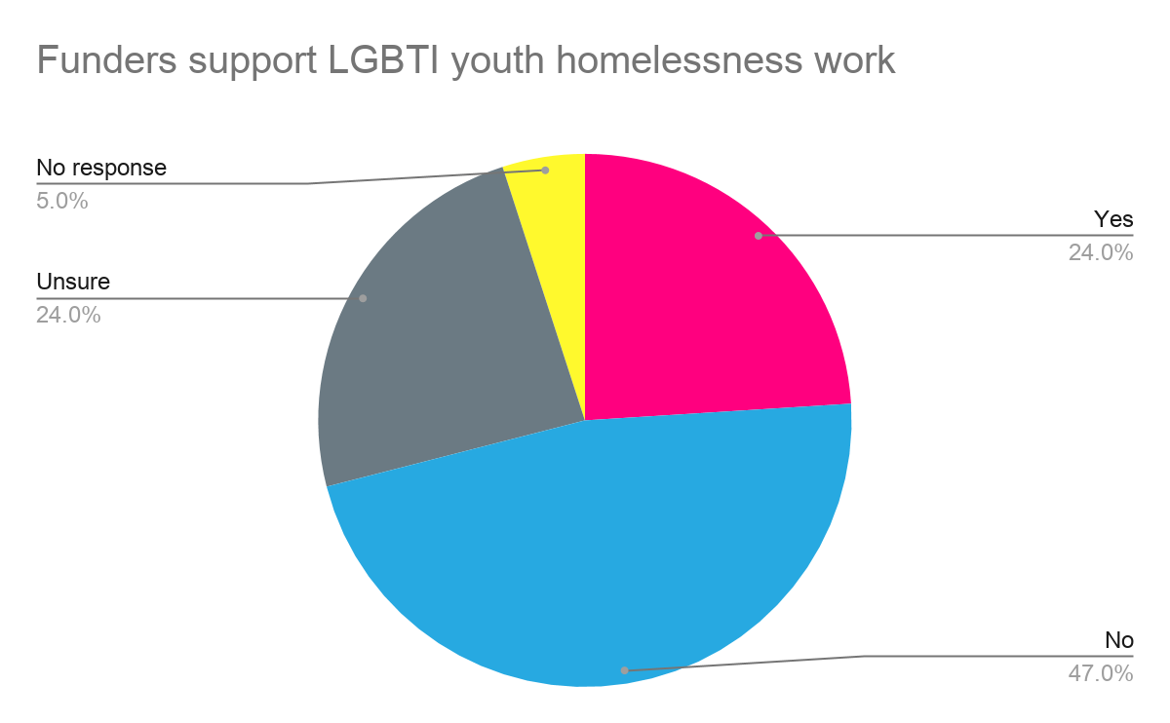
Organisational Context: Government & financial supports

Slide 9
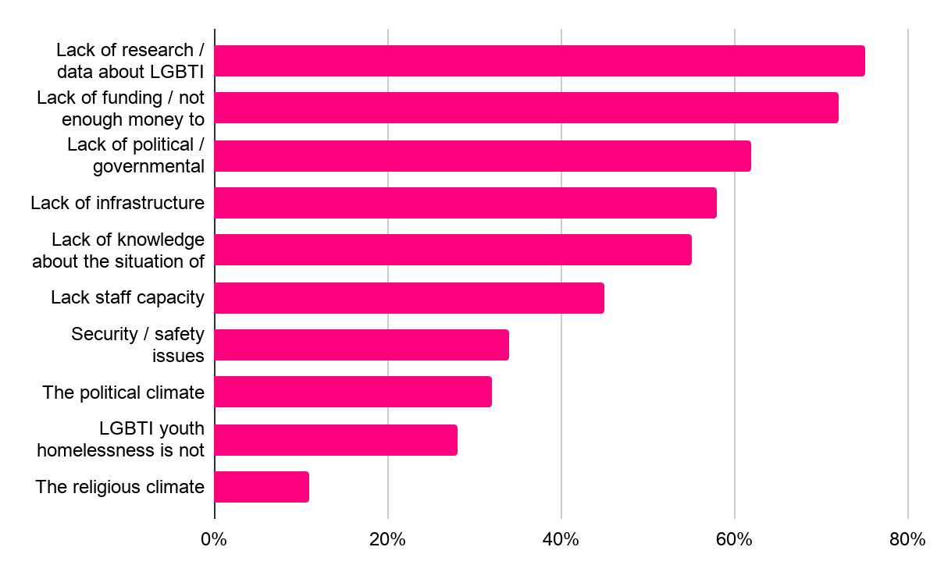
Organisational Challenges

Slide 10
The most difficult challenge is a political climate and a rising wave of homophobia and transphobia. In connection to the political situation, we are concerned with further actions of the government that can make situation of transgender people in Poland even worse, while solving problems already affecting the community could be only possible with governmental legal, financial and infrastructural support.
“
“

Slide 11
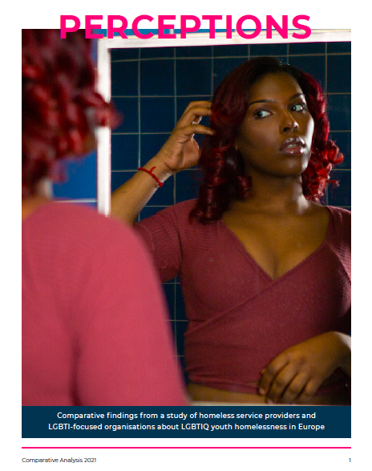
Key Findings:
Comparative findings from a study of homeless service providers and LGBTI-focused organisations about LGBTIQ youth homelessness in Europe

Slide 12
About the Organisations
Homeless Services
LGBTI-focused Orgs.
N = 64
N = 71
21 countries
32 countries
64% work with LGBTIQ youth
68% work with LGBTIQ youth

Slide 13
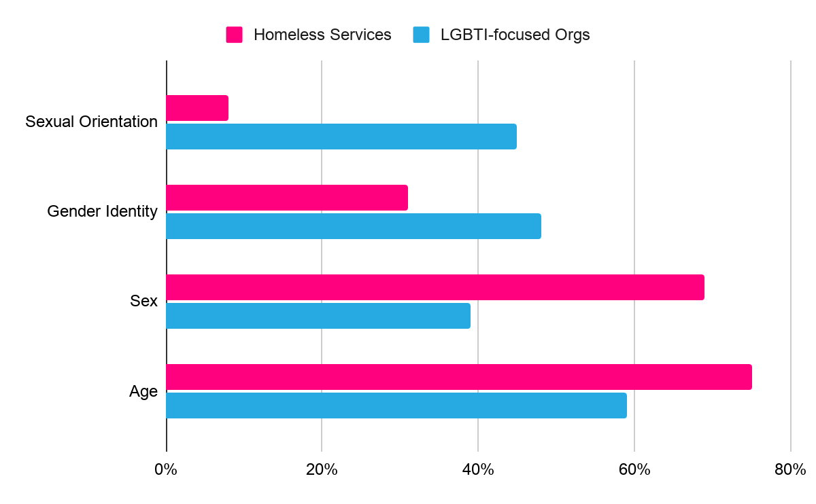
Demographic Data Collection

Slide 14
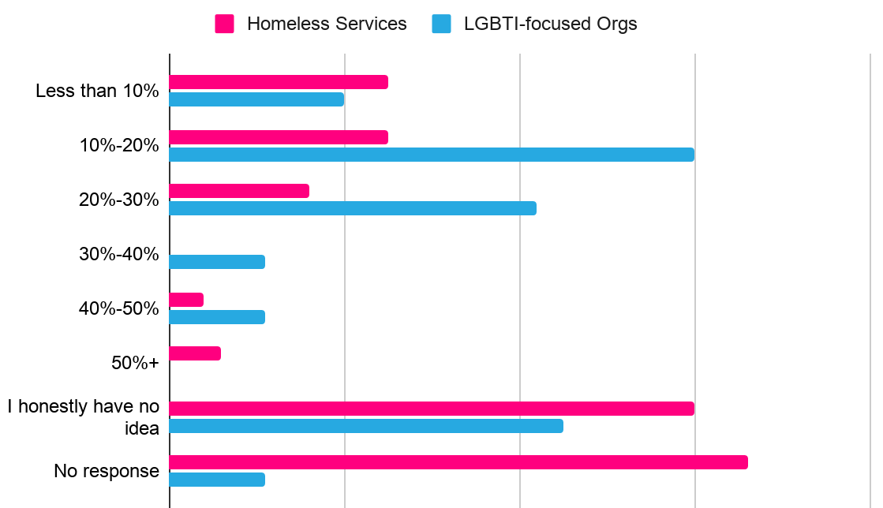
Estimates of LGBTIQ Youth Homeless Population

Slide 15
The field of LGBTIQ* homelessness in this country is hardly elucidated! We have only glimpses.
“
“

Slide 16
Opportunities for change

Slide 17



Develop Prevention Strategies

Slide 18
Develop Prevention Strategies
Long story made short: 50% among LGBT youth, they are driven away by ultra-religious families from disadvantaged and ultra-homophobic backgrounds. Others lost their jobs in the pre-pandemic period.
“
“

Slide 19
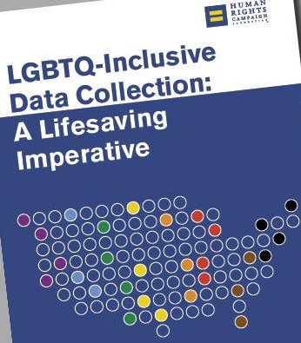
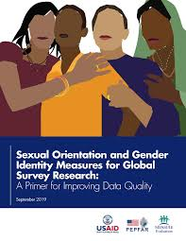
Systematic process of data collection

Slide 20
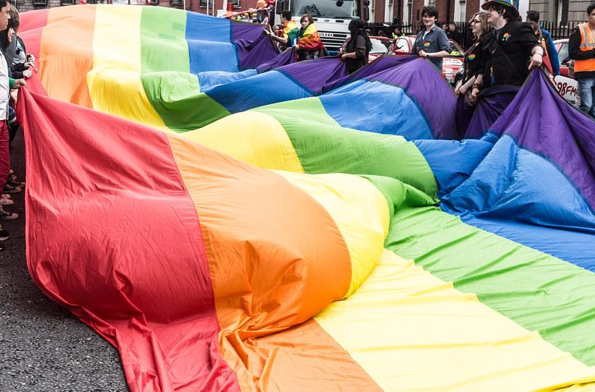
Training & Capacity Building

Slide 21
Cross -
sector Collaboration
Homeless Services
LGBTI-focused Orgs
Government

Slide 22

Check out the full reports for more info!

Slide 23


THANK YOU!

