Slide 1

Feantsa webinar
Covid19 & Homelessness
8 th of October 2020
Actions-reactions - Sanna Tiivola , No Fixed Abode

Slide 2

Situation in a nutshell spring 2020
After the covernment had set ”The state of emergency” all the public places closed
Everyone were saying: Stay home, stay safe
Homeless people felt that they were left alone totally (comparing the situation in other countries)
Many actors closed their places becauce of the districtions for NGO: s to stop people gathering together.
No Fixed Abode the grassroot advocacy organization kept places open, day centre, night centre outreach work, housing advice – districtions for the people staying in same time etc..
No Fixed Abode got extra funding to double the services for 4 months during the Covid19
Night Cafe Kalkkers moved to a other place were people could sleep

Slide 3

What was done?
No Fixed Abode published the Feantsa recommendations in contension and in social media
A member of parliament maid a questionnaire for the government of the rights of Homeless people to have a safe place
A lot of Media attention – City of Helsinki reacted
The City of Helsinki (2/3 of homeless people are in Helsinki area) gathered the group of homeless actors and organizations and started to have once a week a meeting to gather the information from the situation in the streets.

Slide 4
What was done?
The group understood very quickly that there was a little advantage of moving support . People needed a place to go and stay. Substance abuser care was increased, but people were not going there.
The city started to give advice for testing Covid-19, food and masks to be shared in the streets and places, gave more resources for emergency accomodation. The city gave more crises apartments for people who were infected.
There was also arranged the straight test line for people experiencing homelessness.

Slide 5
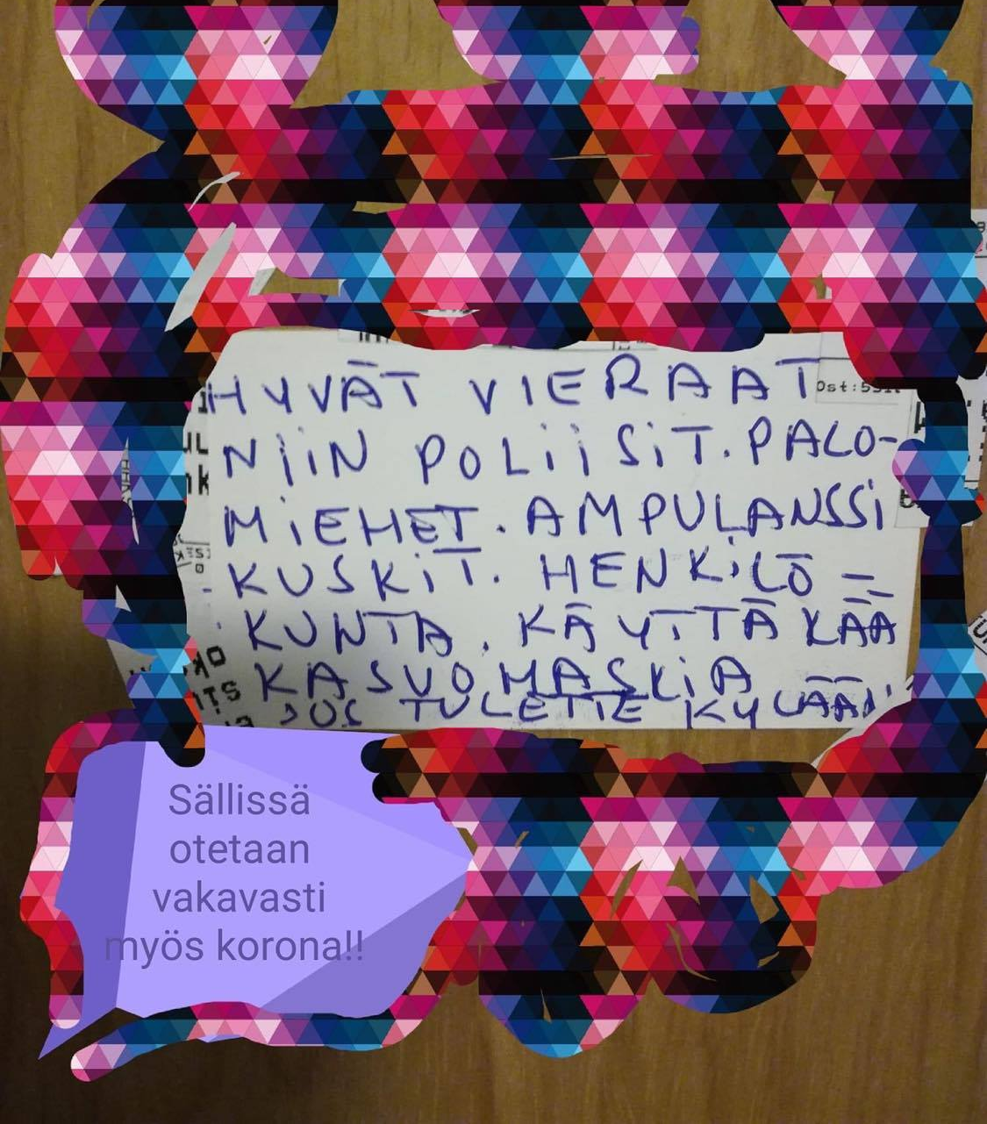
Homeless people´s reactions

Slide 6
Reactions
At the early stages people were sleeping in the public toilets in the city area. Approximately 100 people in 25 toilets. The city shut down the invalid toilets, were could sleep more people. Many people who normally could do sofa surfing was not taken in.
People were tired, dirty and hungry, and didn´t want to discuss. Some homeless people said they dont care about the Corona and said they feel immune becauce they are living a hard life anyway.
Later on many young homeless people made own groups in parks and used them as their own area , using openly drugs etc.
People collecting empty bottles could not take them from the carbidge bin- becauce it was full of used masks.
People said it was bad that you could not see your parents, relatives etc..

Slide 7

Big picture
Later on many people said they feel isolated and totally left outside of the society. The community they belonged in services disappeared- services were helping only homeless people in the streets.
In Finland not all homeless people stays out 365 days /a year, many people have a contact for the service system, or have friends and so on..people assume that the society is sort of equal and a feeling that they are part of society. The situation when all the public areas and services were closed and there was only some commercial places open, from were homeless people could not go many people were shocked and felt that they really have no part in society.
Lessons learned: Never close totally the services the most vulnarable people need.

Slide 8


Thank you!
www.vvary.fi
sanna.tiivola@vvary.fi
+358504079702

