Slide 1
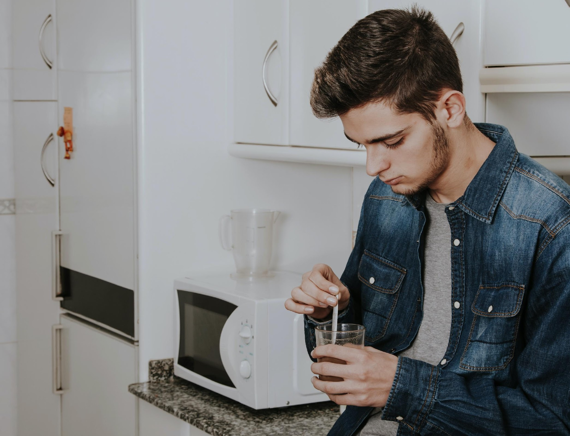


17 years
Providing accommodation and support for young LGBT+ people.
LE REFUGE FOUNDATION
Recognized by French state

Slide 2

WHAT IS
LE REFUGE ?
Recognized by the French state as public a public utility, Le Refuge is providing an emergency accommodation and support for young LGBT+ people in order to fight against isolation and suicide of LGBT+ youth undergoing homophobia, transphobia and family breakdown. From it’s creation in 2003, Le Refuge is helping those young adults to allow an emotional and materiel reconstruction.
The godmother of the Foundation is Muriel Robin, French Humorist.

Slide 3
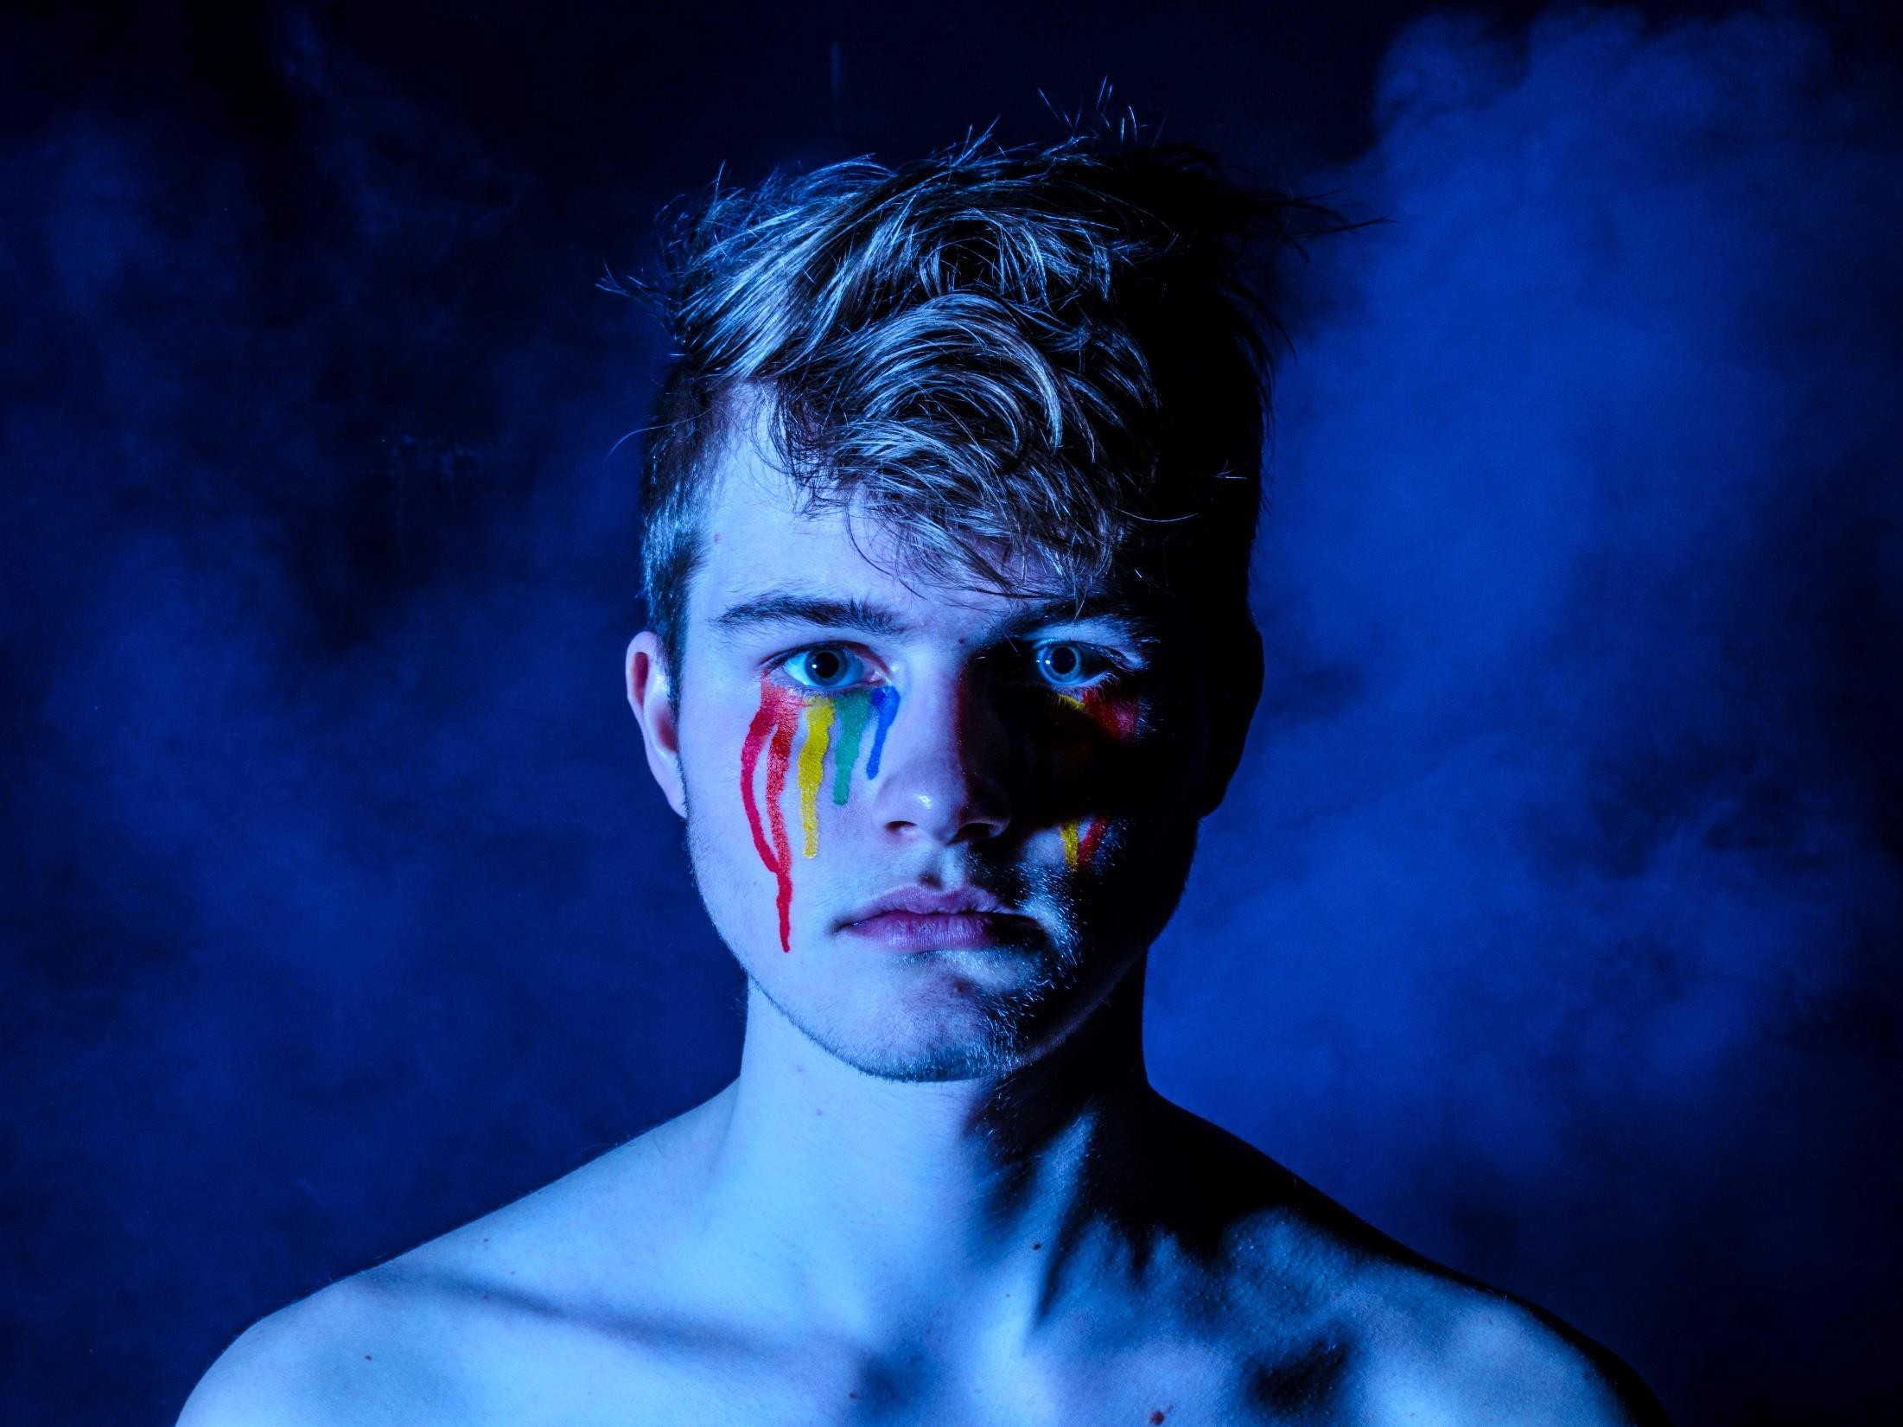
«At the age of 18, I decided to come out… My father began to hit me, to insult me. I didn’t let myself go and i went against his will. Every single day, we had an argument, even hitting each other… It kind of became our daily lot. Until that day when my father pulled out a shotgun and pointed it at me saying “ Now get out, I don’t like fags, they have no room in this house.». Romain

Slide 4

3 AXES OF INTERVENTION
ACCOMMODATION AND ACCOMPANIMENT
24/7 EMERGENCY LINE
RAISING AWARENESS

Slide 5
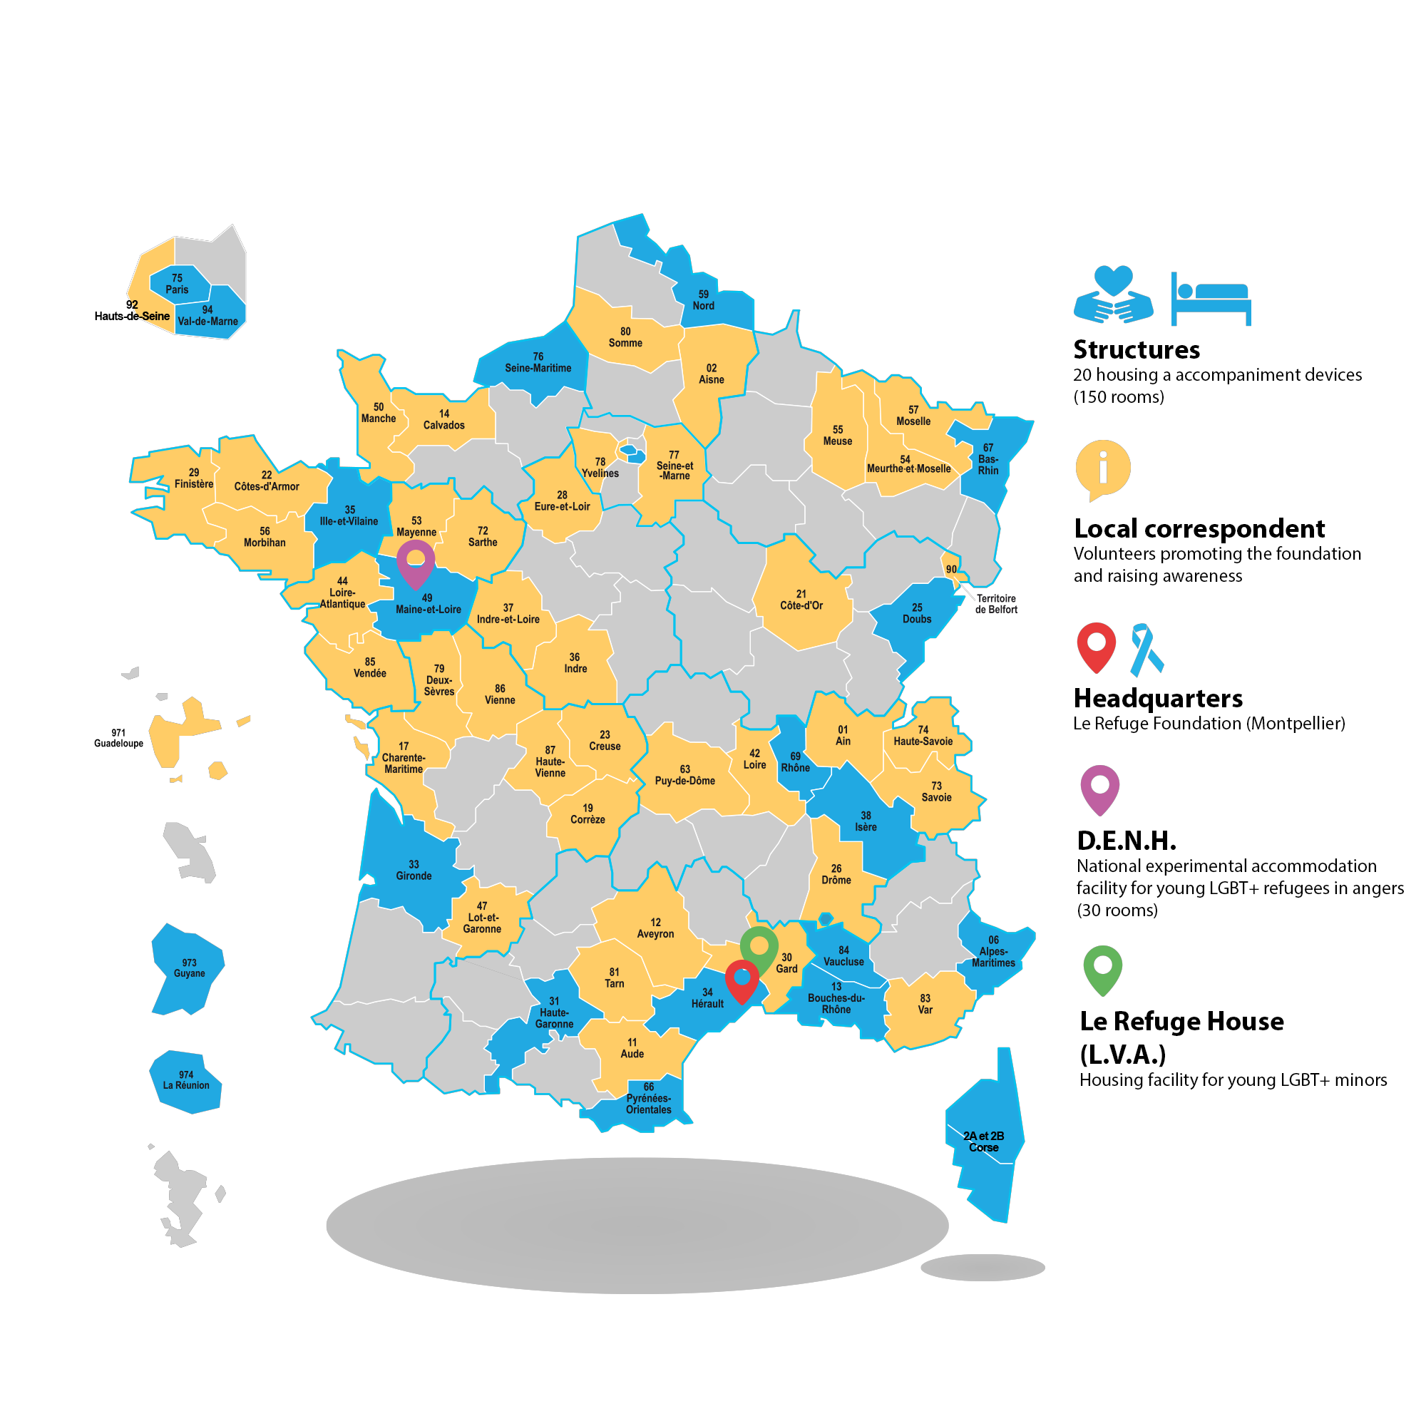
LE REFUGE IN FRANCE
20 Structures
1 National experimental accommodation facility for young LGBT+ refugees (Angers)
1 accommodation faciity for young LGBT+ under 18s (Aujargues)
39 local-correspondent
16 074 members
455 volunteers
21 employees
including 13 social workers and 2 heads of services.

Slide 6

SPEAKING FIGURES
SINCE 2003 :
8503 YOUNG LGBT+ PEOPLE HELPED
2032 YOUNG LGBT+ PEOPLE HOSTED
IN 2019...
39 912 NIGHTS SPENT
EVERY NIGHTS,
187 YOUNG PEOPLE
ARE SAFE
6881 CALLS ON
THE EMERGENCY LINE
827 ACCOMMODATION
REQUESTS
480 YOUNG PEOPLE HELPED 306 HOSTED
20% OF YOUNG PEOPLE HELPED ARE TRANS.
MORE THAN 5569 STUDENTS AWARENED
DURING SCHOOL INTERVENTIONS

Slide 7




HEADQUARTERS
75 place d’Acadie
34000 Montpellier
EMERGENCY LINE 24/7
06 31 59 69 50
INFOS & DONATION
le-refuge.org
CONTACTEZ
NOUS

