Slide 1

FEANTSA online conference week
Asylum Seekers & Refugees - Insights from the 5th Overview of Housing Exclusion in Europe
#HousingExclusion2020
Chloé SERME- MORIN – FEANTSA
Notes:
We recently witnessed collectively the impact of a pandemic & healthcare crisis on our societies: it has never been clearer that housing is a key determinant of health. Housing can be a matter of life and death. And today, we hear that EU is facing « historic » days & decisions. But EU agreements & actions will be truly historic when it will leave no one behind, in particular the homeless & the most excluded parts of the EU population.

Slide 2
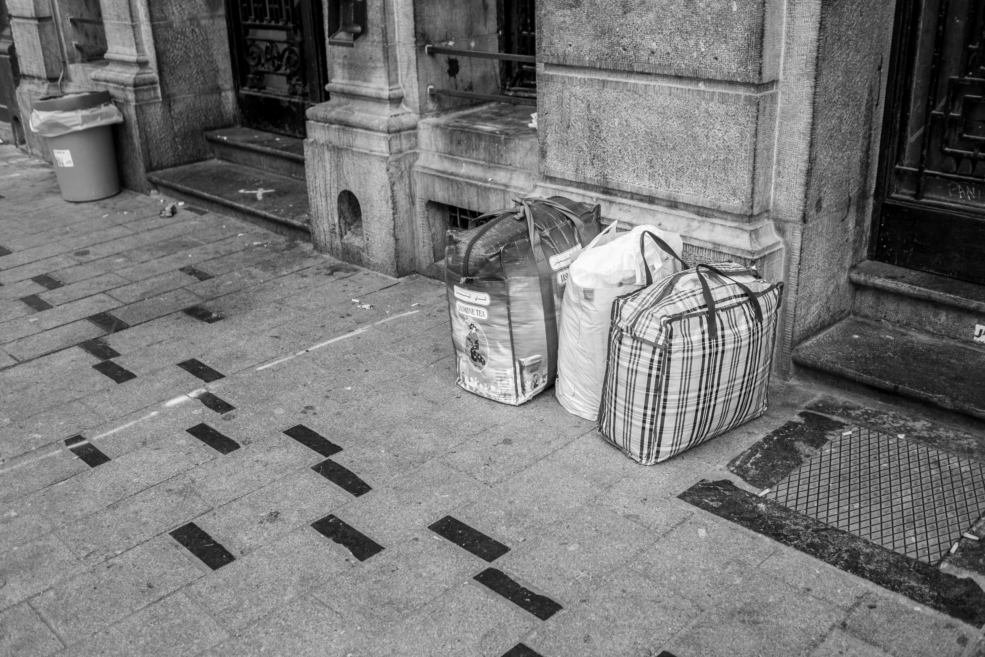


THE MANY FACES & FACTORS OF HOMELESSNESS AND HOUSING EXCLUSION IN EUROPE
Photo: Chloé Thôme – L’Ilot
Notes:
A bit of context

Slide 3
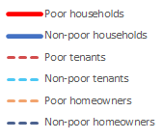

THE MANY FACES & FACTORS OF HOMELESSNESS AND HOUSING EXCLUSION IN EUROPE
Total housing costs
EU average (€ per month)
Poor tenants spent on average 563€ per month in housing costs in 2018 in the EU
+21% in 10 years
Notes:
In the last 10 years in the EU, total housing costs have been rising by 21% for poor tenants. Tenants are on the frontline of the increase in housing prices; and the gap, the inequalities between non-poor & poor households have been increasing too – before 2009, poor tenants housing costs were lower than non-poor households – but it changed, & the housing costs for poor tenants increased since then at an unprecedented pace.

Slide 4
EUROPEAN INDEX OF HOUSING EXCLUSION 2020 (sarah)

Slide 5
HOUSING EXCLUSION IN EUROPE
Social factors exacerbating housing difficulties:
Who are the most vulnerable to housing exclusion?
Poor households
Poor children
People with an activity limitation
→ Non-EU nationals
Notes:
Who are the most vulnerable to housing exclusion?
Children : one out of four poor children live in damp housing in the EU. This is a phenomenon share by all EU countries.
Non-EU nationals

Slide 6

EUROPEAN INDEX OF HOUSING EXCLUSION 2020
Non-EU nationals more likely to live in overcrowding & to be overburdened by housing costs than EU nationals
Notes:
One third of non-EU nationals are living in overcrowding conditions in the EU, compared to 13% of EU nationals. This gap is huge in the countries appearing in this graph. Non-EU nationals are also more likely to be overburdened by housing costs than EU nationals.

Slide 7
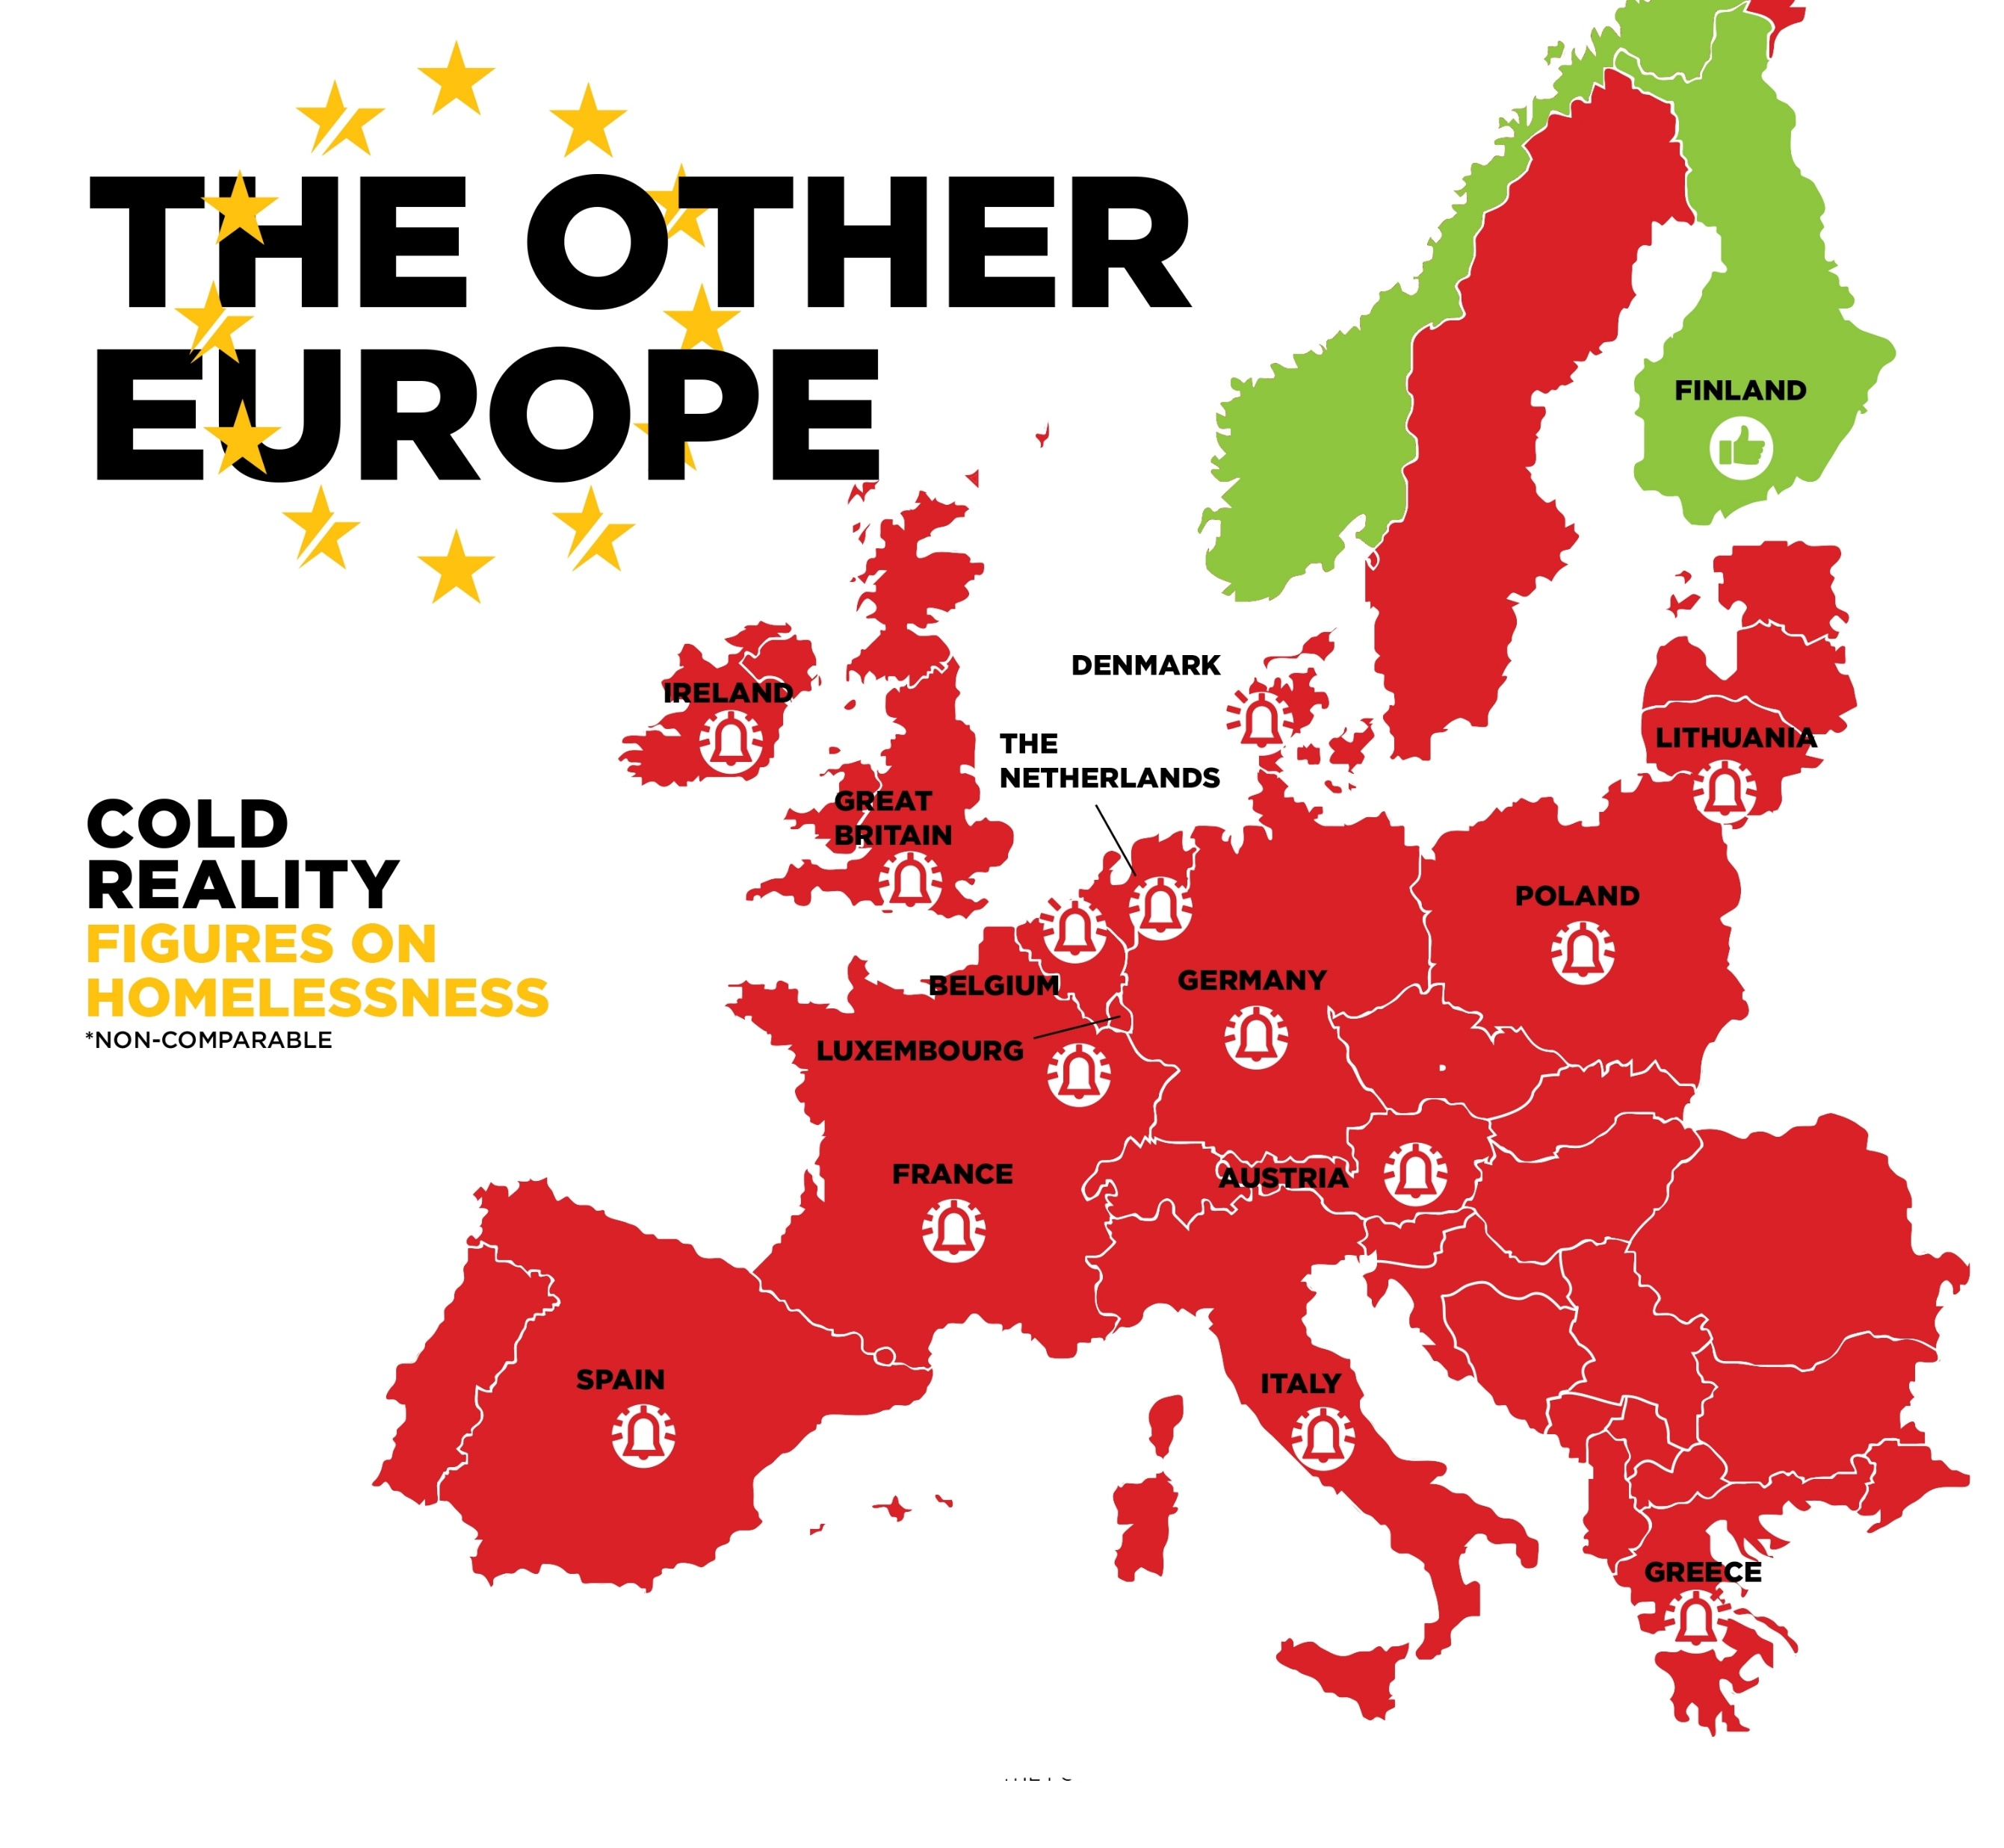
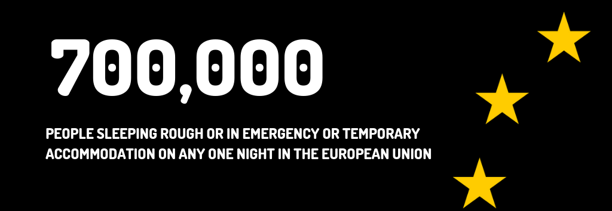
ESTIMATES OF THE NUMBER OF HOMELESS PEOPLE IN EU
+ 70%
in 10 years
Notes:
We tried to estimate the number of homeless people on any given night in the EU: 700 000 / +70% in 10 years

Slide 8
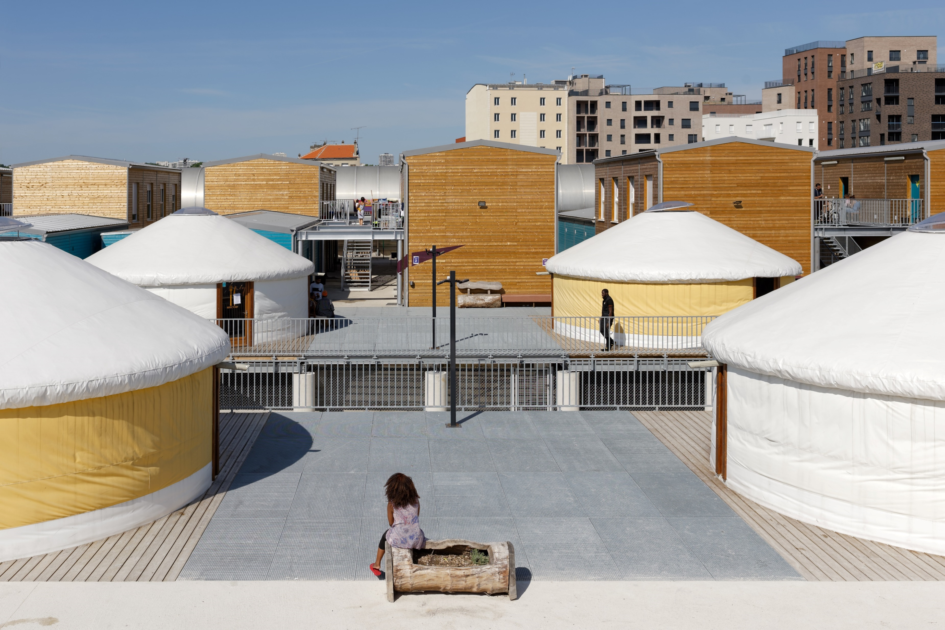
EXILED & HOMELESS: RECEPTION AND ACCOMMODATION CONDITIONS FOR ASYLUM SEEKERS AND REFUGEES IN EUROPE
Photo: David Boureau – Emmaüs Solidarité Paris Ivry
Notes:
Three weeks ago, a fire destroyed almost entirely the Moria camp, leaving 13 000 vulnerable ppl without any shelter on Lesbos island, in Greece. 13 000 asylum seekers had been living there for months or even years in dire & overcrowded living conditions, in a camp initially organized to welcome 3000 ppl. It was a disaster waiting to happen & it is a symptom of the complete failure of EU asylum system.
We tried to understand this failure in the report, investigating the reception & accommodation conditions for asylum seekers & refugees in Europe.

Slide 9
EXILED & HOMELESS
Brussels: 25% of homeless = asylum seekers
Sweden: 43% of homeless = foreign nationals (x2 since 1993)
England: 32% of homeless accommodated in NACCOM services = refugees
HOUSING = ESSENTIAL FOR INTEGRATION
Notes:
Lack of comparable data & common definitions > body of evidence on the over-representation of migrants, AS & refugees amongst EU homeless population
Access to adequate housing for people applying for and benefiting from international protection is & must be an integral part of any functioning asylum system, because housing is essential for any form of integration.

Slide 10


EXILED & HOMELESS
Right to asylum & principle of non-refoulement =
any individual has the right to apply for asylum on EU territory
Geneva Convention (art. 33)
EU Convention on Human Rights
(art. 3)
EU Charter of Fundamental Rights
(art. 18)
Definitions & outlines
asylum seekers, beneficiaries of international protection, ‘dublinised’ people, migrants in transit, rejected asylum seekers
9 countries selected for comparative analysis (highest nb of asylum applications in 2019) : DE, FR, GR, IT, ES, NL, SE, BE, UK
Notes:
We chose to select 9 countries for the comparative analysis – countries where the number of asylum applications were the highest in 2019.
The right to asylum & the principle of non-refoulement forbid Member States who receive asylum seekers on their territory to send them back to their country if they could be exposed to danger or persecution.
competence EU: The Common European Asylum System > standards that EU Member States must meet are set by different directives: among those, the Reception Conditions Directive aims to guarantee asylum seekers access to basic services & accommodation. However, the current Directive gives significant discretionary powers in the definition of what constitutes an adequate standard of living. As such, reception conditions continue to vary considerably between Member States.

Slide 11
EXILED & HOMELESS
SEEKING REFUGE: INADEQUATE RECEPTION & ACCOMMODATION CONDITIONS FOR ASYLUM SEEKERS
« UNDER PROTECTION » BUT HOMELESS: THE DIFFICULTIES BENEFICIARIES OF INTERNATIONAL PROTECTION FACE IN ACCESSING HOUSING
Notes:
2 parts for this chapter

Slide 12
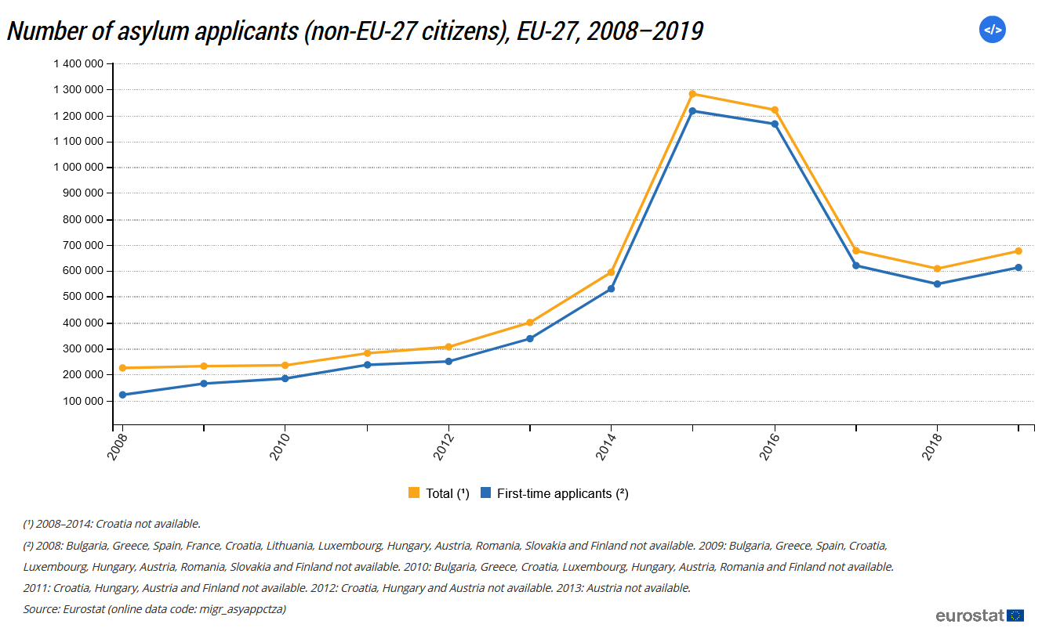
EXILED & HOMELESS
77%
< 35 years old
children < 18 years old
29%
Eurostat, 2020
Notes:
Context data: asylum applicants peak in 2015 > drop in following years. Asylum seekers are young = more than 2 third are less than 35 yo, more than a quarter are minors.
Syria was the main country of origin of asylum seekers in the European Union Member States in 2019,
a position it has held since 2013 (11% of the total number of asylum seekers). Syria was followed by
Afghanistan (8%), Venezuela (6%), Iraq (5%), Pakistan and Colombia (4%).

Slide 13
I. SEEKING REFUGE: INADEQUATE RECEPTION & ACCOMMODATION CONDITIONS FOR ASYLUM SEEKERS
Outdated & unsuitable specialised accommodation systems: the institutionalisation of emergency accommodation for asylum seekers
Unequal distribution among different EU countries + lack of preparation + chronic under-budgeting + political decisions = lack of adequate specialised provisions
Overlapping of homelessness accommodation & specialised reception accommodation
ES
FR
From 930 1st reception places (09/2015) to 9 129 (12/2019)
2018: only 48% of asylum seekers accommodated within national accommodation system
Asylum applications x45 in 6 years
Notes:
First part of the investigation = inadequate reception & accommodation conditions for asylum seekers
Question: Why in a vast majority of EU MS, are specialised accommodation systems outdated & unsuitable, not allowing for a proper reception of asylum seekers?
First factor: unequal distribution of AS among different EU countries . short-term strategies in terms of asylum reception / lack of preparation for most countries that ended up overwhelmed by increased arrivals in 2015 (ES for instance) = lack of EU coherence & cooperation
2nd factor : chronic under-budgeting + political decisions (overcrowding is the direct result of political decisions to close facilities: IT, BE, GR)
Results =
Lack of adequate specialised provisions > back to Greek situation & Moria: NGOs have been warning EU institutions on the situation in Moria for years now. MSF had been recording weekly cases of children attempting suicide; 1 toilet was available for 65 people, 1 shower for 95. These are the « reception » conditions in Greece today.
In other countries, FR, ES, IT, we see an overlapping of homelessness accommodation & specialised reception accommodation: Emergency accommodation is no longer used as a temporary solution to the lack of places in the reception system, but instead has become the default form of accommodation for certain categories of asylum seekers.

Slide 14
SEEKING REFUGE: INADEQUATE RECEPTION & ACCOMMODATION CONDITIONS FOR ASYLUM SEEKERS
2) Access to dignified housing conditions hindered by the abuses of the Dublin Regulation & by a tightening up of national legislation
GR
IT
Law on international protection (2019)
Salvini Security Decrees (2018)
“Being in a hotel is like being locked up because I often feel we are treated sort of like prisoners. Because we are not allowed visitors [...] I don’t understand it really...” Kouma, 17 years old
3) Varied measures when it comes to provision for people in vulnerable situations
Families, unaccompanied minors, asylum seekers with specific mental health care needs very vulnerable to homelessness
Notes:
Several Member States have tightened up their asylum legislation over the last years, which has led to asylum seekers having increased difficulties in accessing accommodation.
Salvini decrees in Italy (Oct 2018) > change procedures to restrict the right to asylum.
Impact on resources & on services & quality of living: ex. Italy, budget cuts for CAS = end of legal aid, school support & language courses.
People under Dublin procedure are very vulnerable to homelessness : arbitrary access to EA (législations in BE & FR), bad reception conditions, etc.
Asylum seekers are, by nature, vulnerable people: a lack of or inadequate provision can amount to degrading
treatment due to this vulnerability.
Some people are particularly vulnerable among asylum seekers = specific needs

Slide 15
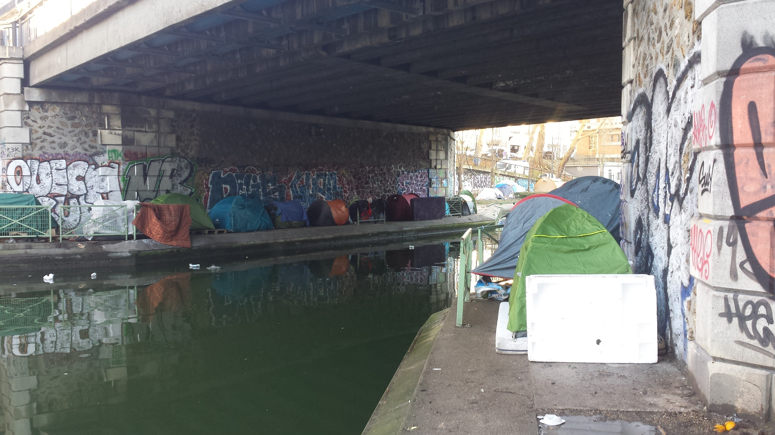
II. « Under protection » but homeless: the difficulties beneficiaries of international protection face in accessing housing
“We have just received our official documents
here. But we cannot transform them into a roof over our heads, we cannot feed our children with them. »
Photo: Mauro Striano – Tents on canal St Martin, Paris
Notes:
> Second part of the investigation: on the difficulties faced by refugees/BIP in accessing adequate housing
_ Refugees are more and more represented among homeless population in lots of EU countries, in a context of growing housing inequalities as Sarah mentioned earlier.
This is linked to different factors:
1/ The problem of housing transitioning despite the change in administrative status: when you change from AS status to refugee status, that involves changes to the process and orientation; so you should be supported to leave facilities intended specifically for asylum seekers in a dignified manner. A minimum amount of time is necessary to prepare for this ‘upwards’ move. In the NL for instance, transition from asylum seeker reception centres to accommodation for beneficiaries of international protection is only made when adequate housing, outside of the reception centres, is found in cooperation with the municipalities. In some other countries however, there is no public system for housing refugees & the very short deadlines to leave AS facilities expose those ppl to homelessness (in England for instace, 28 days to leave AS facilities, more than a quarter of homeless ppl helped by NACCOM = refugees).
2/ There is also an accumulation of financial, legal & administrative obstacles to the increasingly inaccessible housing market, that complicate access to adequate housing for refugees: let me cite here 2 of them:
Growing gap between housing costs & household income, esp for poor households + inadequate financial assistance
Discrimination: Studies in France & Germany show the very high prevalence of racial discrimination when it comes to renting housing: FR= 87% of private landlords racially discriminate when renting out a property. Someone with a Sub-Saharian African profile has 38% less chance of renting a property than a person with a French-sounding name.

Slide 16


EXILED & HOMELESS
CONCLUSION
Migration crisis Reception crisis
Another consequence of the Europe-wide housing crisis
Reception conditions and accommodation for exiles must be an integral part of social policies to combat housing exclusion & poverty in the EU
Housing is a key component of the fight against extreme poverty & exclusion in EU
Notes:
Reception crisis: Predominant approach in EU = focusing on managing migration flows rather than a process based on fundamental rights & looking after the essential needs of people seeking protection.
We are not facing a migration crisis, but a reception crisis.
We came across interesting initiatives, best practices, & the boldest ones were often initiated by civil society, supported by foundations; we can cite here the great work done by EPIM – EU Programme for Integration & Migration, but you will find many more other inspiring examples in the report.

Slide 17
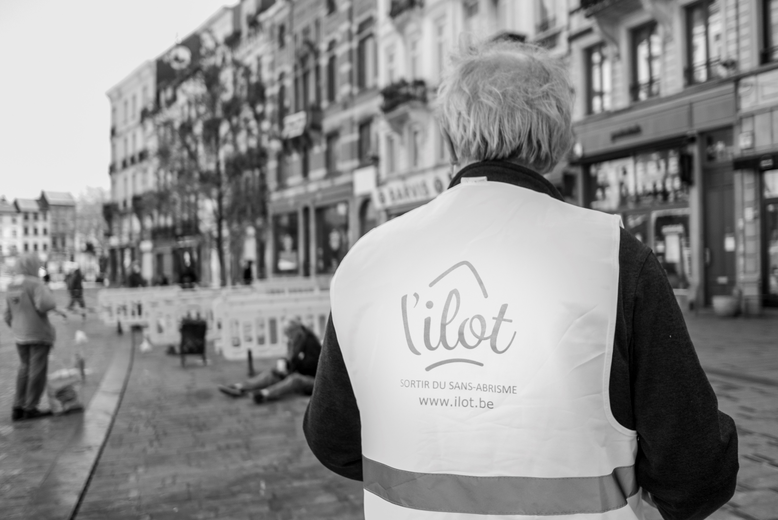
SOME IDEAS OF HOUSING SOLUTIONS
USING SOCIAL HOUSING,
IDENTIFYING SPECIFIC NEEDS AND
INDIVIDUALISED SUPPORT
IN THE NETHERLANDS & SWEDEN
SELF-RESTORATION OF DILAPIDATED
HOUSING – IN ENGLAND & ITALY - BETWEEN RECEPTION
POLICIES AND URBAN RENEWAL
USE OF VACANT PRIVATE HOUSING
- EXAMPLES OF RENTAL INTERMEDIATION IN FRANCE, BELGIUM, GERMANY
Photo: Chloé Thôme – L’Ilot

Slide 18
THANK YOU!
DOWNLOAD THE REPORT ON:
http://www.feantsa.org
http://www.fondation-abbe-pierre.fr
#HousingExclusion2020
chloe.serme-morin@feantsa.org | @ChloeSermeMorin

