Slide 1
A Way Home
Local coalitions in Flanders and Brussels cooperating to end and prevent youth homelessness

Slide 2
Opgroeien – “Growing Up”
Who are we?
New Government Agency from the Flemish Government - °2019
Responsible for: preventive family support, childcare, foster care, adoption, youth care & support of juvenile delinquents
Clear choice of this new government agency = integrated, multidisciplinary approach, in cooperation with a large numbers of partners

Slide 3
Youth care policy:
Important focus on young adults (16 – 25y) – how to support them in the transition out of care?
Action Plan Young Adults (°2017)
Youth care accessible till 25y
Innovative care offer: co- housing projects
Preparation of the transition out of care with the young person and his/her aftercare worker, together with organisations of the other “life domains” as housing, employment, education, leisure, adult care
How to evolve to a structural collaboration that ensures that our youngsters do not fall in extreme vulnerable situations as homelessness and that guarantees that all our youngsters have access to sustainable housing, education, income, …
⇨ A Way Home Canada - a national coalition reimagining solutions to youth homelessness through transformations in policy, planning and practice
⇨ Pilot project Mind the Gap = A Way Home Antwerp, started in 2018

Slide 4
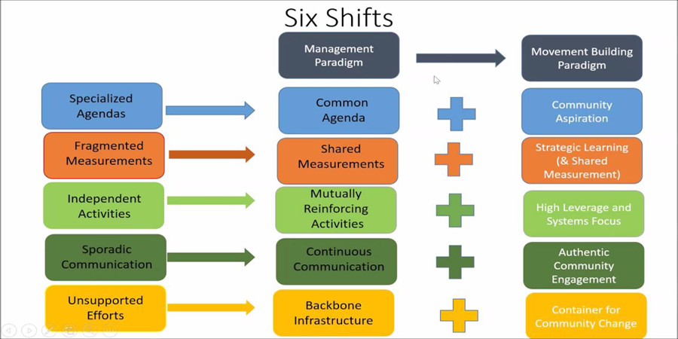
Collective Impact framework
Motor for change with a focus on the process

Slide 5
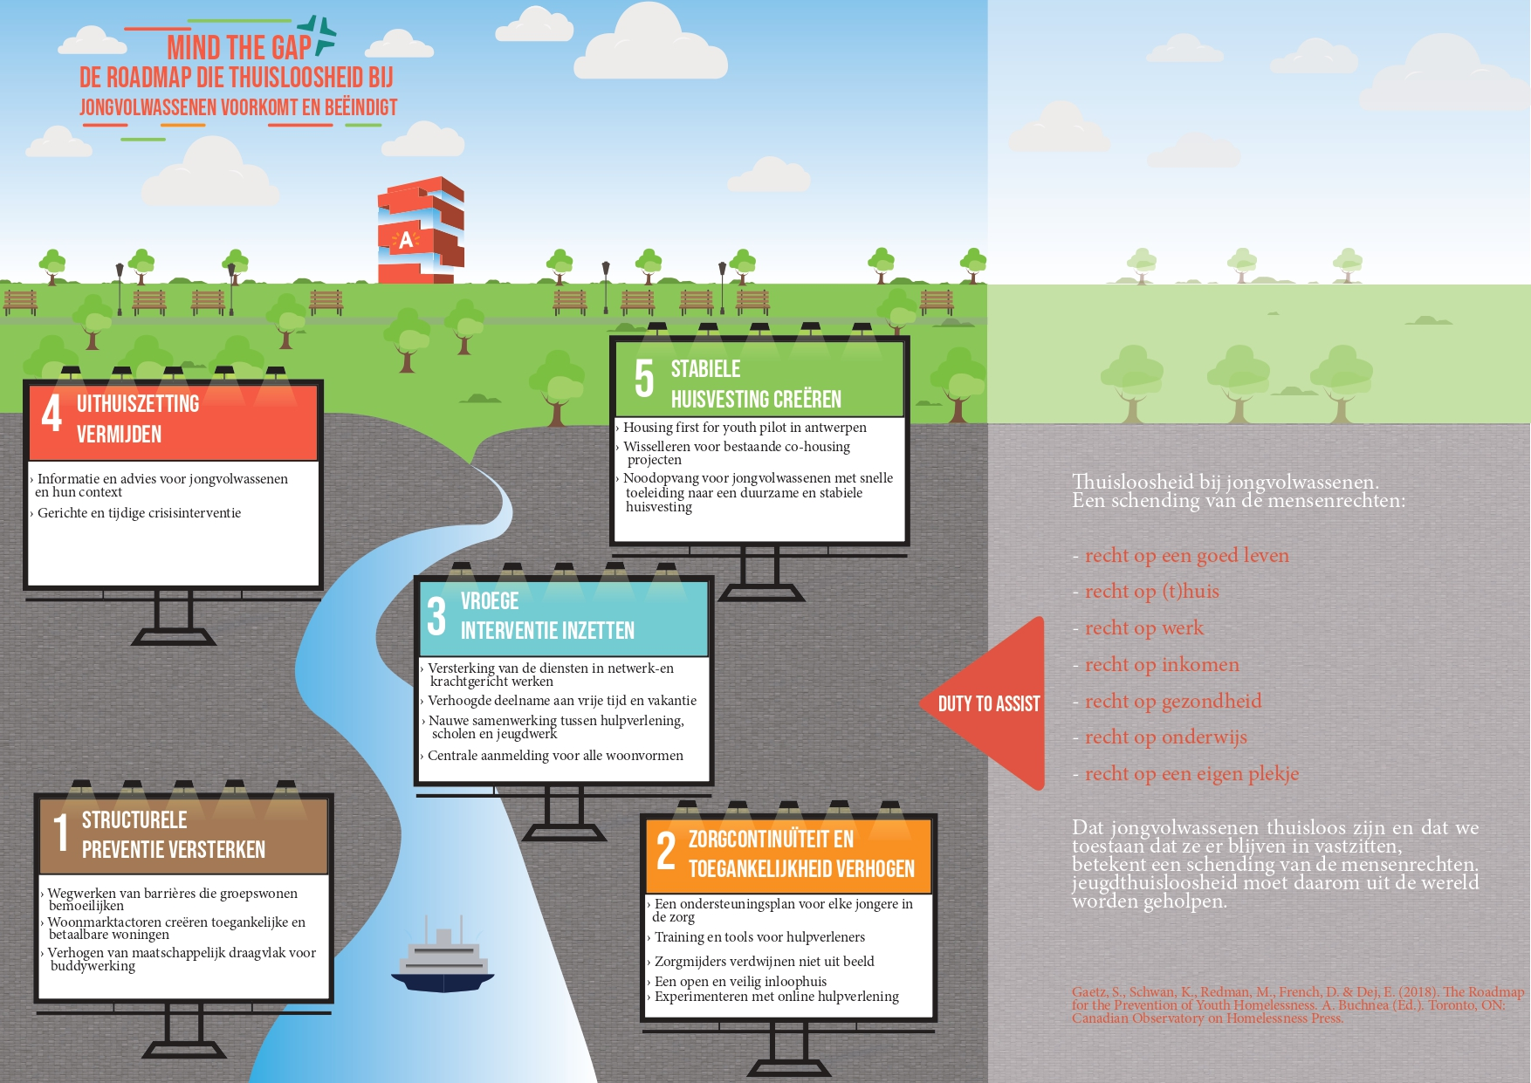
Roadmap for the Prevention of Youth Homelessness
Motor for change with a focus on the content

Slide 6
Succesful results in Antwerp
45 organisations engaged
4 action groups (living, networking, continuity of care, early detection and intervention).
3 times a year a ‘Collectief’.
1 back office
12 running actions (walk in house, access to social housing for youth at high risk, shelter for young people with case management, …). 19 actions are part of our action plan.

Slide 7
Start-up of 9 new local A Way Home Coalitions
Bottom-up choice for Oostende, Kortrijk, Gent, Leuven, Brussel, Mechelen, De Kempen, Sint-Truiden, Noord-Limburg
9 new back offices who will start a local A Way Home coalition to end and prevent youth homelessness in their city / region
Support trajectory in collaboration with AP University College
  Training, individual coaching, learning networks focussing on:
    Youth participation
    Creating a strong local support (Mission Pie model)
    Building bridges with diverse stakeholders
  Sharing of international solutions to youth homelessness in policy, planning and practice -reinforcing A Way Home Europe

Slide 8
Thanks for your attention!!
Contact
An Rommel, an.rommel@opgroeien.be

