Slide 1

Factors contributing to vulnerability among destitute mobile EU citizens in Brussels

Slide 2

framework
Pilot qualitative data collection
About mobile EU citizens accessing homelessness services in Brussels
Based on data collected by a street work service called DIOGENES
Referring to 2018, year in which 228 mobile EU citizens were supported (+ 225 Belgians and 78 TCNs)
Data include demographic information and information about the living situation, access to rights and access to services

Slide 3
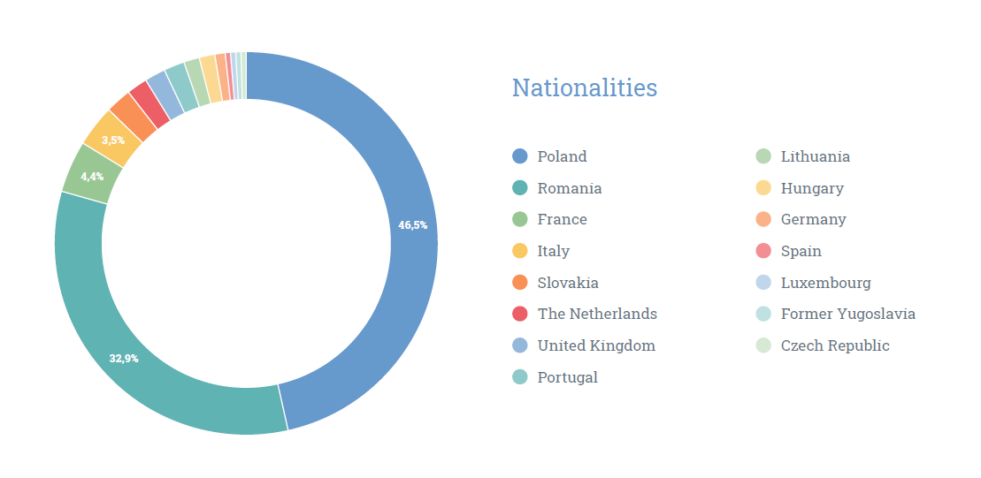

Slide 4
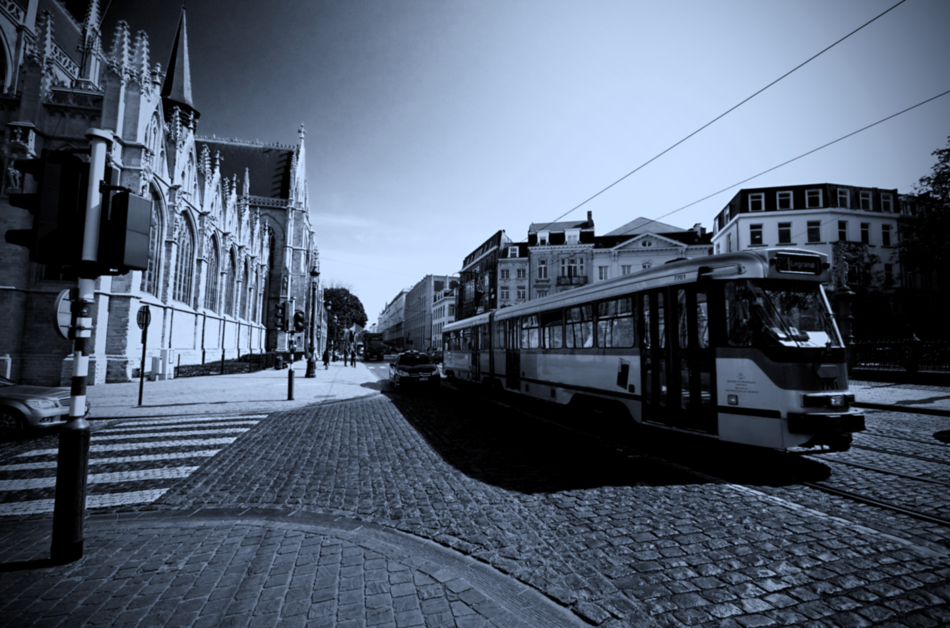
Access to employment
85% moved to Belgium to look for a job
Access to employment is rare: 9% work (7% in undeclared work)
Level of preparedness
Availability of a safety net
No access to employment services
Precarious jobs and exploitation
Refusal to register mobile EU citizens on short-term contract and with atypical contracts as workers

Slide 5
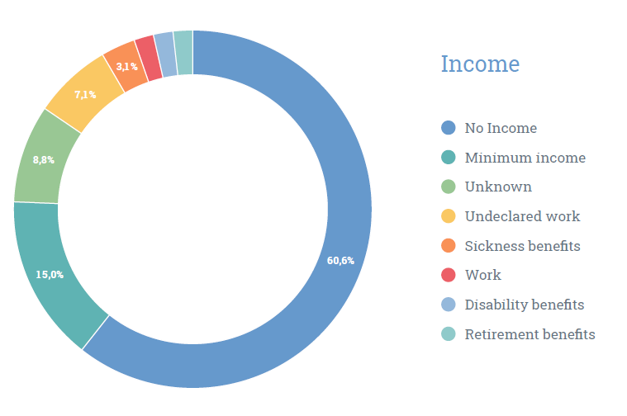
Crisis management

Slide 6
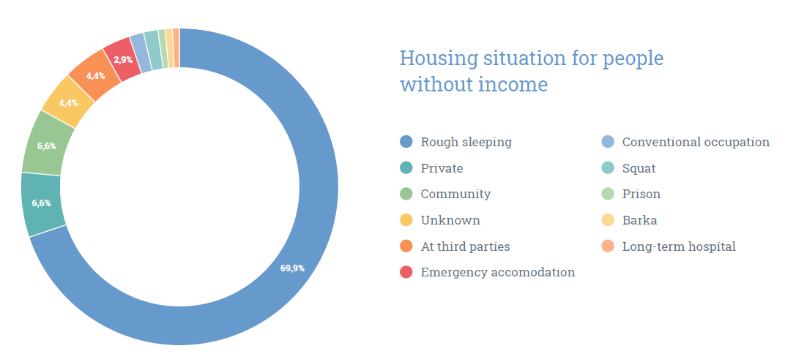

Slide 7
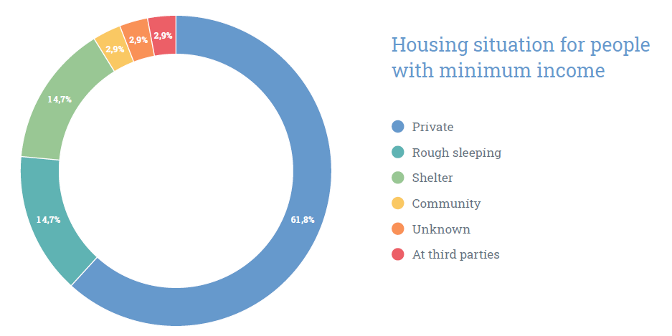

Slide 8

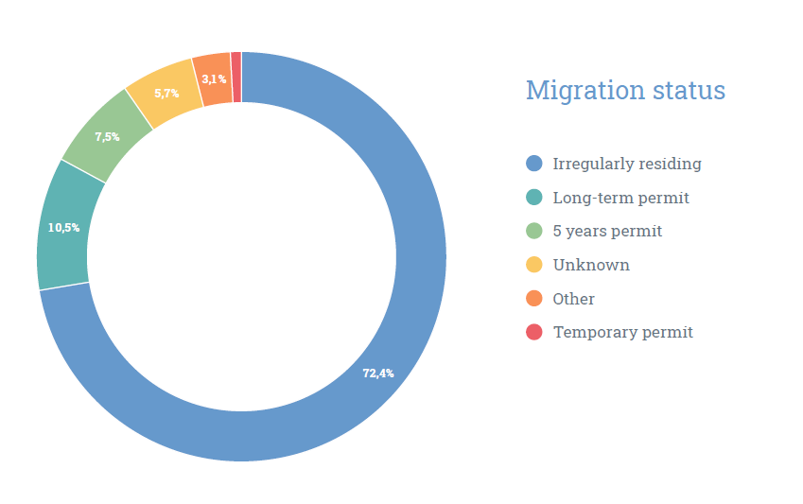

Slide 9
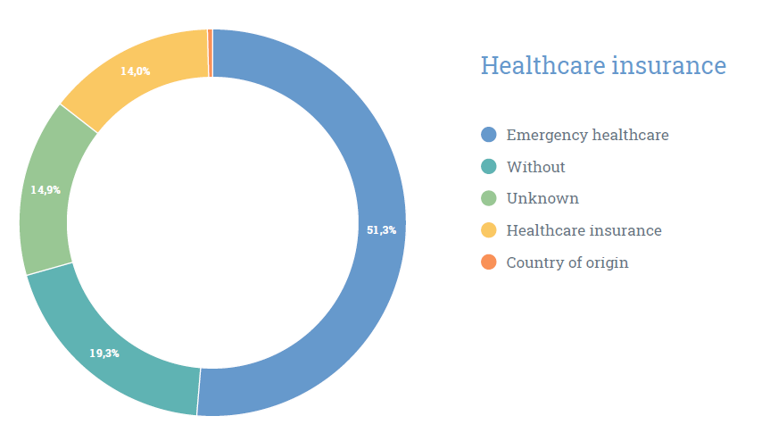

Slide 10
Conclusions
Likelihood of getting into a vicious circle: no job – no income – no housing – no residence permit – no social benefits nor services
Situation protracted for many years: chronic homelessness
Residence permit and a minimum income is often the main solution to get out of homelessness
Absence of a health insurance is a major problem

Slide 11
Thanks for your attention
Mauro Striano
Chargé de mission - Bruss'Help / Projectverantwoordelijk - Bruss'Help
mauro.striano@brusshelp.org
+32 (0)478.82.03.39

