Slide 1


The use of FEAD to provide services for homeless mobile EU citizens in Germany
The projects Frostschutzengel Plus and Europa.Brücke.Münster are supported by the Federal Ministry of Labour and Social Affairs in Germany and the Fund for European Aid to the Most Deprived (FEAD, German: EHAP)
Period: 01/2016 – 12/2018
21.11.2018

Slide 2
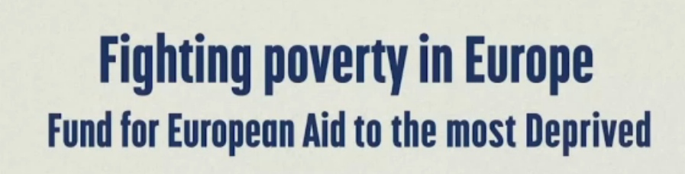
What is FEAD?
Assistance provided: food, basic material support or non-material assistance like counselling, accompaniment and outreach (OP I and II)
Goal: Help the most deprived to integrate better into society
Notes:
What is FEAD?
Fund of the European Aid to the most deprived
support for EU-countries action to provide assistance to the most deprived
Instrument to fight poverty and social exclusion
EURO 3.8 Billion from 2014 - 2020
FEAD-money covers 85% of the projects costs
15% need to be covered by the EU-countries themselves
Assistance provided can be: food, basic material support or non-material assistance, e. g. counselling, to help the target group to integrate better into society
National authorities deliver the support themselves or through partner-organizations (often NGOs) and decide which kind of assistance will be served
FEAD is a complement to ESF through bringing the target-group into conditions that allow them to participate in ESF-programmes after fulfilling their basic-needs
How is FEAD realized in Germany?
national authority: Federal Ministry of Labour and social affairs
FEAD = EHAP
partner-organizations: NGOs in cooperation with municipalities
three target groups:
homeless
mobile EU-citizens in precarious circumstances and
their children until the age of 7
85% of the projects financed through EHAP, 10% through the Ministry, 5% cofinacing through NGOs or municipality
Financial volume for both periods: 93 Mio. EURO

Slide 3

FEAD in Germany: EHAP
EHAP = Bridge between target groups and existing regular services - OP II
Additional counselling staff, especially for outreach
Support for target group to get access to existing local services like homeless shelters, language classes, medical services
Overarching targets: Anti-discrimination, Gender Mainstreaming
Notes:
How is FEAD realized in Germany?
national authority: Federal Ministry of Labour and social affairs
FEAD = EHAP
partner-organizations: NGOs in cooperation with municipalities
three target groups:
homeless
mobile EU-citizens in precarious circumstances and
their children until the age of 7
85% of the projects financed through EHAP, 10% through the Ministry, 5% cofinacing through NGOs or municipality
Financial volume for both periods: 93 Mio. EURO

Slide 4


Examples of projects in Germany:
Europa.Brücke.Münster
EBM
Target-group
Mobile EU-citizens in precarious living-circumstances
Main problems
- Homelessness
- Missing health-care-insurance
- No access to social benefits
Services
- Counselling
- Accompaniment
- Public-relations and networking
Main fields of activities
- Health-care
- (Emergency-) housing
- Education (school, German-classes)
Notes:
place: City of Muenster in Northrhine-Westphalia
cooperation-partners: City of Muenster and Bischof-Hermann-Stiftung
staff: four counsellors (three social-workers, one nurse)
target group: mobile EU-citizens in precarious circumstances most of them homeless
sociodemographic data: around 270 clients every year, 30% of them women, most of the clients between 18 and 40 years old
problems: homelessness, destitution, missing health-care-insurance, lack of education, unemployment, belonging to a minority, social exclusion etc.
services: counselling, accompaniment to regular offers, public relations, networking
counselling and accompaniment of the clients to the existing services with a special focus on people who are in need of protection, e. g.
shelters for homeless
medical services for people without healthcare insurance
German classes
soup-kitchens
citizens registration office
public relations
networking
Logo: https://www.google.com/search?q=logo+stadt+m%C3%BCnster&client=firefox-b-ab&source=lnms&tbm=isch&sa=X&ved=0ahUKEwiN842w49DeAhWPgVwKHes2BFIQ_AUIDigB&biw=1680&bih=936#imgrc=cX5SjvyL7qYw3M: [12.11.2018]

Slide 5
Examples of projects in Germany:
Frostschutzengel plus in Berlin
Cooperation between GEBEWO Soziale Dienste and Caritas Berlin
  In-reach counselling in low-threshold services, eg. homeless shelters, soup kitchens, daycentres
  Healthcare counselling at Caritas Ambulanz clinic for non-insured people
Services available in bulgarian, BCMS, lithuanian, polish, romanian and russian
Networking on a city-wide, national and European level
Senate-funded partner project since 07/2018

Slide 6

Issues within project realisation
Absolute poverty: basic material needs of clients can’t be covered in OP II
Unemployment: no provision for referring clients to labour market, missing link to ESF
(Unlawful) expulsion from social benefits and housing: no allowance to offer legal-advice
Notes:
Picture: https://www.gratis-malvorlagen.de/comics/hund-beisst-sich-in-den-schwanz/ [07.11.2018]

Slide 7
Improvement suggestions
Combination of material assistance and counselling (OP I and II)
Possibility to refer to labour market for sustainable integration into society
Possibility to offer legal advice concerning free movement, (unlawful) exclusion from social benefits or housing exclusion
!?

Slide 8
Thank you for your attention!
Please contact us for further information:
Frostschutzengel Plus
GEBEWO
Anastasia Mikheeva
Hobrechtstr. 65
12047 Berlin, Germany
Phone: +49 3034655500
Fax: +49 3034655502
Email: beratung@frostschutzengel.de
Bischof-Hermann-Stiftung
EUROPA.BRÜCKE.MÜNSTER
Stefanie Beckmann
Hafenstraße 3-5
48153 Münster, Germany
Phone:+49 251 97 44 22 72
Fax: +49 251 97 44 22 70
Email: ebm.beckmann@bhst.de
Notes:
The picture was taken by Stefanie Beckmann on the 19th of May 2016 in Münster. The use for the conference was aligned with kind permission of the clients.

