Slide 1
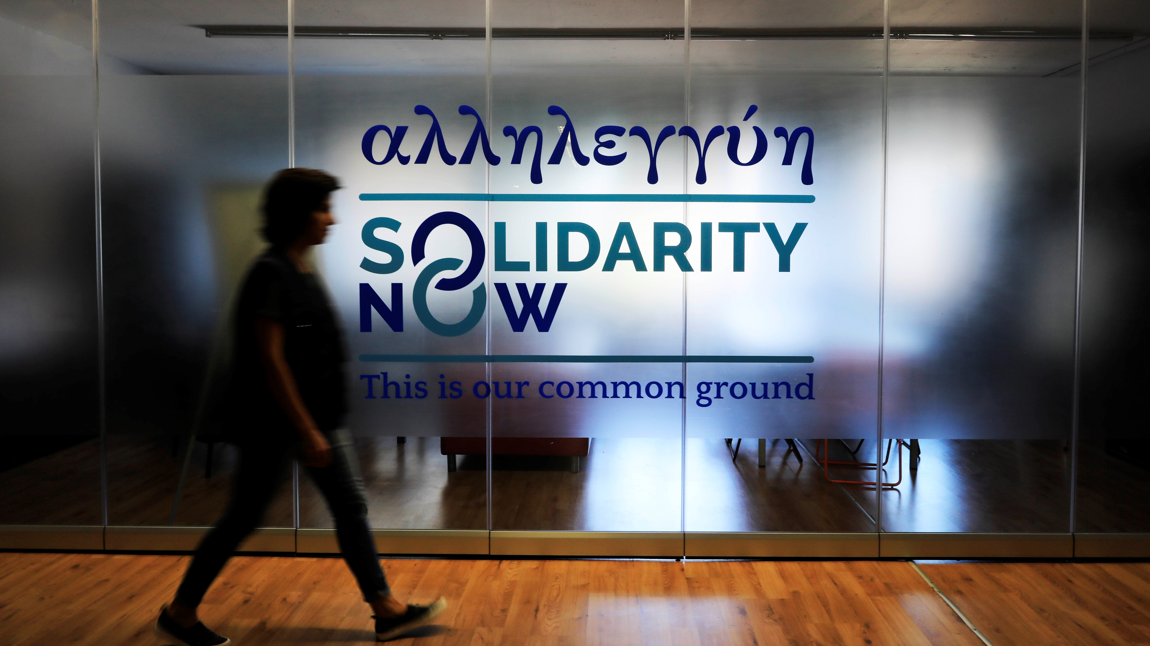
Asylum Seekers and Refugees - Insights from the 5th Overview of Housing Exclusion in Europe
Dominika Spyratou, Advocacy Officer

Slide 2

What we do
SolidarityNow is a non-governmental organisation in Greece, committed to improve vulnerable people’s lives in order to pursue a better future, with dignity and perspectives
ESTIA partner
UNHCR and Greek government urban accommodation programme for asylum seekers
Child and Family Support Hubs in 14 camps in mainland Greece
Child-friendly and female-friendly spaces, non-formal educational activities, legal and psycho-social support and targeted case management
HELIOS partner
IOM integration programme for recognised refugees that offers Greek language learning, cultural orientation, employability support, accommodation support
Three Solidarity Centres in Athens and Thessaloniki
Free provision of psychological support, legal aid, employability services, accounting services, non-formal education and recreational activities, support for parents and children
New programme for unaccompanied minors
Supported Independent Living (SIL), alternative care

Slide 3
The vicious circle of overcrowding
Island reception facilities constantly overcrowded
Samos hotspot capacity: 648
Residents: 4,404
Mainland accommodation facilities at full capacity
(107%)
No alternative accommodation for recognised refugees

Slide 4
Pandemic-related challenges
Freedom of movement in camps
- Movement permits and lockdowns
- Full quarantine in camps with Covid-19 cases
Housing
-No forced exits during the six-week lockdown period
-Forced exits as of 1st June affecting <8,300 people
Access to asylum
-Suspension of registration of new asylum applications
- No renewals of resident permits and cards of international protection applicants
Access to healthcare, employment, educations
-Limited issuance of National Insurance Numbers (AMKA and PAAYPA)
-No financial assistance from the state for migrants working in the black market
-E-learning was difficult due to lack of mobile equipment, digital literacy or access to the internet
Consequences
Mental health issues
Increase in Domestic violence
Levels of stress

Slide 5
Other challenges
Anti-migration laws and policies
International Protection Bill
Restrictions on individual rights and procedural guarantees in the Greek asylum system
Emergency Legislative Order
Fully suspending asylum applications during March 2020
Legislation about exits
Refugees are forced out of their accommodation within 30 days of receiving official refugee status (before the grace period was six months)
Legislation about new NGO Registry (Ministry of Migration and Asylum)
Registration and certification procedure create unnecessary and disproportional barriers on the work of NGOs and impedes freedom of association
Emphasis on returns
Mounting evidence about pushbacks
Criminalisation of solidarity
Criminal case against 33 members of NGOs running SAR operations in the Aegean sea
Lack of an integration policy
No measures to strengthen refugee integration
Revision of terms and requirements for the implementation of ESTIA II
Significant reduction in the funding; quality of services and fulfillment of requirements by NGOs at risk

Slide 6
Recommendations
→To the Greek Government
I. Strengthen asylum system, establishing fair and fast national procedures
II. Invest in integration (language courses, vocational training, employability courses)
III. Offer proper housing solutions (long term accommodation programmes including social housing
IV. Lift obstacles to accessing to social services (issuance of Tax Registration Number, Social Insurance Number, opening a bank account, receiving benefits)
→To the European Union
I. Show real solidarity
Relocate children and vulnerable groups to other MS
Scale up resettlement
IV. Better monitoring of use of EU funding

Slide 7
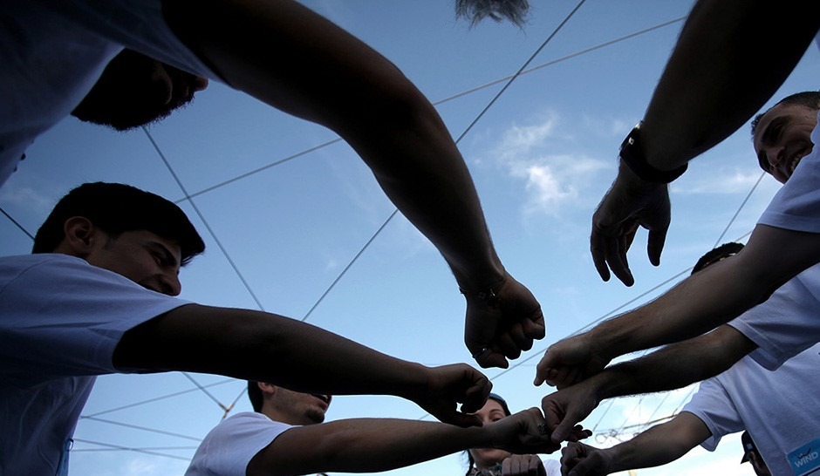

Thank you!

