Slide 1


LIMOR Housing First for Youth
FEANTSA Online Conference Week 2020

Slide 2
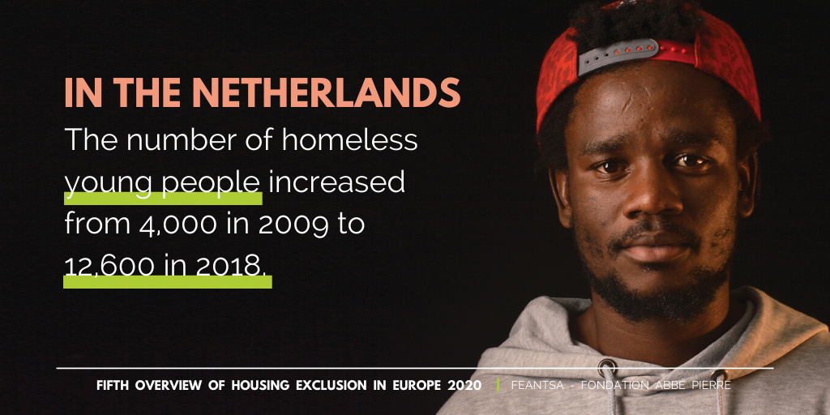
Notes:
Over the last few years youth homelessness has significantly increased in the Netherlands. According to statistics at least 13.000 young people are facing homelessness, which accounts for 41% of the homeless population in the Netherlands. The majority of these young homeless people are found in the five largest cities of the Netherlands, including The Hague.
Young people differ from adults: the causes and conditions of homelessness are different. Therefor the reactions and solutions should be different.
To prevent and end youth homelessness we need youth specific policy.

Slide 3
Why HF4Y in The Hague?
Years of experience with Housing First as an effective approach for adults
In the Hague about 400 young people are registered as being homeless, in addition there’s an unknown number of unregistered young people homeless. The number of night shelter beds was growing. There were more and more young people who were not accepted or dropped out of existing services.
When young people become homeless, their health deteriorates, their psychological condition deteriorates, they are often abused, the risk of addiction increases, they get into contact with the law more often, it results in school dropout, they are more often victims of crime and get (further) traumatised.
Notes:
LIMOR has been delivering Housing First for adults for many years for those who will not or can not use traditional services and it has shown very positive results. Considering the growth of young homeless people and the proven success we knew the time had come to develop Housing First for Youth.

Slide 4

Immediate access to housing with no preconditions
Youth choice and self-determination
Positive youth development orientation
Core
principles
HF
Individualised and client-driven supports
Social and community integration
Notes:
HF4Y The Hague started in January 2018. It follows the core principles of Housing First carefully and therefore has a high model fidelity.

Slide 5

Agreement for participation
Compliance with all obligations of the rental contract
like paying the rent and
not causing nuisance
Contact with the support worker at least once a week
whether this is a home visit or something else

Slide 6
Support on:
HF4Y
The Hague
Housing
01
Health and well-being
02
Income and education
03
Additional supports
04
Social inclusion
05

Slide 7
HF4Y
The Hague
The main thing
Housing First for Youth goes beyond support towards independence. It's about
enabling young people to make a successful
transition to adulthood.
Developing healty behaviour
Developing own identity
Trial and error: young people are allowed to make mistakes. Continue to offer new opportunities.
Providing a safety net and a hopeful perspective
Specialized support and long duration of support.

Slide 8
HF4Y
The Hague
Housing First for Youth The Hague
We have a limited housing stock. That is why we start with young people who "need Housing First the most".
Out ultimate goal is ending youth homelessness.
Therefor, we strive for a simultaneous downscaling of the night shelter for young people.
Young people who are actually homeless and who are unable to connect to the regular services
Then care leavers and young people who are at risk of being expelled from group facilities.
To ultimately help all young people who are (imminently) homeless and who need support and largely focus on prevention.

Slide 9
In principle, Housing First Youth is for every young person who is (imminently) homeless and who needs support.
HF4Y
The Hague
Who are unable or unwilling to connect with the regular services because of their vulnerability or complex problems.
Youth from age 16 to 24
Targetgroup
They are often tired of care and interference due to a problematic past in the youth care system and intergenerational problems.
Have the basic skills to live independently or have the capacities to acquire these skills.

Slide 10

The housing
An independent apartment
A home where the young person can stay as long as desired
Suitable for the stage of life, so preferably small homes
Affordable
Choice and control of the young person around location
Scattered sight
Housing corporation estimates whether a neighborhood or building is suitable for HF4Y
A clear separation between the roles of landlord and support worker
Active (preventive) cooperation between housing corporation and support workers
A permanent rental contract in their own name or the opportunity for the rental contract to be in the name of the Housing First service for the first period.
Notes:
(its own front door, no shared facilities)
(such as studios
(a rent below the housing benefit limit)

Slide 11
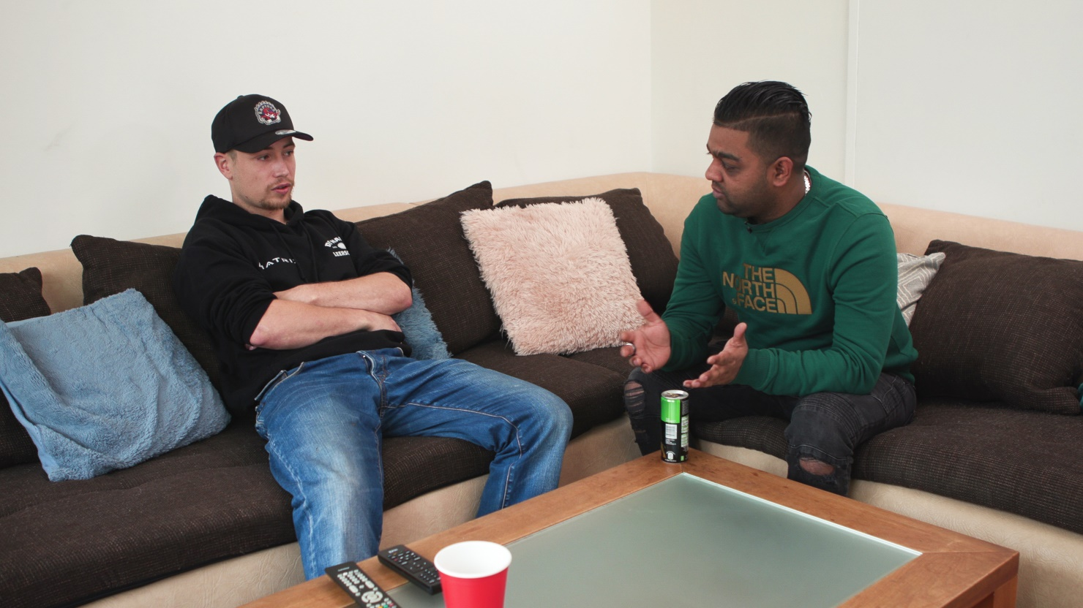
Other arrangements
For young people under 18 our Housing First service rents the apartment. And income is provided for rent and living expenses by the municipality.
A supplement to the income is also necessary for young people aged 18 to 21 if they depend on welfare. The welfare is not sufficient to provide for rent payment and their other living expenses.
In all cases, funds are provided for furnishing the home.
Notes:
https://pixabay.com/photos/person-silhouette-sunset-rock-598191/

Slide 12
Multi
disciplinary team
Projectcoordinator
Support workers
Peer worker
Practitioner/ behavioral scientist
Casemanager of the social services
24/7 accessible by phone
Notes:
We work according to both Intensive Case Management and Assertive Community Treatment. Our team exists of: a coordinator, support workers, a practitioner, a peer worker and a social service case manager. Furthermore we work closely with the housing corporation, municipal services and other healthcare organisations.
The caseload of a fulltime support worker is at 8. We can be reached by telephone 24/7.

Slide 13

Results
Started in 2018
Supporting 23 youngsters at the moment
Adding 17 more youngsters coming months
Housing retention rate: 88%
One person was rehoused
Loss of housing twice, but youngsters still in support.
One youngster has been able to continue without support
High satisfaction rate
Notes:
The HF4Y service in The Hague has been running since January 2018 and shows promising results. A recent experience survey proves that HF4Y really works for young people. Not only satisfaction rates are high, young people also evaluate Housing First as very positive and effective.
HF4Y The Hague is showing a housing stability of 88%. One participant couldn’t keep her first house and was in need of a second chance in another home. She caused a lot of disturbance and wasn’t able to repair the relationship with her neighbours. Because of that we advised her to terminate her lease early and offered her a new apartment. The entire situation has been an important learning experience, challenging for both her and us. Our continuing support resulted in her trusting the support workers and as a result of that she is doing much better now.
We consider participation of the young people we support very important. We encourage everyone to voice their opinions and include participants in the development of our practice.
A survey among the youngsters showed that 100% of the respondents indicate Housing First Youth as helpful and claim that they would recommend it to others. In addition, they have rated the attention that a support worker has for the basic needs of autonomy, competences and connectedness. Autonomy; meaning choice and control, scores 100%. The attention to competencies or the way in which participants are challenged and positively empowered also scores 100%. Connectedness, the degree to which a participant feels connected to others, scores 60%. An explanation for this can be found in the situation of young people often being or feeling alone. Contact with family is mostly either complicated or absent. The majority of their network consists of other young people manoeuvring trough the youth system on the one hand and social workers on the other. Therefore the existing network proves to be temporary as social workers might get another job, and the other young persons are likely to leave care eventually.
At the moment we’ve gained some positive feedback in particular when it comes to the experience of freedom and choice. Furthermore our decisiveness is seen as an attributing factor to success. Participants point out that we actually get things done and actually do as we say, whereas they have experienced different before. Thanks to our unconditional support and respect of autonomy we notice an increase of both self-esteem as confidence in others.

Slide 14

Notes:
Doesn’t have English subtitles yet

Slide 15

Melanie Schmit
President Housing First Nederland
Programmanager Housing First LIMOR
mschmit@limor.nl
06 – 39 333 114

Slide 16



